Slide 1
Product Development Process
What you need to know to succeed in class
What it might look like in industry

Slide 2
..

Slide 3
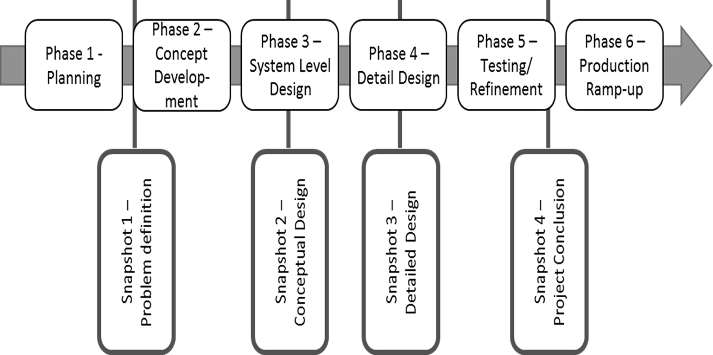
General Process Overview/Milestones

Slide 4
University of Idaho – Interdisciplinary Engineering Capstone Design
Snapshot documentation Deliverables
Snapshot #1
Problem Definition
Snapshot #2
Conceptual Design
Snapshot #3
Detailed Design
Snapshot #4
Project Conclusion
Engineering:
- Team Contract
- Objective/Value Statement
- Project Learning Evidence
- Customer Needs Analysis
- Product Requirements (PRD)
Project Management:
- Project Schedule (Gantt)
- Action Items & Tracking
- Project Budget
- Meeting Agendas/Notes
Engineering:
- Value Proposition
- Concept Design Review
- Design Validation Plan (DVP)
- Initial Prototype Evidence
- Engineering Analysis
- Engr. Purchase Order (EPO)
for long lead components
Continuous maintenance
Engineering:
- Value Prop. / Business Case
- Engineering Release Review
- Design Validation Plan (DVP)
- Failure Modes Anal. (dFMEA)
- Engineering Analysis
- CAD / Drawings / BOM
- Software (SW) Code
- Sustainability Evaluation
Engineering:
- Value Prop. / Business Case
- Functional Prototype
- Design Valid. Results (DVP&R)
- Assembly Instructions
- CAD / Drawings / BOM
- SW Code and Read-Me files
- EXPO Poster
- Final Report
Author: M. Swenson
Update: 6/3/2019

Slide 5
General Process Details
Idea – define problem to be solved / needs assessment, establish product requirements
Research – has it already been solved?
Patent Search, Intellectual Property (IP) rights
Can existing solutions be improved (innovation)?
Economic feasibility/due diligence/value proposition
Establish Team/Who? Resource requirements for team; core members/owners, SME’s (Subject Matter Experts), and MOB’s (Multidisciplinary Outside-the-Box thinkers)

Slide 6
General Process Details (cont.)
Concept Design Review - Concept development and validation – may include focus groups (sponsor input). Engineering analysis and prototyping – test the theories, can you make it work?
Project Management - Establish initial (will change) project scope, budget, timelines, long-lead items, failure modes.
Design Validation – testing/success metrics, sustainability, maintainability, user interface

Slide 7
General Process Details (cont.)
Prototyping – virtual (CAD) to physical models, iterations/innovation/improvements, testing metrics and performance, finding new failure modes…
Final Design and Manufacturing – parts and assembly, specification testing and results,
documentation
documentation
documentation

