Slide 1
Snowmobiles and what we do to them
Me 201/401
Presented by:
Colin Parke

Slide 2
Outline
Key parts
Competition and team goals
Prospective projects

Slide 3
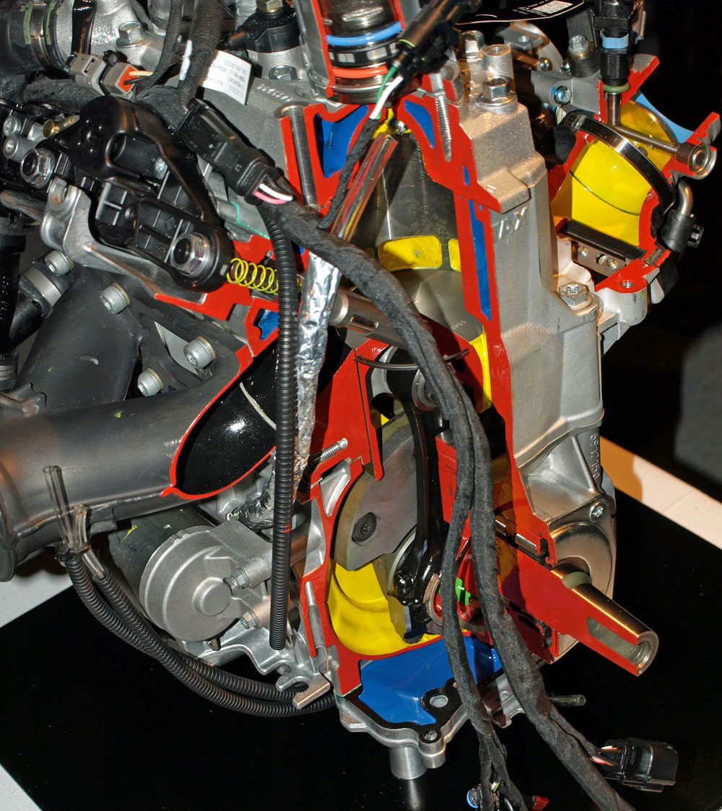
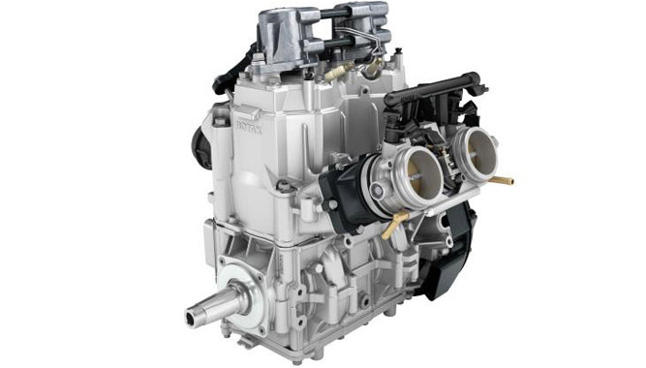
Key parts
Engine
Fuel/air delivery
Exhaust
Internal workings

Slide 4
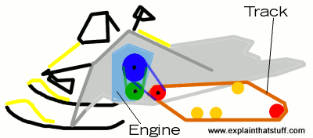
Key parts
Powertrain
Engine
CVT
Jackshaft
Chain case
Track

Slide 5
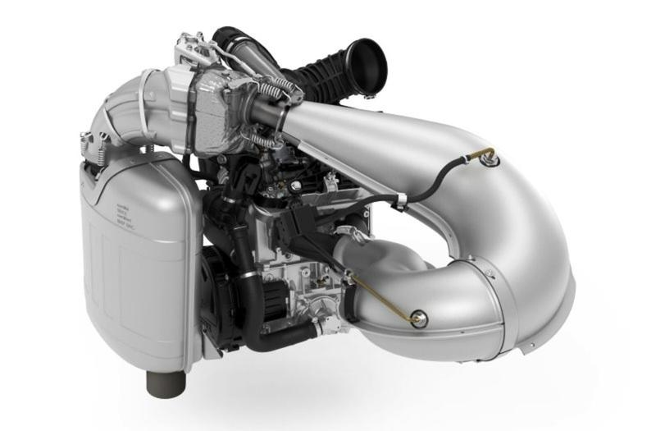
Key parts
Exhaust
Tuned pipe
Muffler

Slide 6
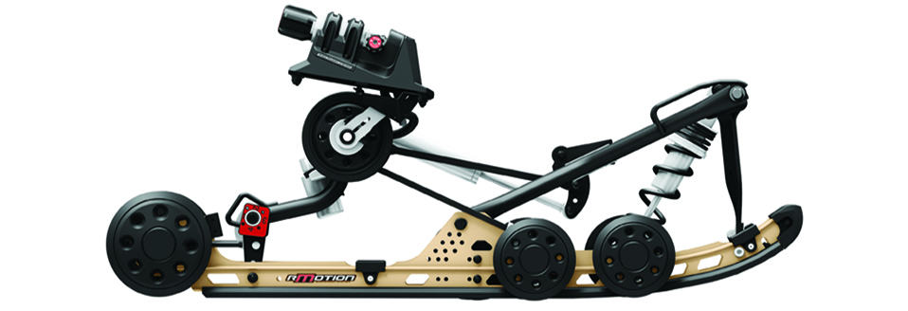
Key parts
Track and suspension
Skid
Front and rear suspension

Slide 7
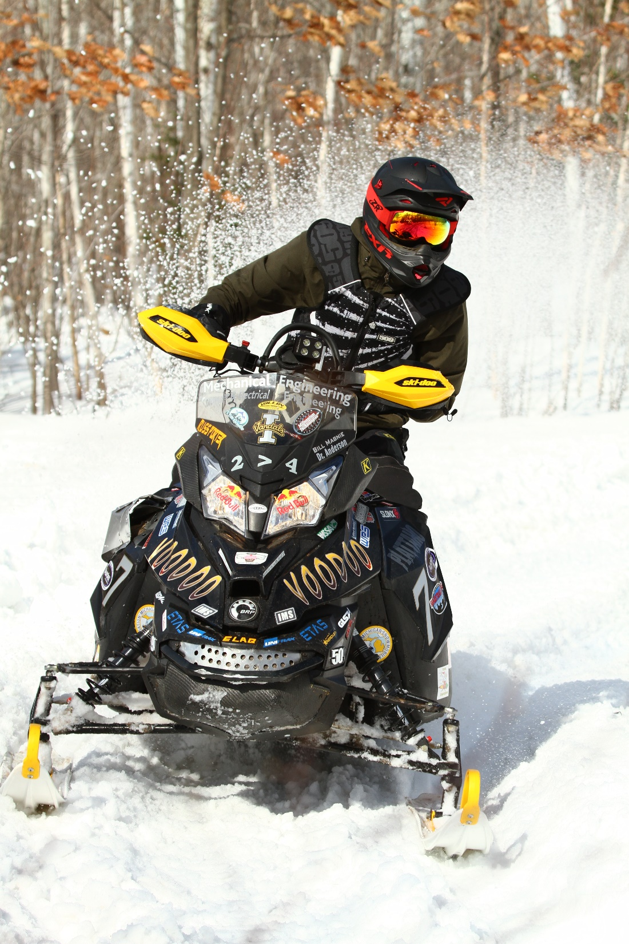
Competition and team Goals
Cleaner
Quieter
Fuel efficient
Powerful

Slide 8
Prospective Projects
Mono-skid
Power steering
Rear Exit
MAQR
Water Injection
Catalyst

Slide 9
Questions?

