Slide 1
Pre-Class Questions
Exam Questions?
Many haven’t seen engineering calculations with friction yet
Homework 7 can be extended if you struggled with friction
Many engineers tend to think: Friction = bad
In reality, friction in the wrong place is bad
Lack of friction when you need it is also bad (think: shoes, tires, playground equipment)
This section is about applying the Equation of Motion (EOM) in rectangular coordinate systems.
Classic x-y-z system
Rotated x’-y’-z’ system

Slide 2
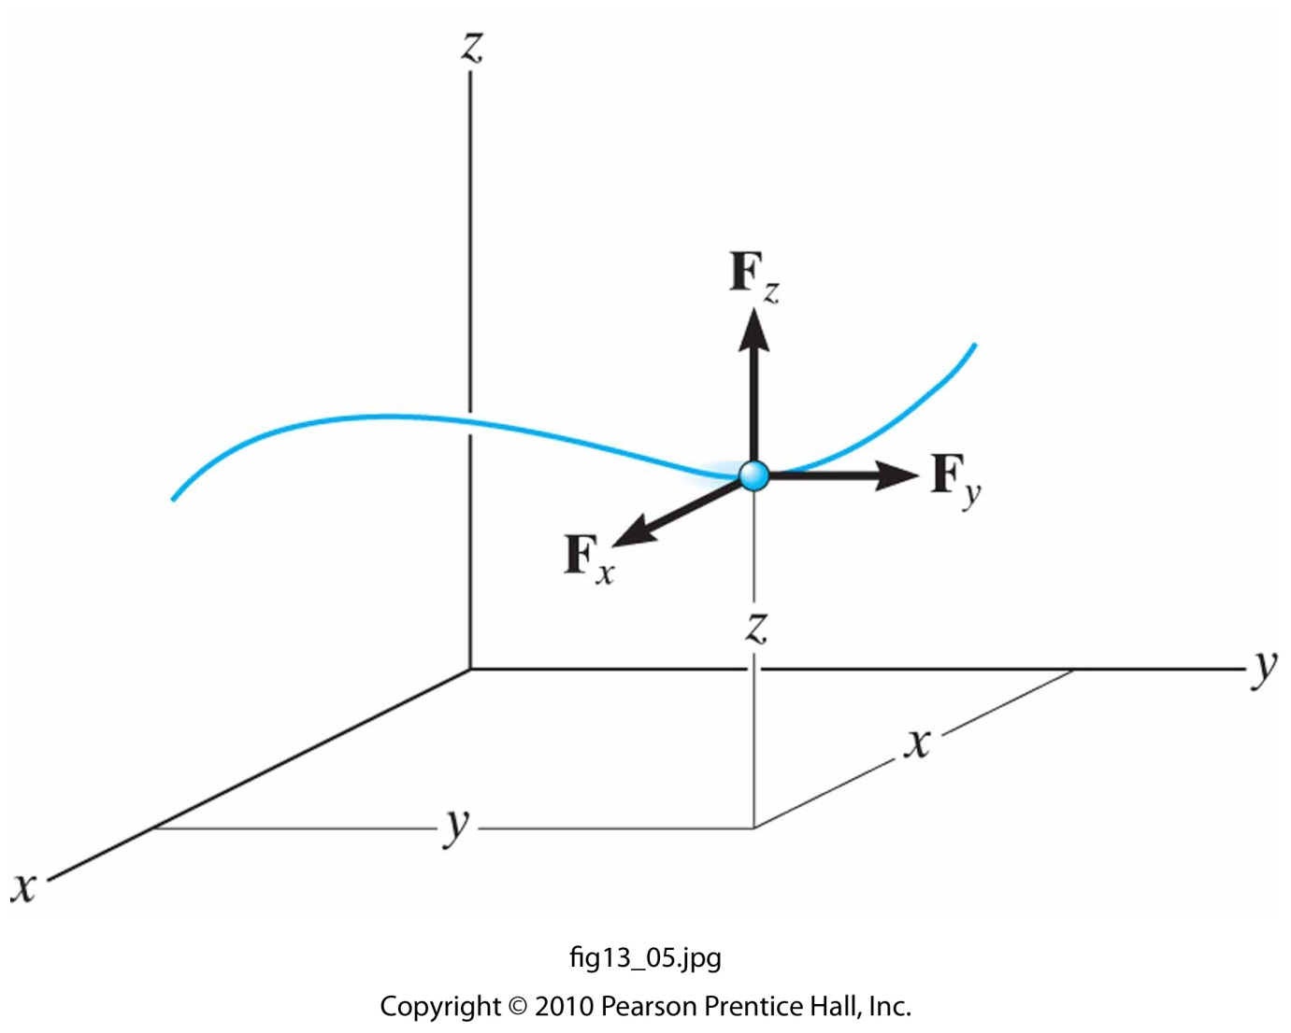
Equation of Motion: Rectangular Coordinates
13.4
Rectangular Coordinates for Equations of Motion
In terms of components:
Or as three scalar equations:

Slide 3
Common External Forces
13.4
Friction (Static and Kinetic) Forces
Static and kinetic equations relate the friction and normal forces acting at the surfaces of contact by using the static and kinetic friction coefficients.
If the particle is on the verge of relative motion, then use the coefficient of static friction.
If the particle is moving relative to another surface, then use the coefficient of kinetic friction.
Friction always opposes the motion of the particle.
Generally, $μ_{s}>μ_{k}$ → *This is why burnouts are lame* ;)

Slide 4
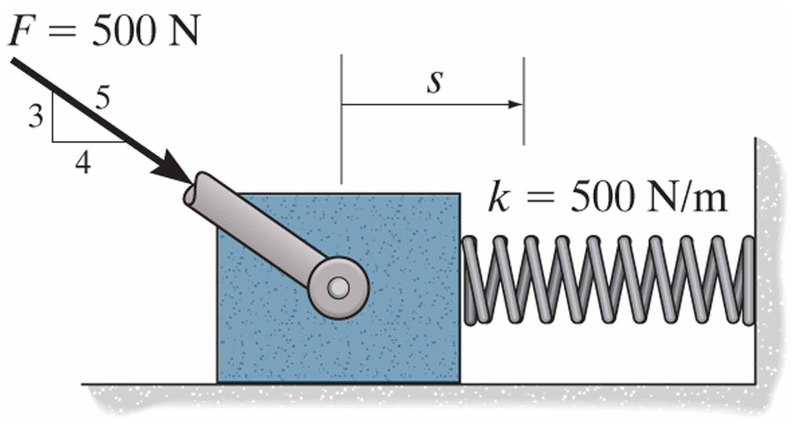
Common External Forces
13.4
Spring Forces
Spring force is related to the deformation (deflection) of the spring by the equation:

Slide 5
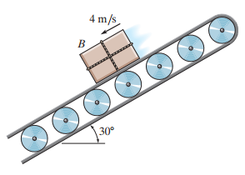
In-Class Practice Problem 1
Box is moving…why static friction?
Can you have a coefficient of friction greater than 1?
What does equation of motion look like?
Where is time in that equation?

Slide 6
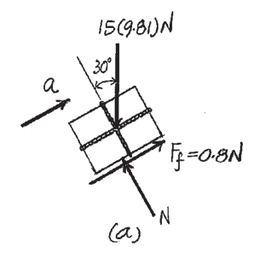
In-Class Practice Problem 1
N in the top arrow is Newton
N on the bottom of the box is Normal Force
Since all forces except weight are orthogonal, rotate the x-y axis 30° CCW to be x’-y’

Slide 7
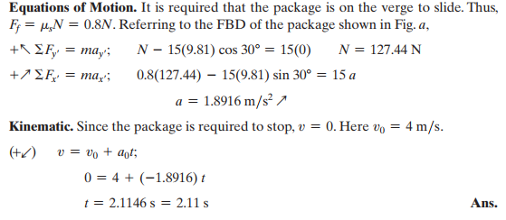
In-Class Practice Problem 1

Slide 8
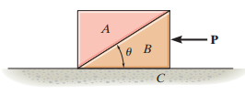
In-Class Practice Problem 2
What does “smooth” mean?
Is there a practical application of this problem?
https://jeb.biologists.org/content/214/8/1369
Another problem without number?!!
What does equation of motion look like for each block?

Slide 9
In-Class Practice Problem 2
What would happen without any P or a_{x}?
Really, this problem is about matching a_{x} to counteract Block A from sliding down Block B.

Slide 10
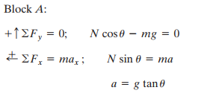
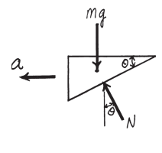
In-Class Practice Problem 2
There is some algebra between these two steps

Slide 11
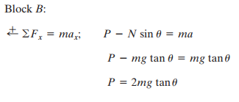
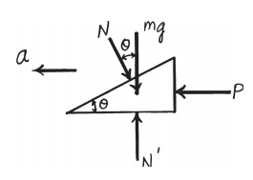
In-Class Practice Problem 2
Why no ΣF_{y} equation?
Does the mass of Block A matter?
What if we keep track of m_{A} and m_{B}?

Slide 12

In-Class Practice Problem 2
Block A:
$$\sum{F_{y}=}N∗\cos\left(θ\right)−m_{A}∗g=0$$
$$N=\frac{m_{A}∗g}{cos⁡(θ)}$$
$$\sum{F_{x}=}N∗\sin\left(θ\right)=m_{A}∗a_{x}$$
Substitute Equation 1 in for N
$$\frac{m_{A}∗g}{cos⁡(θ)}∗\sin\left(θ\right)=m_{A}∗a_{x}$$
$$a_{x}=g∗tan⁡(θ)$$
Equation 1
Equation 2

Slide 13
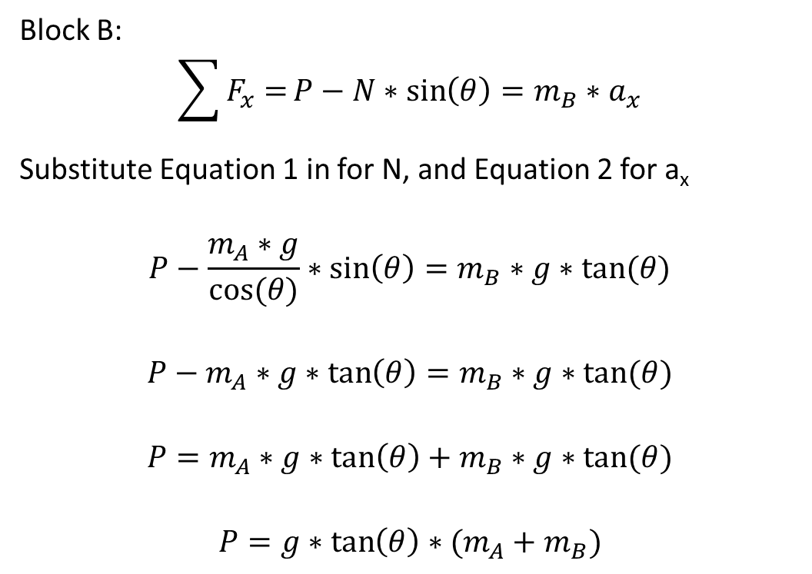
In-Class Practice Problem 2
Block B:
$$\sum{F_{x}=}P−N∗\sin\left(θ\right)=m_{B}∗a_{x}$$
Substitute Equation 1 in for N, and Equation 2 for a_{x}
$$P−\frac{m_{A}∗g}{cos⁡(θ)}∗\sin\left(θ\right)=m_{B}∗g∗tan⁡(θ)$$
$$P−m_{A}∗g∗\tan\left(θ\right)=m_{B}∗g∗tan⁡(θ)$$
$$P=m_{A}∗g∗\tan\left(θ\right)+m_{B}∗g∗tan⁡(θ)$$
$$P=g∗\tan\left(θ\right)∗(m_{A}+m_{B})$$
Equation 3
Equation 3
Equation 3
Equation 3
Equation 3

