Slide 1
Chapter 14
Work (Force dot distance) and Energy Conservation
Chapter 14 is just a bunch of conservation of energy problems.
We’ll talk about Work (one particular form of energy)
This text uses a very simplified form of conservation of energy that only includes kinetic energy and work.
The variables used are unconventional (compared to other classes).
Kinetic Energy = T
Work = U
(not in this section, but in the next section we will use V for gravitational potential energy)

Slide 2
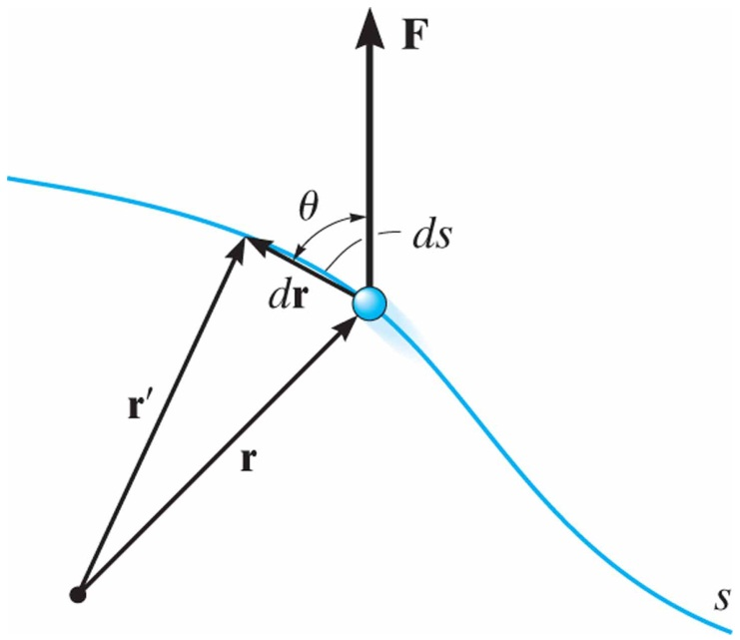
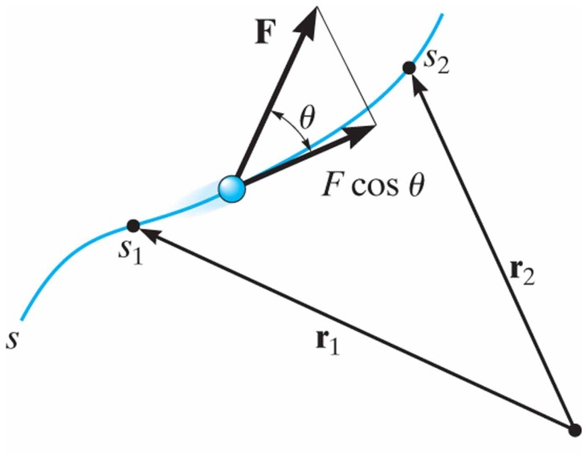
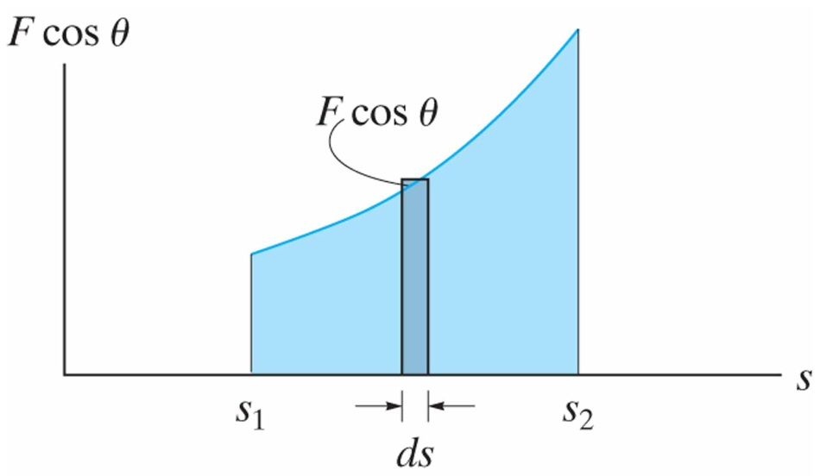
Work of a Force
14.1
Work of a Variable Force
A force does work on a particle only when the particle undergoes a displacement in the direction of the force.
The area under the graph of force along the path vs. displacement.

Slide 3
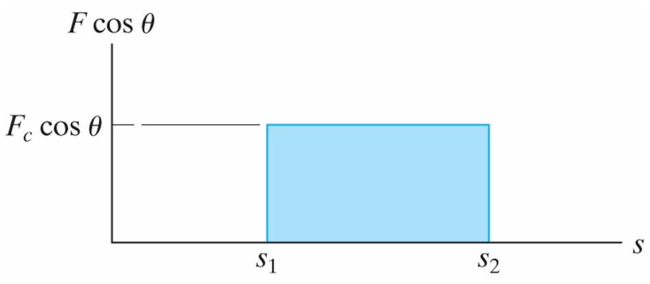
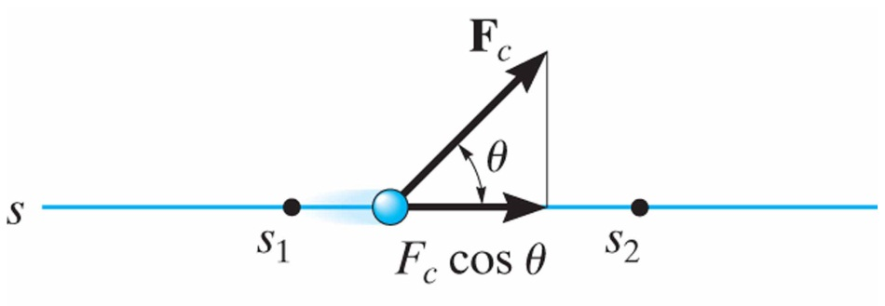
Work of a Force
14.1
Work of a Constant Force Moving Along a Straight Line
If the force has a constant magnitude and acts at a constant angle, the work can be found according to:

Slide 4
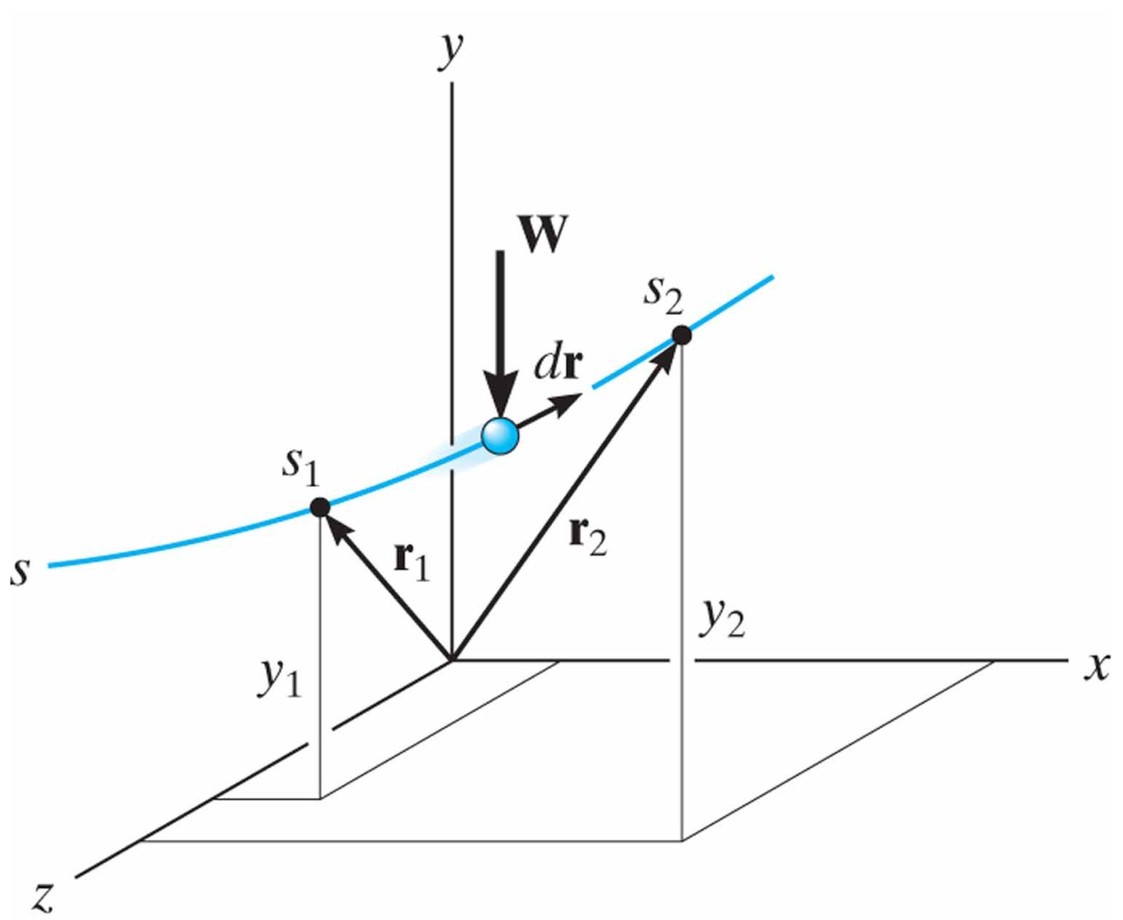
Work of a Force
14.1
Work of a Weight
The work of a weight is equal to the magnitude of the particle’s weight times its vertical displacement. Because weight acts downward and vertical displacement is positive, the work of a weight is negative.

Slide 5
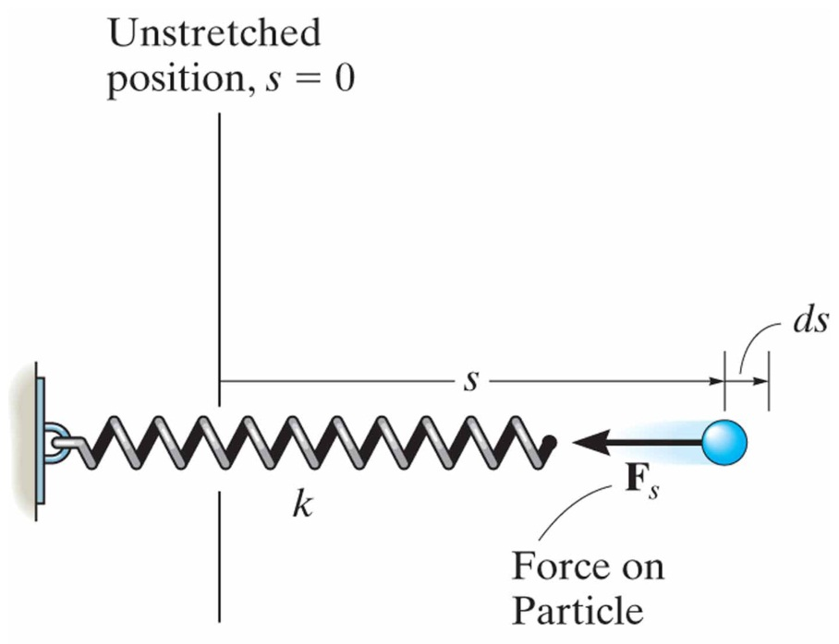
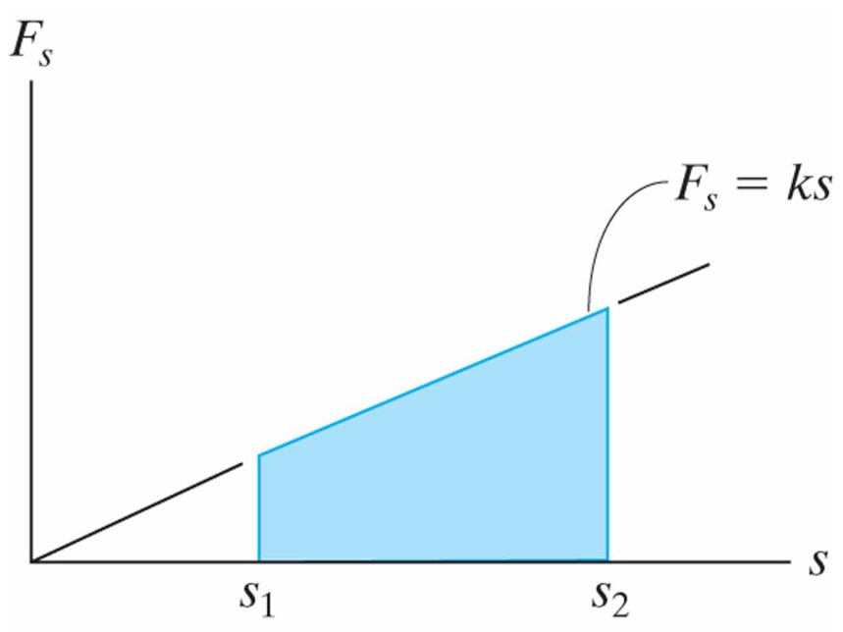
Work of a Force
14.1
Work of a Spring Force
Because the force of a spring is proportional to and in the opposite direction of its displacement, the work of a spring is:
A mistake in sign can be avoided by noting the direction of the spring force acting on the particle with respect to the displacement of the particle.

Slide 6
Principle of Work and Energy
14.2
Principle of Work and Energy
The equation of motion of a particle subjected to a system of external forces along the direction tangential to the path of motion is:
Furthermore, the acceleration is defined as:
Combining the above equations gives:
And by integrating both sides we find the Principle of Work and Energy:
State 2 kinetic energy
State 1 kinetic energy
sum of work from state 1 to 2

Slide 7
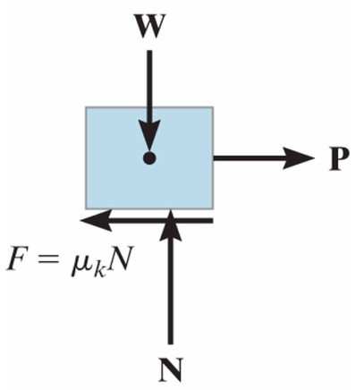
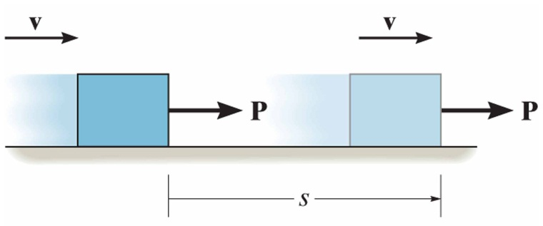
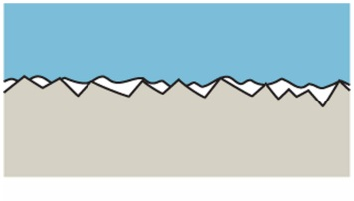
Principle of Work and Energy
14.3
Principle of Work and Energy for a System of Particles
The principle of work and energy can be extended to include a system of particles.
In this case, the initial kinetic energy of the system plus the work done by all external and internal forces acting on the system is equal to the final kinetic energy of the system.
Work of Friction Cause by Sliding
A special case exists where a body slides over the surface of another body in the presence of friction. In the case where the applied force just balances the friction force, we would expect:
In reality, the work of the resultant friction force represents both the external work of friction and internal work converted into various forms of internal energy, such as heat.

Slide 8
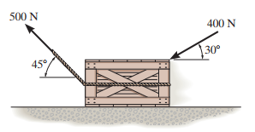
In-Class Practice Problem 1
Draw a FDB
(If you’re trying to move the crate, don’t push in the downward direction!)
Solve for normal force
Put friction force in correct direction
Find Work terms (noting +/- sign)
Apply conservation of energy equation

Slide 9
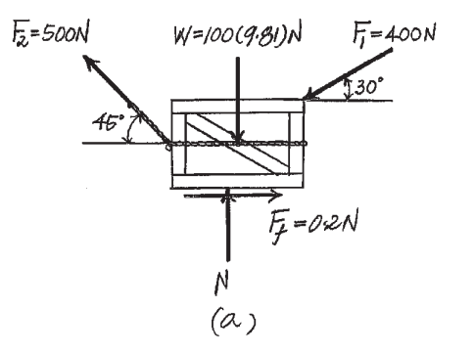
In-Class Practice Problem 1

Slide 10
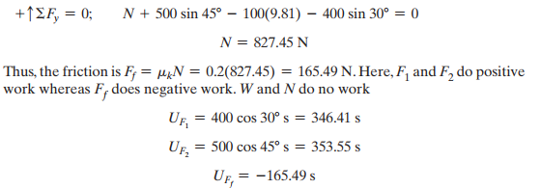
In-Class Practice Problem 1
Here ‘s’ is the distance in the direction of motion (horizontal to the left is positive)

Slide 11
In-Class Practice Problem 1

Slide 12
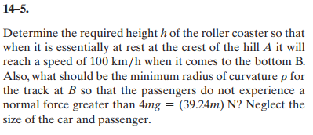
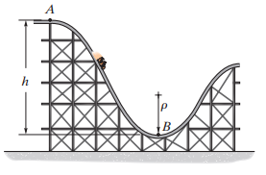
In-Class Practice Problem 2
First Question: Conservation of energy to find height (assume no friction/losses)
Second Question: Draw a FDB of person (note the orientation….gravity acting on person, weight, needs to be included)
Calculate acceleration around a curve

Slide 13
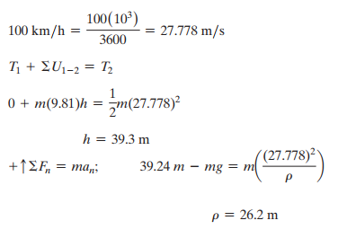
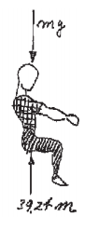
In-Class Practice Problem 2

Slide 14
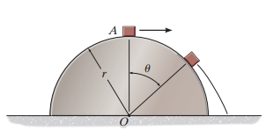
In-Class Practice Problem 3
Work = Force dot distance. In this section your textbook considers a change in potential energy one of the work terms (weight dot change in height)
Draw a FDB of block
Solve for the velocity as a function of angle
Find out where the normal force = zero

Slide 15
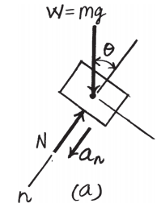
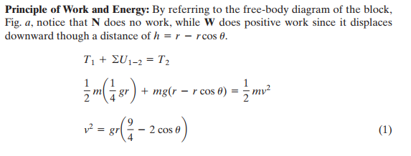
In-Class Practice Problem 3
This is one you’ll probably have to think about.
Can you create a function that uses sine instead?
Speed as a function of theta

Slide 16
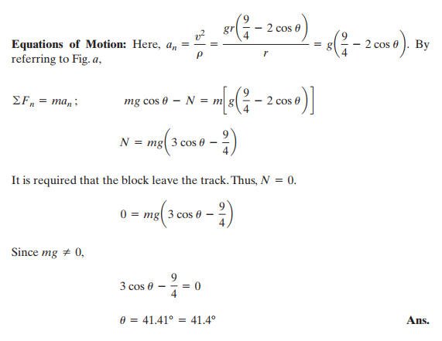
In-Class Practice Problem 3
Normal acceleration as a function of theta
Normal force as a function of theta

Slide 17
In-Class Practice Problem 3
Still struggling with this one? Try:
Give r a value (r = 10 ft)
Give an initial velocity (v = 2 ft/sec)
Solve the problem with these known values rather than symbolically

Slide 18
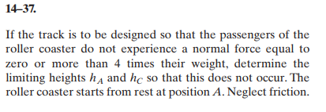
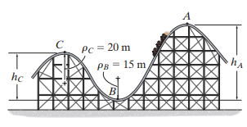
In-Class Practice Problem 4
This is just like problem 4-5, only doing it in a few places.

Slide 19
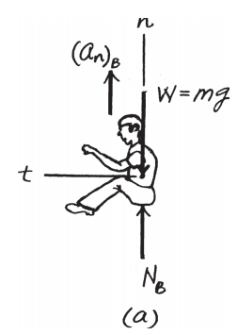
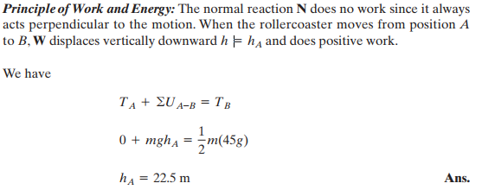
In-Class Practice Problem 4
At point B

Slide 20
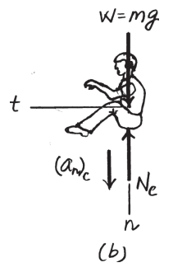
In-Class Practice Problem 4
At point C

