Slide 1
ME 433 Internal Combustion Engines
Professor:
Dr. Dan Cordon (AKA Dr. Dan)

Slide 2
Early Fuel Injection for Spark Ignition
We know that intake runner length and plenum volume both play a significant role in the volumetric efficiency of an engine. But long runner lengths and large plenum volumes do not work well with carburetors.
In the 1950’s Bendix, Bosch, and Kugel-Fischer were making mechanical injection systems (initially adapted from aircraft) for automotive applications.
Used a 3D cam that got information about engine speed and throttle position – a mechanical computer of sorts.
There was no input that measured the load on the engine, so these systems were tuned to operate with rich (safe) air-fuel ratios.
Injectors were located just upstream of intake valve.
Notable production cars using mechanical fuel injection were:
1954 Mercedes-Benz 300 SL Gullwing
1957 Corvette (Rochester Ramjet)

Slide 3
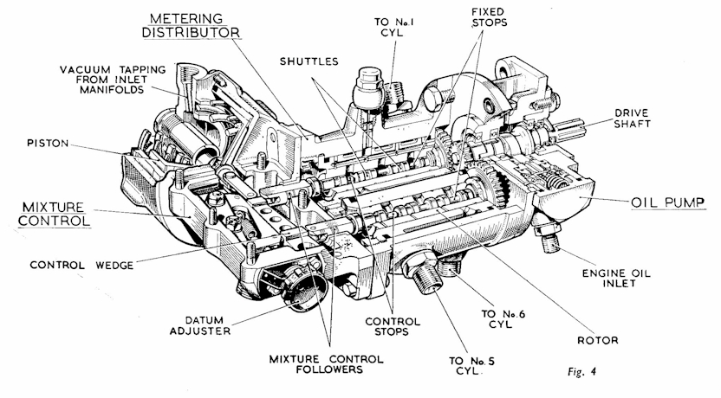
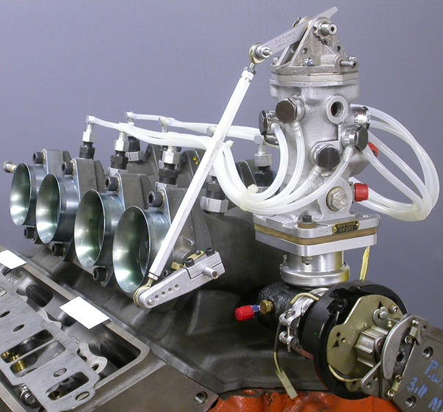
Evolution of Mechanical Fuel Injection
In the late 50’s British company, Lucas, known mostly for the least reliable electronic ignition systems every made, worked on a mechanical fuel injection system that added vacuum (manifold pressure) as an input to the system.
Manifold pressure feedback was a way to measure load on the engine (not just throttle position) and allowed the fuel quantity delivered to be a little more precise.
The Lucas Petrol Injection system was mostly used on British race cars from the 50’s through 70’s.
Jaguar
Triumph
Maserati
Lotus
Tyrrell
Brabham
Cooper

Slide 4
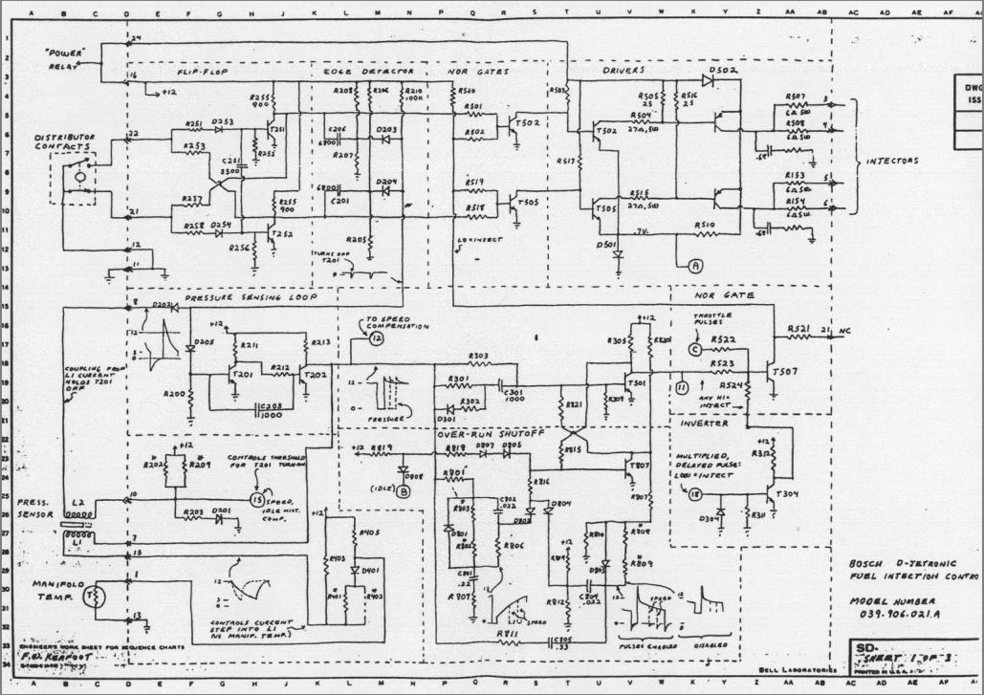
Early Electronic Systems - Bosch
In the 1960’s Bosch was working on mainstream electronic fuel injection systems. First used on a production vehicle for the 1967 VW 1600 TL.
Later used on many vehicles from VW, Porsche, Audi, Volvo, Mercedes-Benz, Saab, Opel, Renault, Lancia, and BMW.
The ECU of the Bosch D-Jetronic is completely analog!
The Bosch D-Jetronic Electronic Inputs
Engine Speed (from distributor)
Manifold Absolute Pressure (MAP)
Throttle Position (TPS)
Two Temperature Sensors (intake air, and engine temp)
Bosch D-Jetronic Electronic Outputs
(4) Primary fuel injectors
(1) Cold start injector (fires continuously for first few seconds)

Slide 5
Early Electronic Systems - Bosch
In the 1960’s Bosch was working on mainstream electronic fuel injection systems. First used on a production vehicle for the 1967 VW 1600 TL.
Later used on many vehicles from VW, Porsche, Audi, Volvo, Mercedes-Benz, Saab, Opel, Renault, Lancia, and BMW.
The ECU of the Bosch D-Jetronic is completely analog!
The Bosch D-Jetronic Electronic Inputs
Engine Speed (from distributor)
Manifold Absolute Pressure (MAP)
Throttle Position (TPS)
Two Temperature Sensors (intake air, and engine temp)
Bosch D-Jetronic Electronic Outputs
(4) Primary fuel injectors
(1) Cold start injector (fires continuously for first few seconds)

Slide 6
Early Electronic Systems - Bosch
In the 70’s Bosch developed an update to the D-Jet called L-Jetronic
The L-Jet is still a completely analog computer!
The Bosch L-Jetronic Electronic Inputs
Engine Speed (from distributor)
Air Flow Meter (AFM) – swing gate style
Throttle Position (TPS) – with idle switch
Two Temperature Sensors (intake air, and engine temp)
Thermotime switch (for cold start)
Lambda sensor (closed-loop feedback)
Bosch D-Jetronic Electronic Outputs
(4) Primary fuel injectors
(1) Cold start injector

Slide 7
1980’s through 2000’s Electronic Systems
These have lots of different names depending on the parent company, and what systems are controlled:
ECU – Engine Control Unit
EMM – Engine Management Module
PCM – Powertrain Control Module
EMS – Engine Management System
Fuel Control Strategies
Alpha-N (engine speed and throttle position)
Speed Density (engine speed and manifold pressure)
Fuel Tables (duty cycle)
Volumetric Efficiency Tables
MAF (engine speed and mass air flow)
Ignition Control Strategies
Engine speed and manifold pressure
Knock Sensor Feedback
Set values, or adaptive

Slide 8
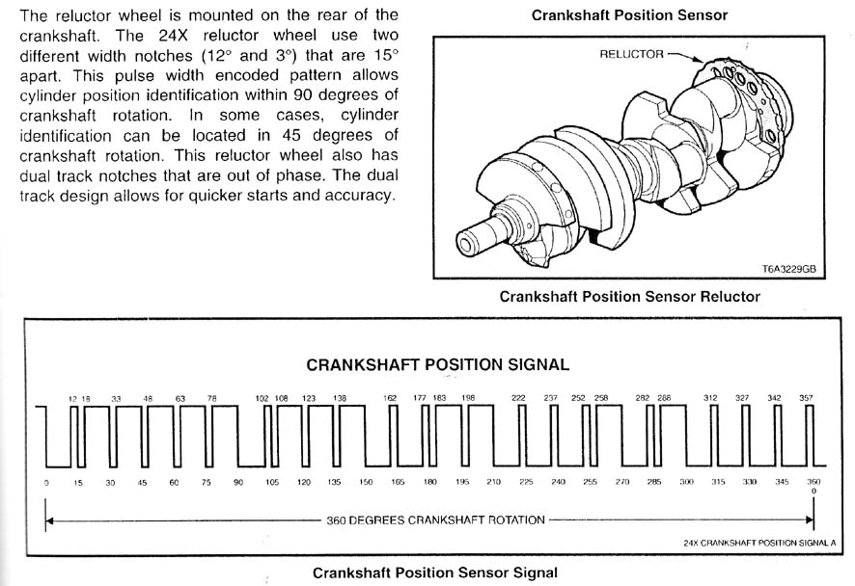
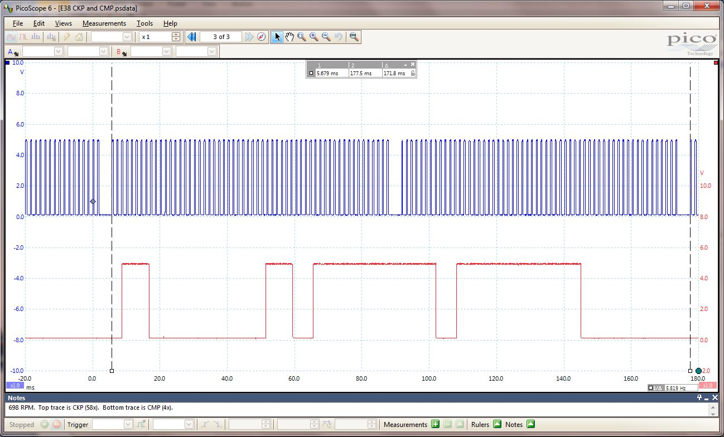
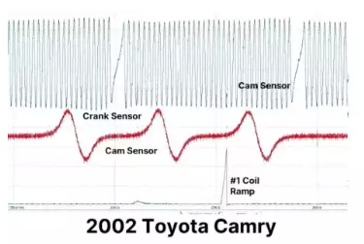
Primary Sensor Inputs to ECU (Speed)
Engine Speed
Missing tooth, or pattern
Magnetic (variable reluctance)
Hall Effect (square wave)
Cam Position
1 pulse per 2 crank revolutions
Magnetic (variable reluctance)
Hall Effect (square wave)
GM 58x 4x

Slide 9
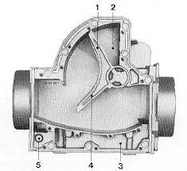
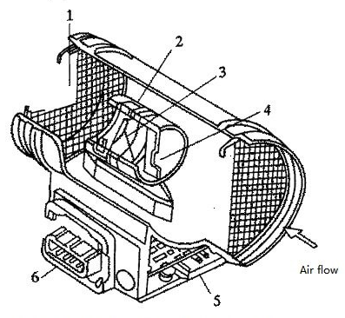
Primary Sensor Inputs to ECU (Load)
Mass Air Flow (MAF) Sensors
Bosch AFM (Air Flow Meter) – blade or wing gate style
Hot Wire
Hot Film
Karman Vortex
Manifold Absolute Pressure (MAP) Sensors
0-5V DC (1 bar, 2 bar, 3 bar, etc.)
Frequency (80-160 Hz) (Ford EEC)
Mounts to intake manifold (plenum), or remotely with vacuum hose

Slide 10
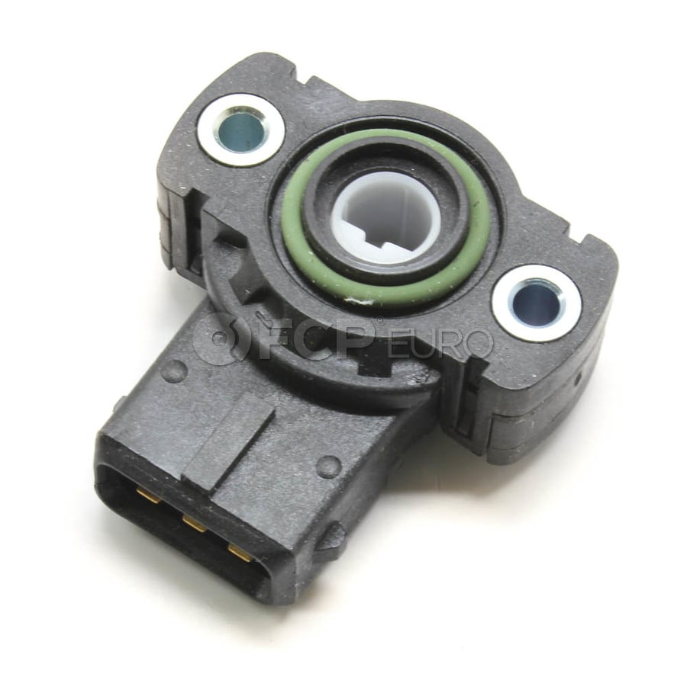
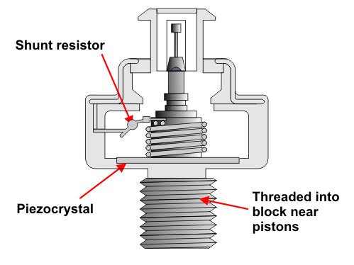
Secondary Sensor Inputs to ECU
Throttle Position Sensors (TPS)
0-5V DC, 90 degree sweep
Used for transient response (accelerator pump)
Intake Air Temperature Sensor (IAT)
Usually variable resistance type (thermistor or RTD)
Sometimes part of the MAF sensor
Engine Coolant Temperature (ECT)
Usually variable resistance type (NCT thermistor)
Located in hottest zone (near thermostat)
Knock Sensor
Piezoelectric microphone, used to detect detonation
Will adjust ignition timing if detected
Rigidly attached to engine block (sometimes multiple locations)
Ethanol Content Sensor

Slide 11
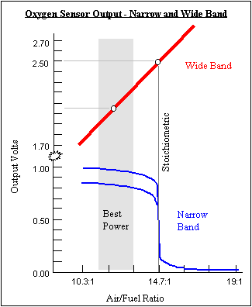
Closed Loop Feedback to ECU
Oxygen Sensors (O2 or Lambda)
Narrow Band (1-wire and 4-wire)
0-1V DC, switching near stoichiometric
Provides feedback about post-combustion air-fuel ratio to the ECU.
Usually one per engine, or one per bank.
Makes an overall fuel trim
Somewhat slow feedback time (few seconds)
Wide Band (4-wire and 5-wire)
0-5V DC, usually linearized over range
Allows closed-loop control away from stoichiometric region
Still slow feedback time, but sensor response is very fast (can detect individual cylinder AFR)
Started being used in OEM vehicles ~2010
Used for both short term trim and long term trim
Individual cylinder trim, and cell-based fuel trim in ECU tables

Slide 12
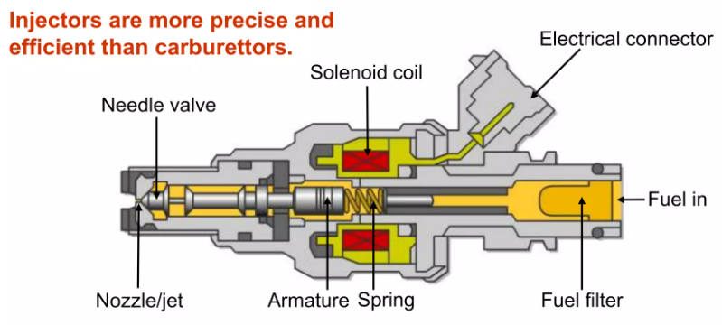
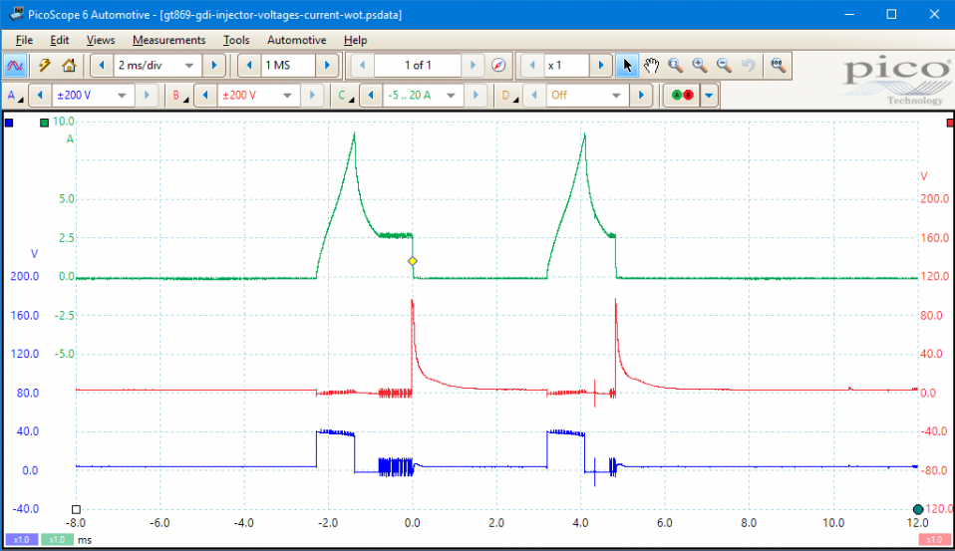
ECU – Primary Controlled Outputs
Fuel Injectors – Sequential Multiport
PWM signal to each injector, timed to specific points in the cycle
Fuel Injectors – Direct Injection
Signal to open quickly, adjust duration in open position, then signal to close injector

Slide 13
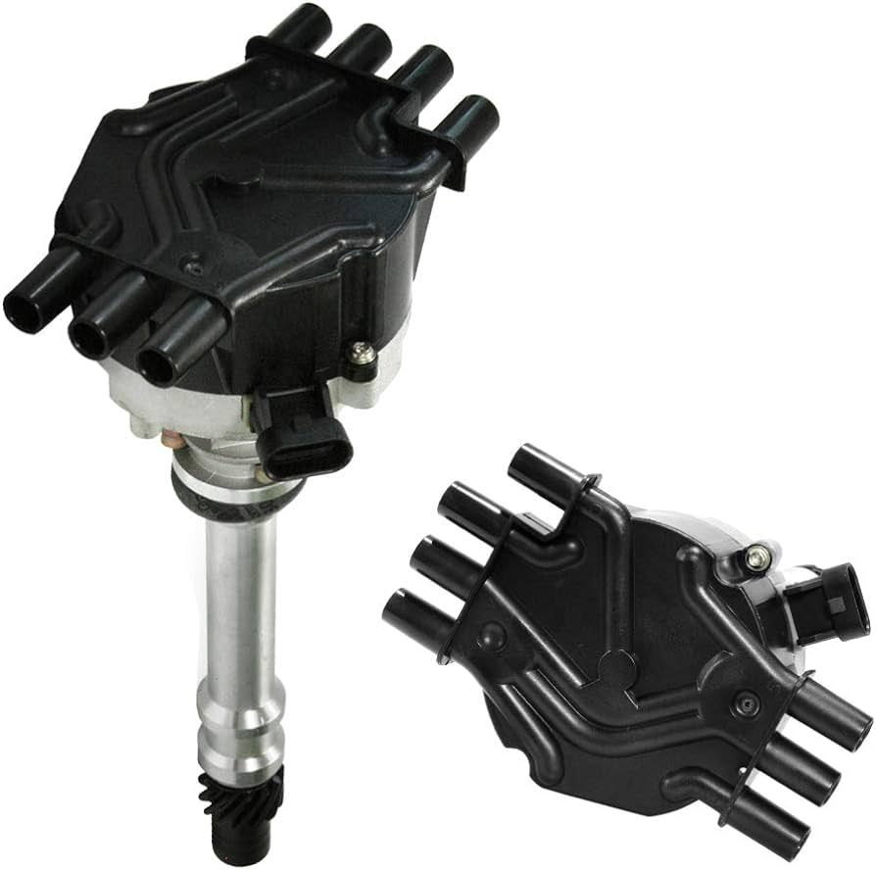
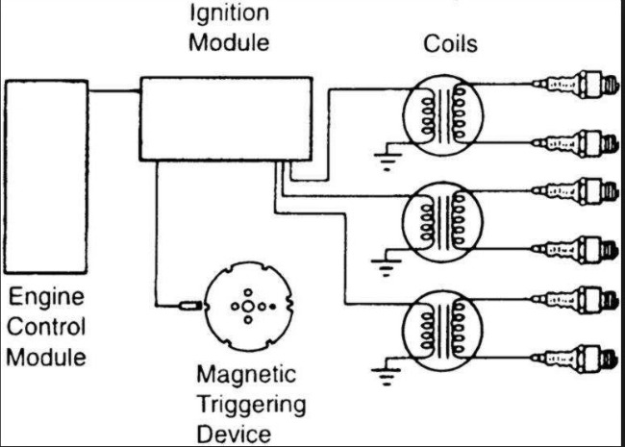
ECU – Primary Controlled Outputs
Ignition – Central Distribution
Square wave (steep V vs. time), timed to specific points in the cycle.
Distributor position dictates which cylinder is fired
Ignition – Wasted Spark
Square wave to each coil that feeds multiple cylinders near TDC
Will fire the spark plug on both on combustion and exhaust strokes
Ignition – Coil-on-Plug (COP) or Coil-Near-Plug (CNP)
Square wave to a coil that feeds just one cylinder
Coils can be much smaller, and with much more time to recharge between ignition events.
Failure of a single coil only affects one cylinder.

Slide 14
ECU – Secondary Controlled Outputs
Idle Air Control Valve (IACV)
Either PWM or Stepper Motor (2-wire or 4-wire)
Lets air bypass throttle to control idle speed, usually as a function of engine temperature
Can also adjust for additional loads like A/C compressor, electric water pump, etc.
Fuel Pump
On/Off for older return systems
PWM signal to fuel pump for returnless systems
Cooling System
Electric fan(s) and water pump
Other Things
Camshaft Phasing, VTEC solenoid, Turbo wastegate, Supercharger bypass, Nitrous Oxide, Water injection, Intercooler Spray, A/C clutch

Slide 15
ECU – Bonus Features
Anti-lag and Launch Control
Retard ignition timing a LOT.
Allows engine to run at certain RPM while at WOT.
Pre-spools the turbocharger
Shift Cut
Will cut ignition or fuel to allow throttle to remain WOT during shift.
Usually gets signal from clutch pedal, but can be a timed delay for sequential gearboxes.
Electronic Throttle (Drive by Wire)
A ‘Torque Request’ input is required, then ECU controls the actual throttle position.
Requires duplicate signal of throttle position for safety.
Traction Control
Can make adjustments to ignition, fuel, or throttle if slip conditions are detected.

Slide 16
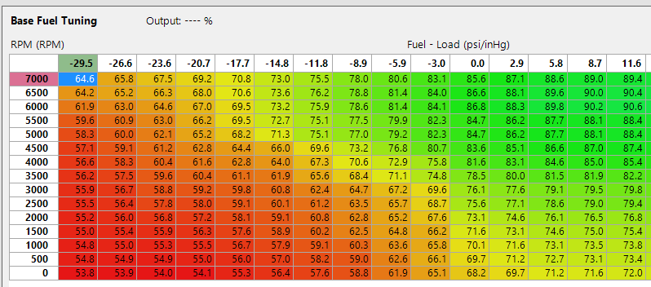
ECU – Primary Fuel Tables
Load Axis can be: Throttle position, Manifold Pressure, or MAF
Values in the table can be:
Volumetric Efficiency [%]
Injection Time [ms]
Fuel Flow Rate [lb/hr, cc/min, etc.]
Factor to Correct MAF Signal

Slide 17
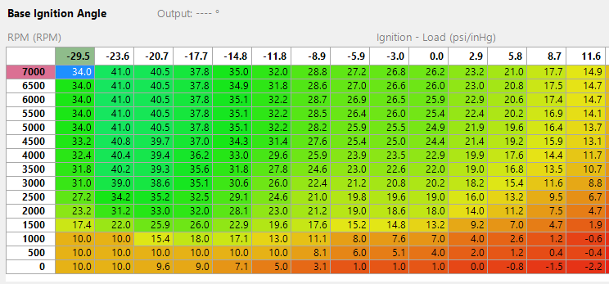
ECU – Primary Ignition Tables
Load Axis can be: Throttle position, Manifold Pressure, or MAF
Values in the table are usually:
Crankangle before TDC
Negative numbers would be after TDC

Slide 18
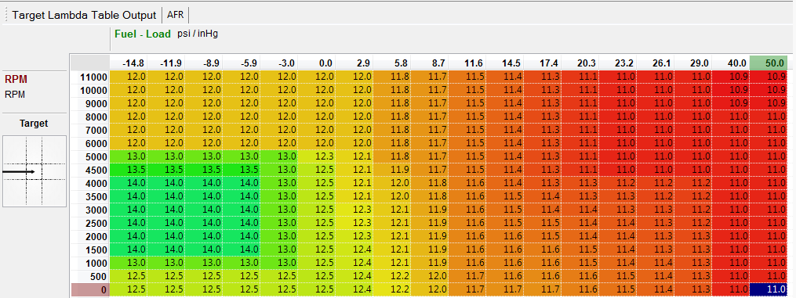
Closed Loop ECU – Primary Fuel Tables
If a WBO2 sensor is used you can set a desired air-fuel ratio for each cell in your fuel table.
You also need to choose the following:
Set limits on how much the ECU is allowed to change fuel value from the primary fuel table.
Are adjustments stored in a separate table for review?
Are adjustments applied to your primary fuel table?

Slide 19
Closed Loop ECU – Small Tasks
The ECU may have several other closed-loop control systems. The most common are:
Control idle speed (output to the IACV)
Control electric fans
Control electric water pump
Control intercooler temperature (spray bar)
Control ignition timing (knock sensor input)
Control power output (wheel slip detection)
Control throttle position (drive-by-wire)
Control camshaft phaser(s)
Control fuel pump PWM (based on injector pressure)
Boost control for turbo wastegate PWM (based on boost pressure)

Slide 20
Modifiers to Injector Signal
The primary fuel tables dictate fuel injection quantity. But there are many other tables used to alter the quantity that actually gets injected.
Auxiliary Tables, Secondary Maps, Fuel Modifiers, etc. for:
Adjust injection quantity based on coolant temperature (2D map)
Adjust injection quantity based on ethanol content (3D map)
Adjust injection quantity based on system voltage (2D map)
Adjust injection quantity based on fuel pressure (2D map)
Adjust injection quantity based on fuel temperature (2D map)
1D maps for changes based on switched inputs
Nitrous injection
2-step rev limiters
3D maps for changes based on switched inputs
Map switching (race fuel vs pump gas)
Backup maps in case sensor failure

