Slide 1
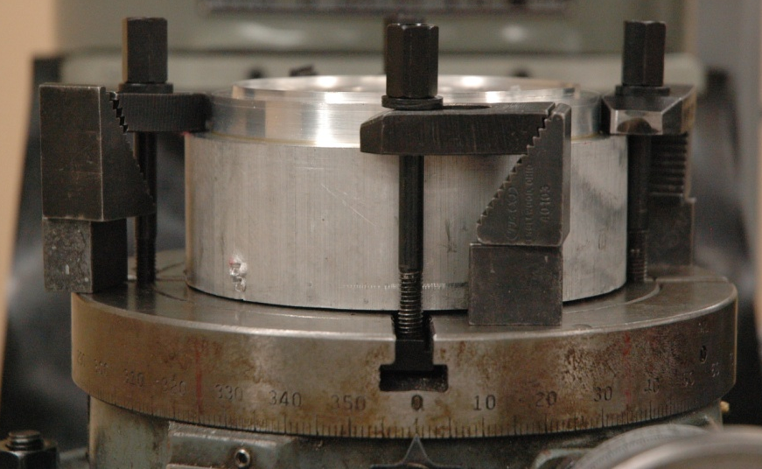
Rotary Table
Mount for mill table
Clamps
Uses/ Purpose:
Cutting Circular Grooves
Circular hole patterns
Angled Cuts
Setup:
1. Mount the rotary table to the mill table
2. Find the center of the rotary table using Dial Indicator and set X and Y to zero on read out.
3. Position material to find the true center using a dial indicator or a wiggler with respect to the center of the rotary table.
4. Mount the material to the rotary table using proper clamping equipment.
5. Reference a zero axis using the dial indicator on the rotary table.
Lock
Location:
Clamp Setup

Slide 2
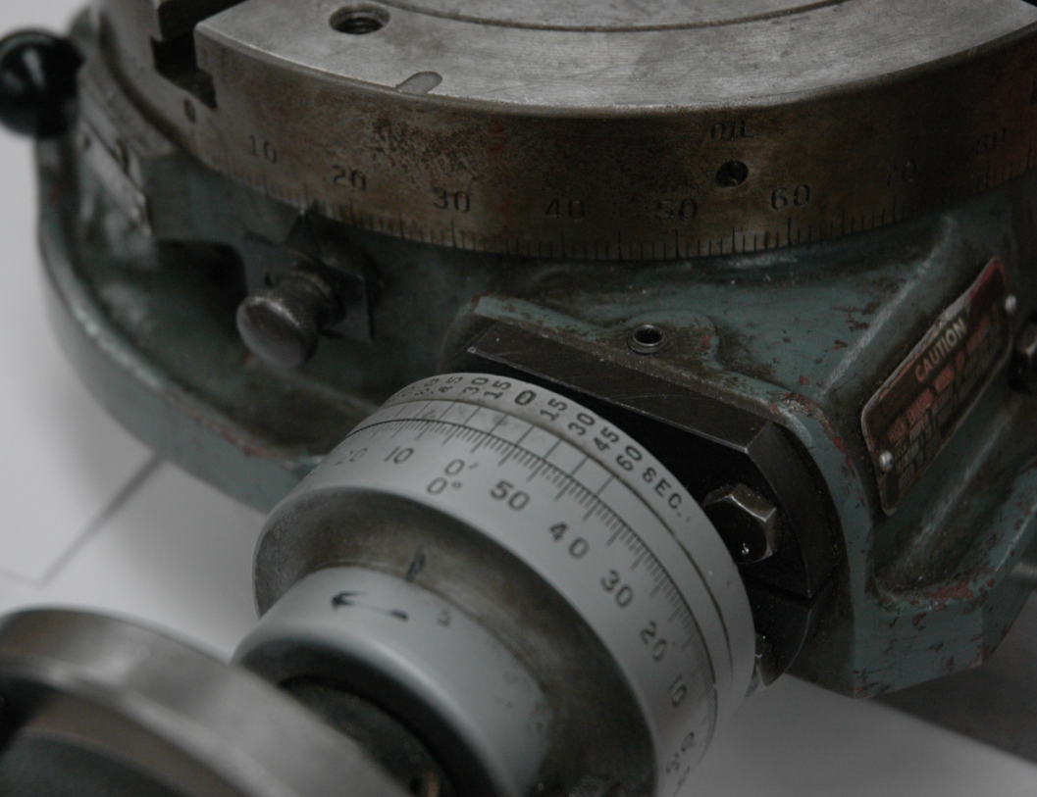
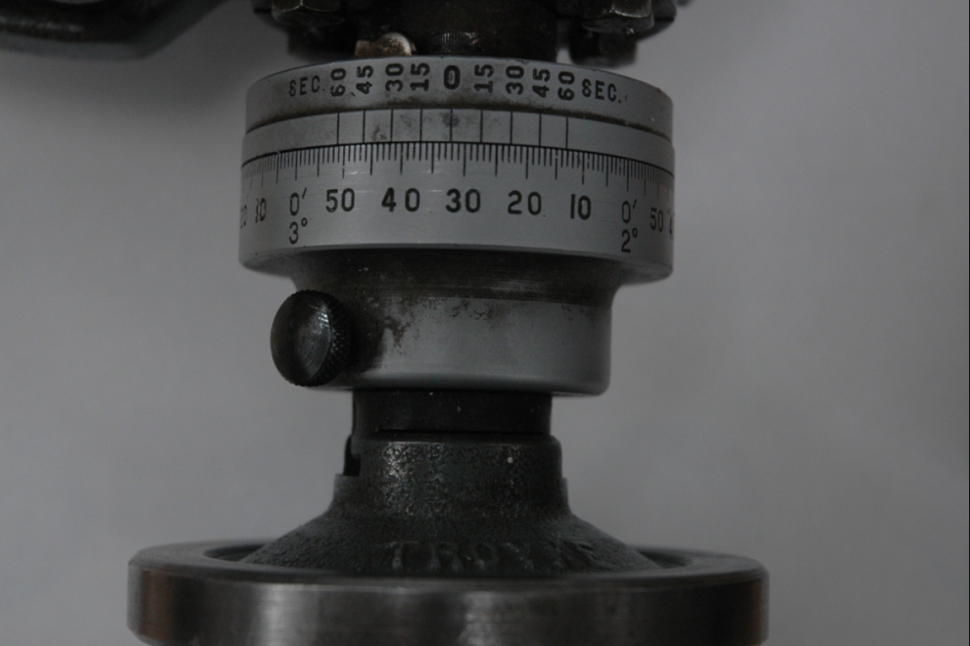
Reading the Dial:
1. Read the degree dial to get the number of full degrees rotated.
2. Use the Min. and Sec. dial to get an exact value of degrees.
Notes:
One full Rotation of Crank equals 4 degrees.
The resolution is 15 seconds.
Zero Mark Sec.
Zero Reference Point
Minutes
Seconds
Adjustment Tab
Precautions:
Make Sure the Table is Properly fastened and locked down.
Make sure material is properly centered and clamped down.
Make sure the true zero is documented.
Andy Florence
Bryan Riga
2008
Zero Mark Minutes
Degree Indicator
Rotary Table dial indicator

