Slide 1
Lecture 7
Thermodynamic Property Tables
Thermodynamic Property Charts

Slide 2
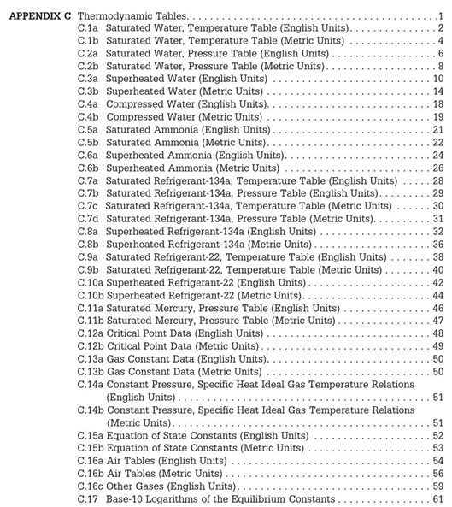
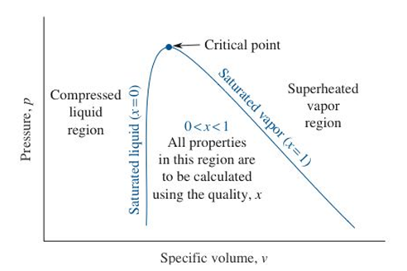

Slide 3
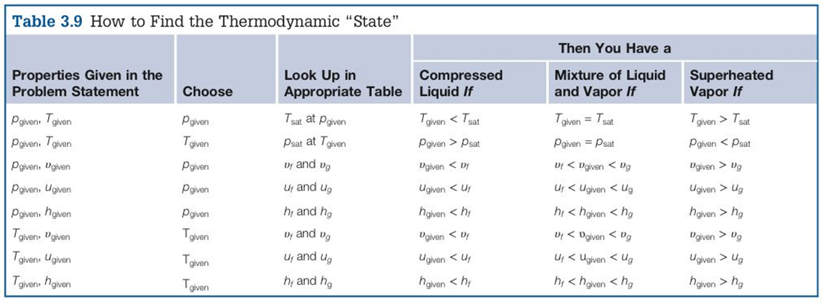
Guide for Finding the Phase

Slide 4
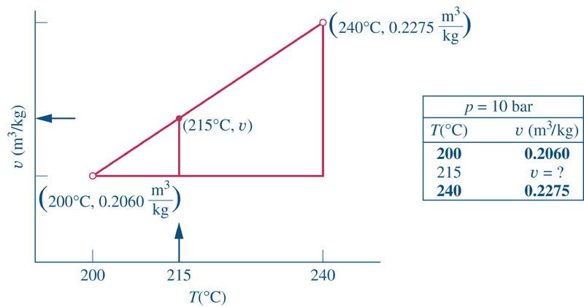
Linear Interpolation in the Tables
Applying this to the above example,

