Slide 1
Review For Exam 1

Slide 2
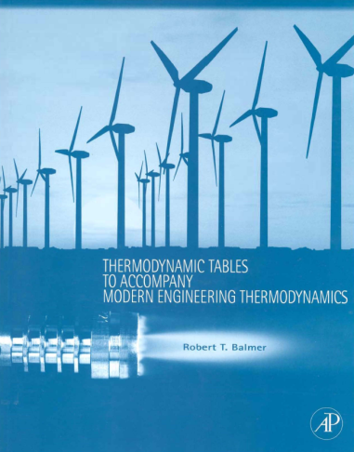
Exam Information
50-minutes (strictly enforced)
Resources allowed
The blue properties booklet
You can write anything you want in the white space of this booklet.
NO photocopies, no taping, pasting, photocopies, or loose papers (exception is the table to find phase)
A handheld calculator
No other electronic devices may be used including cell phones, computers, tablets, music players, etc.

Slide 3
Exam Information
A table of conversion factors will be provided with the exam ☺
NO interpolation will be required ☺
Material covered
Everything since the first day of class
All in-class lecture material
All in-class problem solutions
All assigned reading questions
All homework assignments

Slide 4
Do you know ...
How to work with moles as well as mass?
How to work with English and SI units (including g_{c} )?
How to express fundamental dimensions in FLt or MLt?
How to distinguish open, closed, and isolated systems?
How thermodynamic properties are related to derivatives (as in Eqn 3.7)?
How to apply the incompressible substance model? (using saturation data)
How to apply the ideal gas model? (for PVT behavior as well as for internal energy, w/isochoric heat capacity, and enthalpy, w/isobaric heat capacity)
How to apply the real fluid model (w/property Tables and w/EES)?
How to locate thermodynamic states and sketch simple processes on P-T, P-v, and T-v diagrams? (critical point, triple point, saturation line, fusion line, compressed liquid region, two-phase region, superheated vapor region)
What is the meaning of the technical terms inside back cover of your text (except entropy, isentropic, reversible, and availability)?
What is quality? When is it used and how do you calculate it?

Slide 5
Do you know ...
How to calculate moving boundary work (for real fluids and for ideal gases)?
What is a polytropic process (with special values of n for isochoric, isobaric, and isothermal ideal gas processes)?
How to apply the Conservation of Mass to a system?
How to apply the First Law of Thermodynamics to a system?
What is the sign convention for heat, work, and energy transport within the First Law of thermodynamics (as used by engineers)?
How to represent processes and cycles on P-V diagrams? How to use these diagrams to visualize process work as well as net cycle work?
How to apply a thermodynamic problem solving methodology?
How to code in EES (managing units, accessing fluid properties, using parametric tables, checking equations, and formatting results)?
Can you calculate First Law efficiency of various systems?
Can you use the Air Tables to find values and perform isentropic calculations?

Slide 6
Do you want ...
FE-Style questions on your exam?
These should take ~2-5 minutes per question, so up to 20 of these questions in 50 minutes
Circled correct answer without supporting information gets you no points
Circled incorrect answer, but with reasonable work can get you partial credit
Can be conceptual, or calculation types of questions
Traditional calculation questions?
These should take 12-16 minutes per question, so 3-4 questions in 50 minutes
Need to show all of your work
A mix of FE and Calculation Questions?

