Slide 1
Lect 27b
Jet Aircraft Propulsion

Slide 2
Aircraft Propulsion
Thrust produced by increasing the kinetic energy of the air in the opposite direction of flight
Slight acceleration of a large mass of air
Engine driving a propeller
Large acceleration of a small mass of air
Turbojet or turbofan engine
Combination of both
Turboprop engine
2

Slide 3
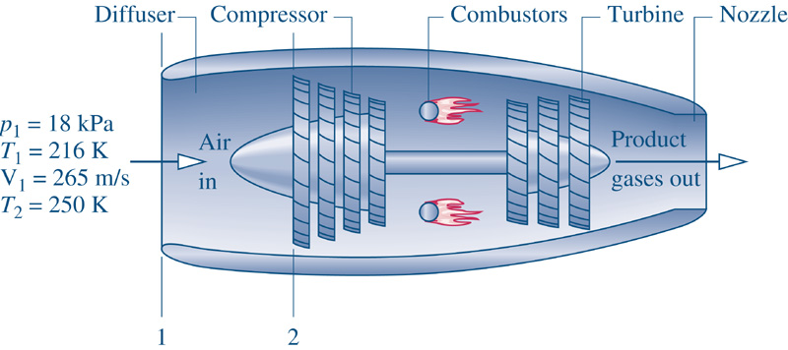
Aircraft Gas Turbine Engines
Turboprop
Small commuter planes
Turbofan
Larger passenger airliners
Turbojet
high speeds
3

Slide 4
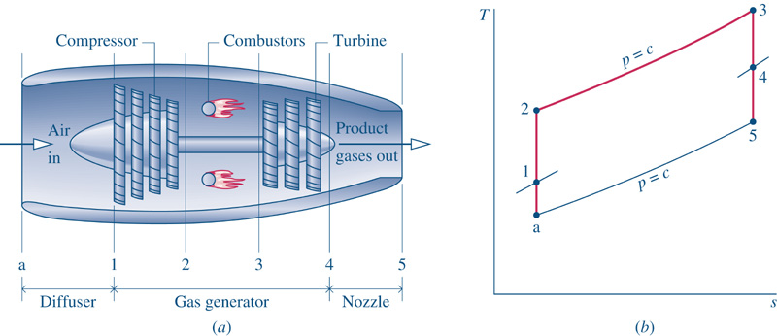
The Turbojet
Ideal Turbojet
Pressure drop with acceleration
Ram effect - pressure rise with deceleration
a-1 Isentropic increase in pressure (diffuser)
1-2 Isentropic compression (compressor)
2-3 Isobaric heat addition (combustion chamber)
3-4 Isentropic expansion (turbine)
4-5 Isentropic decrease in pressure with an increase in fluid velocity (nozzle)

Slide 5
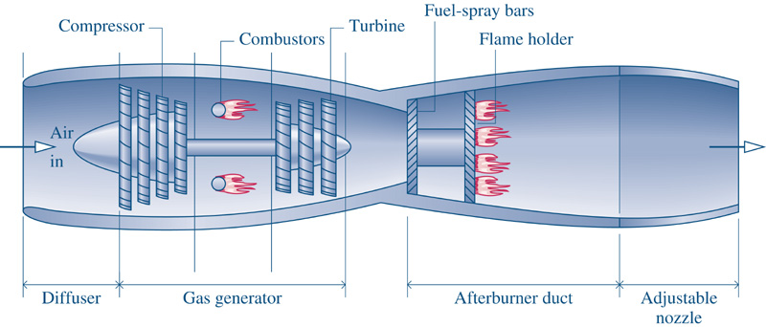
The Turbojet with an Afterburner
The turbine exhaust is already hot. The afterburner reheats this exhaust to a higher temperature which provides a higher nozzle exit velocity

Slide 6
Turbojet Irreversibilities
Isentropic efficiencies
- Diffuser
- Compressor
- Turbine
- Nozzle
Fluid Friction effects
- Combustion chamber

Slide 7
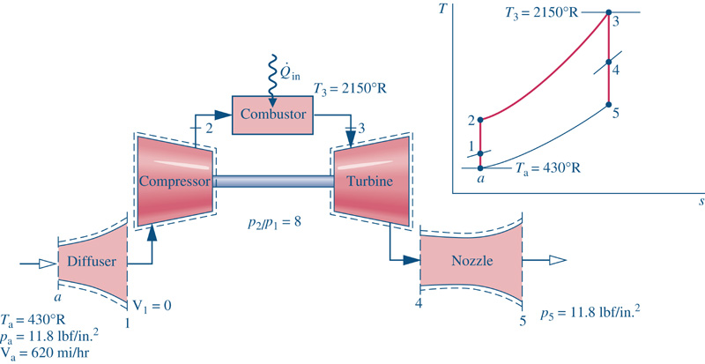
The Turbojet Model
First Law analysis of the components in the cycle
Combustion is replaced with a heat transfer
Air is the working fluid throughout the complete cycle

Slide 8
Turbojet Performance
There is no net power output of the turbojet engine. Therefore, the idea of net power and thermal efficiency are not meaningful. In turbojet engines, performance is measured by,
Propulsive Force (Thrust)
The force resulting from the velocity at the nozzle exit
Propulsive Power
The equivalent power developed by the thrust of the engine
Propulsive Efficiency
Relationship between propulsive power and the rate of kinetic energy production

Slide 9
Turbojet Performance
Propulsive Force (Thrust)
Propulsive Power
The power developed from the
thrust of the engine
in (a)
exit (5)
In this equation, the velocities are relative to the aircraft (engine). For an aircraft traveling in still air,

Slide 10
Turbojet Performance – Efficiencies
Overall Efficiency
Kinetic energy production rate
Thermal Efficiency
Thermal power available from the fuel
Propulsive Efficiency
Propulsive power
Kinetic energy production rate

Slide 11
Turbojet Example
Given: A turbojet engine operating as shown below
Find:
The properties at all the state points in the cycle
The heat transfer rate in the combustion chamber (kW)
The velocity at the nozzle exit (m/s)
The propulsive force (lbf)
The propulsive power developed (kW)
The propulsive efficiency of the engine

Slide 12
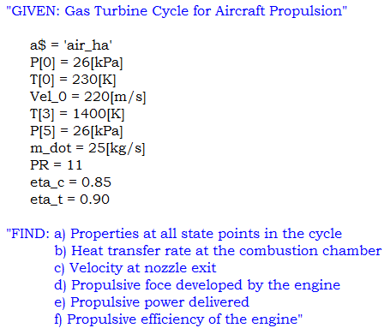
Turbojet Example
Note: An array position of [0] is allowed in EES!

Slide 13
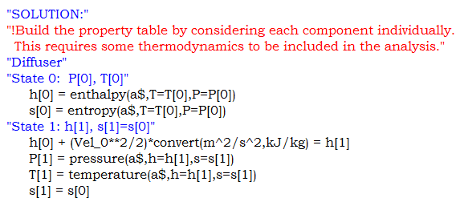
Turbojet Example
Strategy: Build the property table first. This will require some thermodynamic analysis. Consider each component in the cycle.
Diffuser

Slide 14
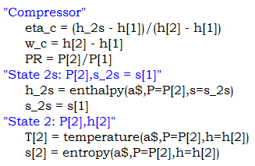
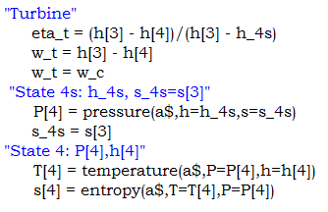
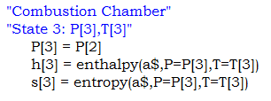
Turbojet Example
Compressor
Turbine
Combustion Chamber

Slide 15
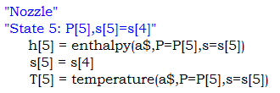
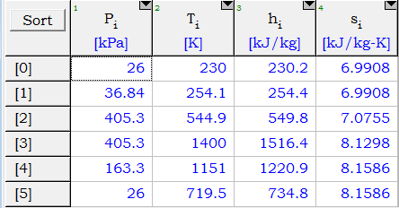
Turbojet Example
Nozzle
At this point, the property table is complete!

Slide 16
Turbojet Example
Now, we can continue with the rest of the thermodynamic analysis.
Combustion Heat Transfer Rate
Nozzle – Exit Velocity

Slide 17
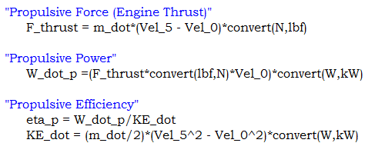
Turbojet Example
Now the propulsive parameters can be calculated,

Slide 18
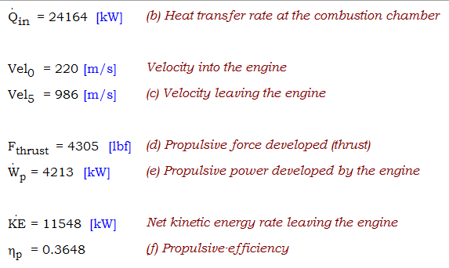
Turbojet Example
Solution (Key Variables):

Slide 19
Turbojet Example – Analysis
How is the energy input to this engine distributed?
excess thermal energy transfer
kinetic energy production rate

