Slide 1
Lecture 34
The Psychrometric Chart
Psychrometric Properties in EES
Air Conditioning Processes

Slide 2
Moist Air Properties
Using a combination of the ideal gas and real-fluid models along with ideal mixing we have discovered,
Note: The textbook puts a ‘#’ sign on the enthalpy to remind us that its mass basis is per lbm of dry air in the mixture.
Applying this notation to the heating problem from Lecture 33,

Slide 3
Moist Air Properties
Question: Is there an easier way to determine h# ?
Answer: YES! ☺
As with pure fluids, a real-fluid mixture formulation has been developed for the dry air-water vapor mixture. The formulation uses the real-fluid behavior of the components along with real mixing. As such, the resulting formulation is complex. Fortunately, it can be displayed graphically in a series of charts known as the psychrometric charts. The psychrometric charts are published by ASHRAE. They were drawn at the Center for Applied Thermodynamic Studies (CATS) at the University of Idaho. There are 5 IP (English unit) charts, and 7 SI charts.

Slide 4
Psychrometric Properties
The Psychrometric Chart

Slide 5
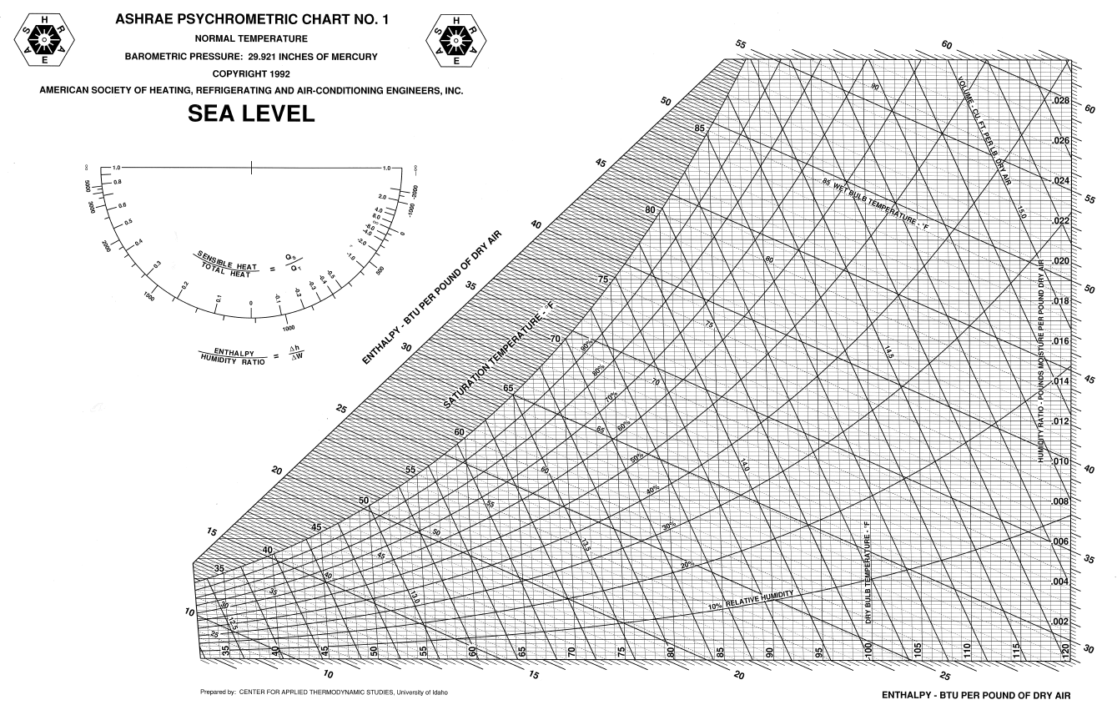
Chart No. 1 is available on the BbLearn website!

Slide 6
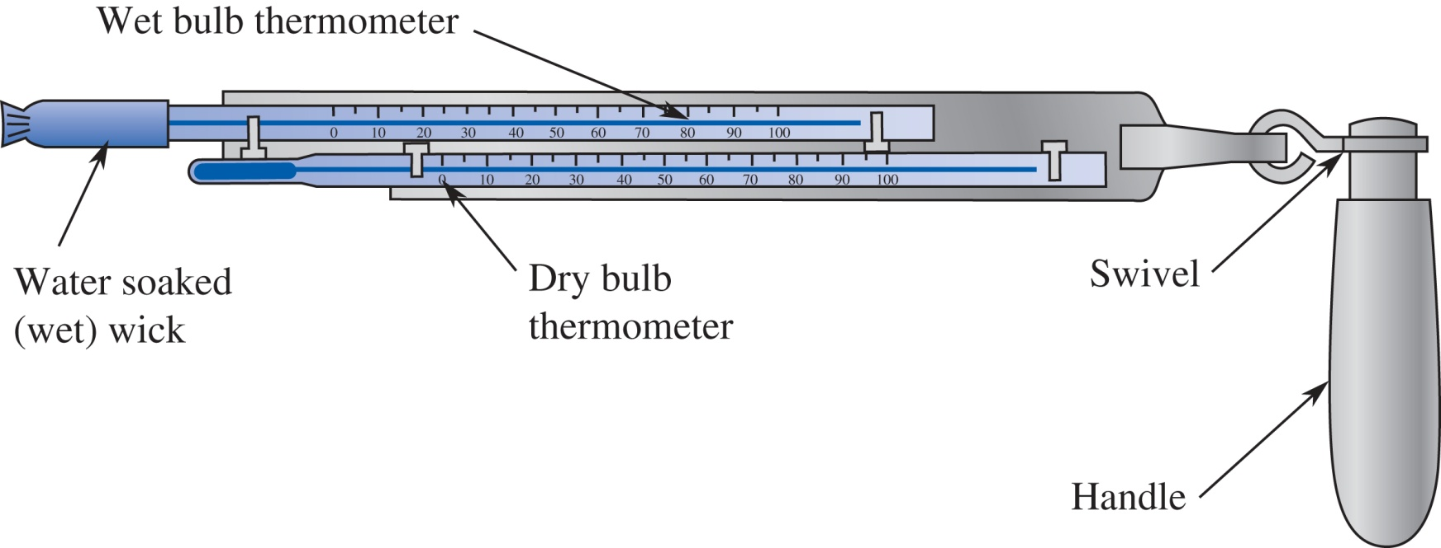
Wet Bulb and Dry Bulb Temperatures
Wet bulb and dry bulb temperatures are thermodynamic properties of the moist air mixture. They are measured with a device known as a psychrometer.

Slide 7
Psychrometric Properties using the Chart
Given: Moist air mixture in our classroom; T, T_{wb} measured with a sling psychrometer.
Find: The following psychrometric properties of the mixture using the Psychrometric Chart
relative humidity
humidity ratio
specific enthalpy
specific volume
dew point temperature

Slide 8
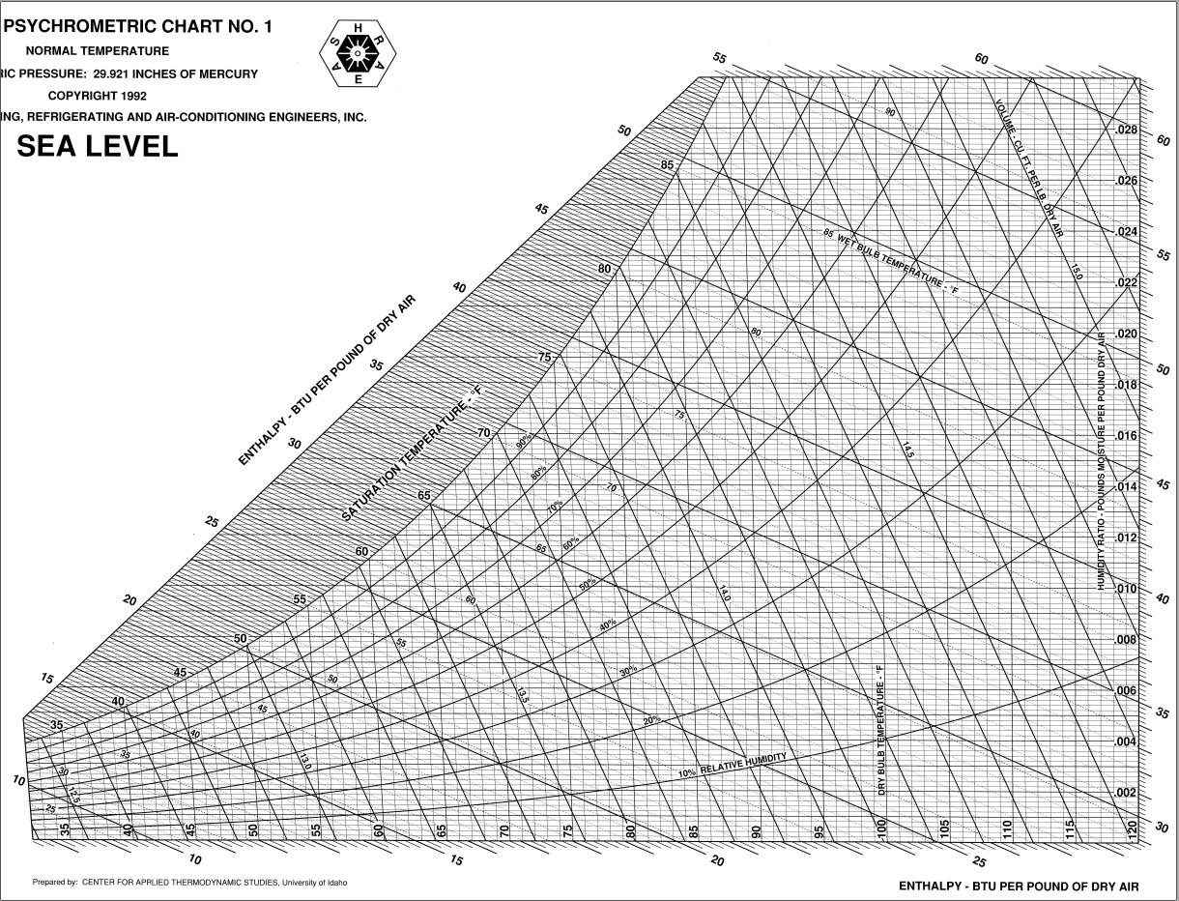
Given: T = 72 °F
T_{wb} = 57 °F
ϕ =
ω =
h# =
ν =
T_{dp} =
39%
.0065
24.5
13.55
46

Slide 9
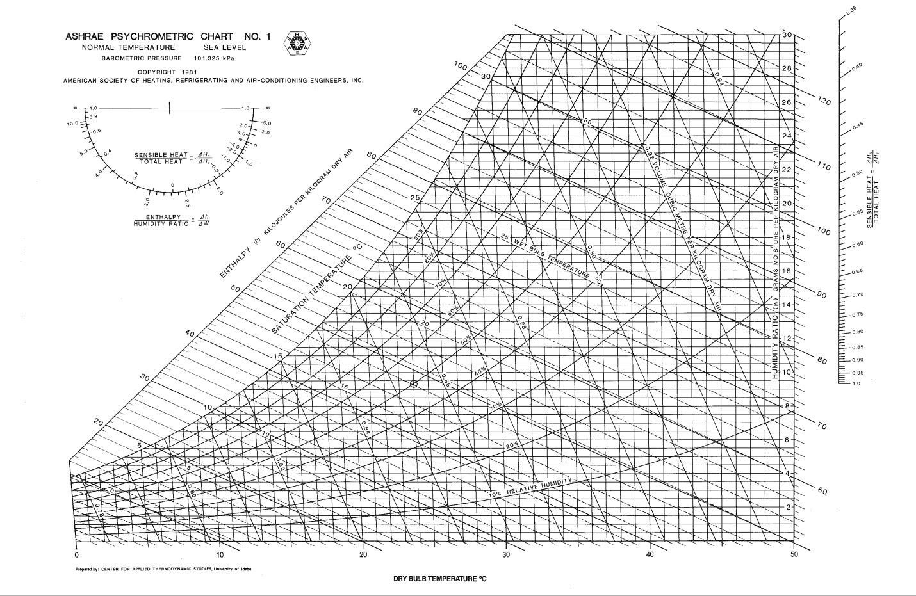
Given: T = 32 °C, T_{wb} = 24 °C
ϕ =
ω =
h# =
ν =
T_{dp} =
50%
15.4
72.0
0.887
20.8

Slide 10
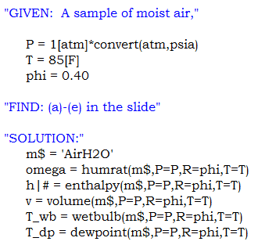
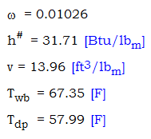
Psychrometric Properties in EES
Given: Moist air at 1 atm, 85°F, 40% relative humidity
Find: The following psychrometric properties of the mixture using EES
humidity ratio
specific enthalpy
specific volume
wet bulb temperature
dew point temperature

Slide 11
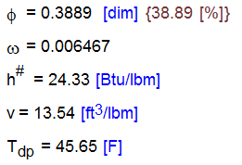
Comparison of Answers
Given: Moist air at 1 atm, T=72°F, T_{wb}=57°F
Find: Various psychrometric properties
EES Calculations
Psychrometric Chart
ϕ = 39%
ω = .0065 lbm_{w}/lbm_{dry air}
h# = 24.5 Btu/lbm_{dry air}
ν = 13.55 ft³/lbm
T_{dp} = 46 °F

Slide 12
Preview of Air Conditioning Processes

Slide 13
The Five HVAC Processes
Heating
With and without humidification
Adiabatic humidification
Cooling
With and without dehumidification
Adiabatic mixing of moist air streams
Evaporative cooling

