Slide 1
The Final Exam for ME 322 has been posted.
What you are about to see are student solutions to real exam problems.
Please do not follow their examples!!!

Slide 2
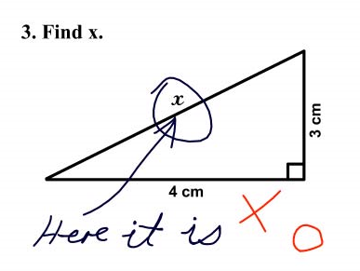

Slide 3
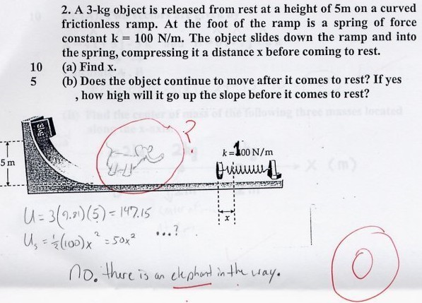

Slide 5
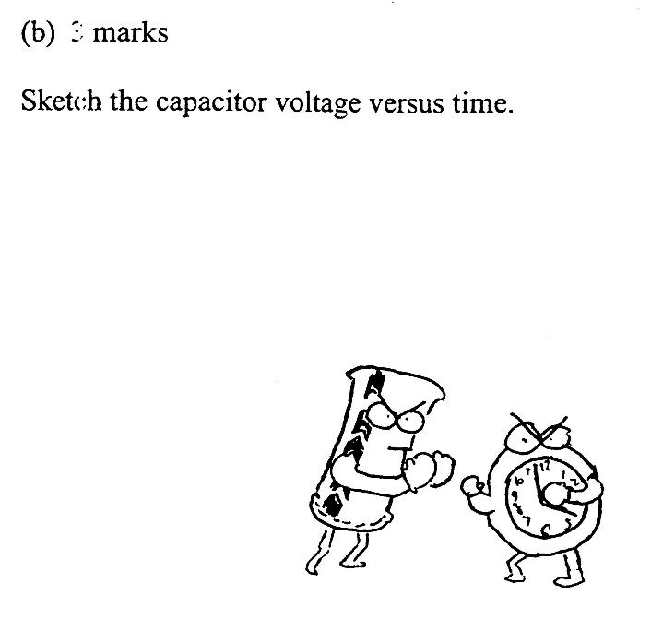

Slide 6
From a chemistry exam …

Slide 7
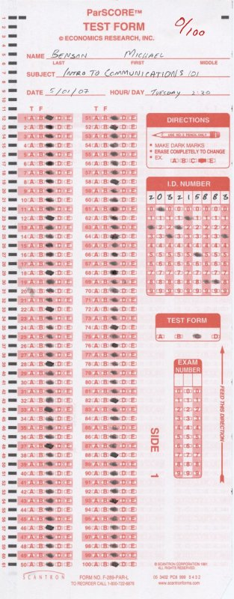

Slide 8
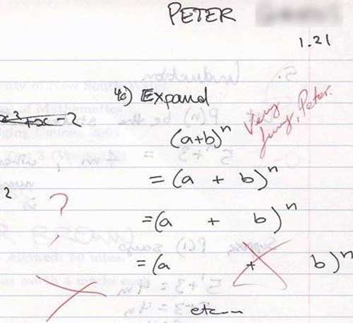

Slide 9
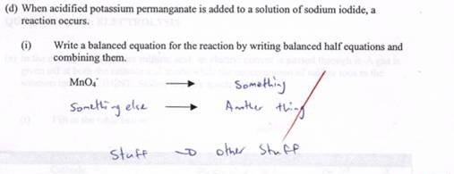

Slide 10
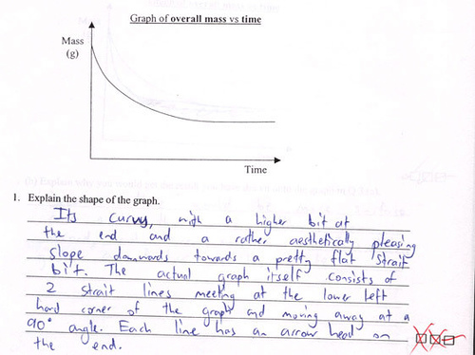

Slide 11
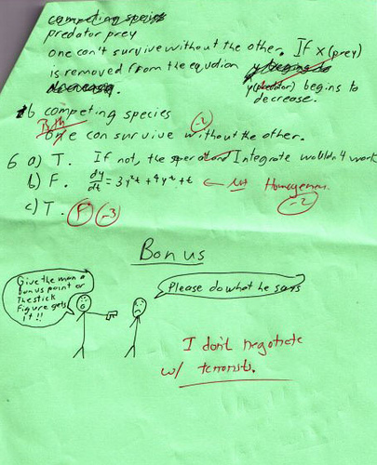

Slide 12
Real Science Exam Answers
H2O is hot water. CO2 is cold water.
When you smell an odorless gas, it is probably carbon monoxide
Three kinds of blood vessels are arteries, vanes, and caterpillars
A super-saturated solution is one that holds more than it can hold
Momentum: What you give a person when they are going away.

