Slide 1
Energy Feed Ingredients
Grains,
By-Products,
tubers and roots,
liquid feeds,
Lipids

Slide 2
Characteristics of grains
High in starch: 70%
  In grains starch is located primarily in the endosperm
High in digestibility: > 85%, at times > 90%
Low in protein: 8 to 14%; because kernel is concentrated with starch
Deficient in Ca and some vitamins

Slide 3
Characteristics
Energy feed cost more per pound than forage but may be a cheaper source of energy
  Alfalfa: $145/ton; 2.56 Mcal DE/kg = 1.16 Mcal/lb
  Alfalfa: 145/(2000 * 1.16) = $.062Mcal
  Corn: $215/ton; 3.92Mcal DE/kg = 1.78/lb
  Corn: $215/(2000 *1.78) = $.060/Mcal
  Corn is worth about 1.54 times what hay is worth (1.78/1.16) (in this situation)
Notes:
So why do use forages as the basis for cow rations?

Slide 4
Grains
Corn-
  Most important - nationally and worldwide
  80% of all grains fed to livestock in this country
Barley
  Especially in the PNW
Wheat-only 50% of ration in cattle and in swine
Oats
Triticale
Grain sorghum – milo (in the southern US)
Rice, rye
Notes:
89-82% TDN

Slide 5
Nutrient composition does not vary within grains as it does with forages!!!
Sampling?
Analysis?

Slide 6
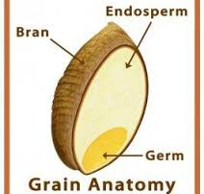
Structure of the grain kernel
Endosperm – contains most of the starch
Germ – embryo or the sprouting portion of the seed
  High in oil and protein
Bran – seed coat (pericarp) and other layers
  Fiber

Slide 7
Kernel Anatomy
Notes:
In order to understand how one might manipulate the nutritional content of corn grain it may be helpful to review the anatomy of the corn kernel. The largest portion of the kernel is the endosperm. This is where the starch is stored. There are two distinctly different types of endosperm; vitroeus or hard endosperm and floury endosperm. The vitreous endosperm is the more dense yellow colored material located on the sides of the kernel while the floury endosperm is the white or opaque material in the center and top of the kernel. The second most important component of the kernel is the germ or embryo. This is were the bulk of the oil is and also approximately half of the crude protein. The paricarp is the outside covering which contains the more fiberous material which most of us refer to as bran. The relative percentage of each of these components will differ for different corn hybrids and thus this is the primary reason we see differences in nutrient composition between hybrids.

Slide 8
Endosperm
Cells fill with starch granules
Starch granules are enveloped in a protein matrix, which impedes digestion of starch
If we process to break open the granule, can increase the digestion of starch
Grains differ in rumen fermentability largely due to the nature of the endosperm and protein matrix surrounding the granules

Slide 9
Vitreous endosperm
Vitreous (also called hard, or flinty) endosperm are the higher density, yellow-colored starch granules on the outer edges of the kernel
tightly bound in a starch:zein protein (prolamin) matrix
This matrix becomes more prominent as the kernel approaches grain harvest maturities
  Ranges from 25 to 80% in dent corn
    Most commercial corn hybrids have 55 to 65%
  Almost none in soft wheat, barley, oats
Notes:
This is where corn grits come from.
Hard wheat has vitreous endosperm but soft wheat has floury endosperm

Slide 10
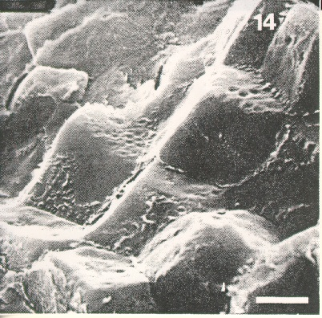
Cross section of the vitreous part of a kernel, showing the
polygonal shape of the starch granules, the indentation in
the starch, and the tight compact structure.
Notes:
This slide is an electron microscopic photo of the starch granules in the vitreous or hard endosperm. Note the polygonal shape and the tight compact structure. Vitreous starch will digest at a slower rate than floury starch due to its physical structure..

Slide 11
Floury endosperm
Floury (also called soft) endosperm has whitish starch granules in the center of the kernel more loosely bound in a starch:protein matrix
Dent corn derives its name because this softer starch dents in at the top of the kernel as it matures
More floury hybrids have more air space between starch granules

Slide 12
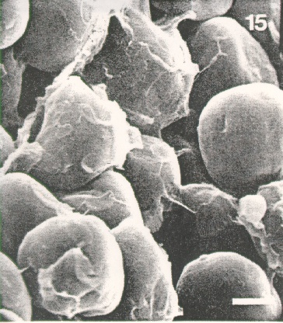
Cross section of the opaque (floury) part of a kernel, showing the
spherical shape of the starch granules, the protein, and the
large amount of air space.
Notes:
This slide shows an electron microscopic photo of the floury starch granules. Note their spherical shape and open nature. Also note the film covering some of the starch granules. This is protein. It has been suggested by several researchers that this protein matrix may restrict enzymatic access to the starch granules which restricts the rate and extent of starch digestion. It is thought that one of the primary effects of heat processing (steam flaking) is to breakup this protein matrix.

Slide 13
Ruminal fermentation
Rate of fermentation
  Wheat (faster)
  Barley
  Corn
  Sorghum (slower)
The rate of fermentation = correlated to the difference in protein matrix in the endosperm (around the starch) between the grains
Notes:
The rate of fermentation of the starch is largely correlated to the difference in protein matrix between the grain.
Corn and Sorghum more slow degradable protein in the endosperm (Zein and Kafrian, respectively) interferes with digestion
Wheat, barley more rapid

Slide 14
Summary
Two major barriers to grain/starch digestion
  1) Seed coat/hull, especially important for
    Monogastric animals because of the fiber
    Hard, small kernels (i.e., barley)
  2) Protein matrix surrounding the kernel, especially important for corn and milo

Slide 15
Grains

Slide 16
Grains differ
  Small cereal grains very fermentable starch and may actually be dangerous
  Corn is slower in fermentability and is usually processed to increase rate of starch fermentability
  Grain sorghum or milo is slowest; must be processed

Slide 17
CORN
By far the most important feed grain
  Grain by which other grains are valued
  Yields most digestible DM per acre
  One of the most energy dense grains: 3.51 Mcal of ME / kg
  Extremely palatable
Areas grown
  Midwest- Illinois, Iowa, Indiana
  Irrigated, Low elevation areas of Pacific NW

Slide 18
CORN
Large endosperm
  Contains lots of starch
  Contains 70% of total protein = zein protein
    Low digestibility and low in lysine/tryptophan
    Mixed with oil-seed meals as they are adequate in Lys but low in Met – balance
Opaque-2 corn (lower zein; high lysine) –
  may have advantage in monogastric diets
  has greater rate of ruminal starch degradation
  yields are typically lower
Notes:
It is a warm season grass

Slide 19
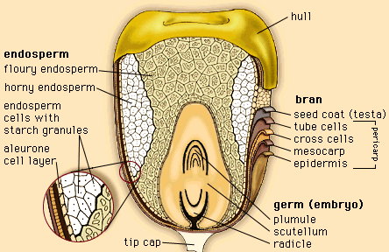
Corn: protein
Zein protein
  70% of protein in the corn seed
  in the endosperm
  Low digestible
  Poor amino acid profile
Glutelin is type of protein mostly in the embryo – much better feed protein

Slide 20
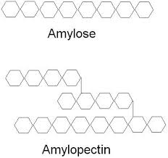
Form of starch
Normal dent corn varieties contain
  75% amylopectin
  25% amylose
Amylopectin is a form of starch which consists of branched subunits
Amylose is made up of straight glucose molecules

Slide 21
WAXY CORN
Waxy corn = 100% of starch is amylopectin
  Rapidly fermentable in rumen
  Is this better?
  Not completely clear if there is a benefit to fermentable corn in the rumen vs. post-ruminal (SI) digestion of starch
  Mixed performance results – summary of nine beef feeding trials, the effect of waxy corn on animal gains ranged from a decrease of 3.3% to an increase of 10%.
  Averaged over all nine, waxy corn had a 2.2% advantage.
  Reduced yield = not typically grown for livestock feed

Slide 22
Corn used for livestock
Corn may be fed as:
  Whole shell corn < 12-14% moisture
  Rolled or cracked corn
  Steam flaked corn
  High moisture corn(> 22% moisture)
    Less field loss
    Better feed efficiency
  Ear Corn or Earlage: watch out for ADF content – will indicate the cob:grain ratio

Slide 23
Barley
Lower in energy than corn (but much more rapidly fermented in rumen)
  1.34-1.42 vs 1.51 Mcal/lb
  20 vs 9% NDF
Limits its use for monogastric animals, especially poultry and young growing pigs
Processed – except perhaps for sheep
  Dry rolled 2.73 vs 2.51 ADG; 7.4 vs 8.7 F:G
  No advantage for steam rolled
***can afford 15% more for dry rolled barley

Slide 24
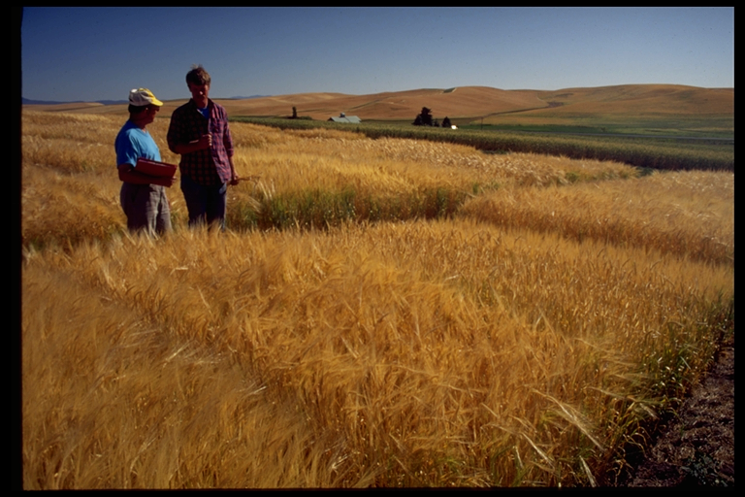
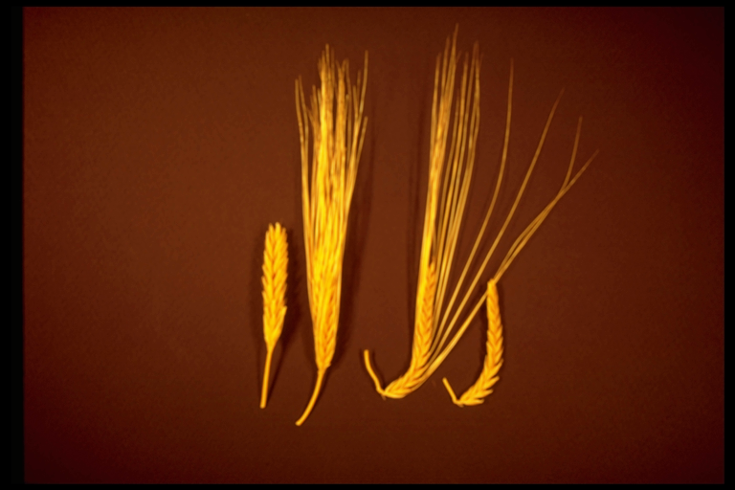
Barley
Grown throughout the US
  Pacific Northwest
  Better in cooler climates (CS grass)
Higher in protein than corn
  10-15%; but the better the grain quality (higher starch content) the lower the protein
  Higher in Lys
Notes:
Higher levels of lysine, tryptophan, methionine and cysteine than does corn

Slide 25
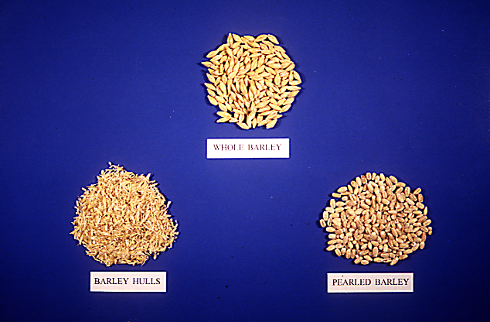
UI research indicates barley
is actually two feeds:
hull and kernel
Barley hulls very
poorly digested
Notes:
Pearled barley is mainly used for human consumption

Slide 26
Barley
Barley is usually priced at 94% the value of corn
  52-62 vs 70% starch
    For monogastric animals, it is a trade of energy) for protein
    For ruminants, barley has similar energy value but more ruminal than intestinal digestion compared with corn
  Types of barley
    Malting barley – mostly 2-row (40% of total)
      Higher energy, lower fiber
      Less yield
    Feed barley – mostly 6-row (50% of total; seed and export are the rest)

Slide 27
The bushel
Grain | Lbs in a bushel
Wheat | 60
Corn, Sorghum and Rye | 56
Barley | 48
Oats | 32
A bushel is a U.S. customary unit of dry volume, equivalent to 8 gallons.
Test weights is a measure of density and is a comparison of the density to the standard
Notes:
Test weight (TW) is a measure of density (weight per unit volume) with the current standard at XX lb/bu. Many stress factors can contribute to lower test weight: hybrid, temperature, solar radiation, hail, disease, and drought. The result of a reduced growing season is grain with higher protein, fiber, and mineral concentrations. The greater concentrations of these nutrients come at the expense of reduced starch content, the primary fraction used for energy when grain is fed to livestock

Slide 28
Barley, test weight
48 lb per bushel is standard
Range from less than 40 to more than 53
Seems to vary with environment as much as variety
Less optimum environment = lower test weight = seed does not fill
  less starch and more fiber
Test weight is important for the lower range (< 49 lbs.) as the energy value decreases when test weight decreases
Notes:
Barley test weight approaches 40 pounds or less, the energy content is low enough where differences in feed efficiency are noticeable. Animals offered high-concentrate diets will tend to consume more of the lighter test weight grain as a mechanism to compensate for the lower energy content. This results in poorer feed conversion efficiency.”
Test weight can be used as an approximation of feeding value, but it does not tell the whole story because lower test weight grain tends to be higher in protein. Depending on the nutrient requirements and other ration ingredients, additional protein may be useful.

Slide 29
Growth performance of beef steers – Montana State University
Variable | CP | ^{ADG}
Irrigated
51 lb | 9.2 | 2.84
49 lb | 10.4 | 2.73
45 lb | 10.6 | 2.75
Dryland
42 lb | 11.0 | 2.52

Slide 30
Barley
Lower test weight means more fiber, less starch
Finishing cattle offered high-concentrate diets will tend to consume more of the lighter test weight grain as a mechanism to compensate for the lower energy content.
This results in poorer feed conversion efficiency

Slide 31
Barley: Potential problems
Bloat
  Avoid combinations of alfalfa and barley
  70:30 to 30:70 combinations of alfalfa and barley seem to be the most dangerous
  Ionophores, especially monensin, seem to help
Beta glucans
  Mixed 1,3 and 1,4 beta glucans; referred to as soluble fiber
NDF + sol. fiber = total fiber
  In the endosperm cell wall
  Negative nutritive factor for monogastrics; feeding beta glucanase is effective for young
  No problem with ruminants although may be involved in bloat
Notes:
Bloat in feedlot cattle when major part of the ration. Due to the high fiber can’t be used much in poultry and will limit feed efficiency in swine.
Responses to additions of beta-glucanases to diets based on covered barleys (intact or mechanically dehulled) and fed to swine have not been consistent. The bacterial populations in the digestive tracts of older swine appear to be able to hydrolyze beta-glucans to the point that few, if any, problems are encountered with beta-glucan levels found in covered barleys

Slide 32
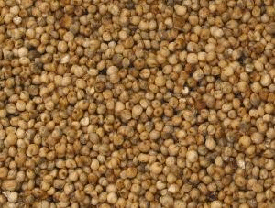
Grain: Sorghum – Milo
Drought tolerant – grown in drier climate
Similar in chemical composition to corn
  Somewhat higher in protein (kafirin)– 11%
Grain is exposed – not covered by husk or hull
  Susceptible to birds
  Bird-resistant milo – bitter tasting
    Contains tannins
    Lower DE
  Kernel is very hard – must be at least dry rolled
Notes:
Sorghum contains a protein kafirin that is similar to Zein. Starch content somewhat lower than corn. More protein in the starch than corn can effect digestibility…processing important.
Hybrids in use: normal, bird resistant and Waxy. Waxy has better feed efficiency, less amylose!

Slide 33
OATS!
Oats are palatable but a poor energy source – ($/Mcal)
  11 to 14% CP and good AA profile
  Not good feed for high performance animals
    Dairy cows
    Finishing pigs, chicks
    Finishing beef cattle
  Good for low requirement animals
    Breeding stock and creep feeding rations for young
    Horses
Notes:
Not fed to poultry, hull = 28% of kernel up to 45% in lightweight oats. Hull quite fibrous (31% CF) and poorly digested. Fed to young pigs to prevent stomach ulcers.

Slide 34
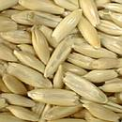
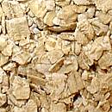
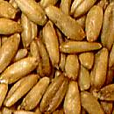
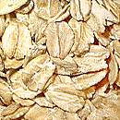
OATS
Much higher in fiber than any other grain
  TDN= 66% vs 89% for corn
  Rolling helps digestibility
  Oat Groats = hulled oats, looks like rye or triticale, outer bran layer still intact, hull removed
Notes:
Three varieties White oats= corn belt, red = south and gray=PNW

Slide 35
WHEAT
Mostly for human consumption – only fed if in surplus
Equal or better energy value compared to corn
  It is usually drier so would be worth more as feed
Palatable
Higher quality protein than corn – better AA profile

Slide 36
WHEAT
U.S. wheat grain can be classified into U.S. Grade No. 1 to 5
  test weight
  damaged kernels
  foreign materials
It is expected that lower grades of wheat will have a lower concentration of energy and nutrients

Slide 37
WHEAT
Types
  Hard wheat (usually winter)-13 to 16% CP
    Higher protein content, more gluten
    May be red or white
  Soft wheat (usually spring)
    Lower in protein, make pastries
Wheat is highly fermentable
  May produce acidosis – requires better feedlot management
  Restricts its use to 50% of diet DM (this may be preferred over all corn in the concentrate)
Notes:
High gluten content of wheat which in the rumen can result in a "pasty" consistency to the rumen contents and reduced rumen motility.
Fine grinding of wheat generally reduces the feed intake and is likely to cause acidosis and/or bloat.

Slide 38
WHEAT-processing
  Difficult to keep from “flouring” – need to roll well enough to process all of the kernels but not too much to completely crush some kernels and produce a lot of dust
    Ulcers in swine
    Acidosis in cattle
  Performance
    Cattle on 50% wheat diet – same as corn
    Swine – may perform better
      At least as much energy
      Better amino acids
Notes:
Wheat contains variable amounts of non-starch polysaccharides (NSP), mainly arabinoxylans, which can interfere with nutrient digestibility.
However, the effects of wheat NSP appear to be less in pigs than in poultry.

Slide 39
TRITICALE – Wheat x Rye Hybrid
78% TDN, 15% protein!
  Higher quality protein
    Good AA profile
  Equivalent to an energy/protein mix – (corn + soybean meal)
    If add Lys
  Well adapted to the pacific NW
Notes:
Similar to hard wheat or rye with just alittle more fiber. Good distribution of AA for monogastrics.

Slide 40
TRITICALE
  Somewhat unpalatable
    Limit to 50% of diet (beef)
    Data are inconsistent, but generally get lower performance with triticale than corn – both ruminants and monogastric animals
  Old varieties are ergot prone, new ones are not

Slide 41
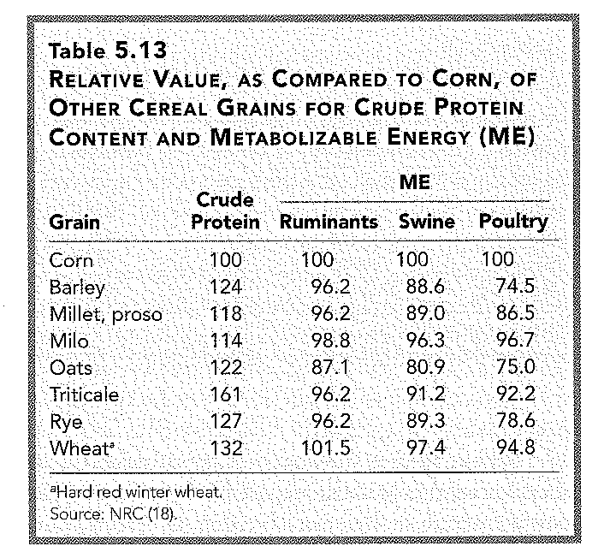
Why does barley rank differently as compared to wheat when fed to ruminants vs being fed to Swine?
Notes:
Lower energy of many of the small grains in monogastics is due to the greater fiber levels

Slide 42
Processing Methods

Slide 43
Grain Processing
Physical – interrupt the seed coat
  Expose grain to digestive enzymes
  Make more palatable
Heating – starch swells and gelatinization occurs
  Granules burst
  Gelatinized starch is more digestible
***advantage of physical processing is with small, hard grains and/or thick seed coat grains
*** advantage of heating is with less fermentable grains; corn and milo
Notes:
For grain processing to be effective, a positive balance between processing equipment and maintenance costs, labor availability
and skill level, energy efficiency, management practices, and performance must be achieved. The feeding value of unprocessed wheat for cattle will be reduced by 20-25%. Feed value of unprocessed barley is 10% -25% less.

Slide 44
Why process grain?
Main reason: to increase digestibility
  The hull/coat is a barrier
  Heat treatment with sufﬁcient water present will cause gelatinization = increase susceptibility for starch degradation (Corn and Sorghum)
  Reduce sorting of feed
  Reduce variation individual animal performance
Must consider the maximization of net returns
  Balance cost with benefit
Notes:
Sheep chew more rapidly and have a smaller mouth than cattle so whole grain can be used in their diets, similarly young cattle will chew more than older cattle so corn may not need to be processed but the small grains still do. Processing can also have benefits in terms of palatability and Reduce variation individual animal performance

Slide 45
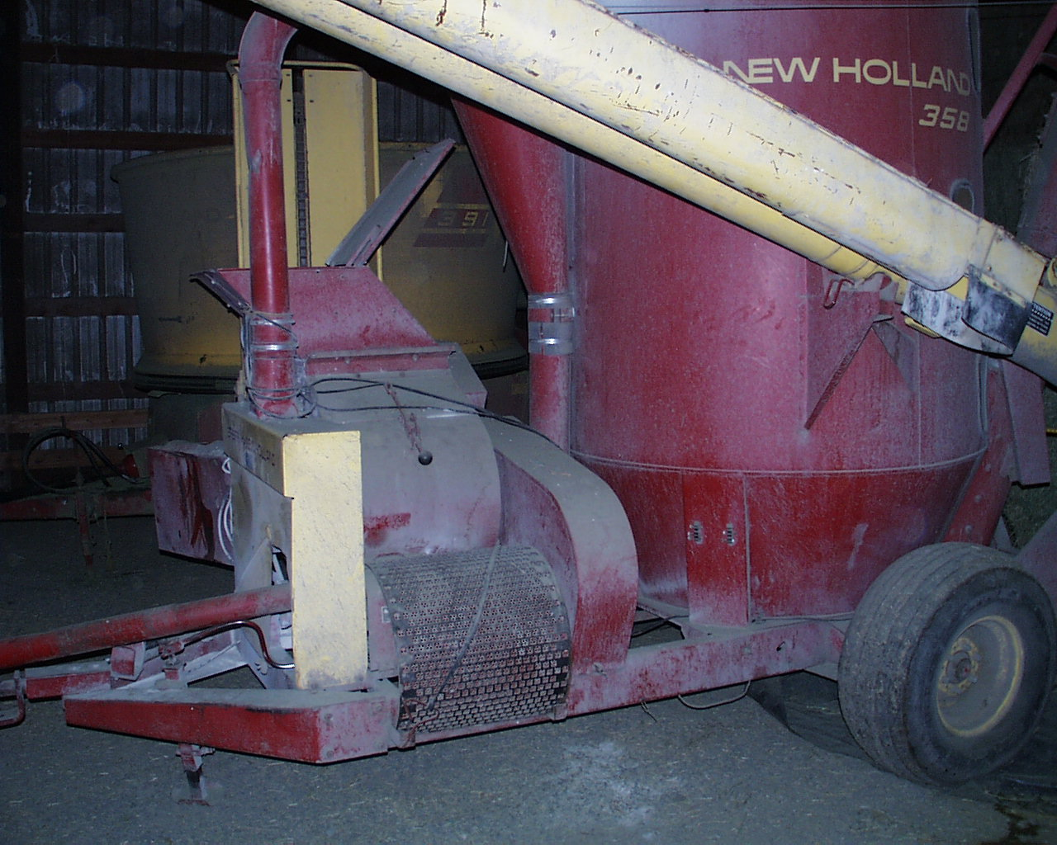
Methods: Dry Processing
Grinding – hammer mill – anywhere from coarse to fine particle size
Notes:
Hammermills consist of a rotor assembly made
from two or more rotor plates fixed to a main shaft and
enclosed in a screened grinding chamber

Slide 46
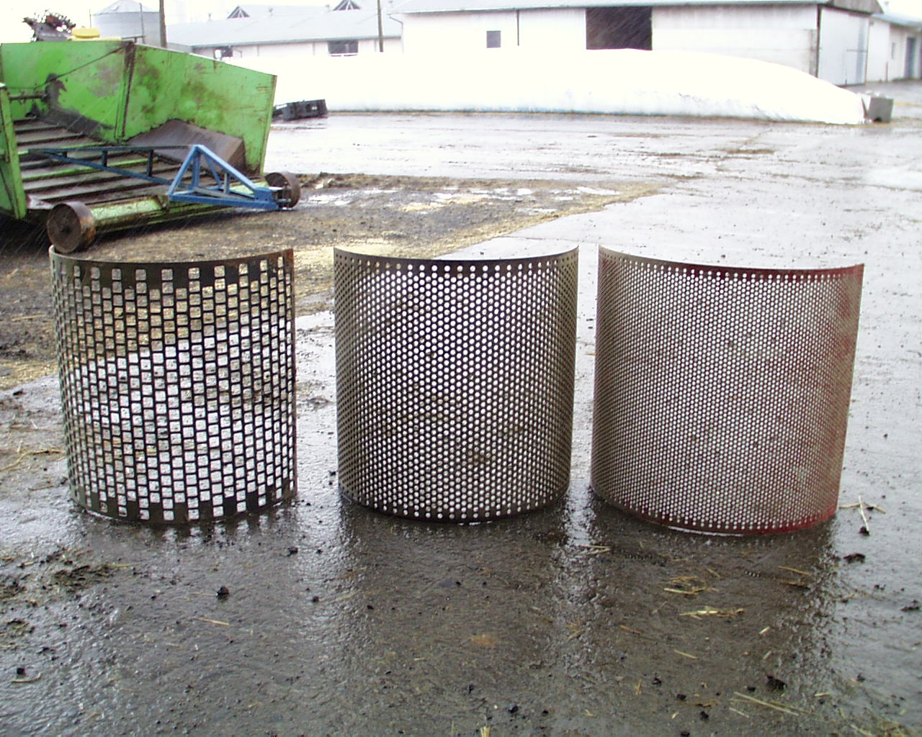

Slide 47

Particle Size & Source
Grind Mean
Feed mm Size μm <50 μm
Barley 0.8 288 41.3
3.0 540 30.3
6.0 1,267 17.9
Corn 0.8 342 10.4
3.0 540 9.0
6.0 966 10.5
In situ starch
disapp. %
98.3ª
94.6^{ab}
90.9^{b}
57.8ª
61.0ª
44.0^{b}
kp = 0.06
Cerneau and Michalet-Doreau, 1991
46 μm pore size
^{a,b,c} P <0.05

Slide 48
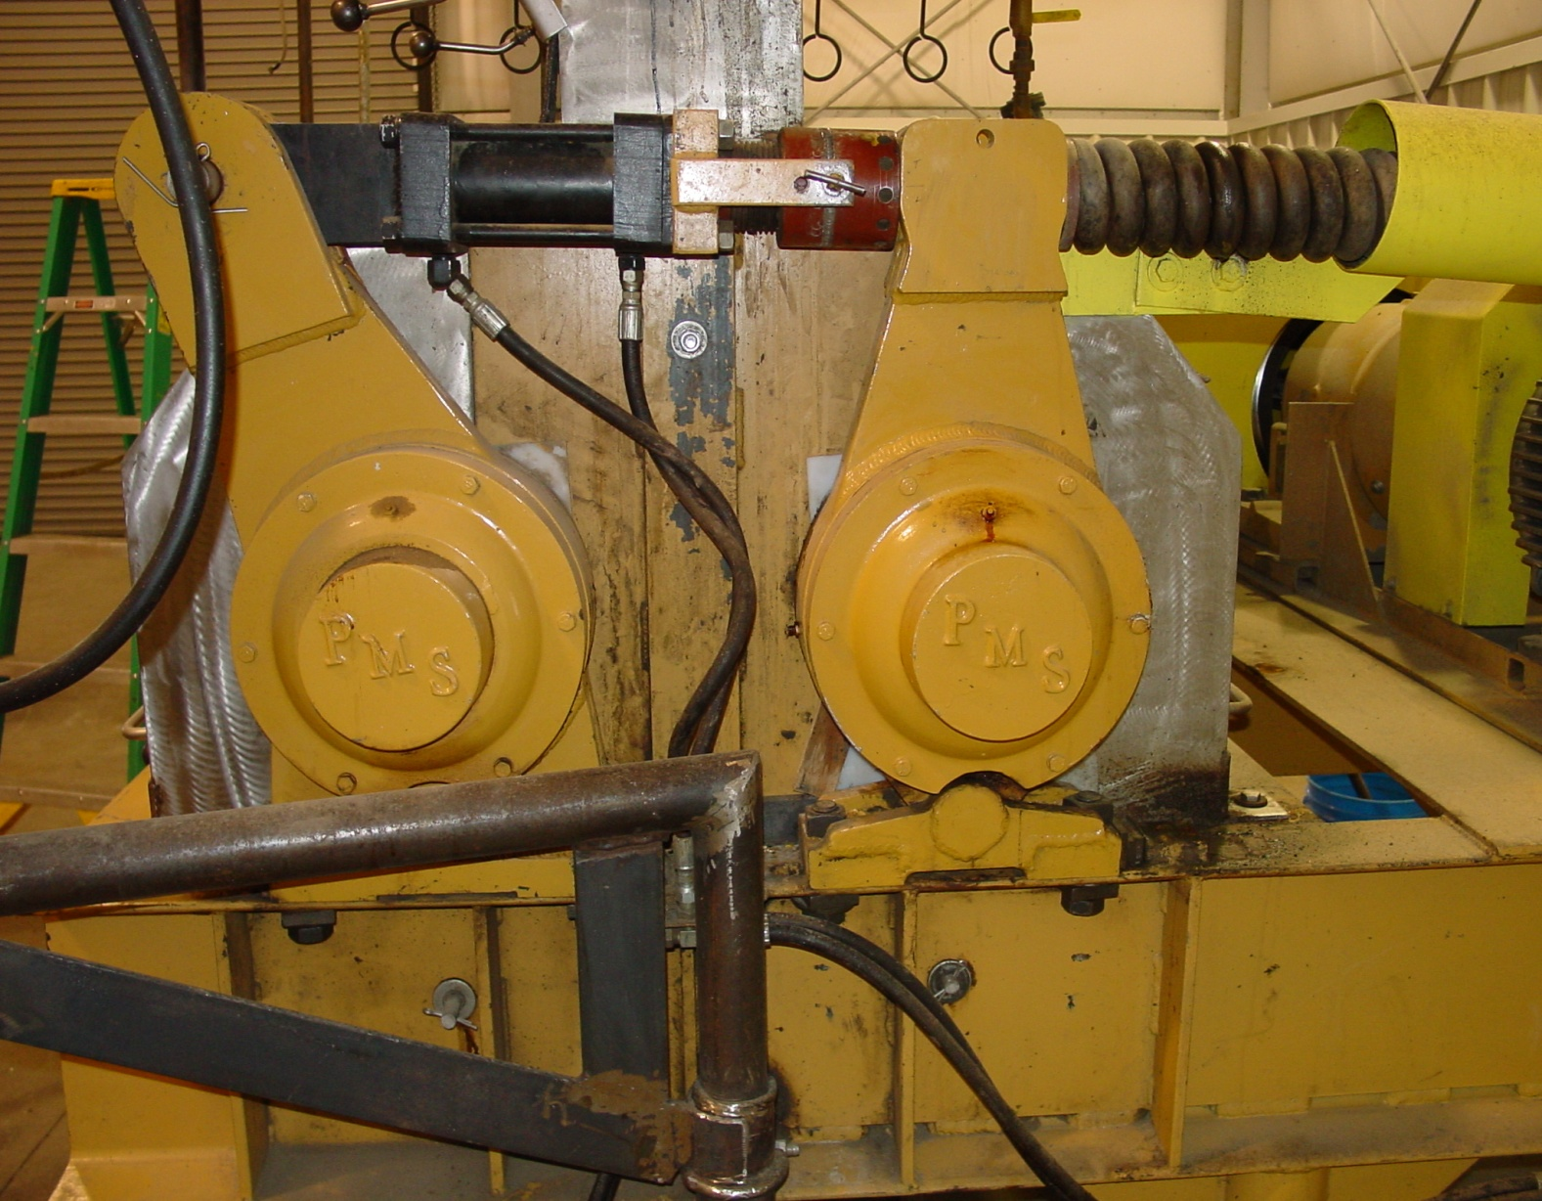
Methods: Dry Processing
Dry rolling – pass between two rollers – get a crack or a coarse grind
  Can adjust closeness of the rollers for some adjustment of fineness of grind
Notes:
Roller mills can consist of a single, double, or triple pair of rolls that are stacked and enclosed in a steel frame. All kernels in dry-rolled barley grain should be broken and fines (particles less than 1 mm in diameter) should be less than 3%. The recommended grain processing method for cattle is rolling it by passing between two large steel rollers since this is the least expensive and the amount of fine particles in feeds can be kept to a minimum. Fines are undesirable since they reduce palatability, increase sorting and feed refusals, increase the incidence of acidosis, and may contribute to respiratory diseases. Grain can be rolled without the addition of moisture (dry-rolling), after addition of water (see tempering), or after the addition of steam (steam-rolling). The digestibility of whole barley will be 10-25% less than that of rolled barley.
Rolling compresses the grain

Slide 49
Methods: Dry Processing –other
Micronize – microwave to 300° F (especially done with milo)
  Can also be used on wheat = increased intake in cattle
Roasting – 300° F – puffed grain
Extruded – heat + pressure = ribbons or flakes
Pellet (or cube) – grind, mix with binder and pass through dies
Notes:
These are expensive

Slide 50
Methods: Wet processing
Steam rolled
  Steam for 1 to 8 minutes – get very little gelatinization – not much different than dry rolled
Steam flaked
  Steam for 15 to 30 minutes, then roll into a flake, regulate flake thickness (test weight)
  Probably the most extreme treatment and most improvement in digestion
Reconstitution
  Add water to 25- 30% moisture, ensile at least 14 to 21 days
  Does not equal high moisture grain
Notes:
Disadvantage of reconstitution is that large amounts of storage is needed

Slide 51
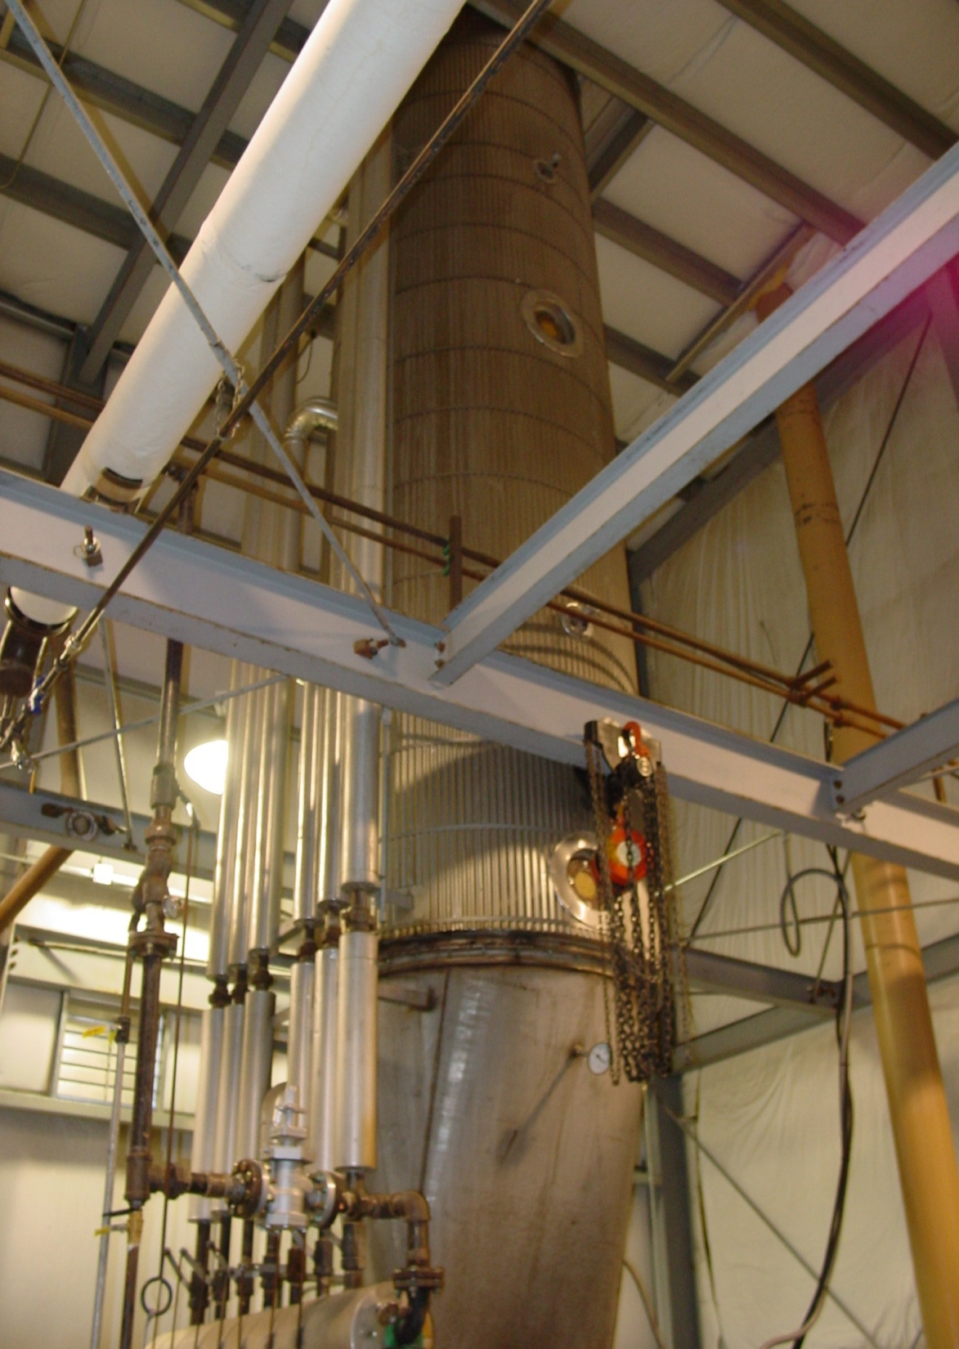
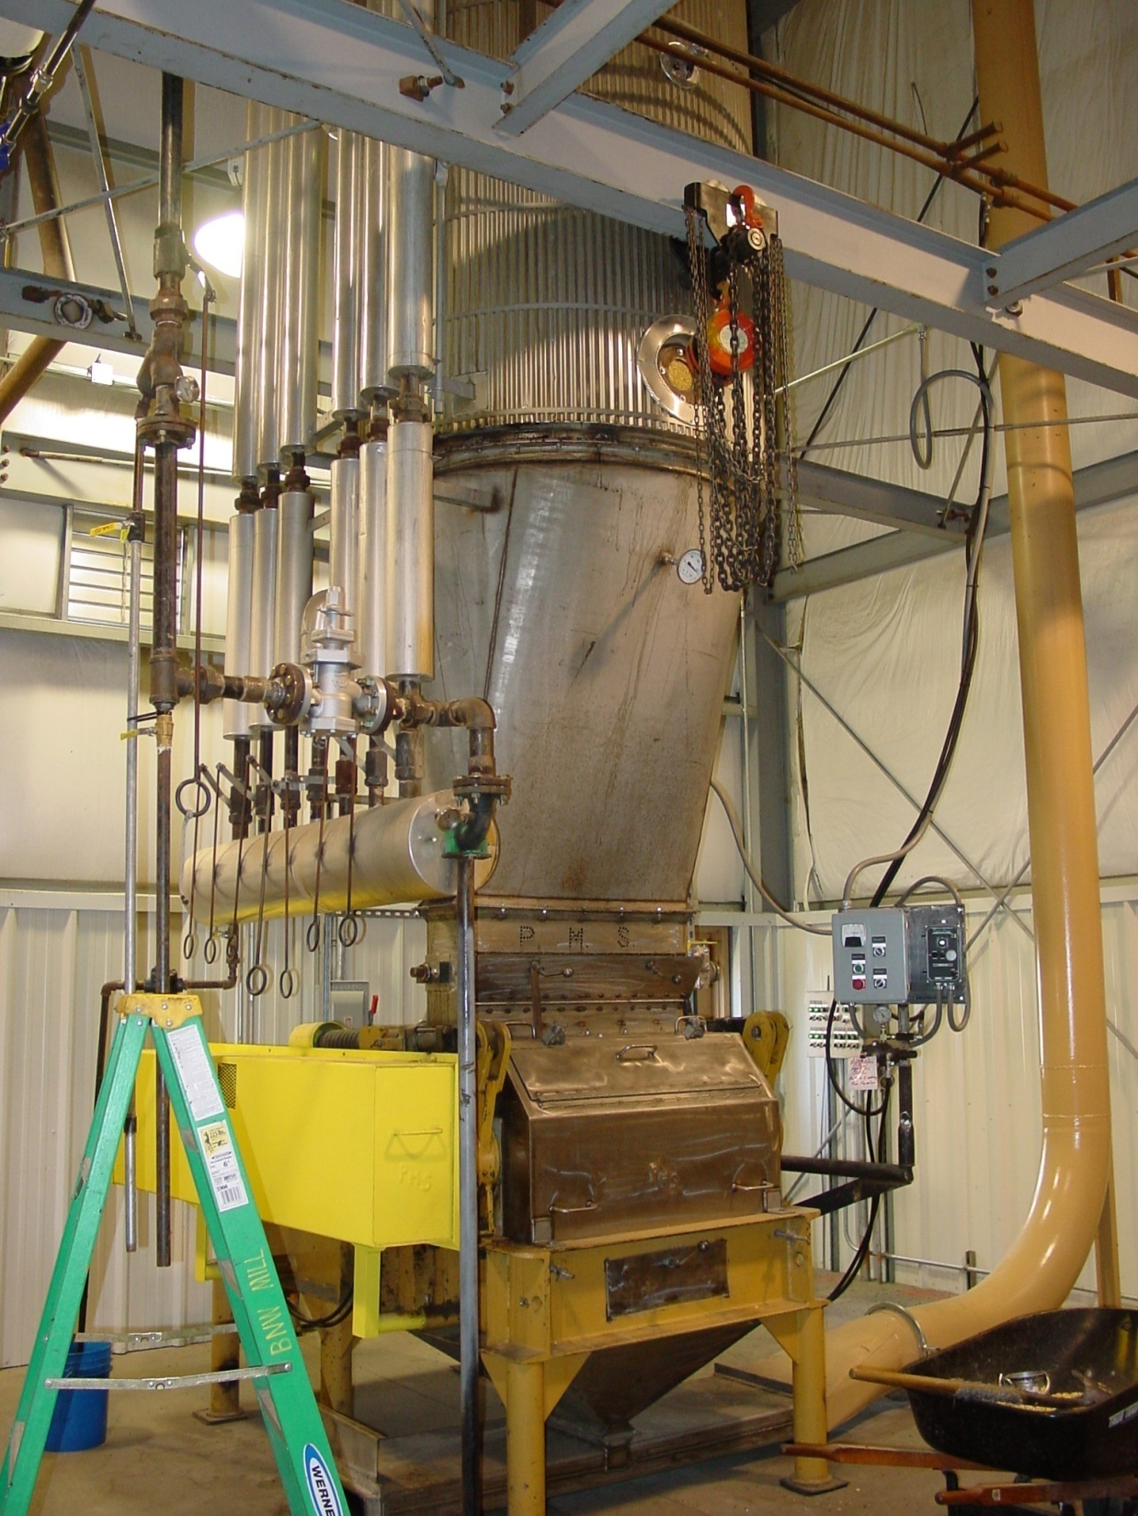
Notes:
Steam roller. The steaming is accomplished by passing steam up through a chamber that holds the grain above the roller mill. Steamed for a short period of time 5 min. Softens the grain but dose not modify the starch. Increased performance of animals due to fewer fines and larger flakes thus improved physical texture when feeding high levels of grains.
Steam flaking is similar except that grains are subjected to steam for 15 to 30 min, moisture is raised to 18 to 20% and then rolled through corrugated rollers

Slide 52
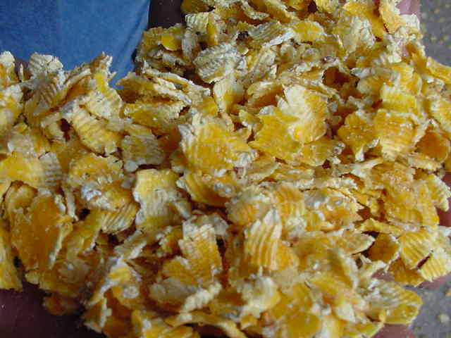
Notes:
For feeding feedlot cattle corn does not need to be processed although improvements in feed efficiency of up to 10% may be associated with steam-processing.

Slide 53
Methods: Wet processing, cont.
Tempering
  Add water and allow to soak for 18 to 24 hours before feeding – some swelling of starch
  Sometimes add a tempering agent; aids in the uptake of water
  Probably most benefit with small, hard kernels (barley and wheat)
    softens kernel

Slide 54
Methods: Wet processing, cont.
Tempering is often coupled with rolling
  Facilitates processing of grains containing different sizes of kernels
  Reduces loss of grain as dust
  Increases moisture content of diet
  Can only be stored for short period of time
  Reduces FINE particles!!

Slide 55
Problems with fine grind
Dusty feed= reduced palatability
Wind loss
Stomach ulcers in swine
Ruminants:
  Acidosis
  Liver abscesses in finishing cattle
  Reduced rates of gain
Therefore, want a medium grind for swine and coarse grind for cattle
Notes:
For finishing cattle greater than 3% pass through 1 mm screen is excessive fines but also don’t want over 3% whole kernels either

Slide 56
Processing of grain
Reducing the seed coat as a barrier
Grinding (hammer mill)
  Quickly change from one feed to another
  High capacity
  Dust is a problem as are fines
Rolling (common for grains)
  Least energy required and fines can be kept to a minimum
  Dry rolling or tempering plus rolling
    Tempering reduces fines
Will increase the feed value of wheat and barley by 10 to 20% for cattle

Slide 57
Processing of grain
Corn and sorghum contain dense protein matrices
  limit the access of amylolytic microbes to starch granules
Protein matrices of wheat and barley are more diffuse
  do not impede the access of rumen microbes to granules.
Steam-flaking disrupt the protein matrix
  increase the rumen availability of starch within the vitreous endosperm.
  Increase feed efficiency 10% in feedlot cattle compared to dry rolling
Steam-flaking is higher cost than many other methods so only viable when grain prices are high
Notes:
The rate of fermentation of the starch is largely correlated to the difference in protein matrix between the grain.

Slide 58
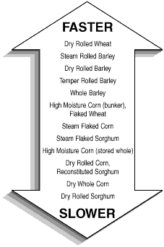
Ruminal Fermentation Rate

Slide 59
To process or not to process?
Processing is expensive; and is usually more beneficial when grains (energy) are expensive
Have to balance the increase in feed value with the cost

Slide 60
Storage

Slide 61
Grain storage
Moisture is the major factor involved in grain storage
  Need to have dry feeds for bin or shed storage
    Small grains – whole: 12% moisture
    Corn – whole: 14% moisture
    Ground grains (or with >12% broken kernels): 11% moisture
** Note: grains will need to be drier if insects are a problem; also can fumigate
  These values depend on humidity, temperature and air flow

Slide 62
Grain storage, cont.
  Higher moisture levels cause:
    Heating
    Caking
    Mold that produce poisonous mycotoxins, cause
      reduced performance
      poor feed efficiency
      diarrhea
      liver disease
      infertility or abortion
      poor immune functions

Slide 63
Important Grain Molds
  Important molds found in grains
    clavicep purpurea (Ergot)
      Produces a very potent toxin (alkaloids) that accumulates in the animal, especially in cereal grains (rye, triticale), zero tolerance

Slide 64
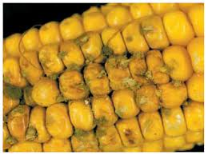
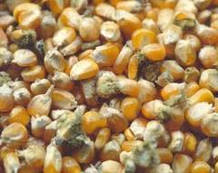
Aspergillus flavis
Extremely common mold
produces aflatoxin (a mycotoxin)
Aflatoxins cause:
  liver damage
  decreased egg, milk production
Maximum Levels | End Use of Grain
20 ppb | Feed for dairy*, immature poultry, and stressed animals
20 ppb | Human consumption
100 ppb | Grain intended for breeding cattle, breeding swine, and mature poultry
200 ppb | Grain intended for finishing swine of 100 pounds or greater
300 ppb | Grain intended for finishing beef cattle
Notes:
Concern about transfer in the milk can have less than 5 ppb

Slide 65
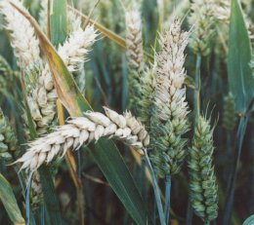
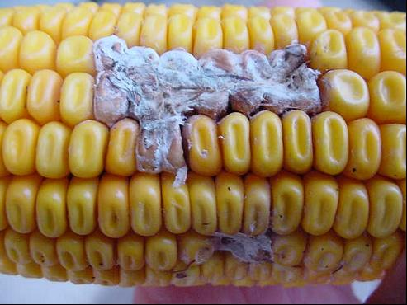
Fusarium fungus
Often called Scab or ear rot
Produces two main mycotoxins
  zearalanone (ZEA) and vomitoxin (DON)

Slide 66
Vomitoxin (Deoxynivalenol; DON)
Swine are very sensitive
  Cause feed refusal and even vomiting
Poultry and other livestock not as sensitive
Recommended Maximum in diet
1 ppm | Swine
5 ppm | Ruminating beef and feedlot cattle and poultry

Slide 67
Zearalenone (ZEA)
A mycotoxin that has estrogen-like activity
  detrimental effect on reproduction
Swine are the most sensitive
Cattle are not as sensitive as swine but can cause infertility
Poultry show little reaction

Slide 68
Zearalenone (ZEA)
Maximum ZEA in complete Swine diets
Young growing | 1 ppm
Breeding gilt and sows | 2 ppm
Finishing pigs and boars | 3 ppm
Maximum ZEA in complete beef cattle diets
Virgin heifers | 5 ppm
Early lactation cows, pre-breeding | 10 ppm
Non-lactating mature cows, growing/finishing cattle | 20 ppm

Slide 69
Grain storage, cont.
  Steps to prevent molds/mycotoxins
    Moisture test, reject any grain which is too wet or that you can’t dry (15% moisture or your known moisture content for your storage)
    Obtain a sample and analyze any suspect grains for mycotoxins
    Keep equipment clean and mold free – don’t contaminate clean grain!

Slide 70
Grain storage, cont.
  Amount of mold (except ergot) to tolerate:
    < 10% damage is probably safe
    10 to 40% damage is risky
    >40% damage – absolutely not
  Do not feed to young, growing animals or to reproducing animals (toxins can kill the embryos)

Slide 71
Grain storage, cont.
  2% reduction in price for each moisture point over permissible level
    Lower level of DM (** don’t pay for water)
    Storage loss or cost of drying

Slide 72
Grain storage, cont.
Drying grain
  Longer field drying
  Artificial drying – solar or natural gas
Alternatives (to drying grain)
  Preservatives
    0.5% propionic acid – protects grains up to 24% moisture
    Microbial inoculants; seems to be effective
    Both also extend bunk life
  High moisture grain storage
  *** high moisture grains have superior feed value (feed efficiency)
Notes:
High moisture alternatives to drying have less market as they must be feed to livestock and limited shipping. Storage a consideration.
Acid preservation may be more favorable as fuel costs increase to reduce need for artificial drying.

Slide 73
Grain storage, cont.
High moisture grain at harvest
  22 to 35% moisture – optimum is about 32%
  As with silage need airtight structure for anaerobic fermentation
  Faster fermentation
    More soluble nutrients
    Can expel oxygen with lower water content – acids concentrate faster

Slide 74
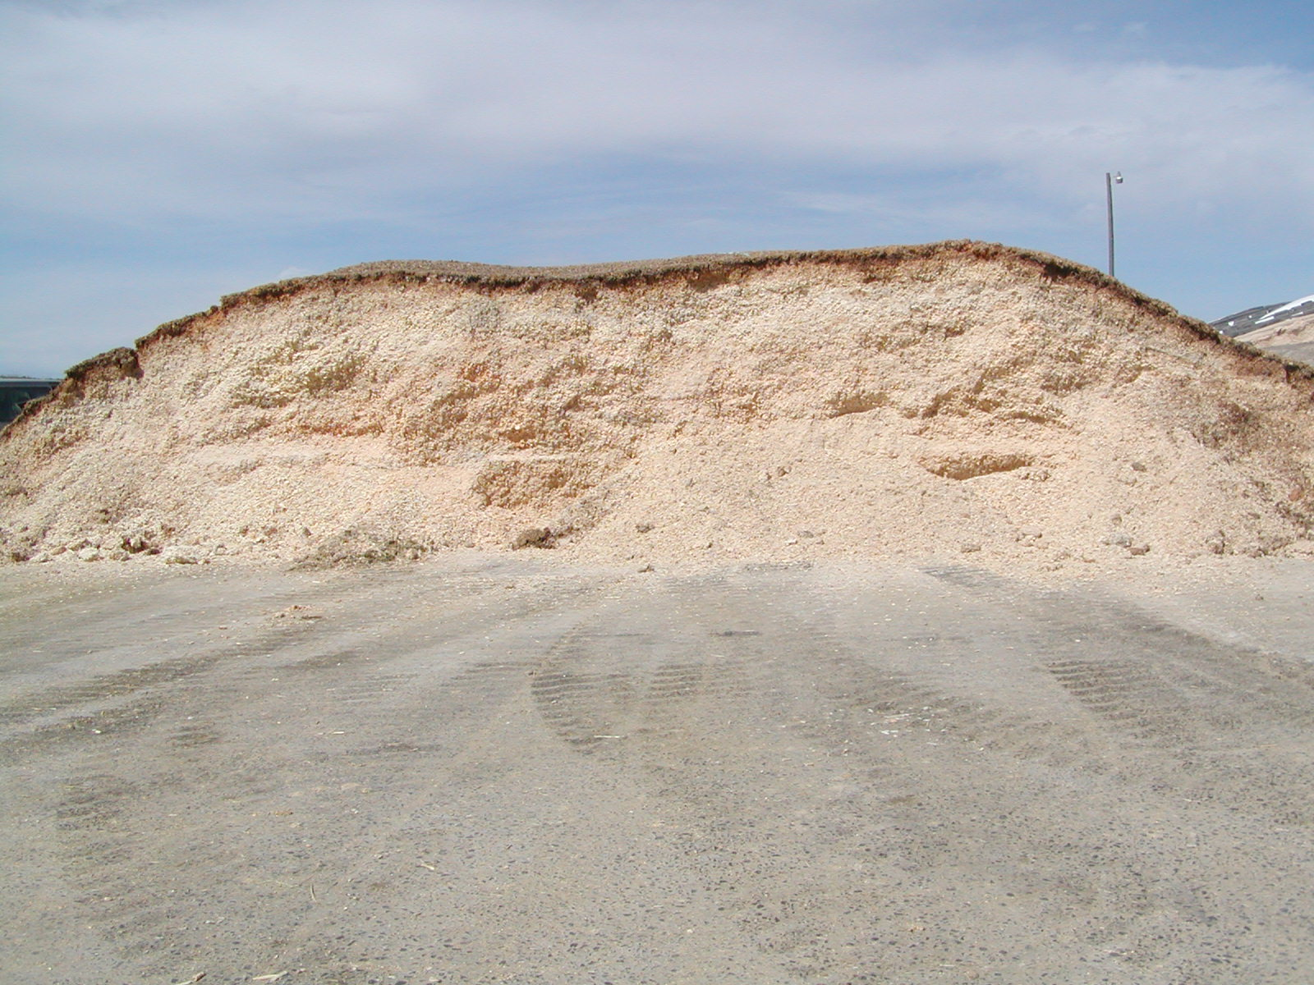

Slide 75
Grain storage, cont.
High moisture grain at harvest, cont
  Advantages
    Early harvest – reduce field loss; shattering, lodging, hail, bird, deer
    No artificial drying needed
    Bunker may be lower storage cost
    Corn: less risk of frost damage
    ** increased feed efficiency

Slide 76
Grain storage, cont.
High moisture grain at harvest, cont
  Disadvantage
    Grain must be stored immediately – does not allow much buying and selling
    Must be fed to livestock
    Must be stored air tight
    Handle more weight because of water

Slide 77
Energy Byproducts

Slide 78
Energy By-Products
Potato waste
  Problem is consistency
  Potatoes = 80% water, if you put 50 lbs. of potato waste in front of a steer, you’re really feeding 40 lbs water and 10 lb DM.
  High moisture creates a problem with storage and transportation, and nutrient loss

Slide 79
Potato Waste
4.3 million tons (as fed) of waste from the frozen potato industry was produced in USA and Canada combined
The vocabulary used to describe the different types of potato waste varies significantly
52% of all potatoes are produced (in the USA) in Idaho, Washington and Oregon

Slide 80
Potato waste products
1) potato peels
2) Screen solids
(small potatoes and pieces);
3) fried product
(fries, hash browns, batter, crumbles)
4)material from the water recovery systems (oxidation ditch, belt solids, filter cake)
  In addition all or some of these may be combined into a product known as slurry

Slide 81
Potato Waste
Potato Waste
  Potato waste can be ensiled in a bunker, flow through pit, designed for 6 months of storage (except fried products)
  Advantages:
    Excess supply can create stockpile for future use
    Blended product enables easier ration balancing more uniform composition
  Disadvantages:
    Potato waste will freeze
    Can’t pile too high
    Feeding too much potato waste – acidosis
  Can ensile 2:1 with a hay crop silage

Slide 82
Potato waste
Variability!!

Slide 83
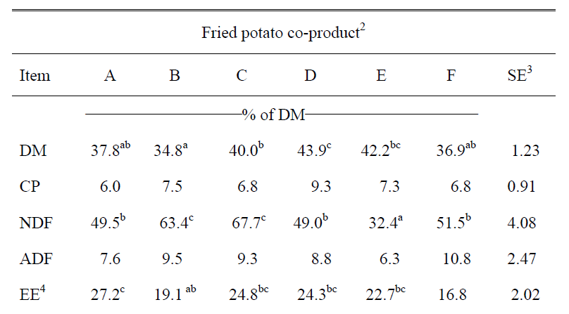
Fried products
Notes:
High energy due to fat (in addition to the starch)

Slide 84
Other Potential issues with potatoes
Glycoalkoids
  Glycoalkoids are toxic substances found in some potatoes and can not be fed in large amounts to cattle
  Glycoalkoids are in higher concentrations in sunburned (green-skinned) and sprouted potatoes
  Glycoalkoids are a bigger problem in potato peels
Cysticercosis
  Caused by encysted human tape-worm larva
  Large problem in Pacific Northwest feedlots, linked to feeding of potato byproducts
  Can result in huge losses due to meat being condemned
  Ensiling or pasteurization greatly reduces the incidence
  Pasteurization carries its own risk, mainly heating causes gelatinization of the starch crystals and can result in increased risk of acidosis

Slide 85
Energy By-Products
Beet pulp
  Residue from sugar beet manufacturing
  Fiber = 15-20%, very digestible
  Very palatable, 6-7 lbs in a dairy cow ration per day
Citrus Pulp (Florida, California)
  Mixture of peel, inside and cull fruit which are dried to produce a coarse, flaky product
  High energy, Ca, digestible fiber, low protein
  Once cows are used to it, cirtus pulp is very palatable and can be used at 25-30% of total ration DM

Slide 86
Chemical Compositions | Dried Orange Pulps | Dried Lemon Pulps | Dried Grapefruit Pulps
DM in the air | 926.70 | 885.30 | 774.00
Ash | 109.80 | 76.40 | 60.20
Ca% | 0.83 | 0.75 | 0.52
Fe% | 0.12 | 0.03 | 0.03
K% | 0.43 | 0.45 | 0.40
Mg% | 0.06 | 0.05 | 0.04
Na% | 0.02 | 0.01 | 0.01
P% | 0.05 | 0.05 | 0.04
CP | 31.50 | 65.70 | 77.00
EE | 204.40 | 60.40 | 65.90
NPN | 34.40 | 664.40 | 640.00
CF | 28.50 | 12.30 | 14.60
NDF | 355.20 | 21.90 | 20.20
ADF | 34.00 | 20.00 | 21.60
ME Mcal/kg DM | 1.584 | 2.492 | 2.356

Slide 87
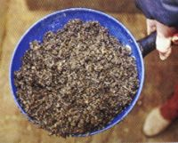
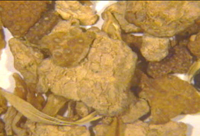
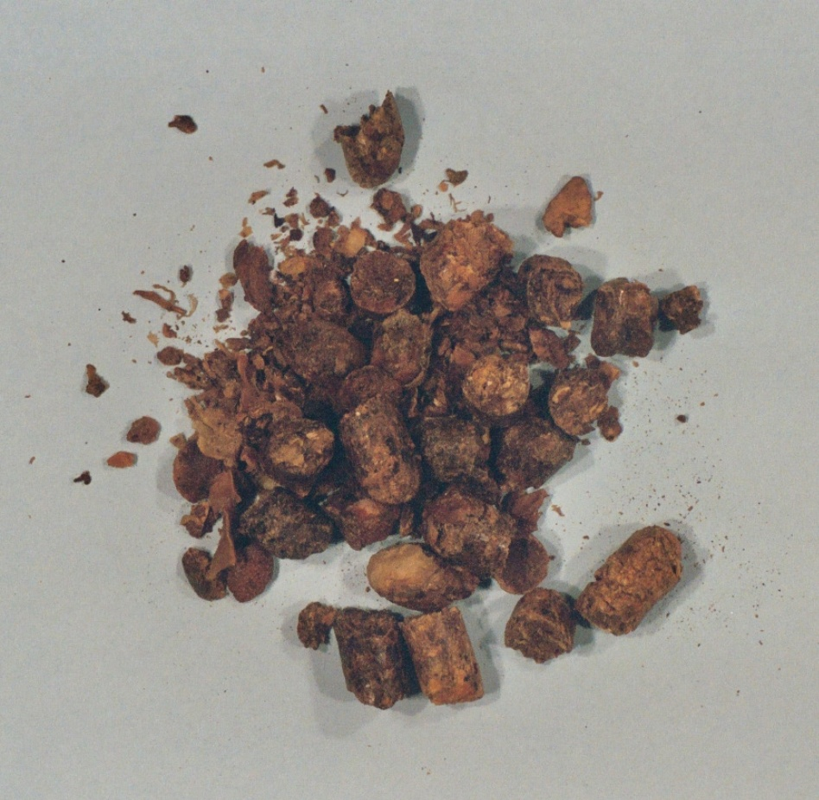
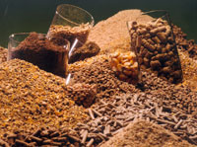

Slide 88
Other Energy By-Products
Bakery Waste
  Usually a variety of products, around 11% CP, 80% TDN (as fed)
  Higher in salt, low fiber
  Can’t use at high levels or some will depress fat test
  inconsistency

Slide 89
Other Energy By-Products
Cane molasses
  Most common liquid supplement fed to dairy cattle
  Control dust in TMR
  65% TDN (as fed)
  2-3 lbs/per cow/day
Whey
  Dried whey = 12-14% protein, 80% TDN
  5-10% can be included in ration

Slide 90
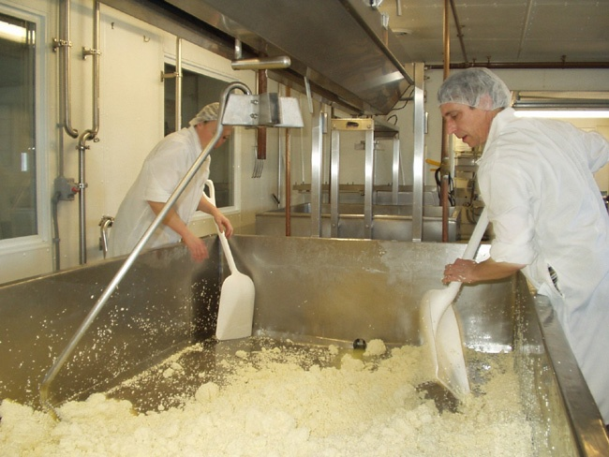

Slide 91
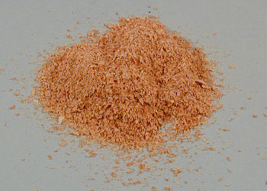
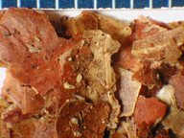
Others..
Hominy feed
Peanut skins
Rice bran
Soybean hulls
Wheat middlings
Others….

Slide 92
Dietary fats

Slide 93
Sources of Fat in Diets for cattle
1. Basal ingredients (forages, grains)
2. High-fat by-product feeds
3. Oilseeds
4. Animal fats
5. Granular (inert) fats

Slide 94
Properties of Fat that Need to be Considered
Digestibility
  - Post-ruminal digestion and absorption
Palatability and effects on intake
Ruminal inertness (i.e., rumen degradation)
  Saturated vs. unsaturated

Slide 95
Saturated
Unsaturated
Hydrogenated Fats
Tallow
Grease
Vegetable Oils
(Corn, Soybeans)

Slide 96
Oilseeds
1. Provide other key nutrients (protein, digestible fiber)
2. Economical
3. Ease of handling (except cottonseed)
4. Slow release of oil in rumen

Slide 97
Fat Content & Feeding Rates of Oilseeds
Type Fat % Max. lb to feed/d
Cottonseed 18 - 20 4 to 6
Soybeans 18 - 20 3 to 5
Canola 40 - 55 2 to 3
Sunflower 38 - 50 2 to 3
High oil corn 6.5 – 10 --------

Slide 98
Types of Feed-Grade Fats
Tallow
Choice white grease
Yellow grease
Blended animal & vegetable fats

Slide 99
Feed-grade Commodity Fats
Advantages:
  1. Lower cost
  2. High-quality fats are acceptably inert in rumen and are highly digestible
Disadvantages:
  1. Handling and mixing difficult
  2. Quality control - variable
  3. Low-quality fats can disrupt fiber digestion, decrease intake, decrease milk fat percentage

Slide 100
Quality Standards for Tallow
The more saturated, the better
  - Iodine value (IV) < 50
    prefer 38 to 45
Free fatty acids < 5%

Slide 101
Commercial Granular Fats
Advantages:
  1. Easy to handle and mix
  2. Quality control
  3. Few effects in rumen
Disadvantages:
  1. High cost
  2. Some are less digestible

Slide 102
Relative Digestibility of Commercial Fats
(Highest to lowest)
Type Product name FA%
Calcium salts of Megalac, 80
fatty acids EnerGII
Saturated free Energy Booster 99
fatty acid prills
Palm fatty acid Biopass 95
distillates
72-78% digestible

Slide 103
Choose Fat Sources on the Basis of:
1. Cost
2. Convenience
3. Characteristics of fat

Slide 104
How Much Fat Should Be Fed?
Thumb rule #1:
  Total fat fed = milk fat produced
Example:
  90 lbs milk, 3.5% fat = 3.15 lbs fat
  50 lbs feed DM, 3% fat = 1.5 lbs basal fat
So, could supplement 1.5 to 1.65 lbs of (supplemental) fat

Slide 105
Other thumb rules for max (dairy):
  up to 8% total fat in diet DM
  up to 5% supplemental fat
  1 lb commodity fat, 0.5 to 1 lb of granular (inert) fat

Slide 106
Production Responses to Supplemental Fat
Production
Response
0 1 2 3 4 5 6 7
Supplemental Fat (%)

Slide 107
What is an Economical Amount of Fat to Feed to Dairy?
Up to 3% of total diet DM or 1.5 lb. per cow daily
If high corn silage, up to 2.5% of total DM or 1.25 lb.

Slide 108
Other Considerations
Reproduction
Milk fat depression
Consumer health

Slide 109
Reproduction
↑ conception and pregnancy rates
↓ days open
Provide additional energy?
Energy independent response
  PUFA used in prostaglandin synthesis
Results are inconsistent (WHY?)

Slide 110
Milk Fat Depression
Linoleic acid
cis-9, trans-11 CLA
trans-11 C18:1
C18:0
*
trans-10, cis-12 CLA
trans-10 C18:1
*Requires a shift in rumen fermentation (lower pH)

Slide 111
Human Health
Milk fatty acids
  ~70% saturated
  Oleic acid makes up 20-25% of total FA
Beef fatty acids
  ~ 40% saturated
  Oleic acid makes up 30-40% of total FA
Little PUFA in either milk or beef – WHY?

