Slide 1
PROTEIN FEEDS
Protein Feeds are defined by NRC as feeds which have >20% CP
PNW is largely deficient in these feeds
cull peas = 22 to 24%
canola or rapeseed meal = 38-40%, canola is usually priced at 75% of the value of SBM

Slide 2
Factors to consider in the value of protein feeds
Protein content
Amino acid profile
Essential amino acids for monogastric animals - Complement amino acids deficient in basal feeds
Lysine: common limiting AA as grain sources are low
generally protein feeds complement the lysine deficiency
Tryptophan
grains: corn and milo are deficient, wheat and barley are higher
meals: SBM, fish meal are good
Methionine
grains are marginal
legumes are low
animal sources are generally good

Slide 3
Forms of Nitrogen Needed
Microbes
ammonia
peptides
amino acids
Animal tissues
amino acids
assume 10 essential amino acids

Slide 5
Amino acid composition
EAA | Tissue | Microbes | CGM | SBM | Blood meal
Met Lys His Phe Trp Thr Leu Ile Val Arg | 2.7 8.3 2.7 5.3 1.4 4.6 10.0 6.0 6.7 3.7 | 2.7 10.5 2.7 5.2 1.6 5.6 7.5 5.9 6.2 7.0 | 2.2 1.9 2.1 5.8 0.5 2.8 14.9 3.8 4.3 3.8 | 1.6 7.2 2.8 5.3 1.6 3.9 7.8 4.9 4.9 8.5 | 1.2 9.7 6.2 6.9 3.1 4.1 12.3 5.0 7.8 4.9
EAA = essential amino acids; CGM = corn gluten meal; SBM = soybean meal

Slide 6
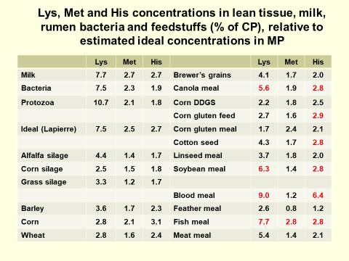

Slide 7
Factors to consider in the value of protein feeds
Digestibility coefficient
usually quite digestible: 80+ %
want rumen by-pass but not total tract
Heat damage: common problem with forages and processed (wet) protein ingredients; protein caramelizes and becomes indigestible
Protein (lysine) + sugars + moisture Maillard product
Presence of undesirable compounds
Protease inhibitors: in bean feeds
Toxins
Anti-palatability
Content of other nutrients -- energy, Ca, P ---
Availability and cost -- do not forget to compute the cost per lb of protein content

Slide 8
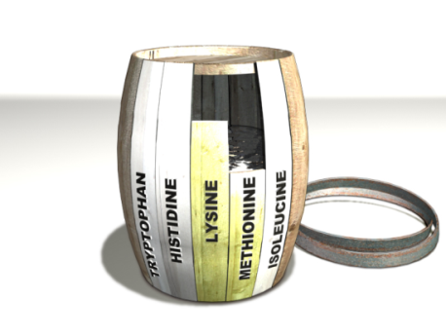
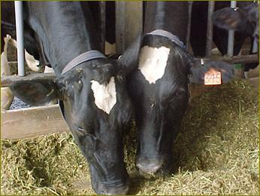
Limiting AA Theory
First limiting AA = the AA supplied in the smallest amount relative to requirements
Second limiting AA = the AA supplied in the second smallest amount relative to requirements

Slide 9
Protein feeds
Plant-based protein feeds
Animal-based protein feeds
Non-protein N sources (NPN)
Single cell proteins (SCP)

Slide 10
Plant-based protein feeds
Oilseed meals (e.g., Soybean; cottonseed; Linseed; Sunflower; Safflower; Rapeseed (canola); Peanut; Sesame)
Plant concentrated proteins (e.g., alfalfa meal; clover meal)
Legume seeds (e.g., peas; beans; lentils)

Slide 11
Oilseed Meals: Seed Extract Sources
Residue from extraction of oil from seed
Oil is used primarily for cooking and influences the price of the meal somewhat
As remove the oil the protein concentration is increased:
EE% CP%
Whole cottonseed 24 23.6
CSM 2 45

Slide 12
Seed Extract Sources-cont.
Different methods of extraction:
Mechanical, screw-press or expeller: cook seed to soften then press through dies to squeeze the oil out, this process produces friction = heat = may be beneficial for inhibitor reduction (and increase ruminal bypass)
Solvent extraction: solubilize the oils in the seed with organic solvent (hexane), then heat to evaporate the solvent
Oilseed meals are generally low in S-containing AA, but complementary in lysine and tryptophan

Slide 13
Soybean Meal
SBM is most widely fed protein ingredient -- combines most of the important qualities described earlier
Solvent extracted with hulls (44%) = 50% DMB
Solvent extracted without hulls (48%) = 54% DMB
Palatable and digestible
Methionine is limiting AA -- works well with corn

Slide 14
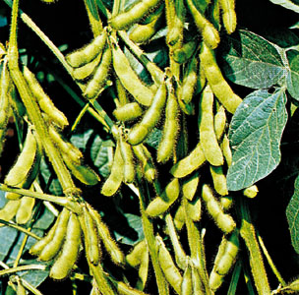
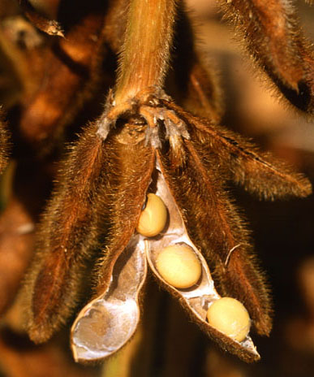
Soybean

Slide 15
Soybean Meal
Trypsin inhibitors
decrease the activity of the protein hydrolyzing enzymes in the small intestine (trypsin and chymotrypsin)
decrease protein digestibility
heat treatment will destroy inhibitors
If SBM is not mechanically extracted it is heat treated -- by pass protein of SBM varies
Genistein (phytoestrogen), phytate P
Some instances of feeding whole soybeans; should be toasted to 150 F for 5 minutes to destroy trypsin inhibitor

Slide 16
Cottonseed Meal
More available in the western states -- Texas and California
45% protein – DMB
Like SBM it is low in S-containing AA
Doesn't have as much energy -- gin trash and hulls
Gossypol - yellow pigment -- toxic to monogastrics
can be destroyed by heat or addition of ferrous sulfate in the diet
should not be more than 30% of dietary protein for monogastrics
don't worry about ruminants, except if feeding at very high levels or in combination with whole cottonseeds
evidence of sperm abnormalities in bulls
Produced by glands in seed, some gland-less varieties available.
Free gossypol is toxic form, heating complexes gossypol to other compounds, including lysine (decrease lysine availability)

Slide 17
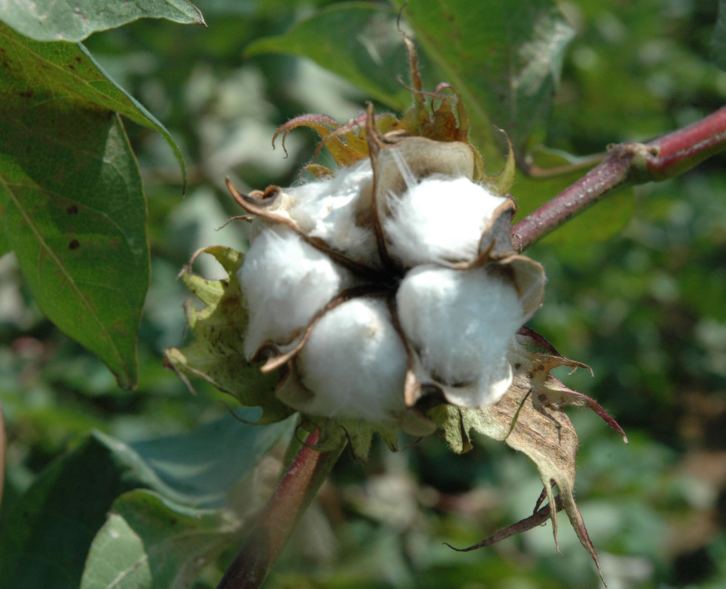
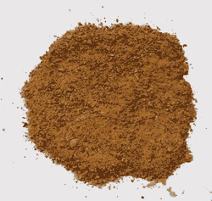
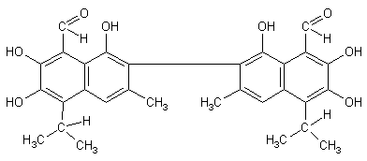
Cottonseed
Gossypol

Slide 18
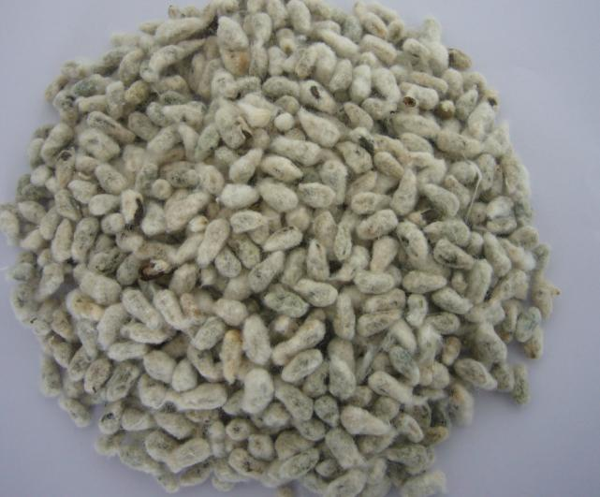
Whole Cottonseed – popular ingredient for dairy rations
20% CF, 24% EE, 24% CP and 98% TDN
For dairy rations, help maintain ration fiber content (for milk fat) while maintaining high energy level
Valuable ingredient for high
production herds
if fed at too high of levels
may reduce milk protein
content; result of high
ration fat content

Slide 19
Rapeseed (Canola) meal -- Brassica is the genus name
Cool climate crop -- Canada and PNW
38-42% CP
A good “de-hulling” procedure has not been developed, consequently the protein is lower than CSM or SBM and the energy value is also lower
Actually a very good balance of AA but is rapidly degradable
Toxins
erucic acid -- fatty hearts in monogastrics
glucosinolates -- converted to thiocyanides – goitrogenic
Canola varieties from Canada -- "00"

Slide 20
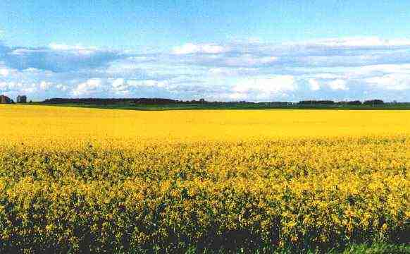
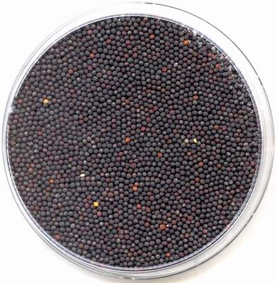
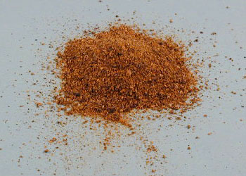

Slide 21
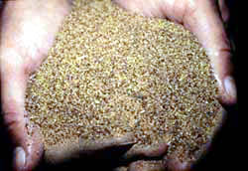
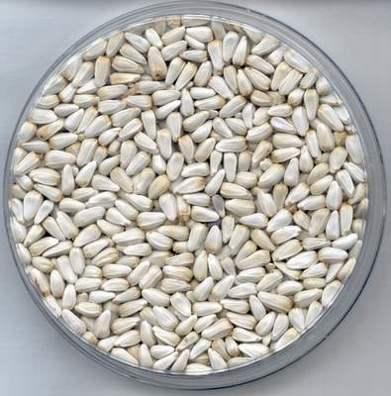
Other Oilseed Meals
Safflower meal
Grown in PNW -- also has
been used for silage
Need to be cautious
about the type as CP
will vary -- varying amounts
of hull and trash; most will
contain a fair amount of
fiber (hulls) and be lower
in energy and CP (24%),
also low in Ca & P

Slide 22
Linseed Meal- flaxseed
CP lower 35% - usually higher in Se (soils where grown)
Poor AA balance (low Lys); not used for monogastrics
Found in Dakotas, Minnesota and Montana
Horse owners may like it for improved hair coat
Usually costs more, too!

Slide 23
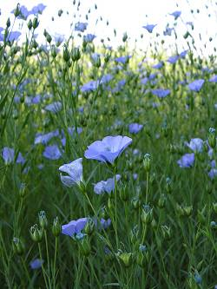
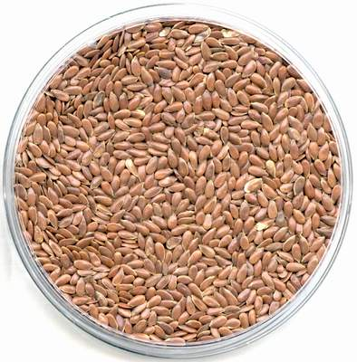
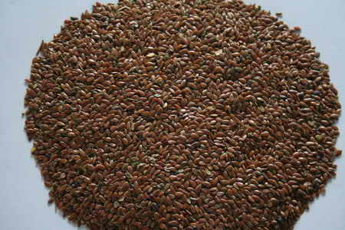
Linseed

Slide 24
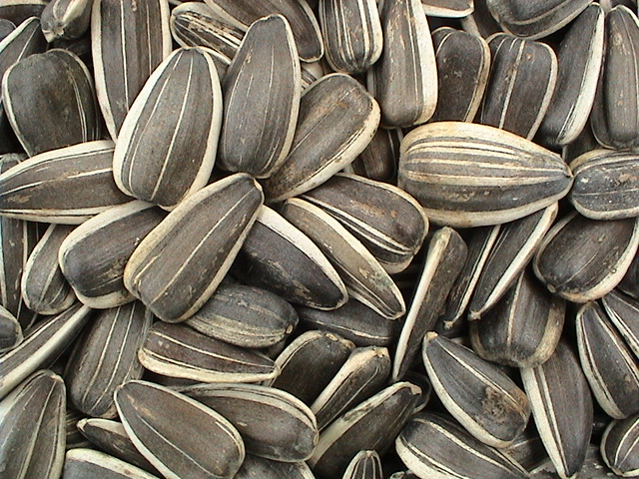
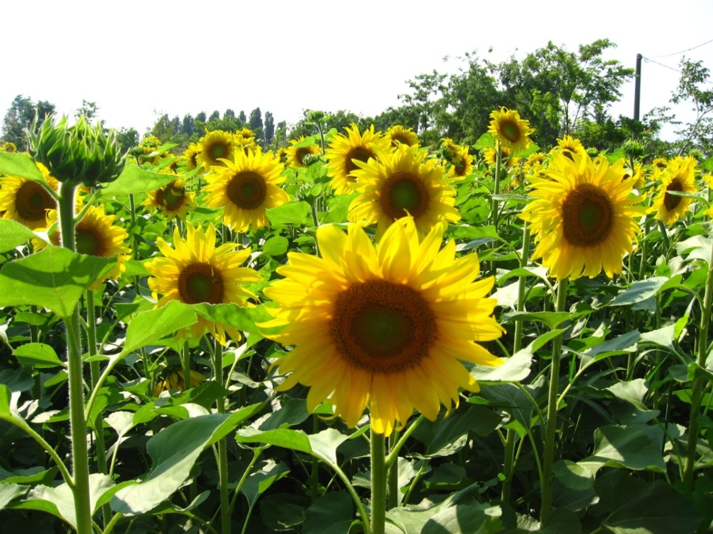
Sunflower
- Cooler, drier climate
- If de-hulled: ~50% CP
- Low in Lys
- Common SFM: high fiber (restriction in monogastric animals)

Slide 25
Other Oilseed Meals
Peanut meal: expensive; CP ~ 41-50%
0.6-0.8% P; 0.13% Ca;
low Met; Lys; Trp
Sesame meal: not a cool season product
CP ~ 37-45%; 2.3% Ca; 1.4% P;
high Met; Arg;
watch for oxalic acid

Slide 26
Corn products Distillers Grains and Brewers Grains
Primarily corn residue for alcohol fermentation (gasohol) or barley (beverage alcohol)
27% protein; good BP protein but may be lysine deficient
distillers grain have much more energy than brewers grains -- 2.0 vs 1.5 Mcal of NE_{l} per kg (44% NDF)
whole stillage = 7% DM
DM can be screened/ centrifuged and /or heat dried (DDG)
liquid = thin stillage = water and yeast cells
can be dried (degradable protein)
added back to DDG to make DDG + solubles
these fermented by-products may have some B-vitamin value
***** if purchasing/feeding, know what the DM content is

Slide 27
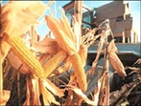
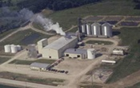
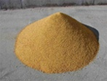

Slide 28
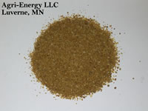
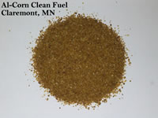
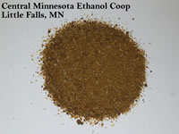
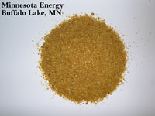
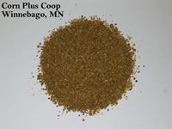
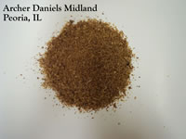
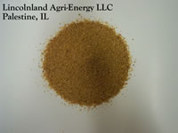
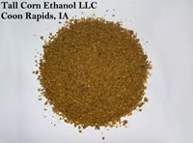
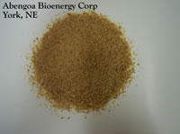
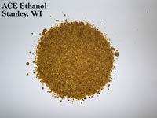
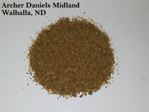

Slide 29
Other Plant Protein Ingredients
Cull peas and Beans
Low in S-containing AA
Trypsin inhibitor
Product may vary -- contain differing amounts of trash, weed seeds, etc *** sample it and know what the protein content is

Slide 30
Animal By-Products
Meat byproducts (e.g., meat meal; tankage; blood meal; meat & bone meal)
Poultry byproducts (e.g., meat meal; feather meal; blood meal)
Dairy byproducts (e.g., skim milk; whey)
Marine byproducts (e.g., fish meal; shrimp/crab meal; fish solubles)
Animal wastes (e.g., poultry manure)

Slide 31
Animal By-Products
In general, most contain a balance of nutrients and most are bypass protein
FDA now restricts/prohibits feeding of ruminant byproducts (except blood meal and tallow) to other ruminants; because of the BSE scare from northern Europe, Japan, Canada and now the US
Meat meal and meat and bone meal
Tankage
dead animal rendering plant
meat packing plant -- carcass trimmings, inedible offal, condemned carcasses and body parts, bone
Products are steamed and dried
bypass protein
about 55% protein
should be included at no more than 5% of the diet

Slide 32
Animal By-Products
Meat meal and meat and bone meal, continued
Ca and P are in good supply especially with bone
Fat content keeps energy value high (about 10% EE)
Future of meat meal and meat and bone meal are uncertain – stay informed!

Slide 33
Animal By-Products
Blood meal – most recently regulated by FDA as ruminant feed
Coagulated, flash dried (bypass protein)
90+% protein
Excellent AA balance
Unpalatable -- restrict to less than 5% of diet
Porcine plasma
For young pigs; often in creep feeds
Good protein levels and may have immunology benefits

Slide 34
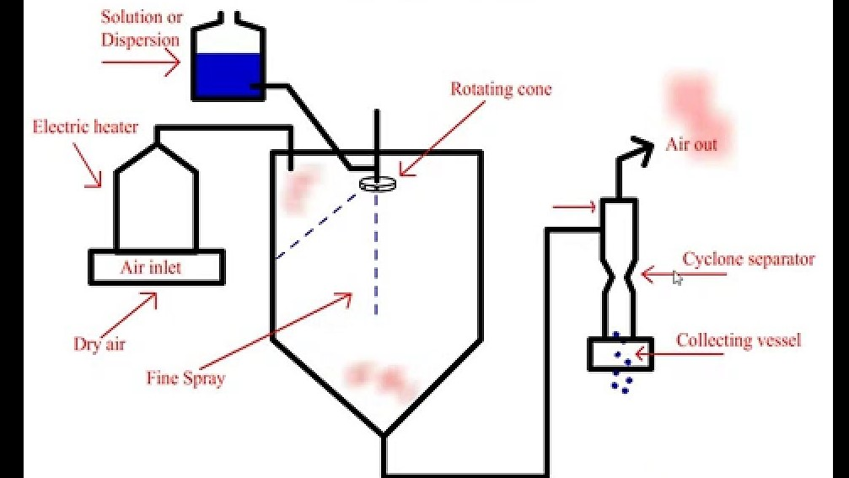
Spray Drier

Slide 35
Animal By-Products
Fish meal
Whole or cut fish
discarded fish
some caught just for making meal -- anchovy, menhaden
dried and ground -- by pass protein
50 - 60% protein
good AA, good Ca, P

Slide 36
Animal By-Products
Poultry waste
Poultry litter -- mostly NPN for ruminants
Arkansas and throughout the SE
Fiber content
Processing; contaminations
Nutrient (%) | Commercial layers | Broiler (w/bedding)
CP | 28 | 31.3
CF | 11-14 | 16-20
EE | 2.0 | 3.0-3.5
Ash | 28 | 15
TDN | 52-55 | 70-75

Slide 37
Single cell proteins
Photosynthetic (e.g., algae)
Non-photosynthetic (e.g., Bacteria; yeast)
Bacteria, yeast
Culture these on biomass of all kinds: crop residue, petroleum by-products, wood, animal waste; then harvest the bugs
Highly digestible in swine
Somewhat methionine deficient
High concentrations of RNA
Palatability ?

Slide 38
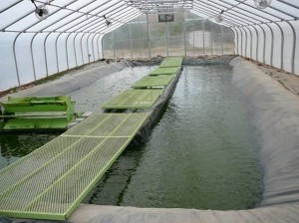

Slide 39
Algae
Soy Algae*
Protein 44% 55%
Lipids 2% 18%
Carbohydrates 39% 15%
Ash 15% 12%
*Chlorella Vulgaris
http://www.alltech.com/future-of-farming/algae-the-growth-platform

Slide 40
Non-Protein Nitrogen
Urea, biuret, amino acids, ammonium phosphate
Urea:
Cheap and convenient in self feeders
1 lb urea + 6 lb of grain = 7 lb of SBM
may need a S source to provide the microbes for producing S-containing amino acids
9 parts urea: 1 part ammonium sulfate
Should contribute no more than 30% of dietary N
Maximum of 1.5% urea of total diet DM
Very effective in combination with escape protein (RUP)

Slide 41
Non-Protein Nitrogen: Examples
Common Name | Formula | Nitrogen Content (%) | CP % Equivalent
Ammonium acetate | CH₃CO₂NH₃ | 18 | 112
Ammonium bicarbonate | NH₄HCO₃ | 18 | 112
Ammonium Carbonate | NH₂CO₂NH₄ | 36 | 225
Biuret | NH₂CONHCONH₂ | 35 | 219
Urea (Pure) | NH₂CONH₂ | 46.7 | 292

Slide 42
Non-Protein Nitrogen: mode of action
NPN NH₃ + CO₂
CHO VFAs + Keto-acids (C skeleton)
HN3 + Keto-acids Microbial AA
Microbial AA Microbial proteins
Microbial proteins Free AA
Free AA body metabolism
urease
rumen microbes
rumen microbes
rumen microbes
abomasal digestion
SI digestion/absorption

Slide 43
Non-Protein Nitrogen
Urea, continued:
Manage to prevent urea toxicity -- avoid the "ammonia peak“
1.2% urea in the total diet is plenty
to spread out the peak would probably make for better N utilization -- bacteria incorporate it more completely
would also prevent toxicity
Symptoms of toxicity: convulsions, salivate, quiver, die
What to do if have toxicity: infuse acid (50% vinegar solution) to prevent ammonia absorption

Slide 44
Non-Protein Nitrogen
Liquid supplements and lick blocks
Fortified molasses and other liquid carriers
Until recently could just have water soluble ingredients, such as urea
Can now suspend most kinds of feeds -- approach equivalency of dry supplements: SBM, CSM, BM, minerals, vitamins, additives
use of suspending agents: clay, xantham gum, xylan
Industry now uses this technology for two types of products:
semisolid blocks or large tubs for use as a range supplement; can contain NPN and/or natural protein and all of the necessary minerals and vitamins
“complete” liquid supplements to add to TMR’s for beef feedlot and dairy, as well as for pasture/range supplement in “lick tanks”

