Slide 1
Lipids in the body
Functions
Membrane component
Thermal insulation and mechanical protection
Metabolic regulator
Energy store
- 90% of an adipocyte is lipid
Notes:
Lipids or fats are stored in cells throughout the body principle in special kinds of connective tissue called adipose tissue. Whereas many cells contain phospholipids in the bilayer cell membranes, adipose tissue cells consist of fat globules of triglycerides which may occupy as much as 90% of the cell volume.
In addition to energy storage, depot fat provides a number of other functions. Fat serves as a protective cushion and provides structural support to help prevent injury to vital organs such as the heart, liver, kidneys, and spleen.

Slide 2
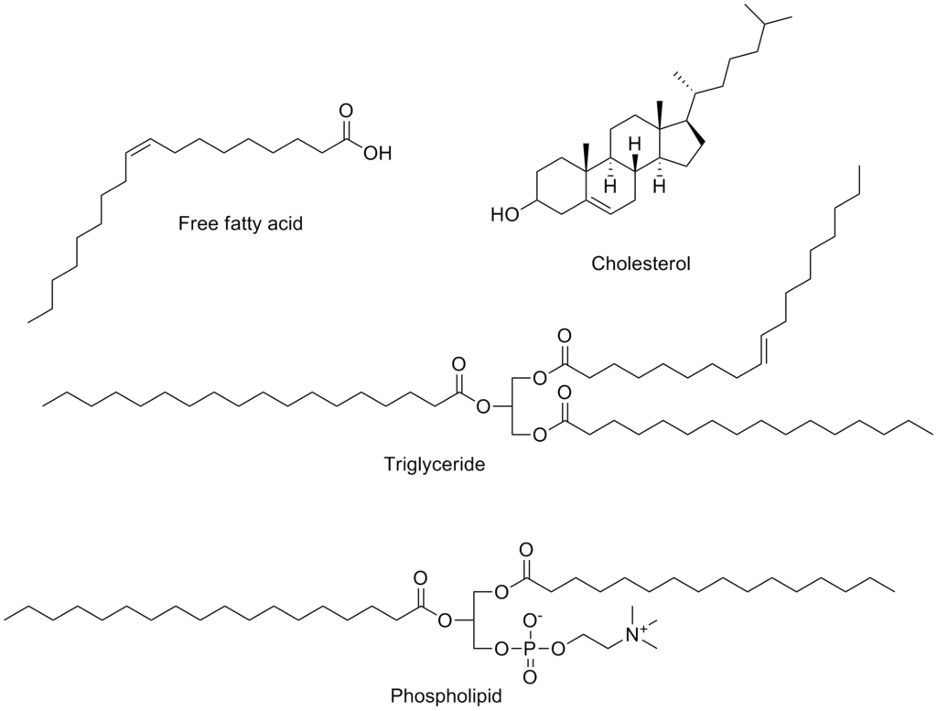
Types of Lipids
https://upload.wikimedia.org/wikipedia/commons/thumb/5/5c/Common_lipids.png/1024px-Common_lipids.png

Slide 3
Types of Lipids
https://upload.wikimedia.org/wikipedia/commons/thumb/b/b5/Sphingolipids_general_structures.png/1920px-Sphingolipids_general_structures.png

Slide 4
In 70 kg man
10 kg fat 93,000 Kcal
glycogen 500-800 Kcal
protein ~ 18,000 Kcal
Notes:
Protein can be catabolized to provide glucose for brain and red blood cells

Slide 5
Adipose tissue is located:
In the abdominal cavity around kidneys and between the mesentery
Beneath the skin
Between skeletal muscle fibers
Notes:
Fat in the muscle is used during exercise

Slide 6
Lipid Digestion and Absorption

Slide 7
Lipid Digestion and Absorption
Triglycerides
Stomach
Little digestion
Gastric lipase is secreted in the stomach that hydrolyze long chain triglycerides
Small intestine
Fat digestion and absorption occurs primarily in the duodenum and jejunum
Notes:
Triglycerides are ~95% of the fat consumed in human diets. Most dietary triglycerides are digested in the small intestine. However, two problems must be solved before digestion can occur. Triglycerides are insoluble in water, and the chyme in the intestine is an emulsion of large fat particles in water. All the lipase proteins by contrast are water-soluble. It follows that, triglycerides must be dissolved in the aqueous phase before they can be digested.

Slide 8
Lipid Digestion
Large Lipid Droplet
Action of bile salts (cholate, chenodeoxycholate)
Lipid emulsion
Small
Bile salts activate pancreatic lipase and colipase
Bile salts reabsorbed, transported back to liver
Water soluble micelles

Slide 9
A. Luminal Phase
Food entering small intestine causes the secretion of hormones such as cholecystokinin, pancreozymin and secretin
Hormones cause gallbladder to contract and secrete bile
Stimulate the pancreas to secrete pancreatic lipase

Slide 10
1. Emulsification
Bile salts in combination with the churning action of the intestine emulsifies the fat breaking it down into small droplets
This increases the surface area of triglycerides by a factor of ~10,000
Bile salts ↑ pH of intestine which causes secretion of pancreatic lipase
Notes:
Increased surface area allows the lipase to be more effective at chopping up the triglycerides.

Slide 11
2. Partial Hydrolysis
Pancreatic lipase
Attacks the glycerol-FA ester bonds of triglycerides at positions 1 & 3 resulting in the release of 2-monoglyceride and 2 fatty acids
Phospholipase A1 and A2
Hydrolyzes fatty acids from phospholipids
Cholesterol esterase
Hydrolyzes fatty acids from cholesterol esters

Slide 12
Triglyceride
+ pancreatic lipase
2-monoglyceride + 2 FA
O
H₂ – C – O – C – R₁
O
H₂ – C – O – C – R₂
O
H₂ – C – O – C – R₃
– R₁
R₁
– R₃
R₃
Notes:
Rate of hydrolysis of 2-monoglyceride
is very low so only small amounts of
glycerol are formed

Slide 13
3. Mixed micelle formation
Consist mainly of long chain FAs, monoglycerides and bile acids
Short (2-6C) and medium chain FAs (6-12 C) are soluble enough in H2O that they can be absorbed into the portal blood
Notes:
The lipolytic activity of lipase requires the emulsifying action of bile salts in order to dissolve triglycerides in water. Pancreatic lipase binds to the surface of the small emulsion ­particles.

Slide 14
Long chain FAs and monoglycerides
Micelles diffuse to the surface (brush border) of mucosal cells where they are broken down
Long chain FAs and monoglycerides are absorbed into the intestinal mucosa by passive diffusion
Bile salts remain in the lumen and move down the intestine where most are actively absorbed from the ileum

Slide 15
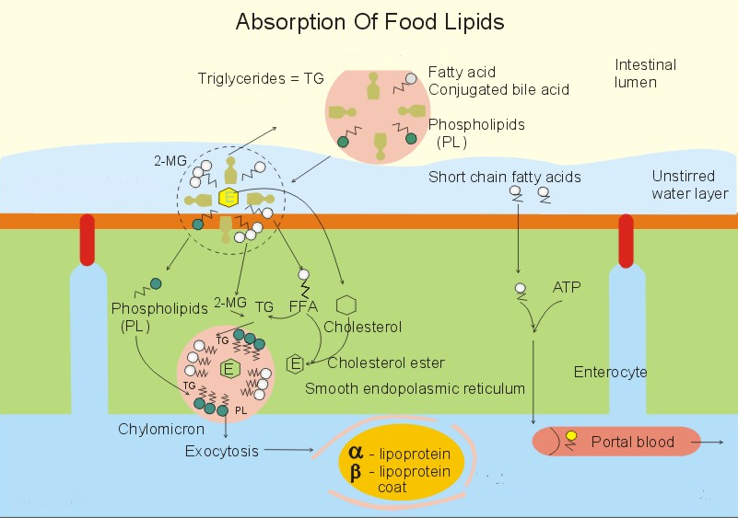
Notes:
Simple bile micelles are aggregates of bile salt monomers that form spherical structures with a diameter of 5 nm, and the micelles have a negative charge. Following a meal, bile micelles are formed above a certain concentration of bile salts, called the critical micellar concentration. The lipophilic, hydrophobic, apolar end of the bile acids faces inward creating a hydrophobic core. The hydrophilic polar end of the bile salts (hydroxyl-, carboxyl- and amino- groups) points outward, so that they are mixed with the polar water molecules. The simple lipids must pass a diffusion barrier - an unstirred water layer, which is the water layer immediately adjacent to the mucosa, where the intestinal flow rate is essentially zero. This water layer contains the water-soluble lipases and cholesterol esterases. Mixed micelles. Simple lipid molecules (cholesterol, phospholipids, fatty acids, 2-monoglycerides or 2-MG, fat-soluble vitamins and lyso-lecithin) diffuse into the lipophilic core of the simple bile micelles and form a mixed micelle (Fig. 22-13). A solution of micelles is water-clear and stable.
The mixed micelles carry the major part of all the lipids that are absorbed by the intestinal microvilli. When the lipids of the mixed micelle have diffused into the enterocyte, emulsifying more hydrolysed lipids recycles the empty bile micelle. Neither bile salt micelles nor bile salt molecules diffuse into the enterocyte

Slide 16
C. Intracellular Phase
Short and medium chain FAs (12 C or <) enter portal blood and bind to albumin without being esterified
Long chain FAs and monoglycerides are resynthesized into triglycerides in the endoplasmic reticulum of the mucosa
Notes:
The fatty acids with a short chain (up to 12 C-atoms) are more hydrophilic than the rest. They can diffuse directly to the portal blood as fatty acids. Once fatty acids enter the enterocyte, they are primarily activated to acetyl coenzyme A by a process that requires ATP and acetyl coenzyme A synthetase. Acetyl coenzyme A enters one of two pathways: the 2-MG and the a-glycerol phosphate pathways. Both bring about the resynthesis of triglycerides (TG) in the enterocyte. In the enterocyte the lipids are reformed to triglycerides, cholesterol, phospholipids etc. The reformed triglycerides, cholesterol, phospholipids, fatty acids, esters and fat-soluble vitamins reach the endoplasmic reticulum, where they are packed in another lipid-carrying particle: the chylomicron.

Slide 17
Lipid Synthesis

Slide 18
Triglyceride Synthesis
Monoglyceride (~85%)
Glycerol 3-phosphate (~15%)

Slide 19
Monoglyceride Pathway
Occurs in the smooth endoplasmic reticulum
Fatty acid + ATP Fatty Acy-CoA + AMP + CoA + P_{i}
Acyl-CoA synthetase is specific for fatty acids with greater than 12 carbons
Monoglyceride + Fatty Acyl CoA Diglyceride
Diglyceride + Fatty Acyl CoA Triglyceride
Acyl - CoA
Synthetase

Slide 20
Glycerol 3-Phosphate Pathway
Occurs in the rough endoplasmic reticulum
Inhibited by monoglycerides
Glycerol
Glycerol 3-P
fatty acyl CoA
Phosphatidic Acid
Fatty Acyl CoA
Pi
Phospholipid Diglyceride Triglyceride
Notes:
Glycerol 3-P is formed via glycolysis

Slide 21
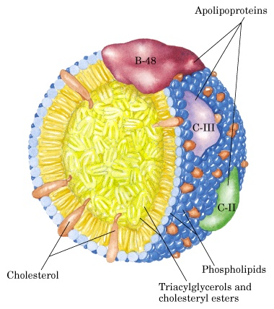
FA content of the triglycerides synthesized in the intestinal mucosa is similar but not identical to that in the diet.
http://homepage.smc.edu/wissmann_paul/anatomy2textbook/chylomicronpic.jpg
Notes:
The centrer of the chylomicron is a cholesterol ester. Chylomicrons are packed into vesicles in the Golgi-system. These vesicles reach the basolateral membrane, and their contents pass through this membrane by exocytosis. Thus the chylomicrons reach the lymphatic channel of the villus (the central lacteal). The lymph delivers the chylomicrons to the blood through the thoracic duct. Lipids are mainly absorbed through the enterocyte and transported by the lymph, which reaches the blood via the thoracic duct. Lipids thus reach the liver through the hepatic artery, with the exception of short-chain fatty acids that enter the portal blood directly. Other nutrients are absorbed directly to the blood and reach the liver through the portal vein. Using the lymph guarantees that extrahepatic tissues, principally adipose tissue and muscle, are the first to be exposed to the newly secreted chylomicrons—if chylomicrons were secreted directly into the bloodstream, they would first be delivered to the liver via the portal vein.

Slide 22
Generally fat is well absorbed 90% +
Long chain saturated FA are not absorbed as rapidly as short chain or unsaturated FA
A higher bile acid concentration is needed for micelle formation with long chain saturated FA
Lack of bile decreases fat absorption
Notes:
All of the dietary lipid is normally absorbed in the intestine. Faecal fat derives from bacterial lipids and lipids of desquamated mucosal cells. - Disorders such as gallstones, pancreatitis, Crohn's disease, and liver disease can lead to fat malabsorption (steatorrhoea or fat-diarrhoea).

Slide 23
II. Phospholipid
Secreted in the bile and some in diet
Phospholipid Lysolecithin + FA
Phospholipid must be dispersed into small micelles for enzymatic hydrolysis
Phospholipases
Pancreatic
Notes:
Lysolecithin promotes micelle formation

Slide 24
Lysolecithin and FA produced become part of the mixed micelles
They are absorbed and then resynthesized into phospholipids in the mucosal cells by the glycerol 3-PO₄ pathway
Phospholipids are then utilized to form the chylomicrons or VLDL

Slide 25
III. Cholesterol
Human diet 400-700 mg/d
combination of free and esterified
Bile secretion 750-1250 mg/d free cholesterol
Cholesterol esters cholesterol + FA
Cholesterol esterase

Slide 26
Free cholesterol must be solubilized (mixed micelles) prior to absorption
More cholesterol is taken up by micelles when micelles are enlarged due to the presence of high fat
Cholesterol is taken up by the intestinal mucosa by passive diffusion then reesterified and incorporated in chylomicrons and VLDL
Cholesterol absorption is much lower than triglyceride absorption
30-60% absorption

Slide 27
Lipid Transport

Slide 28
Lipid Transport
Lipids appear in the blood in 3 forms
Lipoproteins
Free fatty acids – mostly bound to albumin
Ketone bodies
Notes:
What are the two sources of FFA?

Slide 29
I. Lipoproteins
Transport form of lipid (TG, phospholipid, cholesterol) in blood
Micromolecules of lipid and protein
Differ in terms of:
Density
Amount of TG
Phospholipid
Cholesterol
Type & amount of protein

Slide 30
Notes:
In proceeding from LEFT to RIGHT among the six lipoproteins in this table, the trend is toward increasing protein, increasing density, and decreasing size.
Abbreviations include: VLDL, very low density lipoprotein; IDL, intermediate density lipoprotein; LDL, low density lipoprotein, HDL, high density lipoprotein
Largest lipoproteins are chylomicrons followed by VLDLs they are also least dense relatively small protein content and large lipid content
HDLs smallest particles and most dense; high amounts of protein and less lipids

Slide 31
FA
Lipoprotein
Lipase
VLDL
IDL
LDL
Intermediate
density
lipoproteins
Cholesterol esters
Excess PL and
cholesterol
LCAT
HDL cholesterol

Slide 33
A. Chylomicrons
TG are primarily transported in chylomicrons and VLDL because TG are not soluble in H2O
Chylomicrons are produced only in the small intestine and they contain TG of dietary origin

Slide 34
Digestion and absorption of lipid and the formation and secretion of chylomicrons into the blood takes several hours
Turnover of chylomicrons are very rapid once they enter the blood (t ½ 4-5 min)
Triglyceride fatty acids + glycerol
Lipoprotein lipase
clearing factor lipase

Slide 35
Lipoprotein lipase is found on the outer surface of the endothelial cells lining the capillaries (adipose, heart, skeletal muscle,lung, mammary gland)
In liver lipoprotein lipase is attached to the outer surface of the hepatocytes
Following hydrolysis of TG the FAs diffuse into the tissue or they could remain in the blood and be transported to another tissue

Slide 36
Glycerol is transported in the blood to
liver or kidney
Glycerol + ATP Glycerol 3-P + ADP
Oxidized
Fatty Acids Esterified TG
Glycerol kinase

Slide 37
FA
Lipoprotein
Lipase
Chylomicron Chylomicron remnant Liver
(Cholesterol ester & protein)
PL
Free cholesterol
HDL
Cholesterol esters from chylomicron remnants
are secreted into the bile or used in synthesis
of VLDL

Slide 38
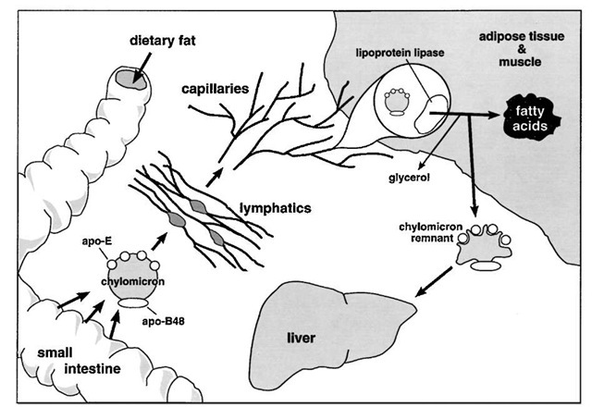
The intestine secretes chylomicron particles into the lymphatics. They gain entrance into the general circulation through the thoracic duct. Lipoprotein lipase, on the luminal surface of adipose and muscle capillary endothelial cells, hydrolyzes the triglyceride core to free fatty acids and glycerol. The free fatty acids are re-esterified and stored as triglycerides in adipose tissue or undergo b-oxidation in muscle. The lipid-depleted chylomicrons, chylomicron remnants, are cleared by the liver through a pathway that depends on apolipoprotein-E as a ligand for cellular receptors
Notes:
Lipoprotein lipase catalyzes the complete hydrolysis of triglycerides to free fatty acid and glycerol. This reaction occurs in the bloodstream, while the chylomicron particle is in proximity to the endothelial surface of the capillary wall. Cholesterol ester is not a substrate for lipoprotein lipase. Therefore, with the selective loss of triglycerides, the particle becomes more enriched in cholesterol ester. The free fatty acids are then taken up and oxidized in muscle or re-esterified and stored as triglyceride droplets in adipose tissue. The abundance of the adipose form of lipoprotein lipase is increased by insulin, thus promoting uptake of free fatty acids and storage as cytoplasmic triglyceride droplets
A chylomicron that has been depleted of its triglyc-eride core is termed a chylomicron remnant. Chylomicron remnants are cleared from the circulation, primarily by the liver.

Slide 39
B. Very low density lipoproteins (VLDL)
Lipoprotein that contains TG secreted from the liver
TG in liver are synthesized from either acetyl CoA or FAs derived from blood or chylomicrons

Slide 40
When dietary cholesterol from chylomicron remnants is not available in adequate amounts for synthesis of VLDL, the liver synthesizes cholesterol
Liver does this by increasing the activity of 3-hydroxy-3-methyl glutaryl coenzyme A reductase (HMG CoA reductase)

Slide 41
LCAT – Lecithin – cholesterol acyltransferase
LCAT esterifies excess cholesterol in HDL with FAs derived from the 2- position of lecithin (PL)
Half life of VLDL 1-3 hours

Slide 42
Lipoprotein lipase
Activity determines which tissues take up FA
Fed state – high in adipose
Fasted state-low in adipose, high in other tissues
Insulin and glucose lipoprotein lipase in adipose and also formation of α glycerol-P which stimulates esterification of FAs
Parturition - LPL in mammary gland

Slide 43
Nutritional State Lipoprotein Lipase Activity
 | Adipose | Heart | Skeletal M
Fasted | 3.3 | 19.0 | 15.4
CHO fed | 14.8 | 9.7 | 8.5
Fat fed | 7.9 | 15.1 | 14.4
J. Nutr. 105:447, 1975

Slide 44
C. Low Density Lipoproteins (LDL)
Involved in cholesterol transport
LDL is taken up by tissues metabolized and the cholesterol is released and used for cellular functions
Specific receptor on the surface of the cell that binds LDL
Most tissues except liver depend on LDL for their cholesterol supply
~45% of plasma LDL pool turns over per day

Slide 45
D. High density Lipoproteins (HDL)
Functions in cholesterol and phospholipid exchange and cholesterol esterification reactions in plasma
Accepts cholesterol from tissues

Slide 46
Cholesterol bound to HDL can be esterified in plasma by LCAT and transferred to VLDL and IDL to form LDL
HDLs are synthesized in liver and small intestine
Half life of 5-6 days

Slide 47
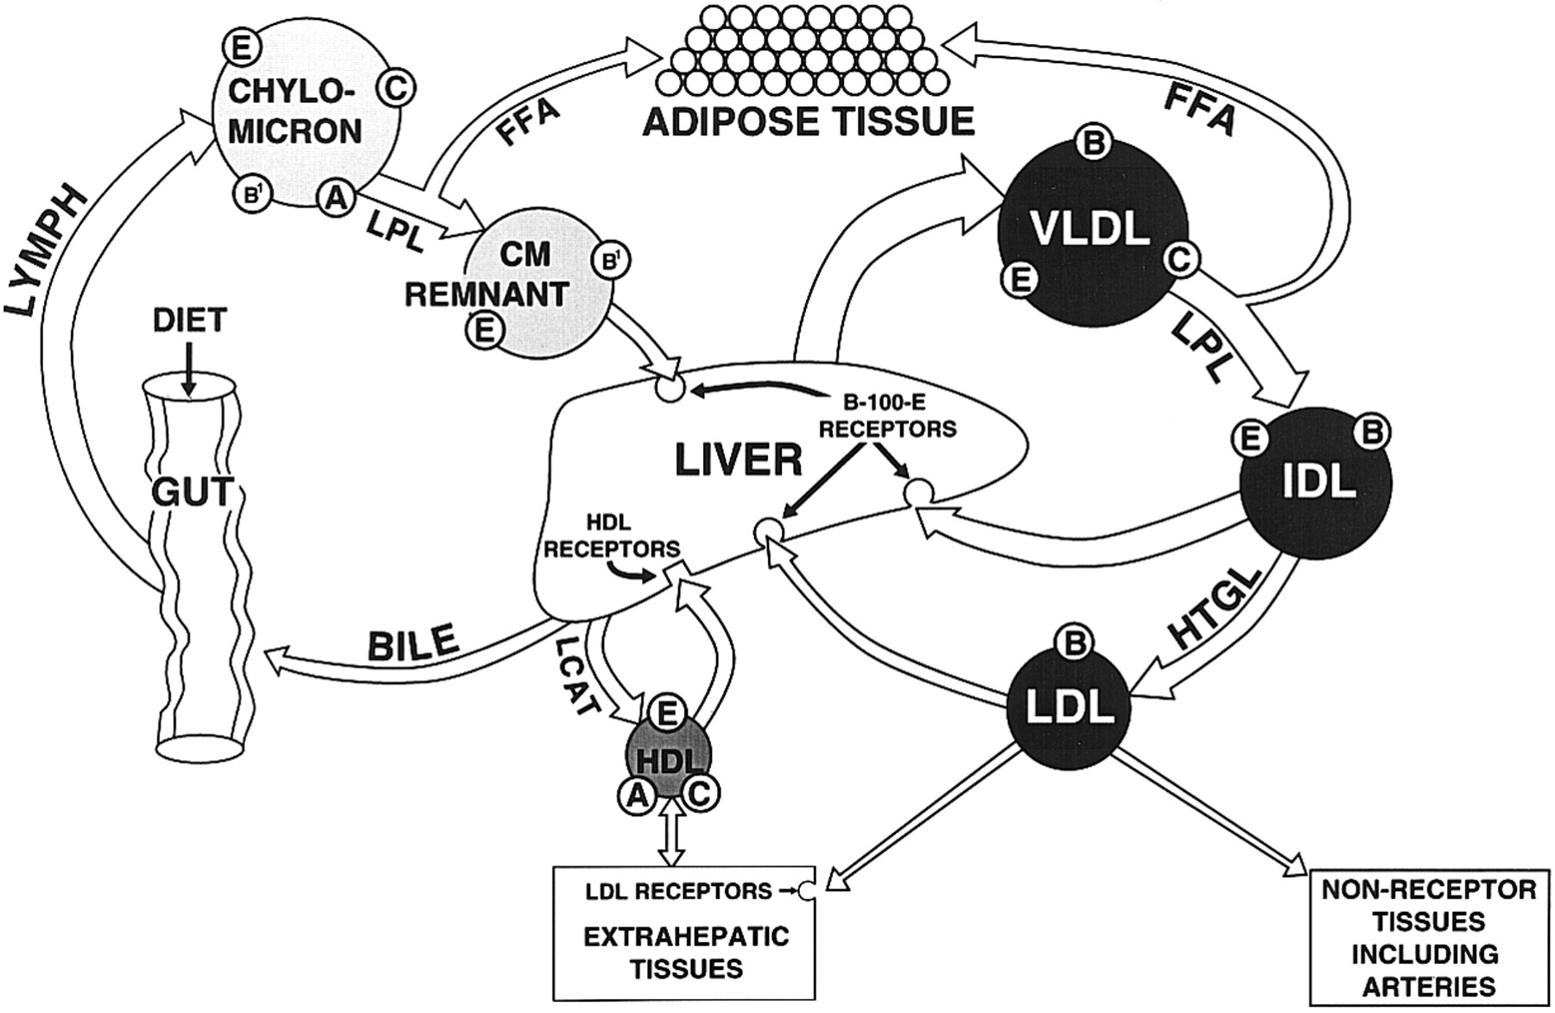
Notes:
Receptor-mediated pathways of lipoprotein metabolism. Three major pathways are involved: chylomicrons, VLDL and HDL. Intermediate density lipoprotein (IDL) is the remnant of VLDL and is cleared by the liver. LDL, which contains only apolipoprotein B-100, is the final product of the pathway; most of it is returned to the liver. Some LDL is taken up by extrahepatic LDL receptors and some by a scavenger pathway. The apopeptides contained in each lipoprotein are indicated. Three plasma enzymes essential for lipoprotein metabolism include LPL (lipoprotein lipase), LCAT (lecithin-cholesterol acyltransferase) and HTGL (hepatic triglyceride lipase.)

Slide 48
Lipid Transport
Lipids appear in the blood in 3 forms
Lipoproteins
Free fatty acids – mostly bound to albumin
Ketone bodies
Notes:
What are the two sources of FFA?

Slide 49
II. Free Fatty Acids
Some from intestinal absorption
Most FFA arise from TG breakdown in adipose tissue

Slide 50
III. Ketone Bodies
Synthesis
Gut epithelium (esp. ruminants)
Liver
Uses (requires thioporase)
Heart
Brain
Muscle

