Slide 1
CENTRAL DOGMA
Replication
Transcription
Translation
DNA
RNA
PROTEIN
Reverse
Transcription

Slide 2
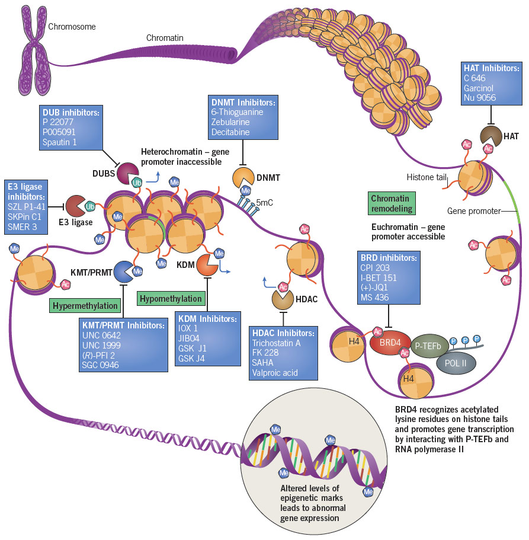
https://resources.tocris.com/images/targets/epigenetics-in-cancer.jpg

Slide 3
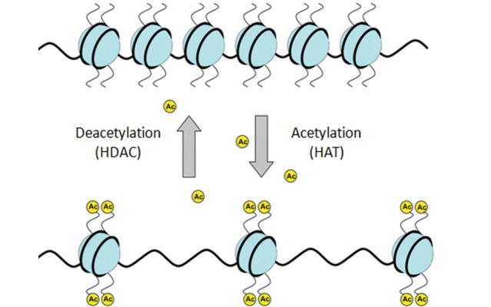
https://www.researchgate.net/profile/Mohamadreza_Eslaminejad/publication/236934361/figure/fig2/AS:202498271911937@1425290758359/Histone-acetylation-and-deactylation-Histone-acetyltransferaseHATs-adds-acetyl-groups.png

Slide 4
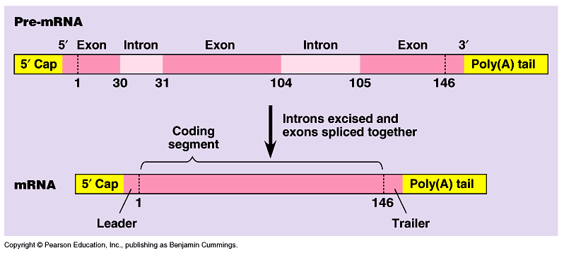

Slide 5
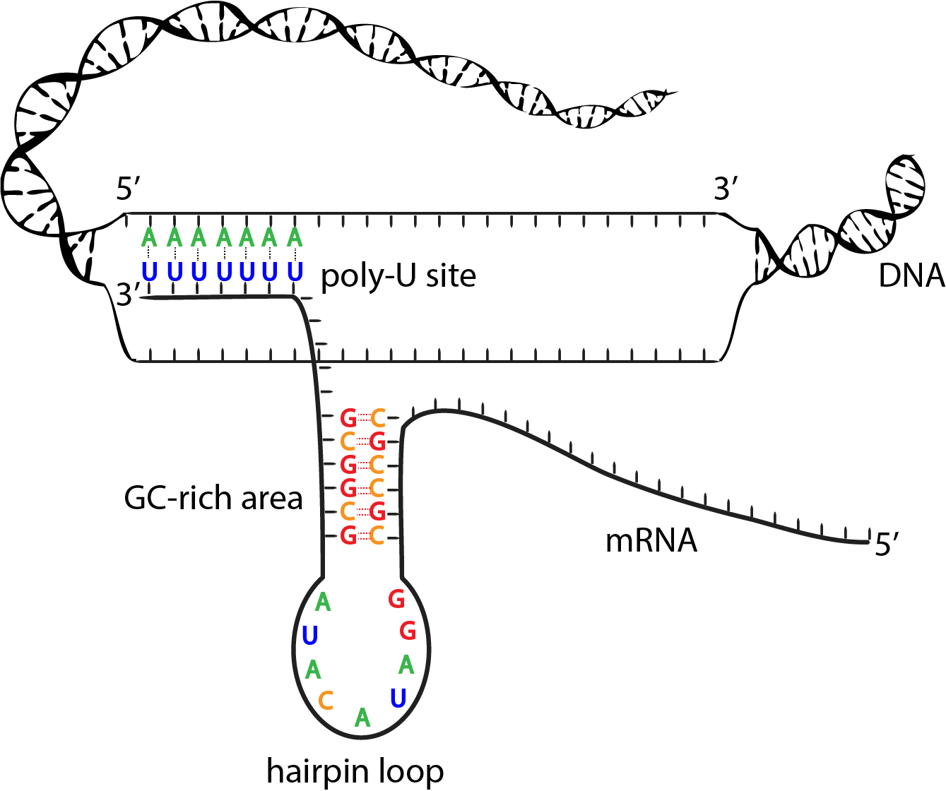
https://adapaproject.org/images/biobook_images/loop.gif

Slide 6
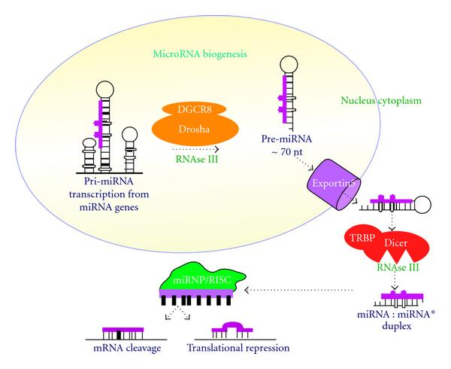
https://www.hindawi.com/journals/jo/2010/950201.fig.001.jpg

Slide 7
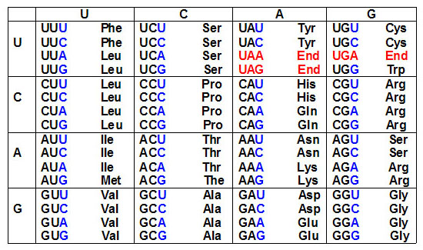
The Genetic Code
Shown below are the triplets that are used for each of the 20 amino acids found in eukaryotic proteins.

Slide 8
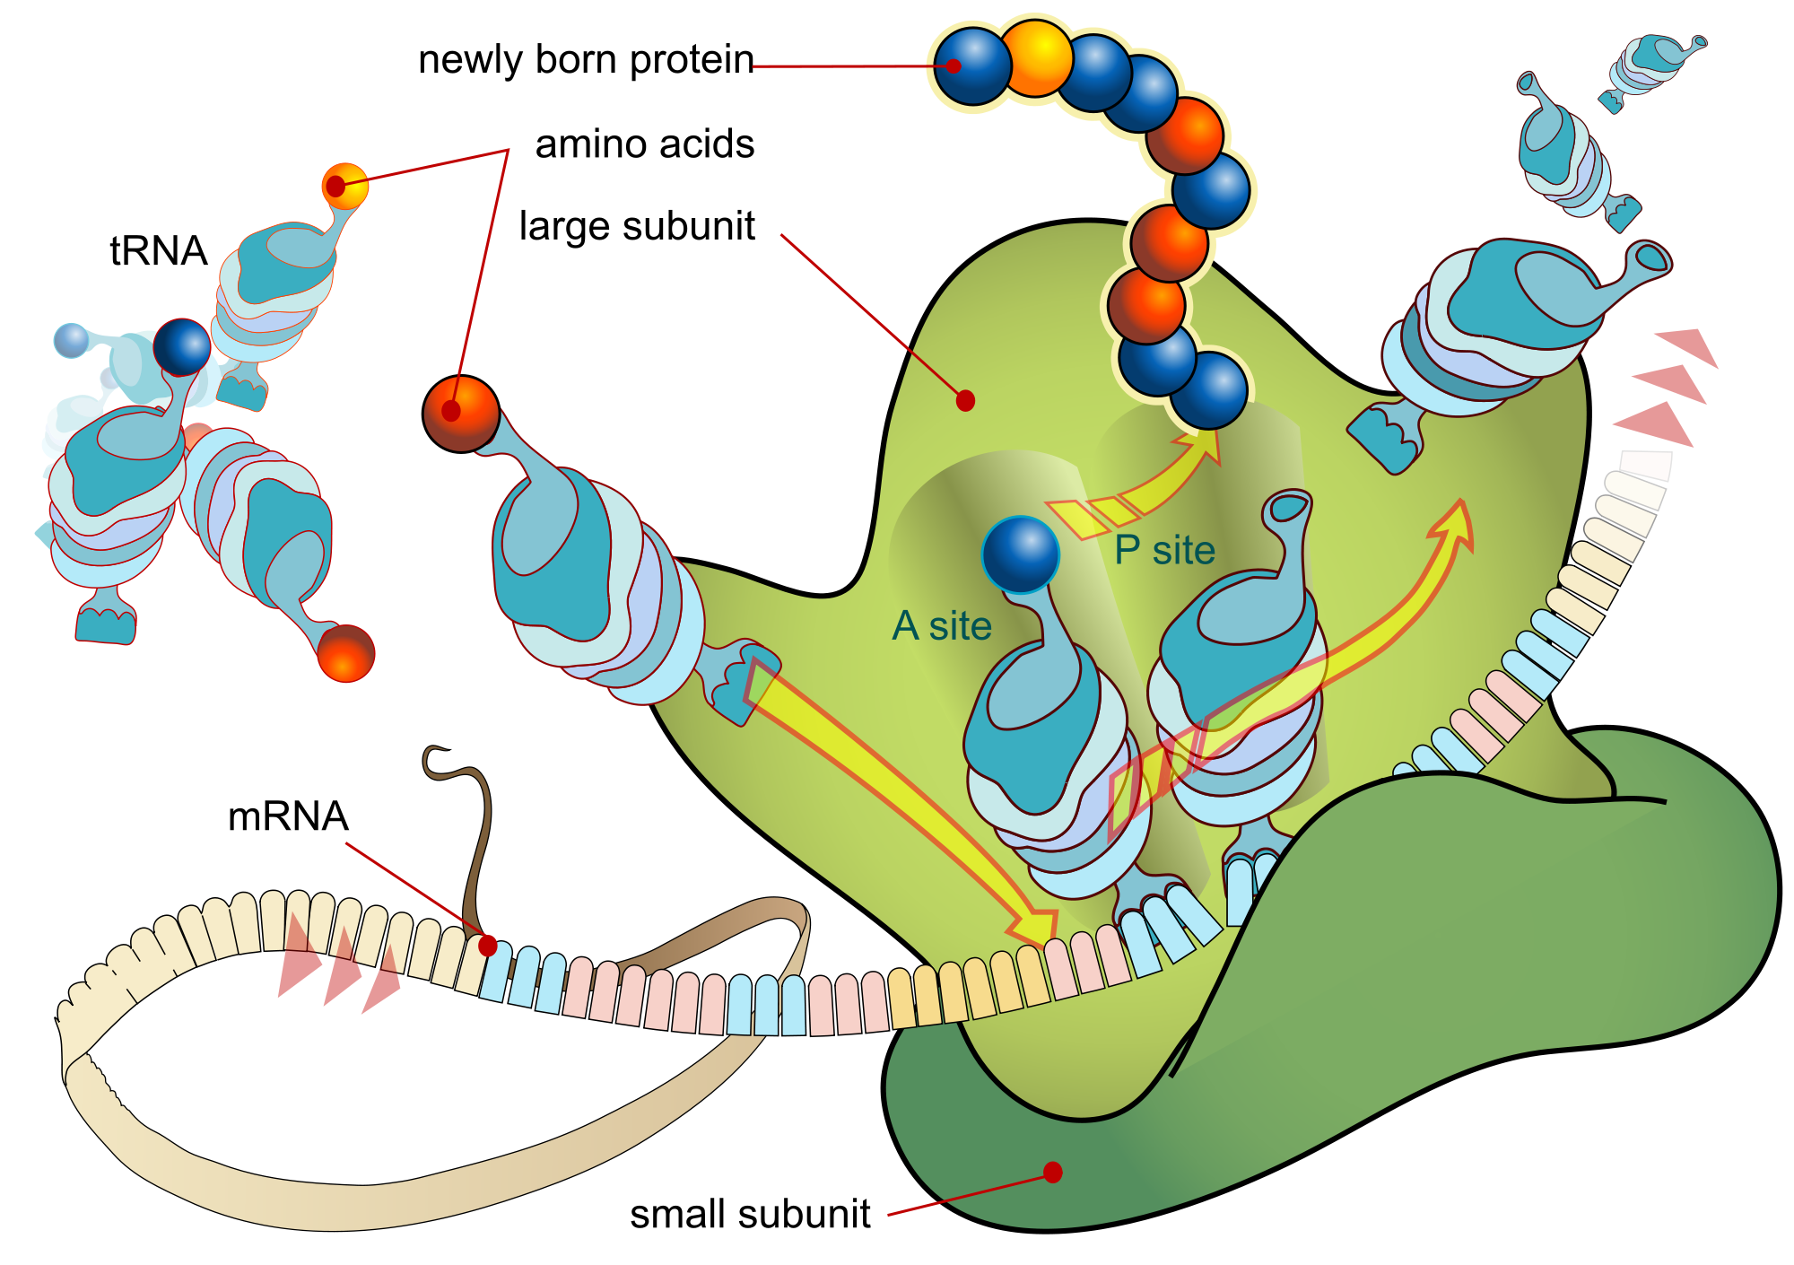

Slide 9
Order of Events in Translation
The ability to begin to identify the roles of the various ribosomal proteins in the processes of ribosome assembly and translation was aided by the discovery that the ribosomal subunits will self assemble in vitro from their constituent parts.
Following assembly of both the small and large subunits onto the mRNA, and given the presence of charged tRNAs, protein synthesis can take place:
Synthesis proceeds from the N-terminus to the C-terminus of the protein.
The ribosomes "read" the mRNA in the 5' to 3' direction.
Active translation occurs on polyribosomes (also termed polysomes). This means that more than one ribosome can be bound to and translate a given mRNA at any one time.
Chain elongation occurs by sequential addition of amino acids to the C-terminal end of the ribosome bound polypeptide.
Translation proceeds in an ordered process: initiation, elongation and termination.

Slide 10
Initiation
Initiation of translation requires a specific initiator tRNA, tRNA^{met}_{i}, that is used to incorporate the initial methionine residue into all proteins.
The initiation of translation requires recognition of an AUG codon.
In eukaryotes initiator AUGs are generally, but not always, the first encountered by the ribosome.
A specific sequence context, surrounding the initiator AUG, aids ribosomal discrimination. This context is ^{A}/_{G}CC^{A}/_{G}CCAUG^{A}/_{G} in most mRNAs.

Slide 11
Initiation of translation requires 4 specific steps:
A ribosome must dissociate into its' 40S and 60S subunits.
A ternary complex termed the preinitiation complex is formed consisting of the initiator, GTP, eIF-2 and the 40S subunit.
The mRNA is bound to the preinitiation complex.
The 60S subunit associates with the preinitiation complex to form the 80S initiation complex.
The initiation factors eIF-1 and eIF-3 bind to the 40S ribosomal subunit favoring antiassociation to the 60S subunit. The prevention of subunit reassociation allows the preinitiation complex to form.

Slide 12
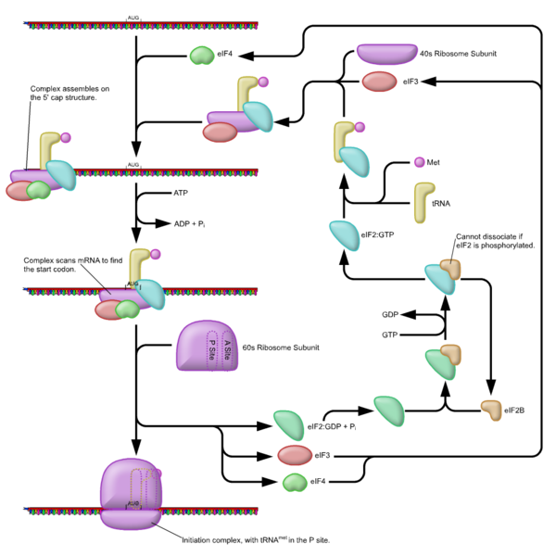
Eukaryotic Initiation Factors and Their Functions
The specific non-ribosomally associated proteins required for accurate translational initiation are termed initiation factors or eIFs.
Numerous eIFs have been identified.

Slide 13
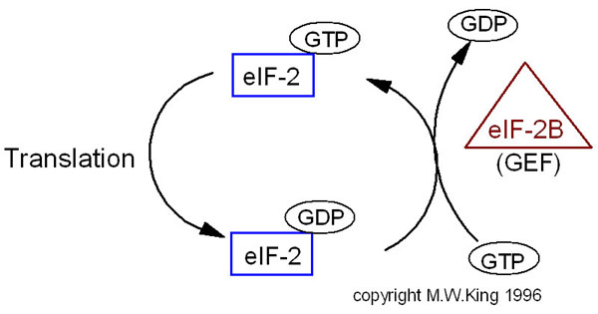

Slide 14
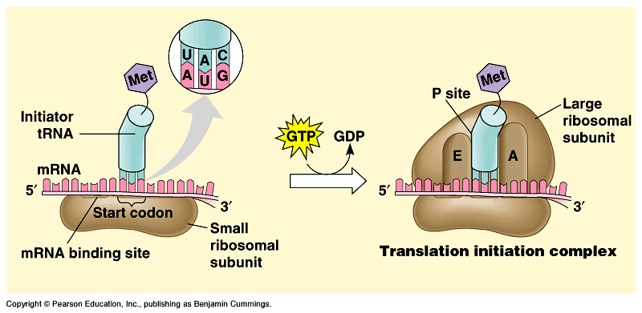

Slide 15
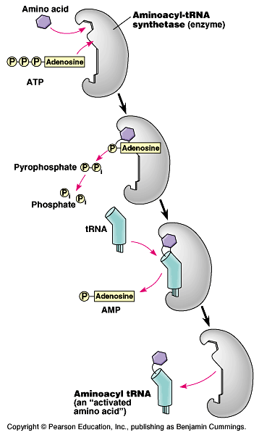
Activation of Amino Acids
Activation of amino acids is carried out by a two step process catalyzed by aminoacyl-tRNA synthetases.
Each tRNA, and the amino acid it carries, are recognized by individual aminoacyl-tRNA synthetases.
There at least 21 since the initiator met-tRNA is distinct from non-initiator met-tRNAs.

Slide 16
tRNAs
More than 300 different tRNAs have been sequenced, either directly or from their corresponding DNA sequences. tRNAs vary in length from 60–95 nucleotides (18–28 kD). The majority contain 76 nucleotides. The role of tRNAs in translation is to carry activated amino acids to the elongating polypeptide chain.
All tRNAs:
1. Exhibit a cloverleaf-like secondary structure.
2. Have a 5'-terminal phosphate.
3. Have a 7 bp stem that includes the 5'-terminal nucleotide and may contain non-Watson-Crick base pairs, e.g. GU. This portion of the tRNA is called the acceptor since the amino acid is carried by the tRNA while attached to the 3'-terminal OH group.

Slide 17
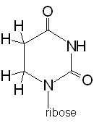
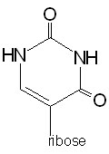
tRNAs
4. Have a D loop and a TΨC loop.
Dihydrouridine (D) | Pseudouridine (Ψ)
5. Have an anti-codon loop.
6. Terminate at the 3'-end with the sequence 5'–CCA–3'.
7. Contain 13 invariant positions and 8 semi-variant positions.
8. Contain numerous modified nucleotide bases

Slide 18
Elongation
Elongation of polypeptides occurs in a cyclic manner such that at the end of one complete round of amino acid addition the A site will be empty and ready to accept the incoming aminoacyl-tRNA dictated by the next codon of the mRNA.
Each incoming aminoacyl-tRNA is brought to the ribosome by an eEF-1α-GTP complex. When the correct tRNA is deposited into the A site the GTP is hydrolyzed and the eEF-1α-GDP complex dissociates.
In order for additional translocation events the GDP must be exchanged for GTP. This is carried out by eEF-1βγ similarly to the GTP exchange that occurs with eIF-2 catalyzed by eIF-2B.
The peptide attached to the tRNA in the P site is transferred to the amino group at the aminoacyl-tRNA in the A site. This reaction is catalyzed by peptidyltransferase. This process is termed transpeptidation.
The elongated peptide now resides on a tRNA in the A site. The A site needs to be freed in order to accept the next aminoacyl-tRNA. The process of moving the peptidyl-tRNA from the A site to the P site is termed, translocation.
Translocation is catalyzed by eEF-2 coupled to GTP hydrolysis.

Slide 19
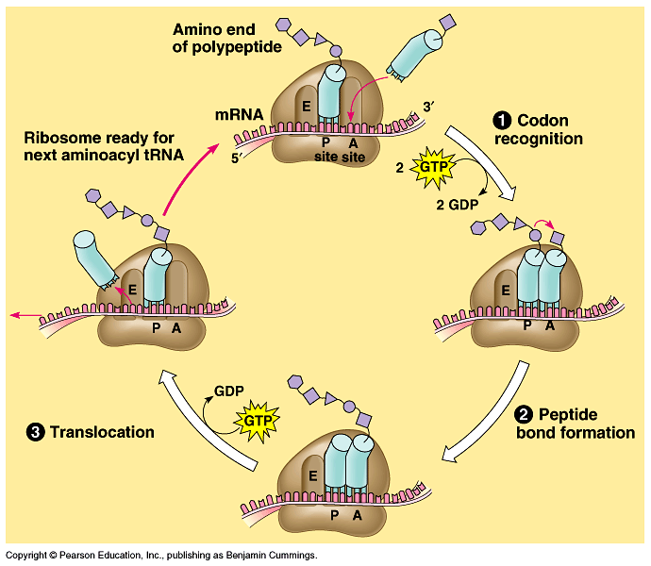

Slide 20
Termination
Termination requires specific protein factors identified as releasing factors or eRF in eukaryotes (prokaryotes have 2).
However, the signals for termination are the same in both prokaryotes and eukaryotes. These signals are termination codons present in the mRNA. There are 3 termination codons, UAG, UAA and UGA.
The eRF binds to the A site of the ribosome in conjunction with GTP. The binding of eRF to the ribosome stimulates the peptidytransferase activity to transfer the peptidyl group to water instead of an aminoacyl-tRNA.
The resulting uncharged tRNA left in the P site is expelled with concomitant hydrolysis of GTP.
The inactive ribosome then releases its mRNA and the 80S complex dissociates into the 40S and 60S subunits ready for another round of translation.

Slide 21
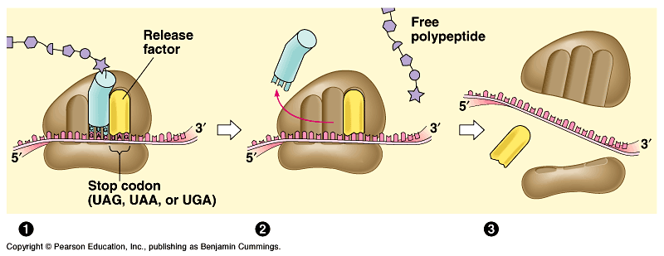

Slide 22
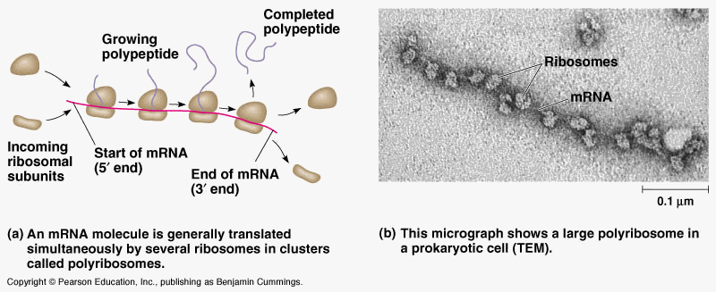

Slide 23
Secreted and Membrane-Associated Proteins
Proteins that are membrane bound or are destined for excretion are synthesized by ribosomes associated with the membranes of the endoplasmic reticulum (ER).
This class of proteins all contain an N-terminus termed a signal sequence or signal peptide.
The signal peptide is usually 13-36 predominantly hydrophobic residues.
The signal peptide is recognized by a multi-protein complex termed the signal recognition particle (SRP).
This signal peptide is removed following passage through the endoplasmic reticulum membrane. The removal of the signal peptide is catalyzed by signal peptidase.
Proteins that contain a signal peptide are called preproteins to distinguish them from proproteins.
However, some proteins that are destined for secretion are also further proteolyzed following secretion and, therefore contain pro sequences. This class of proteins is termed preproproteins.

Slide 24
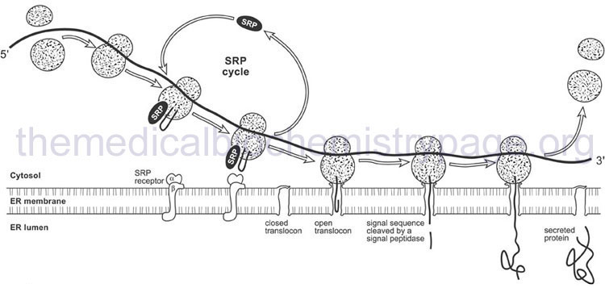

Slide 25
Proteolytic Cleavage
Most proteins undergo proteolytic cleavage following translation. The simplest form of this is the removal of the initiation methionine.
Many proteins are synthesized as inactive precursors that are activated under proper physiological conditions by limited proteolysis. An example is zymogens.
Inactive precursor proteins that are activated by removal of polypeptides are termed proproteins.
An example of a preproprotein is insulin.
Insulin is secreted from the pancreas it has a prepeptide. Following cleavage of the 24 amino acid signal peptide the protein folds into proinsulin. Proinsulin is further cleaved yielding active insulin which is composed of two peptide chains linked togehter through disulfide bonds.
Another complex example of post-translational processing of a preproprotein is the cleavage of prepro-opiomelanocortin (POMC) synthesized in the pituitary.

Slide 26
Selenoproteins
Selenium is a trace element and is found as a component of several enzymes that are involved in redox reactions – such as glutathione peroxidase.
The selenium iis incorporated as selenocysteine, during translation.
The tRNA for selenocysteine is charged with serine and then enzymatically selenylated to produce the selenocysteinyl-tRNA.
The anticodon of selenocysteinyl-tRNA interacts with a stop codon in the mRNA (UGA) instead of a serine codons (UCU, UCA, UCG, UCC).
The selenocysteinyl-tRNA has a unique structure that is not recognized by the termination machinery and is brought into the ribosome by a dedicated specific elongation factor.

Slide 27
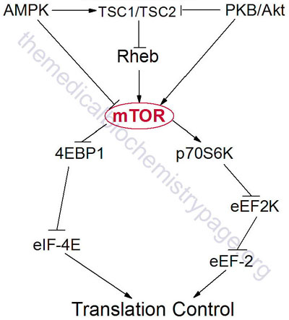
Mammalian Target of Rapamycin

Slide 28
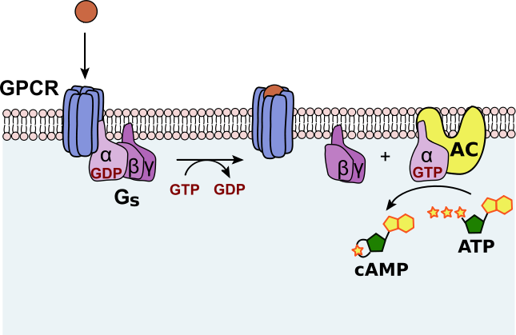
https://upload.wikimedia.org/wikipedia/commons/thumb/7/73/Activatoin-Adenylate_cyclase-outlined.svg/645px-Activatoin-Adenylate_cyclase-outlined.svg.png

Slide 29
