Slide 1
Making Time for the Learning to Happen
CETL HIP Workshop
2/1/24

Slide 2
Time: Its value and a view from the front of the room
As faculty, we know that time is one of the most precious resources we have. We try to guard it because time bandits like to steal it, and this diminishes our productivity.
In the context of our teaching, we try to manage out time effectively. We have, for example, 50 minutes or 75 minutes to accomplish a goal. Sometimes this results in decisions that don’t always advance learning. We fill the time. Will fill the board. We run out the clock. We recite a lecture with metronome precision. We say what the book and the slides say.
Where are the students in this scenario?

Slide 3
What teaching sometimes looks like, but…
“Dense content [is] a barrier to significant learning” (Nilson and Goodson, Online Teaching at its Best).
Like technology, content must be functionally related to the accomplishment of learning goals.
(Re)consider:
The volume of content –less is usually more
Different formats to get the brain firing on all cylinders –and to appeal to diverse learners and enhance engagement
Timing…is usually everything. Revealing the right content, the right way, and at the right time
Expectations –clearly articulated, understood, and goal-oriented.
UDL –provide for multiple means of Engagement, Representation, and Expression.
Make Time for the Learning To Happen!

Slide 4
Time’s value for learning and learners
Time to
Think
Reflect
Analyze
Perform
Get feedback
Reflect
Refine
Perfect
Time to
Interact
With content
Scenarios
One another
You
Any differences between f2f & online?
Regularity
Substantive value
Presence
Belonging
Engagement
Experience
Lab
Field
Community
Time management
Time on task

Slide 5
Are you making time for the learning to happen?
If so,
How?
When
Where
What does learning look like?
How do you know if they’re learning?
How do they know if they’re learning?

Slide 6
Strategies
They all begin with a pause

Slide 7
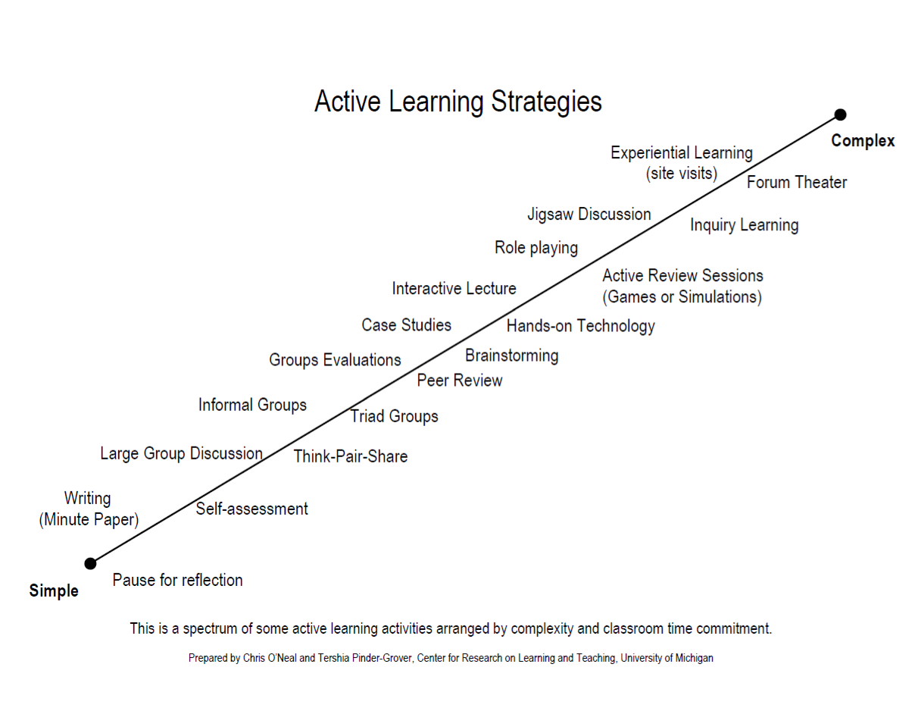
Yeah, this applies to you
If you begin by saying “I don’t have time to…”, you’re probably focusing on disconnected teaching, not engaged learning.
Let’s go ahead and change Think-Pair-Share to Think-Write-Pair-Share
Some of these are CATs and some are LATS

Slide 8
SLOs, CATs, and LATs
SLOs: Student Learning Outcomes https://www.webpages.uidaho.edu/cetl/learning-assessments.asp | CATs: Classroom Assessment Techniques | LATs: Learning Assessment Techniques
The purpose for which the course exists. We should backwards design courses to accomplish these objectives and provide evidence that both the students and the course have been successful. As a result of taking this course,… | Often on-the-spot, non-graded, anonymous in-class activities that stimulate alertness and give students and faculty an opportunity to engage in and give/get JIT feedback. Faculty are systematically engaged observers of learning as it takes place. Classroom as laboratory. | Link teaching, learning, and assessment. An iterative/integrated process of: Identifying meaningful learning goals; Designing & deploying active learning activities that require students to create an assessable product that provides direct evidence of their learning; Analyzing the artifacts.
LATs give us evidence. CATs give us less stressful time to engage.

Slide 9
Low-Risk/High-Yield Active Learning Strategies
Interactive Lecture
Think-Pair-Share
One Minute Papers
Discussions –large & small
Muddiest/Clearest Points
Concept Tests
Debates and Simulations
Peer Review
Info Lit Races
Case Studies, CBL, PBL

Slide 10
Find Out What They Know and What They Don’t Consider these Learning Strategies for New(er) Material
Strategy | Description
CATs and LATS | Set aside 5 minutes of class time for low-stakes quizzes to help students practice retrieving and processing newly learned information. Think, WRITE, Pair, Share.
Distributed Practice | Allow students to work on skills and knowledge acquisition over time. (Less learning happens in class than outside of class, when we have given our brains time to begin to forget, and then to remember, assemble, and develop knowledge).
The Productive Struggle | Offer challenging tasks that require creative and critical thinking. The one who does the work does the learning, and research shows that student effort matches faculty expectations.
3-2-1 | Let students write down 3 things they learned (potentially from the previous class session), 2 things they found interesting, and 1 thing they have questions about.
Ticket In-and-Out the Door | Have students present a question or finding from previous session to current session, and at the end, share one thing they learned or didn’t quite grasp today.
Technology | Use technology APPROPRIATELY and as part of the authentic learning experience.
How I Learned, not What I Learned | Retrieval is critical to new learning (read Make it Stick), but don’t let the students rely on you as the source of all knowledge and information! Learning is about discovery. Get them to think about how they learn, not just what they learn.

Slide 11
CATs and LATs Exercise
For CATs:
I want my students to… (identify a learning goal)
So I … (choose something you do or from the lists above)
For LATs, continue with the following:
So that I have evidence of…(what learning goal accomplishment?)
That I evaluate by…(how do you assess it?)
So that I can then… (Respond and …)

Slide 12
Strategies for Reflection
In and outside of class

Slide 13
Stop thinking about teaching and think instead about…
Read: Make it Stick!
Most teaching focuses here…
…but consider the other side

Slide 14
Why this matters
At this stage of their development, many students haven’t (yet) had the opportunity to think about their thinking and learn about their learning.
Further: “…research on younger undergraduate students reveals [that] students take little or no responsibility for their own learning, blaming their shortcomings in achievement on their ‘ineffective’ instruction and the ‘too advanced’ or irrelevant course… Reinforcing their avoidance of responsibility for their learning is their widespread belief that learning should not require effort”
Linda Nilson, Creating Self-Regulated Learners.

Slide 15
Critical Thinking and Critical Reflection
Critical Reflection is the “active, persistent and careful consideration of any belief or supposed form of knowledge in the light of the grounds that support it, and the further conclusions to which it tends”.
It involves “thinking about our thinking” (Dewey, How we Think).
Do you let your students do this??

Slide 16
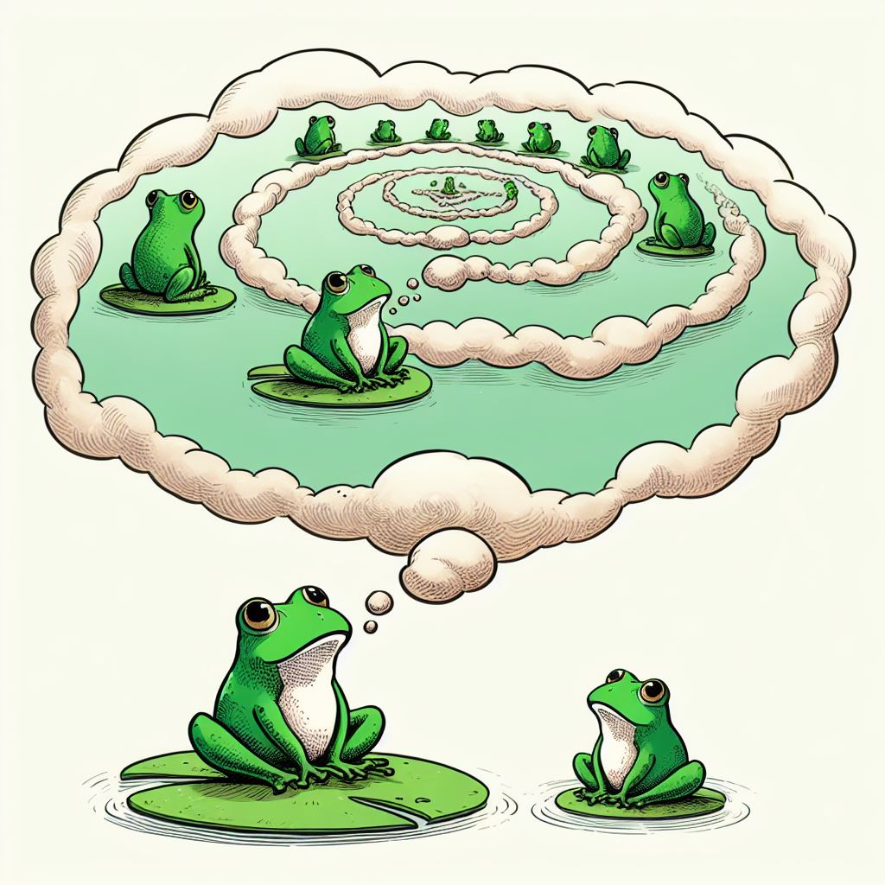
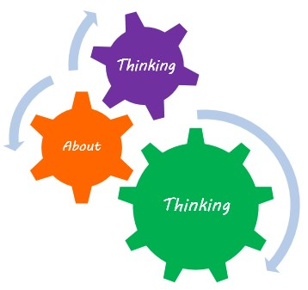
Now Link Critical Reflection to Metacognition, and Metacognition to Self-Regulated Learning
The monitoring and managing of one’s cognitive processes as well as the awareness of and control over one’s emotions, motivations, behaviors, and environment as related to learning.
Conscious control over one’s cognitive processes

Slide 17
Tools to do the Job
Good for you AND your students!

Slide 18
The Cognitive Wrapper Template

Slide 19
DEAL with it! (Derived from Service Learning)
D | E | AL
DESCRIBE the learning experience. Think: What? Where? Who? When? Why | EXAMINE the experience through the lens of academic concepts, theories, or strategies EG: Culturally Responsive Pedagogy, UDL, Course Learning Goals | ARTICULATE LEARNING by discussing and explaining what you learned, when you learned it, how you learned it and why it is important –to you and the field!-- and what you can/will do differently because of it.

Slide 20
The Daily Routine
For every topic/session, students can do the following:
Preassessment: Require students to examine their own/current thinking. What do I already know this topic that could guide my learning? What are my operative assumptions?
1
Muddiest Point: Require students to identify confusion. What was the one thing, or sequence of things, that confused or confounded you?
2
Retrospective Post-assessment: Require students to recognize conceptual change. Exchange error for truth or see something from another angle. Previously, I thought ___ ; now I know that it actually is___.
3
Reflective Journals: Requires students to monitor and chronical their own thinking, questions, answers, and changes.
4
Give students an opportunity to know when and why and how their thinking changed.
5

