Slide 1
New(er) Faculty Orientation

Slide 3
COGS Primary Functions
Primary point of contact for Graduate students/Post-docs
Manages and supports Graduate Applications and department review (Slate)
Processes all committee memberships and study plans
Advise on thesis and dissertations to meet format requirements.
Processes all non-thesis requirement forms
Publicizes all thesis and dissertation defenses - requirements
Processes all graduation applications
Create visibility for U of I and our programs
Specific focus on community and belonging
Bring students to campus for visit and connect to departments and faculty
Recruit nationally and internationally

Slide 4
COGS Primary Functions
Support teaching assistants, research assistants and support assistants
Provide financial support for teaching assistants across campus
Stipend – discipline based
In-state tuition
Out-of-state tuition
Approve all Graduate Assistant appointments
Provide training and orientations
Monitor positions and ensure compliance/expectations
*Not an hourly but exempt position
*Both a student and an employee

Slide 5
COGS Primary Functions
Host event to support Graduate Students and Post-docs
Support the post-doctoral association and organization
Support for Graduate and Professional Student Association (GPSA)
Events and awards
3-Minute Thesis competition (on-campus and statewide)
Winners go to regional and national competition
Outstanding Graduate Student award
Outstanding Graduate Mentor award
Outstanding Post-doc and post-doc mentor awards
Outstanding TA award
Nominate UI theses and dissertation for regional and national awards

Slide 6
Graduate Council
Sets graduate policy and standards for the university
Provides guidance to COGS on practices and policies
Provides guidance and approval on new initiatives
Assists with assessment of programs
Approves programmatic changes
Supports interdisciplinary initiatives
One representative from each college with three at-large members and one representing UWP’s

Slide 7
Heads up! Areas where we have regular issues - Faculty can really help here:
Deadlines – be aware of dates
IP grades
Incompletes
Research credits- limits
Finishing Status – Continuous Registration
Annual evaluation
Petition Process
COGS presents both academic and COGS petitions on behalf of the student or major professor

Slide 8
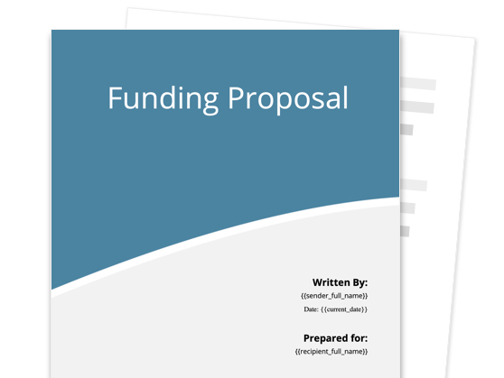
More about COGS . . . .
Grants
Alliance for Graduate Education and the Professoriate (AGEP)
Indigenous Mentoring Program
Indigenous Knowledge Field Camp
LSAMP – Bridge to Doctorate (All-nations with SKC)
Tribal College University Partnership (TCUP)
Alliances/Partnerships
Center for the Improvement of Mentored Experiences in Research (CIMER)
Highly Integrative Basic and Responsive Research Alliance (HIBAR)
Center for the Integration of Research, Teaching & Learning (CIRTL)
Mental Health Opportunities for Professional Empowerment in STEM (M-HOPES)

Slide 9
Graduate/postdoc support programming Fall 2023 Michael Decker Director Graduate student Support Programs

Slide 10
Graduate Student Writing Symposium
The Graduate Student Writing Symposium is a series of workshops aimed at preparing graduate students for the writing process, presented by the Writing Center, the Counseling and Testing Center, and various professors across campus.
Workshops will cover the following topics:
Managing Stress During the Writing Process
Collaborating with your Committee and Co-authors
Long Term Planning – Avoiding Procrastination
Overcoming Writers Block
The Basics of Graduate Writing

Slide 11
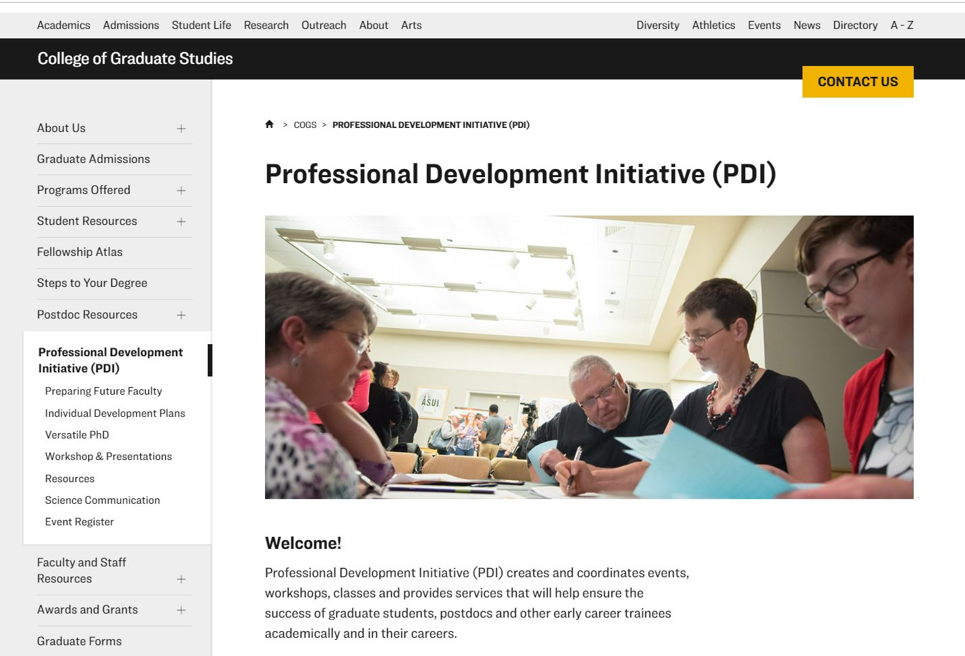
Professional development initiative
Professional Development Initiative (PDI) creates and coordinates events, workshops, and classes; and provides services that will help ensure the success of graduate students, postdocs and other early career trainees academically and in their careers.
CV Workshop
Demystifying Careers in Academia
Networking Strategies
Salary Negotiations Workshop

Slide 12
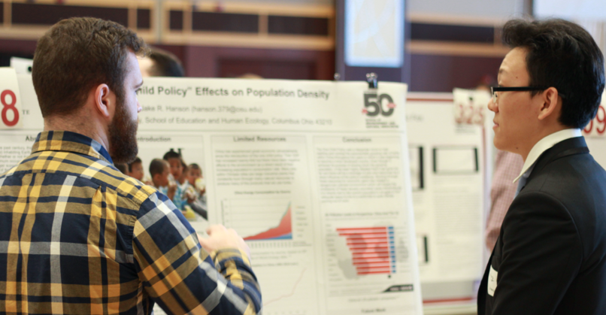
Conference Preparation Series
This workshop series aims to prepare graduate students and postdocs for the academic, professional, and social components of participating in conferences.
Workshop topics include:
Designing a Research Poster
Designing a Research Presentation
Delivering a Compelling Presentation
Networking

Slide 13
Preparing future faculty (PFF)
Prepares future faculty members from all disciplines for working with diverse learners.
This course consists of a series of modules, including topics like:
Creating Significant Learning Experiences
Inclusion by Design
Learning Outcomes, Assessments, and Transparency
Difficult Dialogues
High Impact Practices and Metacognition
Teaching as Research

Slide 14
Mental Health Webinar Series
Led by Faculty from the Counseling and Testing Center (CTC), these monthly webinars center around topics of particular interest to graduate and professional students.
Workshops will cover the following topics:
Avoiding Burnout
Forming Good Habits and Setting Routines
Setting Expectations with your Advisor
Being Kind and Compassionate with Yourself
Imposter Syndrome
Academic Performance Anxiety

Slide 15
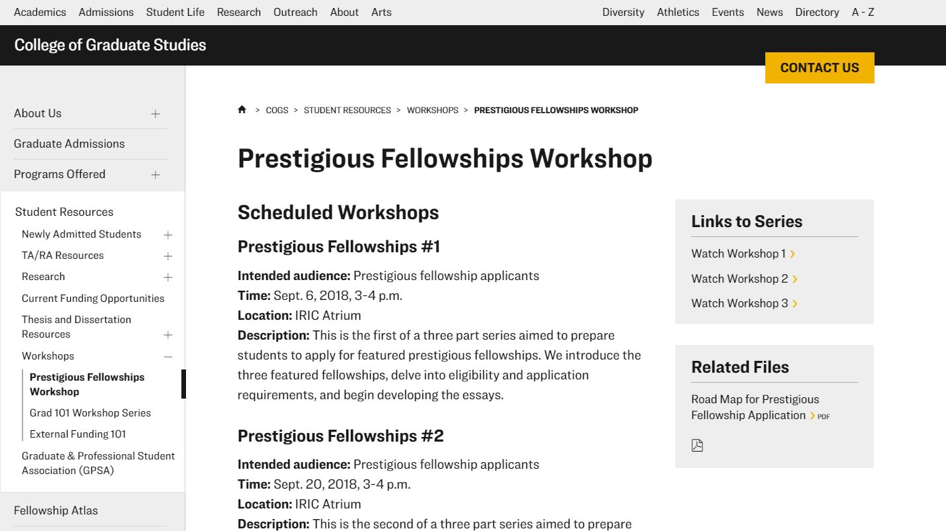
Fellowship Support Program
Workshops offering a step-by-step approach for preparing and submitting grant and fellowship applications, including topics like:
Internal faculty review
Designing your research statement
Writing your personal statement
Road Map for planning
Ongoing COGS support

Slide 16
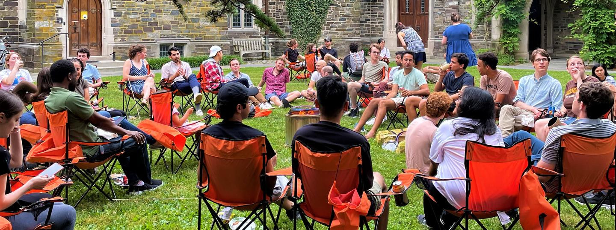
Community Building Activities
XC – Skiing and snowshoeing
Alpine Skiing
Family picnic/BBQ
Bike Repair Workshop
Ski Repair Workshop
Knitting Workshop
Burnout-bonfire

Slide 17
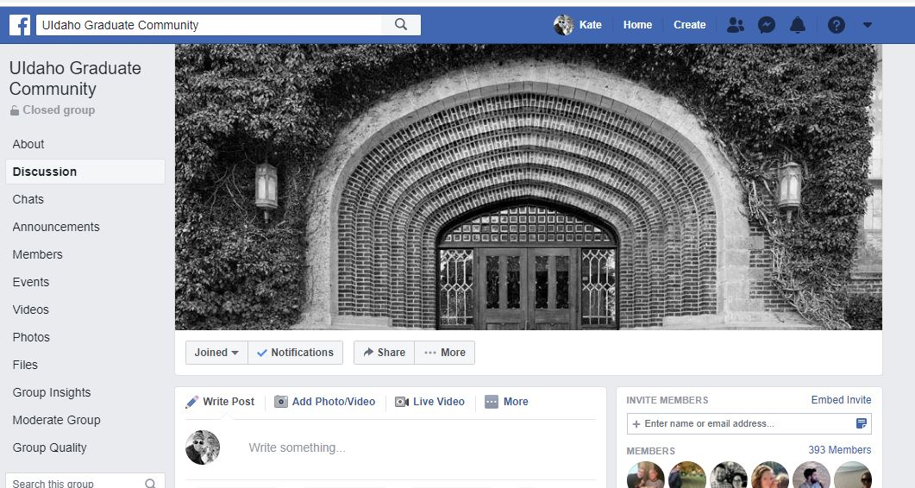
Join us on facebook
Stay connected with:
Questions/networking w/ grad students & postdocs
Reminders/info about upcoming grad support programming
Opportunities for internships, fellowships, grants, jobs
Reminders & notices about other U of I events
UIdaho Graduate Community

Slide 18
Thank you

