Slide 1
Jumpstarting your research agenda - RESOURCES
CARLY CUMMINGS, PHD, CPRA
SENIOR DIRECTOR
OFFICE OF RESEARCH AND FACULTY DEVELOPMENT (RFD)

Slide 2
Office of research and faculty development
Mission: To provide the resources and services to University of Idaho faculty that enhance their success and productivity in their field of scholarly efforts, with the ultimate goal of growing the U of I’s research enterprise
Across all disciplines

Slide 3
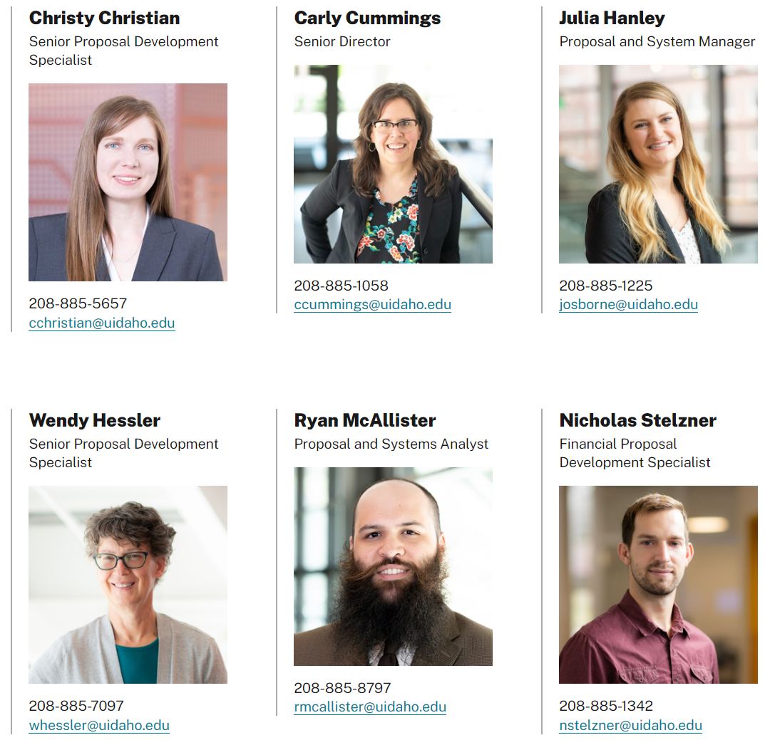
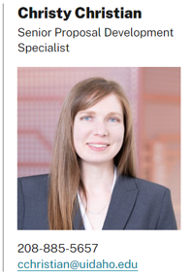
Who is the Office of research and faculty development (RFD)?
Eric Torok

Slide 4
What does rfd do?
Proposal Development
Faculty Development
Leadership Development
Successful, funded research leaders

Slide 5
Proposal development services
Level 0
Brainstorming
Strategic planning for submissions
Level 1
Search for funding opportunities
Training to use Pivot
Level 2
Preparing to contact Program Officers
Assessing “fit” of a proposed idea
Level 3
Strategize for a resubmission
Analyze reviews, develop responses
Level 4/5
Ensuring proposal documents are clear, concise, cohesive, and responsive to the solicitation
Level 6
Support for large, complex proposals
Center grants, infrastructure, etc.
All services are optional and are granted on a first come, first served basis

Slide 6
Faculty development offerings
Proposal competitiveness tips from Program Officers and U of I experts
>50 Recordings and presentations available here

Slide 7
Faculty development offerings
Fall 2023 Planning and Writing Successful Grant Proposals 4-part seminar series
Apply here by 9/1
5 seats reserved for new faculty members
NSF Program Officer visit 8/31 (Correction)
Seminar: 9:00 – 10:00 a.m. PT, IRIC 305
NEW: U of I CAREER Club
Cohort writing and support program
Application window: Nov. 13 – Dec. 20
Intro to NSF CAREER seminar on Nov. 29, 12:30 – 1:30 p.m. PT
Stay tuned

Slide 8
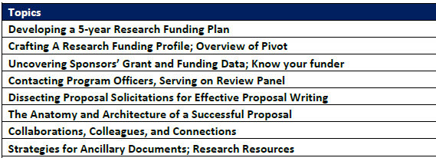
Leadership development offerings
Enhancing proposal readiness of early-career faculty members
9-week cohort program in Spring semesters
Fridays 10:30 a.m. – 12:00 p.m. PT
Dean nomination in October to participate

Slide 9
Manage limited submissions
Limited submission (LS) funding opportunities: the funding agency restricts the number of applications an institution is allowed to submit.
The RFD LS team has established processes for selecting the proposal(s) that will be submitted by the U of I in response to these opportunities.

Slide 10
Office of research and Economic development (ORED)
ORED
OSP
OTT
ORA
ORFD
ORA: Office of Research Assurances
OSP: Office of Sponsored Programs
OTT: Office of Technology Transfer

Slide 11
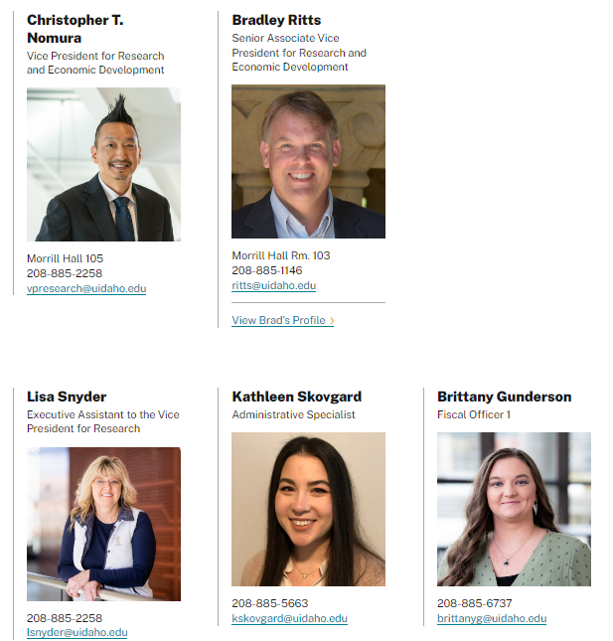
Office of research and Economic development
Internal funding opportunities
P3-R1 Grant Matching Program
Contact Brad Ritts
Operation Resubmission Success
Contact Carly Cummings
Meet Your Program Officer
Contact Carly Cummings

Slide 12
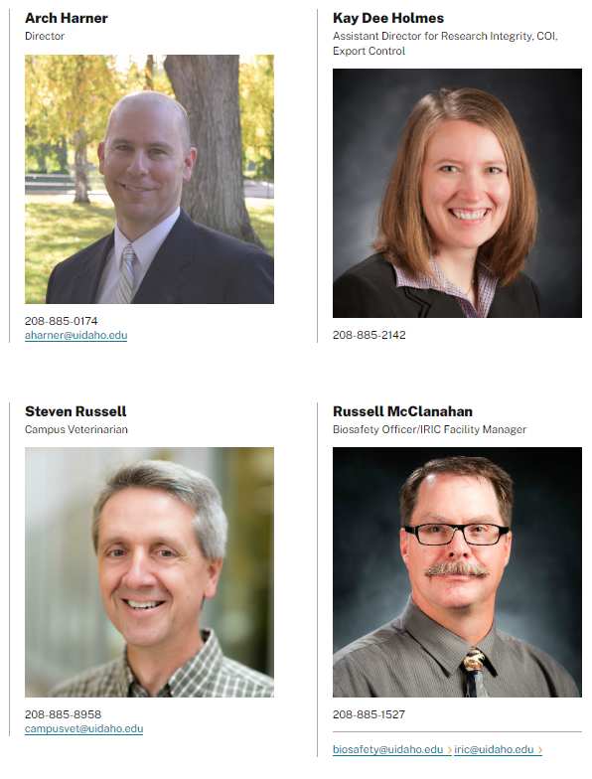
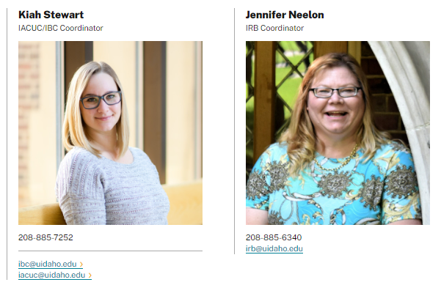
Office of research Assurances
Institutional Animal Care and Use Committee (IACUC)
Biosafety (IBC)
Human Protections Research (IRB)
Responsible Conduct of Research
Financial Conflict of Interest
Unmanned Aircraft Systems
Export Control
WEBSITE

Slide 13
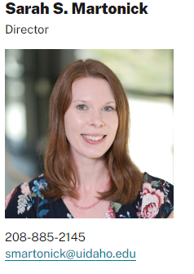
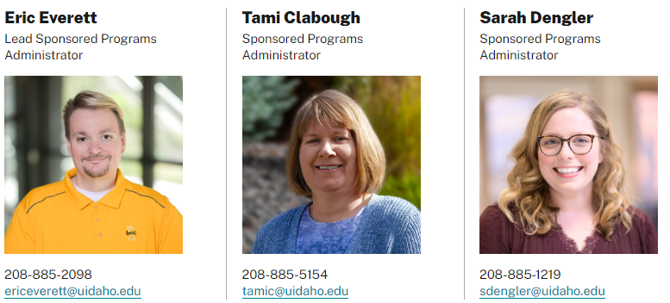
Office of sponsored programs
Compliance review and submission of proposal documents (pre-award →)
Sponsored Programs Administrator (SPA)
VERAS portal
Set up awards from external sponsors (post-award)
WEBSITE

Slide 14
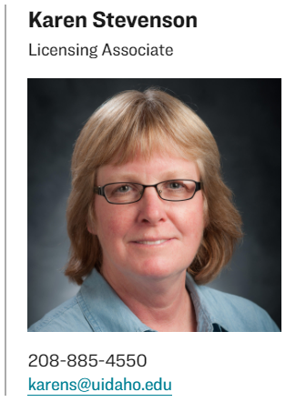
Office of Technology transfer
U of I faculty requirements and forms to patent and license in innovation, discovery, or invention
Resources to learn about patent, intellectual property and external resources
Forming a corporate partnership
WEBSITE

Slide 15
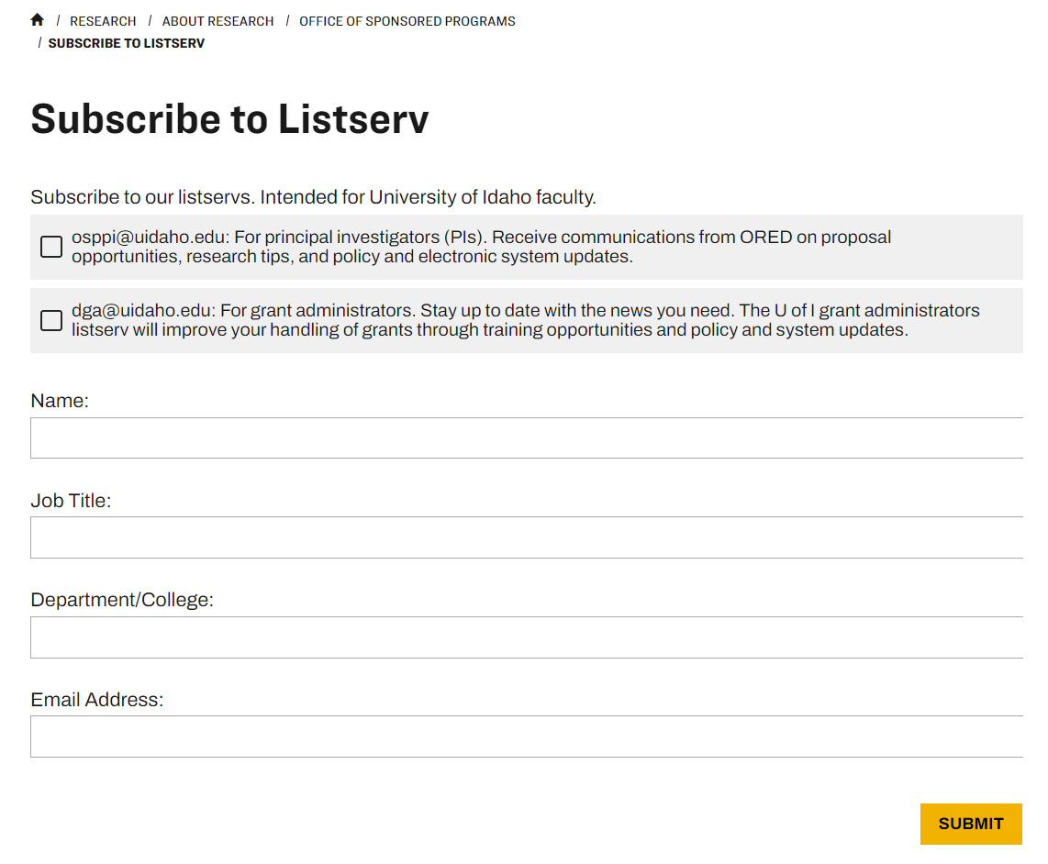
How to stay current
Sign up for OSPPI listserv here

Slide 16
Next/First steps
Sign up for the OSPPI listserv
Review our website and tri-fold brochure
Proposal development resources
Review and request our services
Consultations are welcome!

Slide 17
Take home messages
The University of Idaho provides multiple levels of support for your success and jumpstarting your research agenda
Contact ORED offices with any questions related to research and scholarly efforts
We look forward to working with you!

