Slide 1
Who are our vandals?
Fall ‘23 – New Faculty Orientation

Slide 2
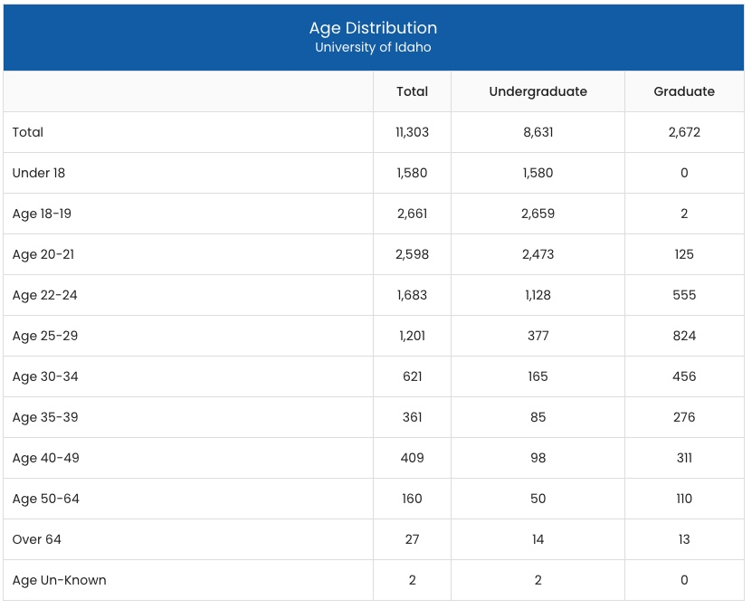

Slide 4
Talking ‘Bout my Generation
Greatest Generation: Born 1901-1924
Silent Generation: Born 1925-1945
Baby Boomers: Born 1946-1964
Generation X: Born 1965-1980
Millennials: Born 1981-1996
Generation Z: Born 1997-2012
Generation Alpha: Born 2013-2025

Slide 5
Fall 2022 Total
11,507

Slide 6
*1951 first-time freshmen

Slide 7
U of I students come from 49 states,
68 countries, the District of Columbia,
American Samoa, Guam, and Puerto Rico.

Slide 8
Race/Ethnicity

Slide 10
New First-Year Profile
High School GPA Average | 3.48
First Generation | 52% (43% overall)
Women Men | 49% 51%
International | 9%
Minority | 16%
Idaho Resident | 59%
Graduated in top 25% of High School Class | 40%

Slide 11
Social media and students

Slide 14
Let’s meet some vandals
*Chronicle of Higher Education, SU 2023

Slide 15
Go Vandals!
Questions?

