Slide 1
University Honors Program
Sandra Reineke, Ph.D.
Director and
Associate Professor of
Political Science

Slide 2
Find out what our Students do
Instagram
@uidahohonors

Slide 3
Honors is HIP!
Join our community of scholars Inside and outside your classroom through a variety of HIPS

Slide 4
Honors is HIP inside the classroom
Teach honors classes
Grant an Honors course contract
Mentor a student completing an Honors Thesis

Slide 5
Honors is hip outside the classroom
Write a letter of support for an Honors Student research grant
Attend a Monthly Honors Colloquium
Take students to WRHC

Slide 6
Why stop there?
Take Honors students abroad
Become an Honors Faculty Fellow
Serve on the Honors Program committee

Slide 7
To get started…
…join other UI faculty at our regularly offered faculty development workshops
…Celebrate 40 years of Honors education with us on October 13th, 4-6pm IRIC

Slide 8
Meet Elizabeth and Sam
NMS scholars
Goldwater scholarship winners
Honors thesis
Honors research grant
WRHC and study abroad

Slide 9
Vandals Scholar Gallery
Ground floor of the ISUB

Slide 10
Questions?
Email honors@uidaho.edu

Slide 11
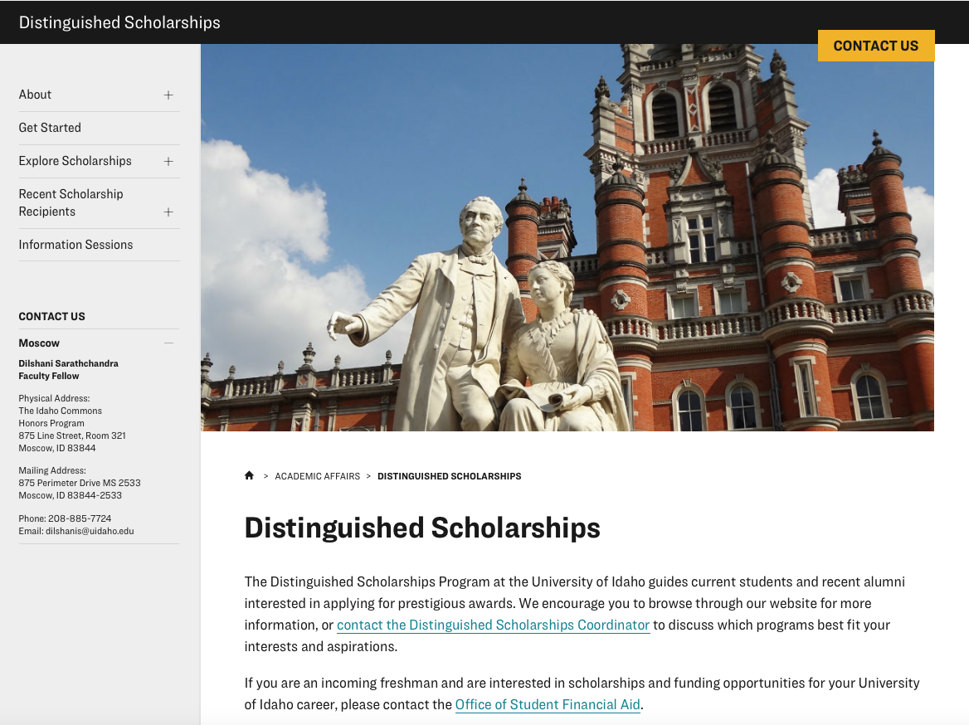
Distinguished Scholarships Program

Slide 12
UI’s Distinguished Scholarships Program:
Provides guidance to prepare application packets
Organizes campus selection committees
Provides instruction on interview strategies
Provides mentorship
Publicizes recipients

Slide 13
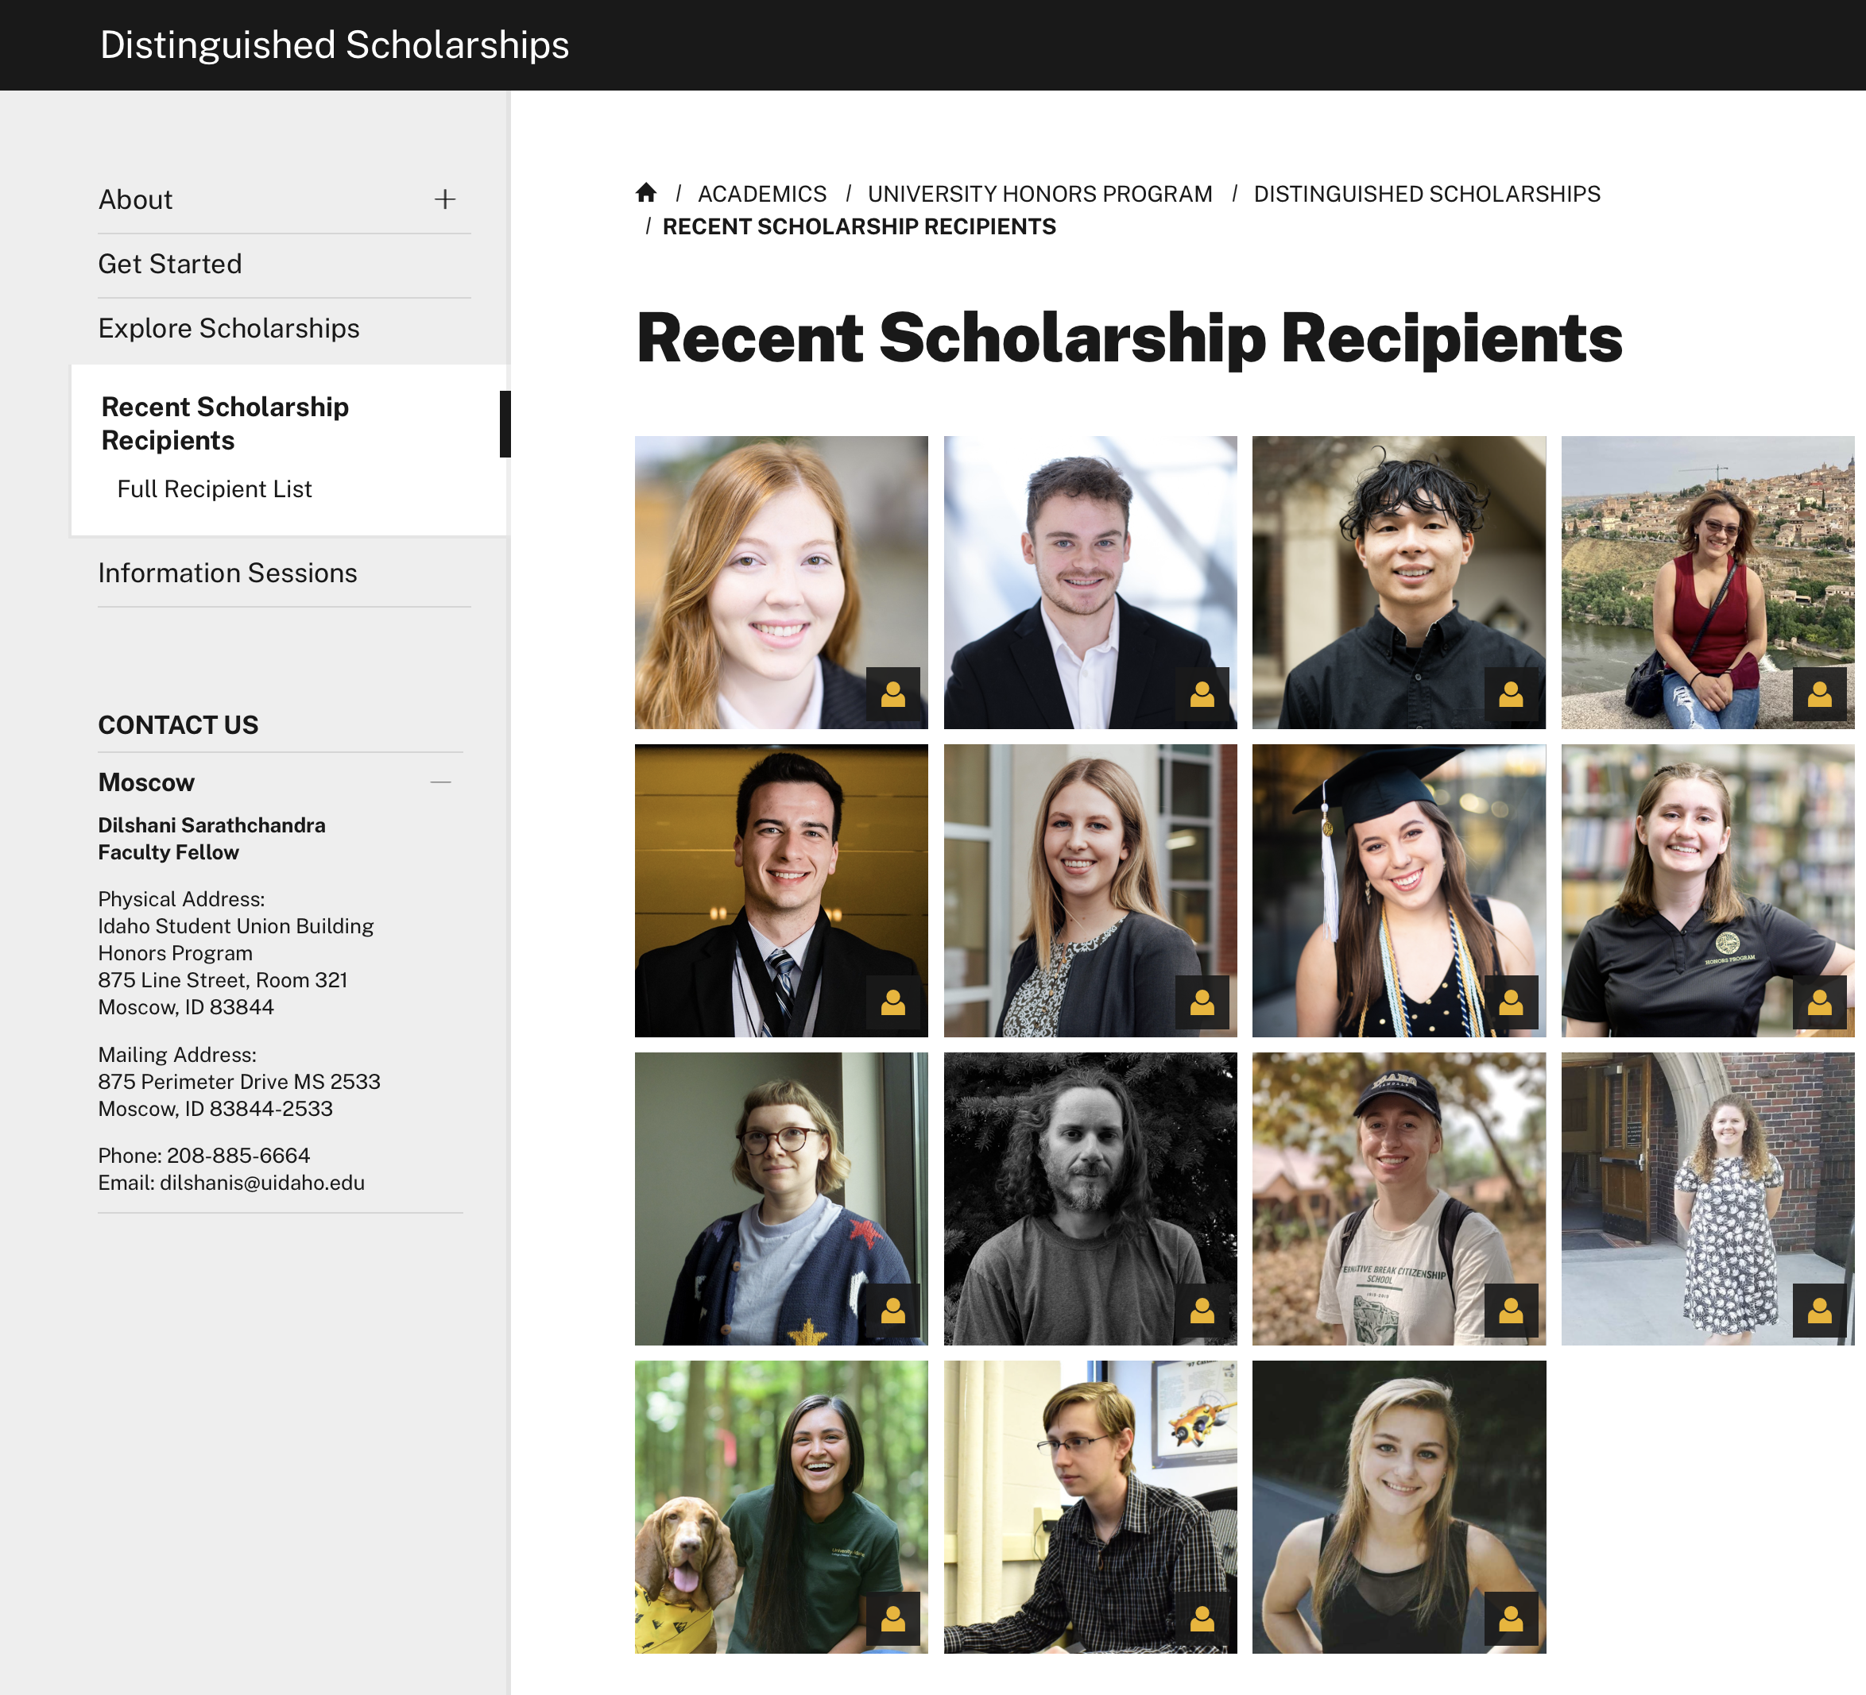
Scholarship Recipients 2019-2023

Slide 14
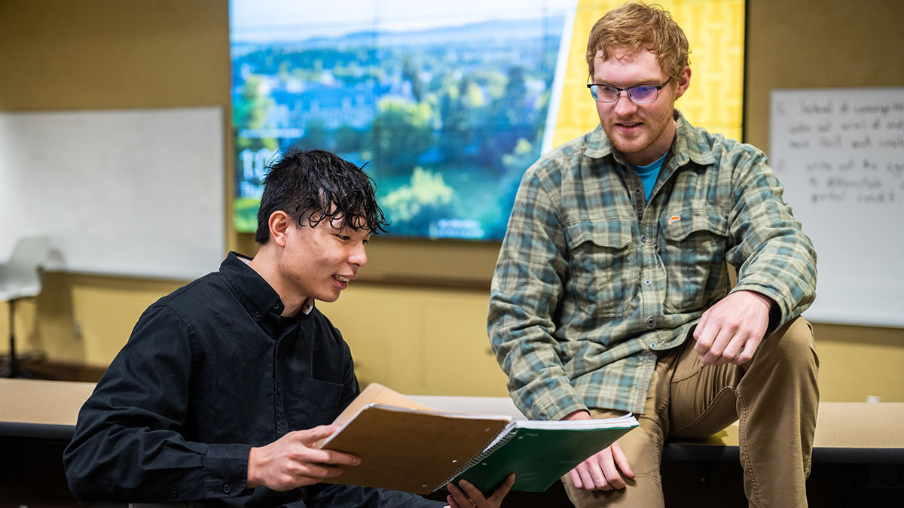
Victor Zhong
2022 Goldwater Scholarship
Peik Lund-Anderson
2021 Goldwater Scholarship

Slide 15
Dilshani Sarathchandra
Faculty Fellow Distinguished Scholarships Program
dilshanis@uidaho.edu

