Slide 1
UI Systems Supporting faculty work
Day 3
New Faculty Orientation
August 16, 2023

Slide 2
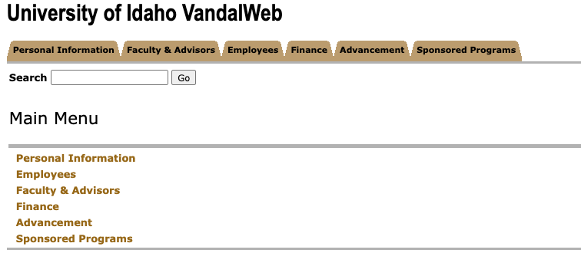
Vandalweb—Portal to all things
Vandalweb.uidaho.edu
Personal information
Access to payroll and benefits
Grades and advising
Other access as assigned

Slide 3
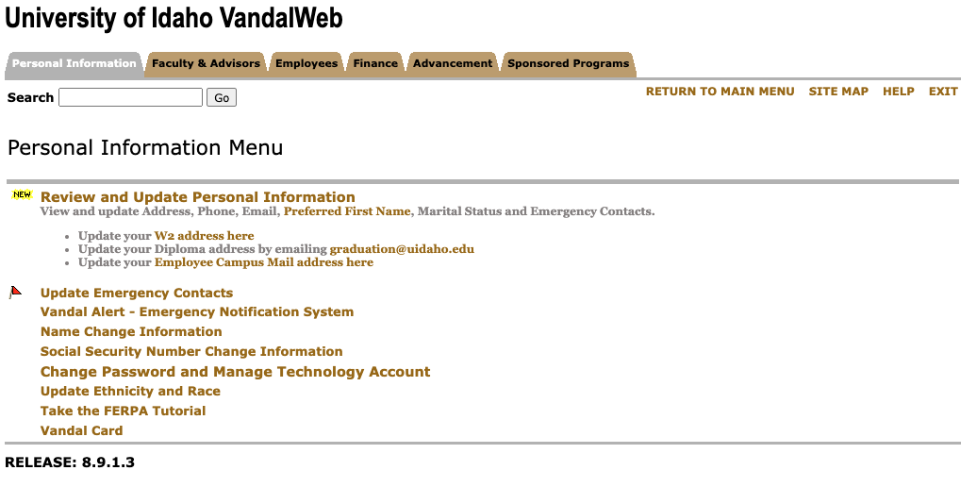
Personal information
Personal information—emergency contact information
Vandal alerts (Moose! Snow! Campus closures! And More)
FERPA Tutorial--The Family Educational Rights and Privacy Act of 1974, as amended, also known as the Buckley Amendment, is a federal law that governs the confidentiality of student records
https://www.uidaho.edu/registrar/faculty/ferpa

Slide 4
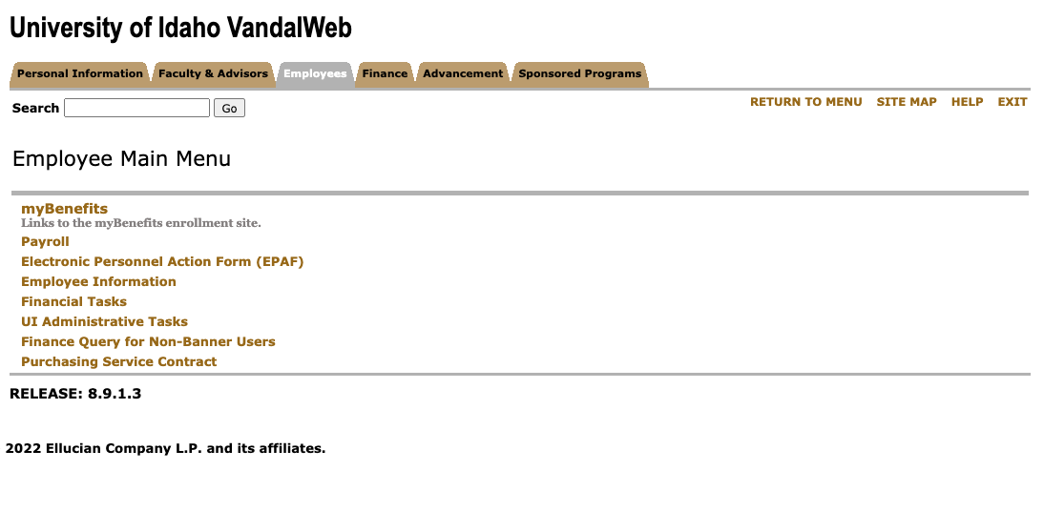
Employee menu items
Enter sick leave under Payroll>Web Time Entry/Supervisor Approvals
If you’re on a fiscal year appointment, enter annual leave under Payroll >Web Time Entry/Supervisor Approvals
Tax withholdings and more
Benefits and medical coverage (renew every year)

Slide 5
Benefits Orientation
Monday, August 28, 1:30-2:30 PM PDT
Zoom!
https://www.uidaho.edu/human-resources/benefits/new-employee-benefit-resources/orientation-events

Slide 6
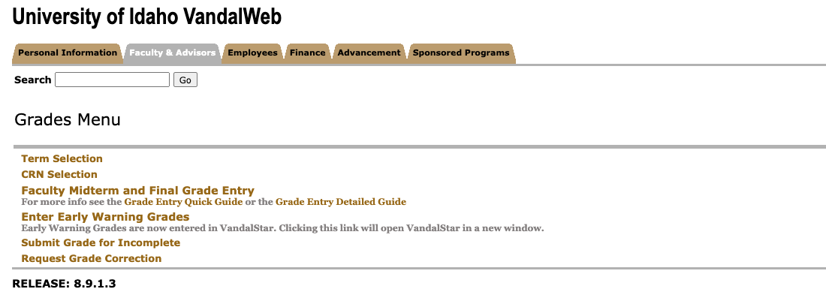
Grades and Advising
Early warning grades, Tuesday, Sept 19 at noon PDT (Links to VandalStar)
Midterm grades—Monday, Oct 16 at noon PDT
Final grades—Tuesday, December 19 by noon PST
https://www.uidaho.edu/registrar/faculty/grades

Slide 7
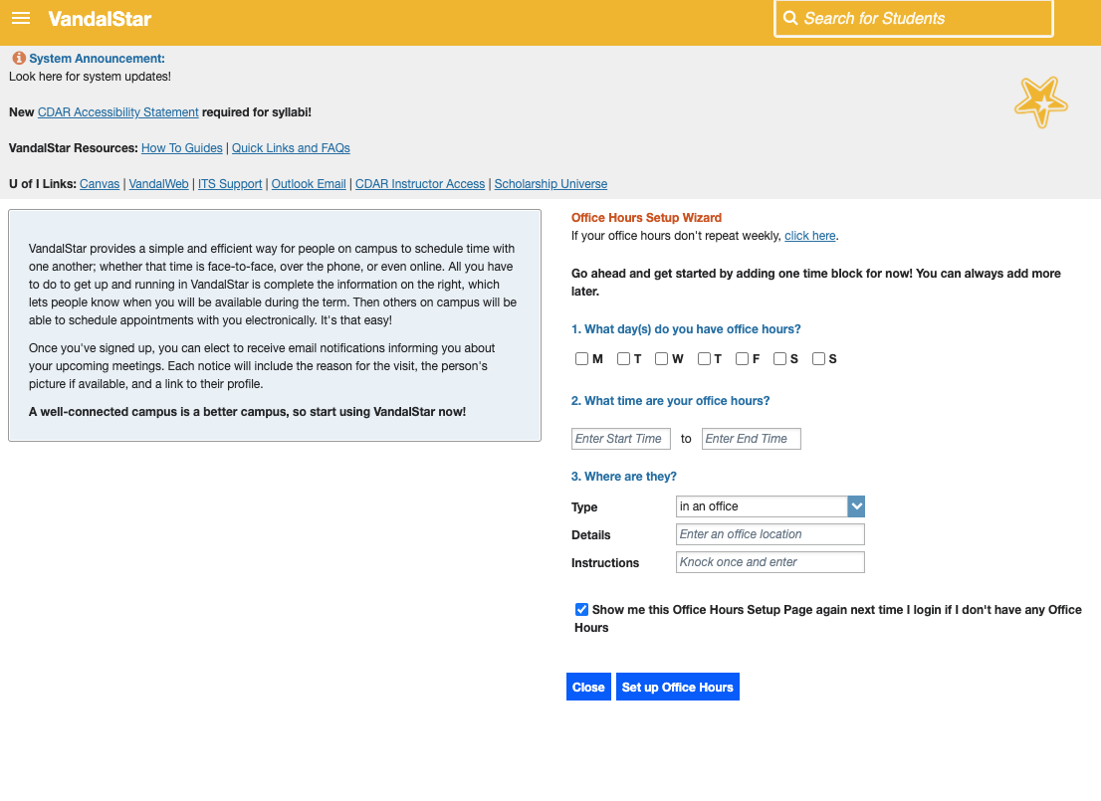
VandalStar
vandalstar.uidaho.edu
VandalStar is an initiative focused on student success and increasing graduation completion rates
Students can communicate with faculty through the platform.
Early warning grades entered here.
Allows communication between offices—sends kudos to students or notifies offices of concerns.
Helps academic support offices reach out to students who are struggling
https://www.uidaho.edu/sem/vandalstar/resources/faculty-staff

Slide 8
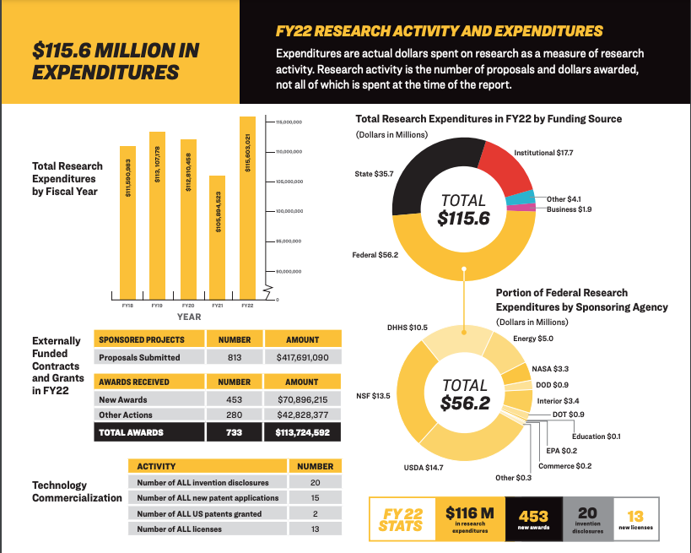
Other ui systems
Vandals electronic Research Administration System (VERAS)
Extramural funding
IRB Protocols
https://www.uidaho.edu/research/faculty/submit-proposal/internal-proposal-routing

Slide 9
New(er) faculty Seminar 2023-24
https://www.webpages.uidaho.edu/cetl/new-faculty.asp#seminar

Slide 10
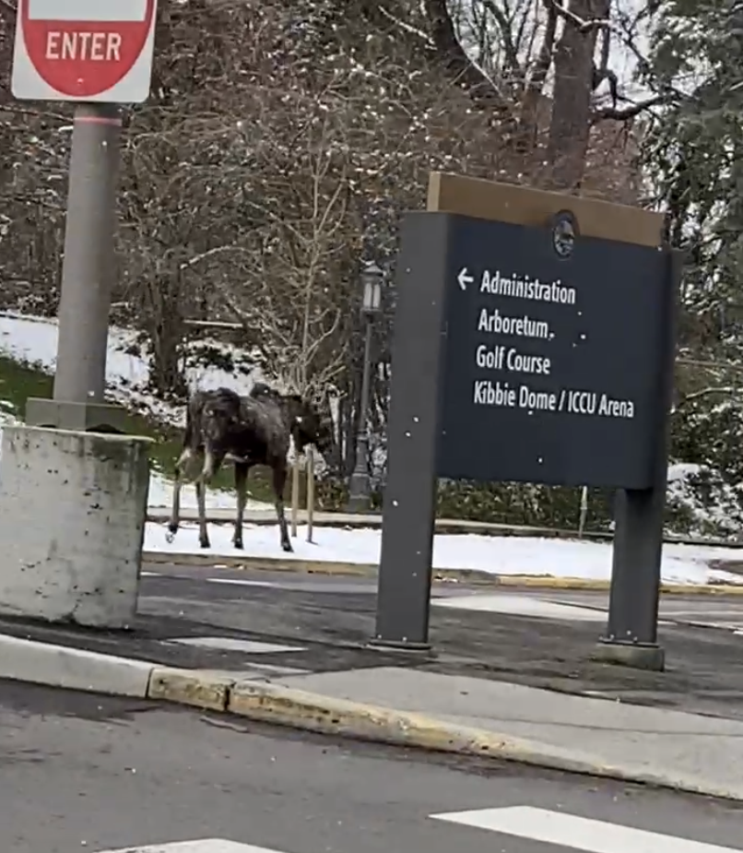
To do!
FERPA tutorial
Emergency contact info
Sign up for Vandal Alerts
Explore VandalStar and set up your preferences
Take a tour around payroll and review your benefits!

