Slide 1
Learning-Through-Diversity
New Faculty Seminar
October 25, 2023
Facilitators:
Brian Smentkowski, Director of CETL
Erin Chapman, Faculty Associate for Diversity & Inclusion in Teaching & Learning

Slide 2
A Framework & Practices
Mindset, Methods, and Relevance to CIRTL Foundations

Slide 3
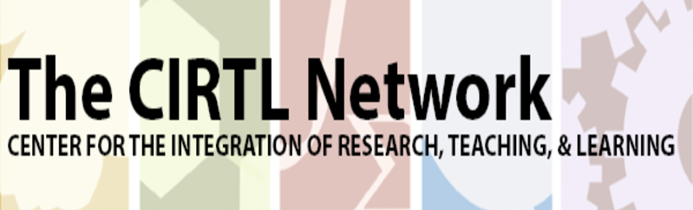
CIRTL is…
The Center for the Integration of Research, Teaching, and Learning.
CIRTL seeks to enhance excellence in STEM undergraduate education through development of a national faculty committed to implementing and advancing evidence-based teaching practices for diverse learners.
CIRTL was founded in 2003 as a National Science Foundation Center for Learning and Teaching in higher education.
CIRTL uses graduate education as the leverage point to develop a national STEM faculty committed to implementing and advancing effective teaching practices for diverse student audiences as part of successful professional careers.
The goal of CIRTL is to improve the STEM learning of all students at every college and university, and thereby to increase the diversity in STEM fields and the STEM literacy of the nation.

Slide 4
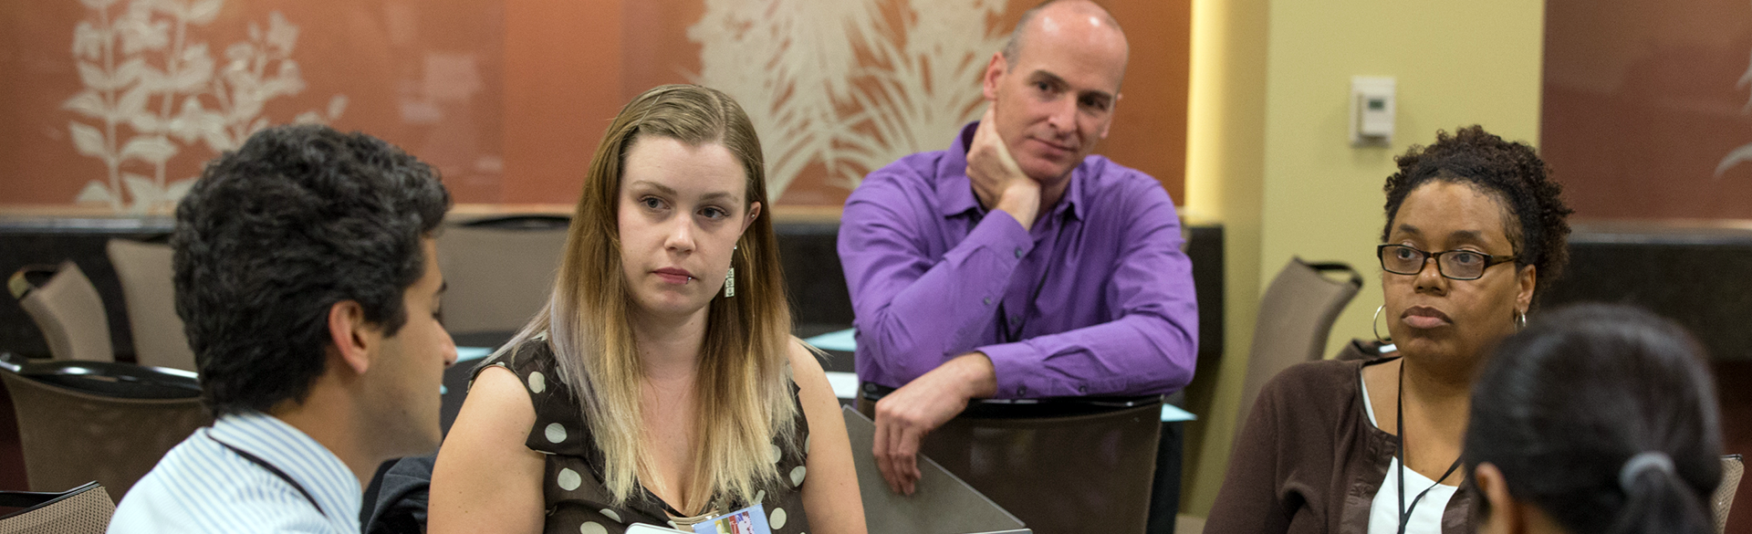
Core Ideas
*Learning-through-Diversity*
Learning-through-diversity capitalizes on the rich array of experiences, backgrounds, and skills among STEM undergraduates and graduates-through-faculty to enhance the learning of all. It recognizes that excellence and diversity are necessarily intertwined
*Teaching-as-Research*
Teaching-as-research is the deliberate, systematic, and reflective use of research methods by science, technology, engineering, and mathematics (STEM) instructors to develop and implement teaching practices that advance the learning experiences and outcomes of both students and teachers
Learning Communities
Learning communities bring together groups of people for shared learning, discovery, and generation of knowledge. To achieve common learning goals, a learning community nurtures functional relationship among its members.

Slide 5
Our Broad Goal
To become mindful and inclusive faculty who improve learning through teaching. {Note the causality, here}
This requires us to:
Appreciate the diverse backgrounds of students and their implications for learning.
Identify curricular, teaching, and assessment practices that promote inclusive learning.
Draw upon the diversity of students to enhance and enrich engaged and inclusive learning.
Recognize existing inequities, and promote an equitable, inclusive and respectful climate for learning.

Slide 6
Our Targeted Goal
To adopt Learning-through-Diversity as a pedagogical prism for designing, developing, and delivering inclusive, equitable, and accessible learning experiences;
To apply strategies to develop, integrate, and assess inclusive, equitable, and accessible teaching practices;
To develop a solid foundation for engaging in meaningful DEIA-informed teaching.

Slide 7
Making the Connection
When we say that Learning-through-Diversity capitalizes on the experiences, backgrounds, identities, and skills of students to enhance learning for all, we are engaging in a representational form of scholarly teaching –bringing who we are and who our students are into the equation.
It is more than that, though: through a TAR prism, we can hypothesize and predict the impact of equitable, inclusive, and accessible teaching practices on learning.

Slide 8
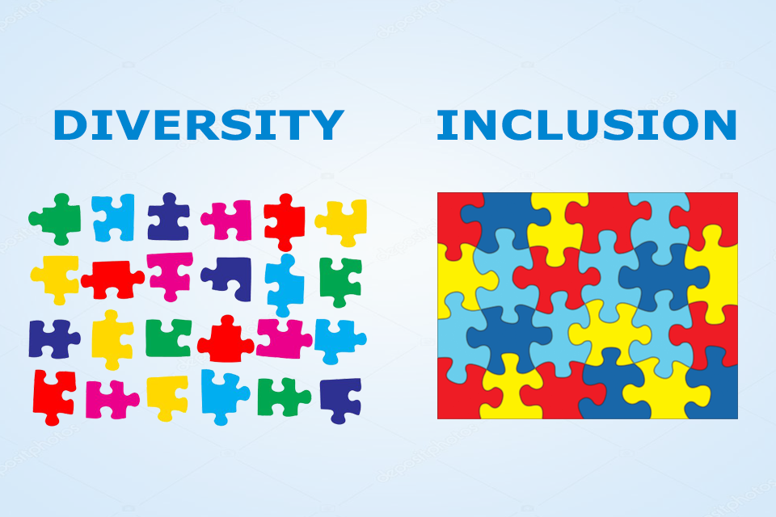
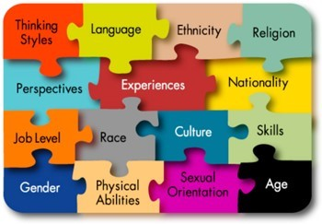
Premise: Inclusive Teaching Practices→ Inclusive Learning Experiences
Faculty and students bring an array of experiences, backgrounds, and skills to the teaching and learning process.
Effective teaching capitalizes on these rich resources to the benefit of all. This is "Learning-through-Diversity".
At the same time, existing social and educational practices do not always promote equal success for all learners.
Creating equitable learning experiences and environments requires intentional and deliberate efforts on the part of present and future faculty alike.
This series is designed to stimulate, frame, and support these efforts.
https://www.cirtl.net/about/core_ideas/learning_through_diversity.

Slide 9
So, how do we teach inclusively?

Slide 10
Let’s consider some key concepts and think about a mindset
What do these words mean to you, and how do they apply to your teaching?

Slide 11
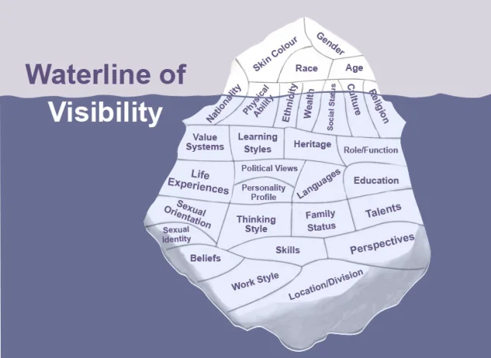
A Slightly Deeper Dive: Visible and Invisible Barriers

Slide 12
Inclusive Practices and Pedagogies: A Primer
Inclusive teaching strategies can be separated into three categories:
Incorporating diverse perspectives into course content by expanding reading lists beyond dominant/narrow narratives and their sources; offering various ethnic, racial, and other perspectives in case studies; ensuring PowerPoints and lecture examples offer a variety of human examples; and avoiding tokenizing particular individuals, students, or representations.
Creating an inclusive classroom climate where all students are encouraged to participate, by learning about students’ backgrounds and tailoring approaches accordingly, establishing ground rules for discussing controversial issues, and developing (and helping students develop) deeper awareness of difference.
Incorporating Universal Design for Learning principles in class, by providing/facilitating multiple means of engagement, representation, and expression.
--Yale Poorvu Center for Teaching and Learning
Implicit Bias and critical self-reflection tools:
https://poorvucenter.yale.edu/ImplicitBiasAwareness and https://implicit.harvard.edu/implicit/selectatest.html
https://projects.iq.harvard.edu/files/eijc/files/inclusive_teaching_strategies_reflecting_on_your_practice.pdf?m=1525282190
See pp. 24-26, below, to learn more about course, curriculum, instructional, and faculty development in DEIA and LTD.

Slide 14
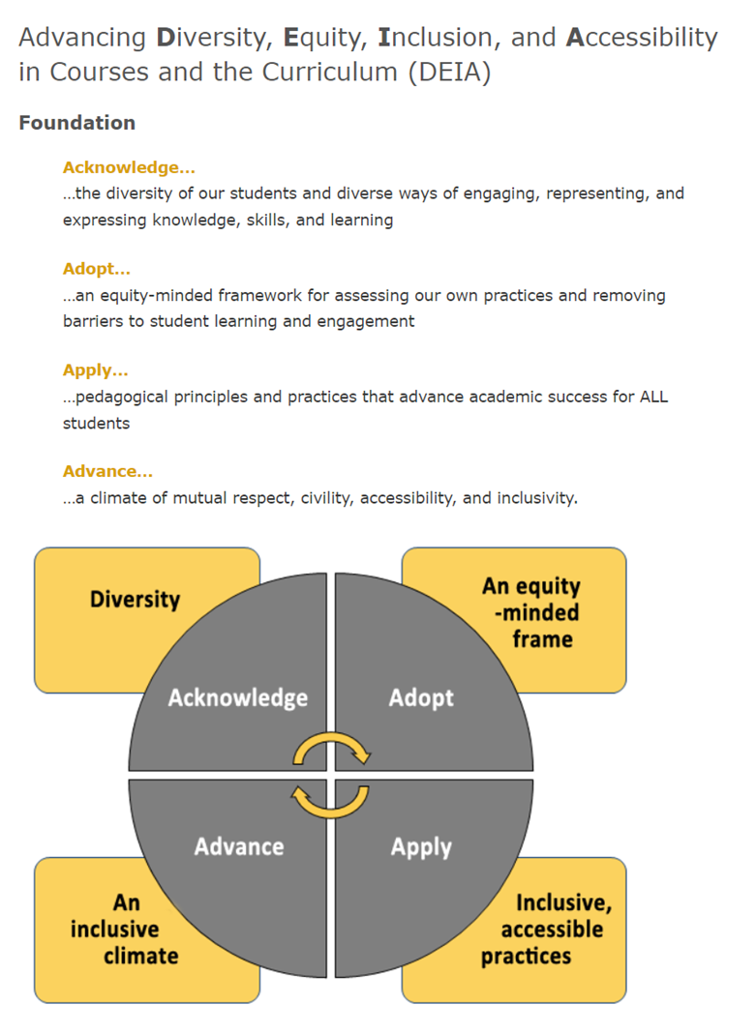
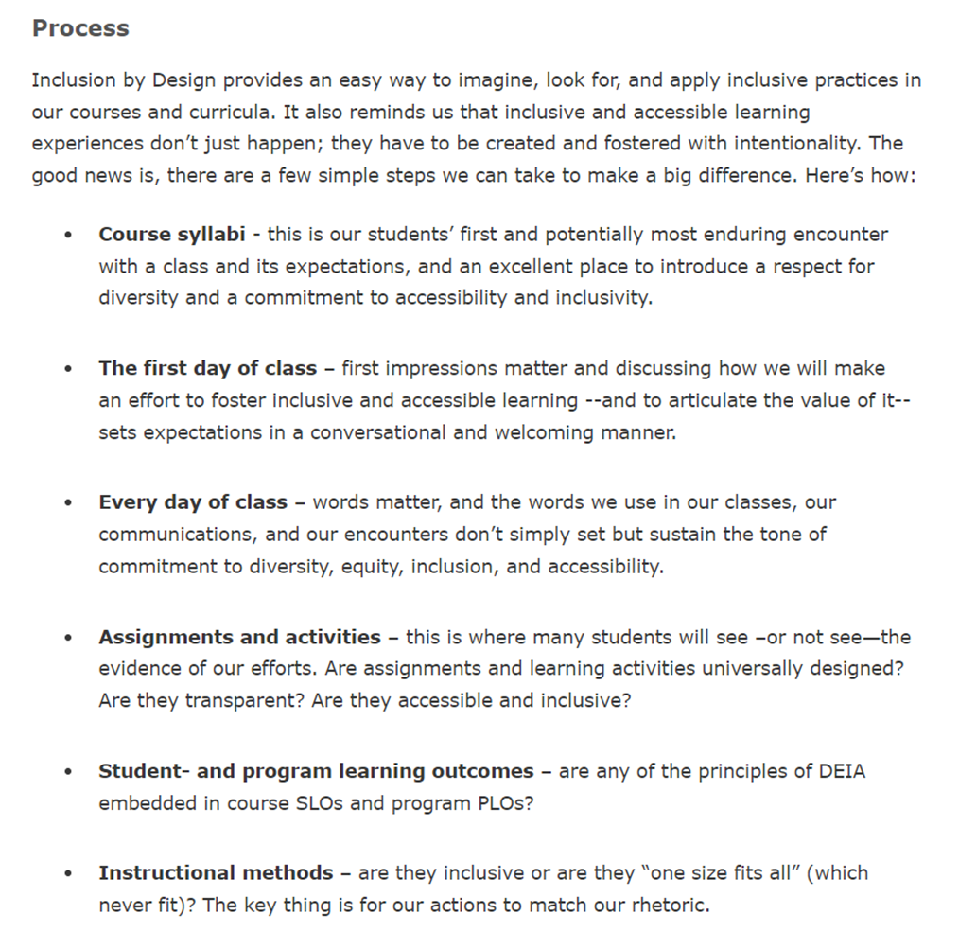

Slide 15
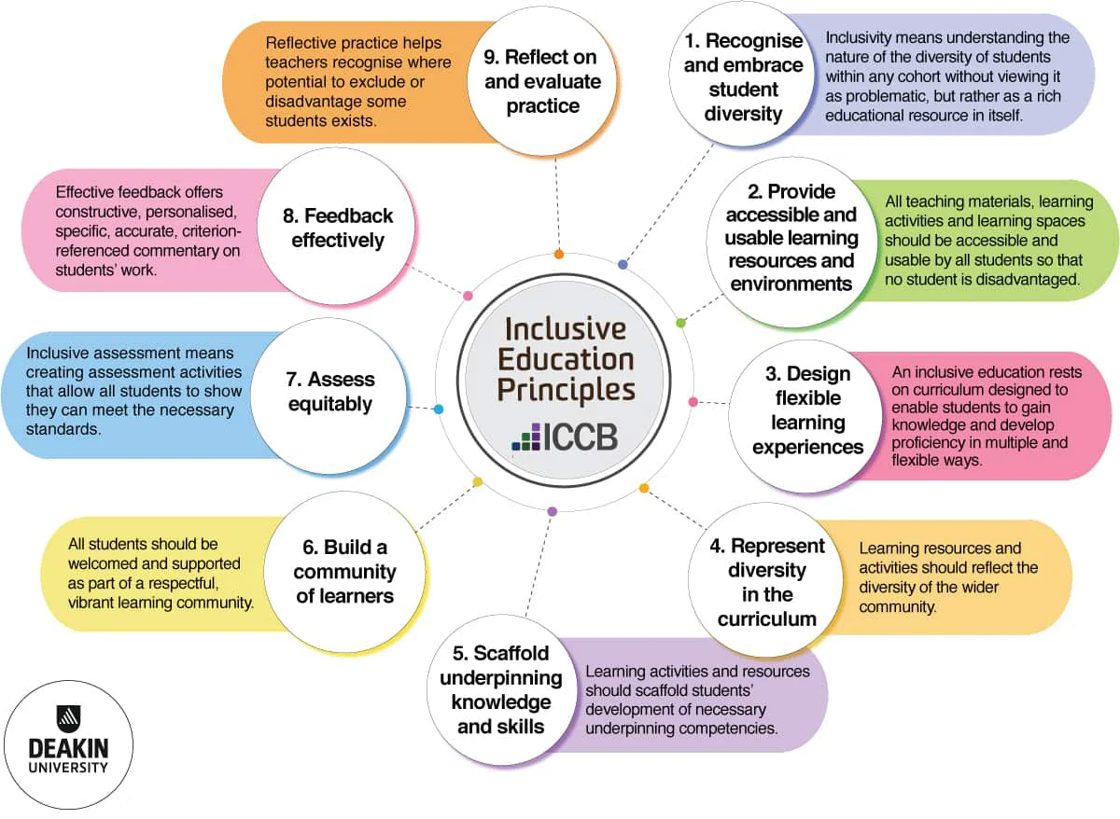

Slide 16
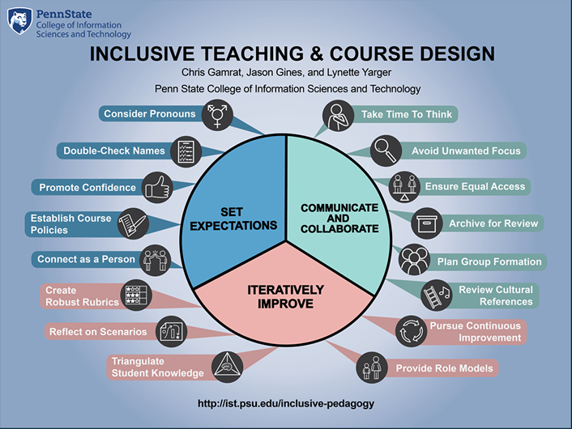

Slide 17
Guides and Resources for Inclusive Teaching

Slide 18
Select CETL Inclusive Teaching and Learning Resources
The Value of Diversity (pdf)
Inclusive Pedagogy Slides (pdf)
Keeping My Class Inclusive: Diversity, Inclusion, and Universal Design Online (pdf)
Universal Inclusive Design Checklist (pdf)
A Quick Guide to Using Inclusive Language (pdf)
Microaggressions in the Classroom (pdf)
Inclusion By Design Syllabus Survey
CETL Repository for DEIA's Inclusion by Design
POD Network’s Key Resources
Tips on Designing Inclusive Learning Experiences
Universal Design for Learning (UDL) Resources
Inclusive Learning Experiences don’t just happen; they are made…carefully and with intentionality

Slide 19
Guides for Growth and Development
Becoming an anti-racist educator, Wheaton College
Center for Urban Education (CUE) Racial Equity Tools, University of Southern California
Diversity Toolkit: A Guide to Discussing Identity, Power and Privilege, Master of Social Work Program, University of Southern California
Faculty Toolkit on Digital Inclusion, Office of Global Inclusion, New York University
Inclusive Pedagogy, University of Chicago
Inclusive Teaching Practices, Office of Teaching & Learning, University of Denver
Inclusive Teaching Resources and Strategies, CRLT, University of Michigan
Teaching Race: Pedagogy and Practice, Center for Teaching, Vanderbilt University
Incorporating Diversity, Center for Teaching Innovation, Cornell University

