Slide 1
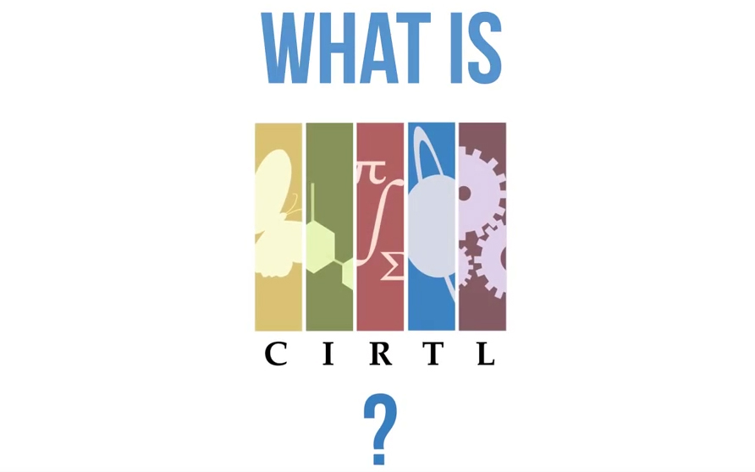

Slide 2
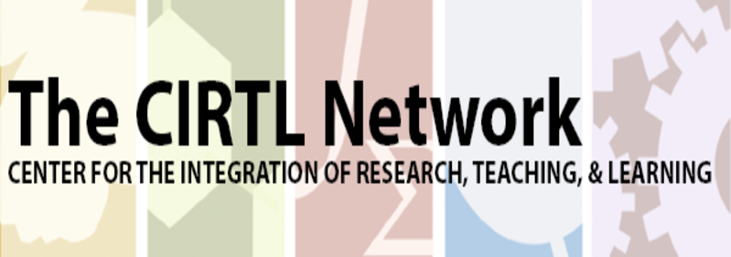
CIRTL IS…
The Center for the Integration of Research, Teaching, and Learning.
CIRTL was founded in 2003 as a National Science Foundation Center for Learning and Teaching in higher education.
CIRTL uses graduate education as the leverage point to develop a national STEM faculty committed to implementing and advancing effective teaching practices for diverse student audiences as part of successful professional careers.
The goal of CIRTL is to improve the learning of all students at every college and university, and thereby to increase the diversity in STEM fields and the STEM literacy of the nation.
Importantly, CIRTL is now more than STEM: it includes and applies to all academic disciplines.

Slide 3
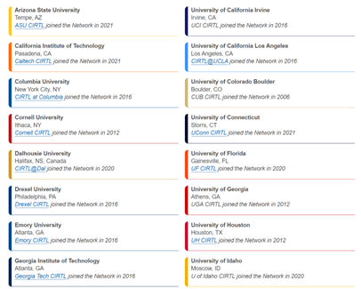
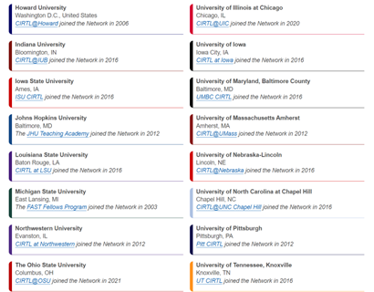
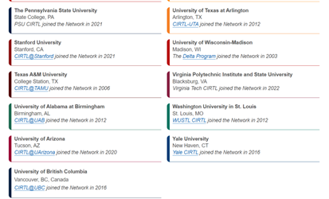
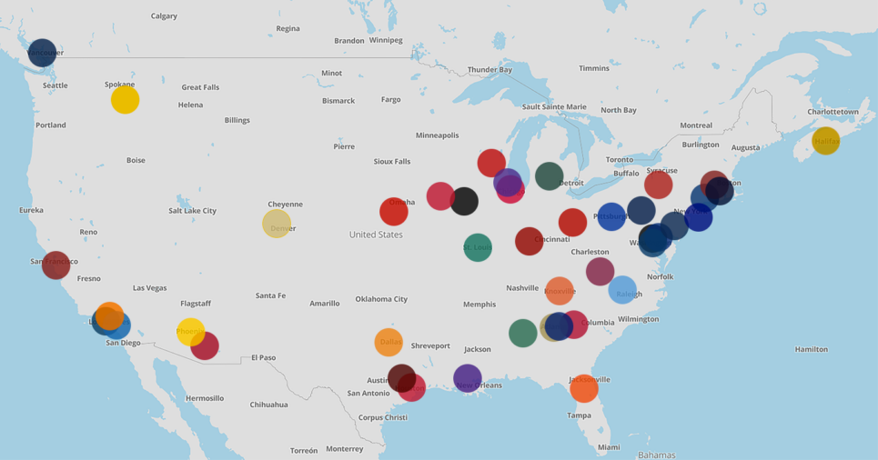
Spatially and Institutionally, We Are…
This year, Brown University will become a member institution,
with UI-CETL as it’s mentor

Slide 4
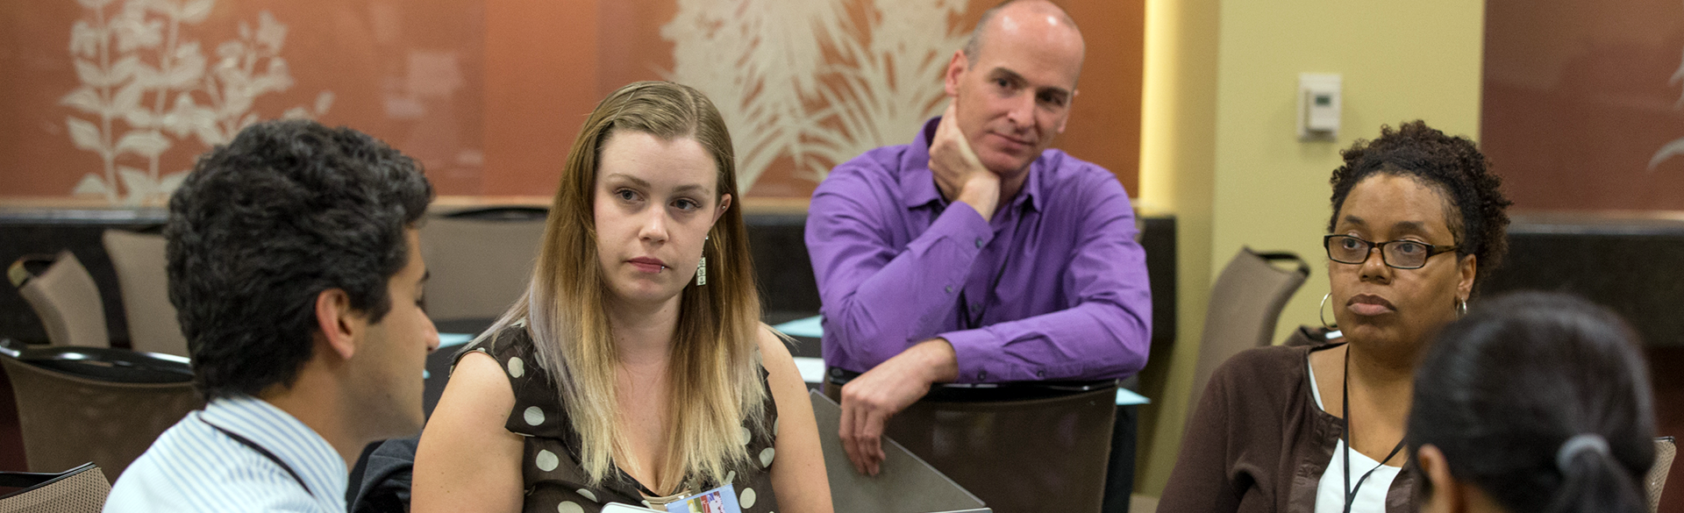
Core Ideas…
Learning-through-Diversity
Learning-through-diversity capitalizes on the rich array of experiences, backgrounds, and skills among undergraduates and graduate-through-faculty to enhance the learning of all. It recognizes that excellence and diversity are necessarily intertwined.
Teaching-as-Research
Teaching-as-research is the deliberate, systematic, and reflective use of research methods by instructors to develop and implement teaching practices that advance the learning experiences and outcomes of both students and teachers. It is curiosity and reflection-driven.
Learning Communities
Learning communities bring together groups of people for shared learning, discovery, and generation of knowledge. To achieve common learning goals, a learning community nurtures functional relationship among its members.

Slide 5
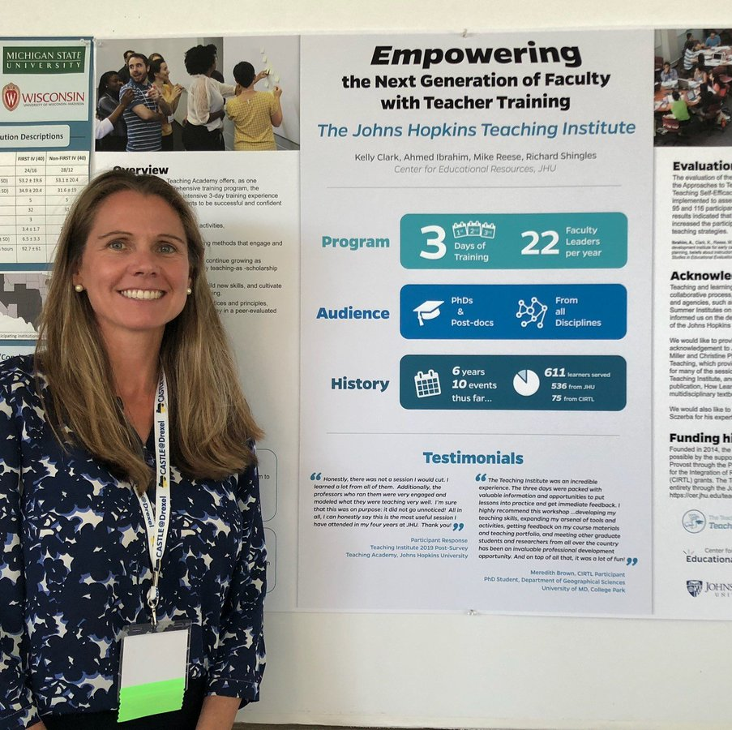
Developed By and Leveraged Through Cross-Network Programming
Through Network-sponsored programs and member institution programming, graduate students and post-docs have access to expert-led workshops, courses, resources, and materials.
All Teaching-as-Research and integrated Learning-through-Diversity<->Teaching-as-Research and SoTL initiatives are led by the University of Idaho. Talk to Brian to learn more!
All graduate students and post-docs have an opportunity to participate in and present at annual CIRTL Conferences.

Slide 6
Value Proposition and Opportunities
As part of the CIRTL Network, University of Idaho graduate students and post docs achieve a differentiating experience that not only provides a competitive advantage in the job market, but positions them as powerful agents of change in STEM education on and beyond our campus.
It enters our students and post docs into a community of future faculty and scientists who learn from the leading scholars at leading research institutions, of which we are one.
In short, CIRTL helps prepare tomorrow’s leaders today.
CIRTL advances success through tiered Learning Outcomes (Levels) for CIRTL-affiliated graduate students and post docs. This is realized through a combination of CIRTL-sponsored- and institutionally-designed programs.

Slide 7
CIRTL at the University of Idaho
Programming Supporting, Offered Through, and Relating to CIRTL is Coordinated through the Center for Excellence in Teaching and Learning. Brian Smentkowski leads Teaching as Research, Learning through Diversity, and other CIRTL initiatives for the Network and UI.

Slide 8
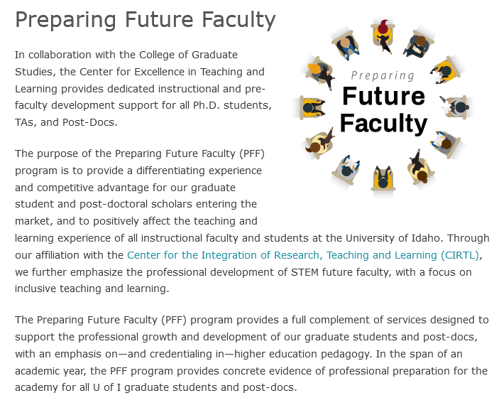
A Collaborative and Evidence-Based Approach to Preparing Future Faculty: CETL’s PFF Program

Slide 9
UI CIRTL Levels, Opportunities, and Credentials
Associate Level: Understanding and implementing evidence-based pedagogy.
1
Participate in 6+ pedagogy PFF/CIRTL workshops
Understand the foundations of evidence-based teaching and learning; integrated research, teaching, and learning; Teaching as Research; and Learning Through Diversity
Practitioner Level: Engage in Teaching As Research
2
Participate in a TAR Cohort
Grad students/post-docs create a TAR Proposal, implement a TAR Project, and submit an experiential reflection.
Scholar Level: Share Your Research
3
Graduate students/post-docs transform their projects into a presentable or potentially publishable manuscript
Manuscript submitted for presentation or publication
1:1 Teaching and Learning mentorship
CIRTL Certificate issued to all participants
Meets twice in the Fall and twice in the Spring
Purpose: develop a curiosity/hypothesis driven question/approach to teaching and its impact on learning and engage in reflective teaching practice
Participants can participate in CIRTL Cross-Network Programming, earn a CIRLT TAR Practitioner Certificate, and be eligible for funding and support to present their work at CIRTL events.
CIRTL Scholar Certificate earned and eligibility for professional development (travel) funding.
For participants interested in TAR, a CIRTL Associate-Level Teaching as Research Certificate.
For participants interested in DEIA, a CIRTL Learning through Diversity Certificate.

Slide 10
Preparing Future Faculty (PFF) Programming and Certificates
Higher Education Pedagogy UI-CIRTL Certificates | Learning-through-Diversity (LTD) CIRTL Certificate 7 IN-PERSON SESSIONS | Teaching-as-Research (TAR) CIRTL Certificate 3 75-minute ZOOM Sessions | The Professoriate & Professions 8 of 9 50-minute Zoom Sessions Faculty Development Certificate | Approaching the Market Mentoring-Based Support
Basic Certificate Associate Level Online-Asynchronous Canvas Class | Session 1: What it is, what it means, and why it matters. The value of DEIA in higher education September | Session 1: What it is, why it matters, principles of reflective/scholarly teaching, thinking about causality and “if-then” teaching for learning OCT | Understanding and Navigating the Changing Terrain of Higher Education SEPTEMBER | Identifying and Pursuing Your Options
Advanced Certificate Practitioner Level Online-Asynchronous Canvas Class | Session 2: Integrating the CIRTL Framework. Diversity and higher education, teaching, and learning October | Session 2: Developing a TAR question, expected results, strategies of inquiry, exposure to the literature NOV | Understanding Different Institutional Types, Expectations, and Contexts OCTOBER | Developing Your Dossier
Self-paced Can be done in one semester or over the span of an academic year. | Session 3: Inclusive and Equitable Teaching and Learning Strategies November | The time between the sessions is for participants to develop a TAR question or an idea about how a teaching strategy or innovation can positively affect teaching and learning. Set-up for CIRTL TAR Summer Program, Practitioner Level, and potentially SoTL/Scholar Level | Working Relationships, Collegiality, and Communication NOVEMBER | Writing to Your Audience: External Mentor-Led Session
 | Session 4: Universal Design for Learning and Accessibility JAN | Session 3: Preparing and Submitting CIRTL TAR Summer Program App FEB | Teaching, Scholarship, & Service: DECEMBER | Developing and Refining an Authentic DEI Statement
 | Session 5: Culturally Responsive Pedagogy FEB |  | Balance, Boundaries, Well-Being, and Different Definitions of Success JAN | Developing and Refining Your Teaching Philosophy
 | Session 6: Indigenous Ways of Knowing MAR |  | Designing A Productivity Pathway FEB | Preparing For Interviews
 | Session 7: Pulling it all Together: A Plan for Advancing Equitable Educational Experiences APRIL |  | Mentoring: What to Look For/What to Expect MAR | Interview Simulations
 |  |  | DEI for Everyday Practice APRIL | Teaching Observations
 |  |  | Alternate Career Options

Slide 11
Basic and Advanced Certificates
CIRTL Certificate in Higher Education Pedagogy/1st Year Cohort Introductory. Foundational. 6 of 9 required. | Advanced CIRTL Certificate in Higher Education Pedagogy/Second Year Application-based. 3 of 7 required. Practitioner Level | CIRTL LTD and TAR Certificates: Associate Level Practitioner Level Scholar Level
Teaching for Learning: Strategies and Approaches/LTD | Developing and refining an instructional presence | See Associate, Practitioner, and Scholar levels of engagement slide. Integrating LTD & TAR “Going Public” with TAR. (TAR → SoTL)
Scholarly/Reflective Teaching | Developing and refining inclusive teaching practices
UDL: a framework for inclusion and accessibility | Developing and refining a teaching philosophy
Online teaching and learning | Designing a Course
Teaching and learning technologies | Teaching Innovations and HIP Integration
Outcomes and Assessment | Fostering critical thinking, reflection, and metacognition
Handling Hot Topics | Application of technology
High Impact Practices
Self-Regulated Learning

Slide 12
Enhancing the Value Proposition
While the primary audience includes graduate students and post docs…
It is the give-back to undergraduate education through their service as scholars and teachers that makes a difference on and beyond our campus;
It is the network of international faculty that enriches the educational and professional experiences of participants through collaboration;
It is a concerted effort to attract, educate, and place graduate students and post docs with reputable CIRTL credentials;
It now extends beyond STEM disciplines in an effort to improve graduate and post doctoral experiences in all fields, and to improve graduate and undergraduate education generally;
It is access to cutting edge and expert-led evidence-based resources; and
A life-long and robust population of CIRTL faculty and alumni that provides support and sustains innovation in the union of research, teaching, and learning.

Slide 13
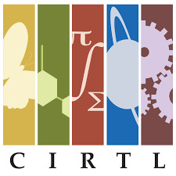
Notes: CIRTL Values
Learner-Centered Education: Learning is shaped by the needs, identities, experiences, communities, and goals of our learners. We develop educators who place learners at the center of their work.
Equity and Inclusion: In equitable and open environments, everyone is respected, valued, and encouraged, so that they are able to contribute to their fullest potential. We work to develop and sustain inclusive working spaces and learning communities that achieve equitable outcomes.
Diversity and Representation: Diversity of people brings forth diversity of ideas and learning. We cultivate and engage participation as a network, including leadership, that is representative of the demographics and lived experiences of the broader population.
Collaboration: Working together allows us to better achieve our co-created goals. We engage constituencies at all levels within and across institutions as colleagues in our work.
Inclusive Excellence and Innovation: Critical examination of data, scholarly reflection, and collective review are our standards of excellence. We innovate for mutual improvement of inclusive educational practices.
Reflective Decision-Making: Reflective decision-making is responsive to the evolving landscape of the CIRTL Network. We gather, share and analyze evidence to make data-informed decisions to collectively guide the CIRTL Network.
Intellectual Generosity: Mutual openness to ideas of each other advances understanding and discovery of knowledge. Acknowledging that there are
multiple ways of knowing, we respectfully listen and share our ideas,
perspectives, practices, and expertise.

