Slide 1
Learning-through-Diversity: A Pathway to Advancing Equitable Educational Experiences
UI PFF CIRTL Workshop, Session 2: The CIRTL Framework and LTD<->TAR
October 26, 2023
Brian Smentkowski, PhD
Founding Director, University of Idaho Center for Excellence in Teaching and Learning

Slide 2
About this series
Session 1 focuses on what LTD is and why it matters
This session will introduce key concepts relating to:
Inclusive teaching practices,
Our role in providing equitable educational opportunities, and
The CIRTL framework
Session 2 more fully integrates the CIRTL framework and links two core aspects of it:
Learning through Diversity and Teaching as Research
Session 3 provides a deeper dive into:
The development of an equity-mindset, and
Applied strategies for creating accessible, inclusive, and equitable learning experiences for diverse learners
Session 4 focuses exclusively on Universal Design for Learning
This expert-led session provides a rich context and evidence-based practices for supporting multiple means of engagement, representation, and expression of knowledge
Session 5 focuses exclusively on Culturally Responsive Pedagogy
This expert-led session provides insights and strategies for identifying and navigating the barriers and opportunities cultural differences provide
Session 6 focuses exclusively on Inclusion by Design
By this time, you will have the tools to think and act with intentionality to advance equitable learning opportunities
This session will focus on how you can embed what you have learned in every-day practice
Session 7 is reserved for sharing how you have pulled it all together. It is a conversational session where you share a reflection and an action.

Slide 3
Review and Reminders from Session 1
Although we are talking about researching an aspect of our teaching, we are ultimately –and importantly– focused on advancing equitable educational experiences. Accordingly,
Our goals are to:
Conceptualize and apply Learning-through-Diversity as a pedagogical prism for designing, developing, and delivering inclusive, equitable, and accessible learning experiences;
Apply TAR strategies to develop, integrate, and assess inclusive, equitable, and accessible teaching practices;
Develop a blueprint for participants to support and engage in DEIA-based scholarly teaching; and to
Develop a framework for evolving two CIRTL Core Ideas through the intersections of them.
Recalling that:
LTD “…capitalizes on the rich array of experiences, backgrounds, and skills among…undergraduates and graduates-through-faculty to enhance the learning of all”; and
TAR is the “…deliberate, systematic, and reflective use of research methods by…instructors to develop and implement teaching practices that advance the learning experiences and outcomes of both students and teachers.”

Slide 4
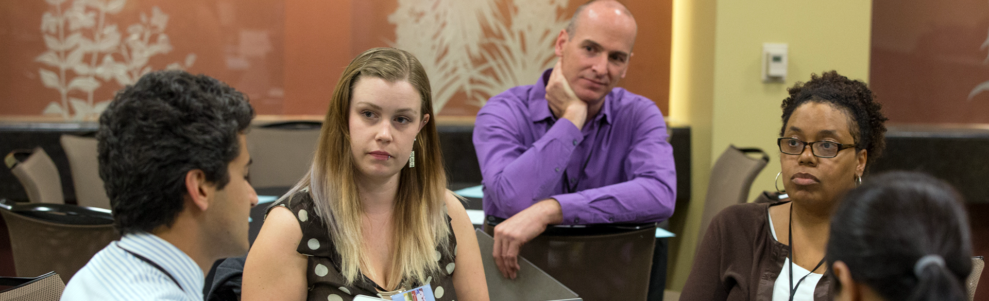
Core Ideas
*Learning-through-Diversity*
Learning-through-diversity capitalizes on the rich array of experiences, backgrounds, and skills among STEM undergraduates and graduates-through-faculty to enhance the learning of all. It recognizes that excellence and diversity are necessarily intertwined
*Teaching-as-Research*
Teaching-as-research is the deliberate, systematic, and reflective use of research methods by science, technology, engineering, and mathematics (STEM) instructors to develop and implement teaching practices that advance the learning experiences and outcomes of both students and teachers
Learning Communities
Learning communities bring together groups of people for shared learning, discovery, and generation of knowledge. To achieve common learning goals, a learning community nurtures functional relationship among its members.

Slide 5
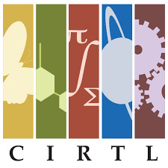
Core Values
Learner-Centered Education: Learning is shaped by the needs, identities, experiences, communities, and goals of our learners. We develop educators who place learners at the center of their work.
Equity and Inclusion: In equitable and open environments, everyone is respected, valued, and encouraged, so that they are able to contribute to their fullest potential. We work to develop and sustain inclusive working spaces and learning communities that achieve equitable outcomes.
Diversity and Representation: Diversity of people brings forth diversity of ideas and learning. We cultivate and engage participation as a network, including leadership, that is representative of the demographics and lived experiences of the broader population.
Collaboration: Working together allows us to better achieve our co-created goals. We engage constituencies at all levels within and across institutions as colleagues in our work.
Inclusive Excellence and Innovation: Critical examination of data, scholarly reflection, and collective review are our standards of excellence. We innovate for mutual improvement of inclusive educational practices.
Reflective Decision-Making: Reflective decision-making is responsive to the evolving landscape of the CIRTL Network. We gather, share and analyze evidence to make data-informed decisions to collectively guide the CIRTL Network.
Intellectual Generosity: Mutual openness to ideas of each other advances understanding and discovery of knowledge. Acknowledging that there are
multiple ways of knowing, we respectfully listen and share our ideas,
perspectives, practices, and expertise.

Slide 6
A Little More about TAR
What is TAR and why does it matter?
Teaching-as-Research (TAR) is an evidence-based approach to reflective teaching and a Core Idea of the CIRTL Network.
Essentially, TAR looks at teaching as a research question, which encourages us to think in IF->THEN terms: “IF I do this ____ (an instructional innovation or technique), THEN I should see ____ (a change in student performance, engagement, interest, etc).”
It provides a framework for imagining, implementing, and analyzing the effects of a teaching idea or innovation on student learning.
As such, it links teaching to learning and provides evidence of instructional impact.
More fundamentally, it’s all about how curiosity and reflection improve teaching and learning.

Slide 7
Thinking Systematically: A 5 Step Process to TAR
Generate an idea
Review the literature
Design a study
Launch it
Collect data
Analyze data
Reflect

Slide 8
The Intersection of LTD and TAR and Why it Matters*
TAR
LTD
PFF
Transformational and Equitable
Teaching and Learning
Can we move from this:
To this?
LTD
TAR
Mindful Evidence-Based Teaching
What’s happening
–and possible– here?
LTD
TAR
{*This intersection will be integral to Session 2 and beyond}

Slide 9
Making the LTD ←→TAR Connection
When we say that Learning-through-Diversity capitalizes on the experiences, backgrounds, identities, and skills of students to enhance learning for all, we are engaging in a representational form of scholarly teaching –bringing who we are and who our students are into the equation.
It is more than that, though: through a TAR prism, we can hypothesize and predict the impact of equitable, inclusive, and accessible teaching practices on learning. LTD then becomes a TAR topic.
Teaching-as-Research transforms curiosity about learning into a research question that can promote improved learning for diverse learners.
Here, an LTD<->TAR framework is used to advance equitable educational experiences.

Slide 10
Exercise 1: Defining What Matters
Part 1: Pause, think, reflect, and write:
What LTD topic interests you the most?
Why?
How can it be addressed in your class or lab?
Can you frame it as a TAR question?
What kind of question is it?*
What is?
What might work?
A vision of the possible?
What is the problem it is intended to solve?
Why does it matter?
Part 2: Report out
My name is ________ and I am interested in ________, because ________.
In my ________ class, I want to ________ to see if ________.
This is important because it addresses and potentially solves the problem of _________________.
*Consider Pat Hutching’s taxonomy of questions, viewable here:
https://www.centerforengagedlearning.org/studying-engaged-learning/asking-inquiry-questions/.
Notes:
Part 1: 3 minutes. Part 2: 10 minutes.

Slide 11
Linking TAR Practices to LTD Principles
We can use the columns below to develop a TAR question that addresses LTD, or that uses LTD to inform a TAR project.

Slide 12
An Alternate Route
LTD “…capitalizes on the rich array of experiences, backgrounds, and skills among…undergraduates and graduates-through-faculty to enhance the learning of all”.
Another approach to exploring the TAR-LTD intersection is to engage in mindful, reflective pedagogical practices that enhance inclusive, equitable, and accessible learning experiences. We can be reflective scholarly teachers. We can think about our thinking and learn about our learning based on the definition, above. We can encourage our students to do so, too. Cast in this light, TAR does not necessarily involve or result in an analytical study.

Slide 13
Exercise 2: Ticket out the Door
Think about an LTD theme, element, or issue that interests you and that you can potentially examine in a class (slide 11).
Write it in the thought bubble to the right.
Remember to keep thinking about it.

