Slide 1
Learning-through-Diversity: A Pathway to Advancing Equitable Educational Experiences
UI PFF CIRTL Workshop, Session 3: Applied Strategies
November 30, 2023
Brian Smentkowski, PhD
Founding Director, University of Idaho Center for Excellence in Teaching and Learning

Slide 2
About this series
Session 1 focuses on what LTD is and why it matters
This session will introduce key concepts relating to:
Inclusive teaching practices,
Our role in providing equitable educational opportunities, and
The CIRTL framework
Session 2 more fully integrates the CIRTL framework and links two core aspects of it:
Learning through Diversity and Teaching as Research
Session 3 provides a deeper dive into:
The development of an equity-mindset, and
Applied strategies for creating accessible, inclusive, and equitable learning experiences for diverse learners
Session 4 focuses exclusively on Universal Design for Learning
This expert-led session provides a rich context and evidence-based practices for supporting multiple means of engagement, representation, and expression of knowledge
Session 5 focuses exclusively on Culturally Responsive Pedagogy
This expert-led session provides insights and strategies for identifying and navigating the barriers and opportunities cultural differences provide
Session 6 focuses exclusively on Inclusion by Design
By this time, you will have the tools to think and act with intentionality to advance equitable learning opportunities
This session will focus on how you can embed what you have learned in every-day practice
Session 7 is reserved for sharing how you have pulled it all together. It is a conversational session where you share a reflection and an action.

Slide 3
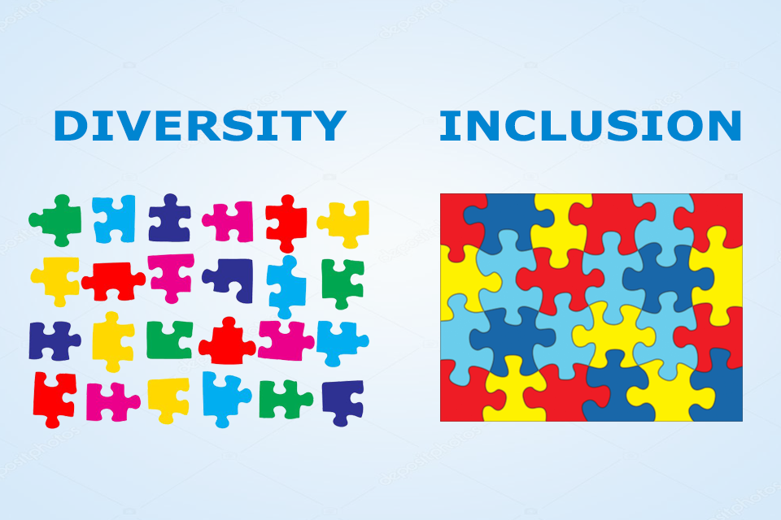
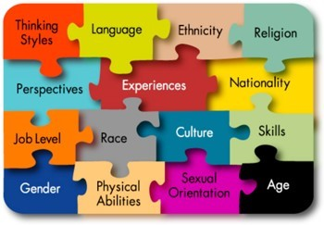
Refresher: Inclusive Teaching Practices→ Inclusive Learning Experiences
Faculty and students bring an array of experiences, backgrounds, and skills to the teaching and learning process.
Effective teaching capitalizes on these rich resources to the benefit of all. This is "Learning-through-Diversity".
At the same time, existing social and educational practices do not always promote equal success for all learners.
Creating equitable learning experiences and environments requires intentional and deliberate efforts on the part of present and future faculty alike.
This series is designed to stimulate, frame, and support these efforts.
https://www.cirtl.net/about/core_ideas/learning_through_diversity.

Slide 4
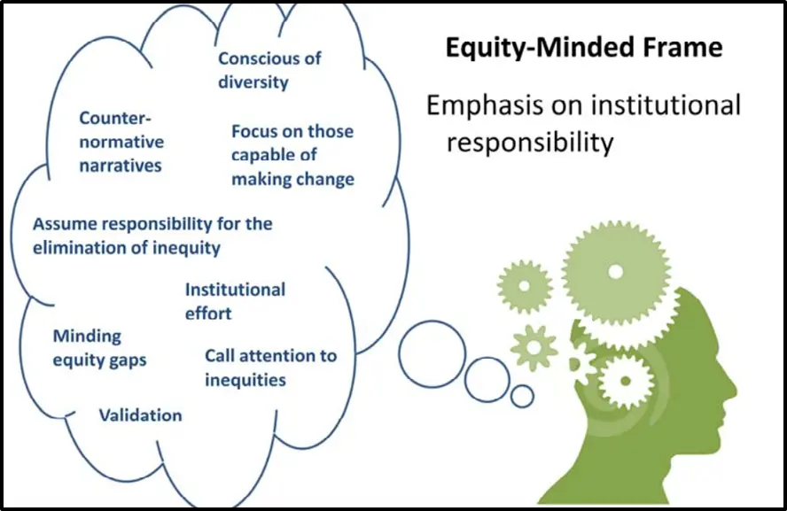
Developing and Applying an Equity Framework
What’s Our Responsibility?
Diversity
Inclusion
Accessibility
Equity

Slide 6
Revisiting our Inclusive Practices Primer
Inclusive teaching strategies can be separated into three categories:
Incorporating diverse perspectives into course content by expanding reading lists beyond dominant/narrow narratives and their sources; offering various ethnic, racial, and other perspectives in case studies; ensuring PowerPoints and lecture examples offer a variety of human examples; and avoiding tokenizing particular individuals, students, or representations. Also, make sure they are accessible!
Creating an inclusive classroom climate where all students are encouraged to participate, by learning about students’ backgrounds and tailoring approaches accordingly, establishing ground rules for discussing controversial issues, and developing (and helping students develop) deeper awareness of difference.
Incorporating Universal Design for Learning principles in class, by providing/facilitating multiple means of engagement, representation, and expression.
--Yale Poorvu Center for Teaching and Learning
Implicit Bias and critical self-reflection tools:
https://poorvucenter.yale.edu/ImplicitBiasAwareness and https://implicit.harvard.edu/implicit/selectatest.html
https://projects.iq.harvard.edu/files/eijc/files/inclusive_teaching_strategies_reflecting_on_your_practice.pdf?m=1525282190

Slide 7
Think About…
Space
Place
Time
Methods
Expectation
Learning Objectives

Slide 8
Engaging your Students Learning: Simple Strategies…but?
Even passive learning
is active learning!
Call…
…and response
This is when the learning happens!

Slide 9
Exercise 1
What would exclusionary teaching and learning look like?
What would inclusive teaching and learning look like?
Can attempts at inclusion inadvertently do harm?
In the diagrams and figures above, do you see any issues relating to inclusion and accessibility?

Slide 10
Mindset and Belonging
A sense of belonging is critical to academic success
There are many reasons why students might feel like they don’t belong
Can you name a few?
Sometimes students feel like they don’t belong because they feel like they “can’t do it”
Often, this is a matter of what’s called mindset, and specifically, a fixed mindset
We can help change that!

Slide 11
Helping Students Shift from a Fixed Mindset to Growth Mindset

Slide 12
Exercise 2: How?
Think about something you can do to help students:
accept “the productive struggle” of learning;
resist the urge to say “I can’t”;
embrace the power of “yet”; and
learn from constructive criticism.

Slide 13
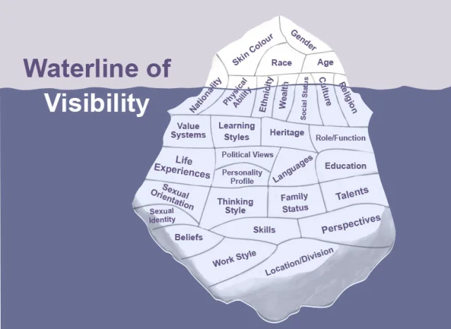
Exercise 3: Visible and Invisible Barriers
What’s Above and Below the Surface?
When we see the tip of the iceberg, what do we see?
When we look beneath the surface, what do we see?
What can we do to respect, represent, and accommodate difference?
How?

Slide 15
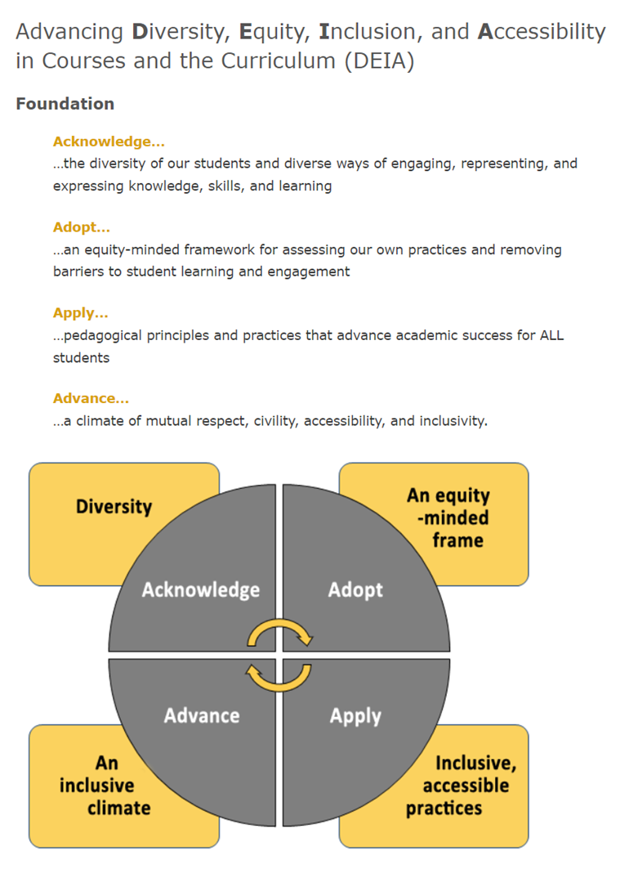
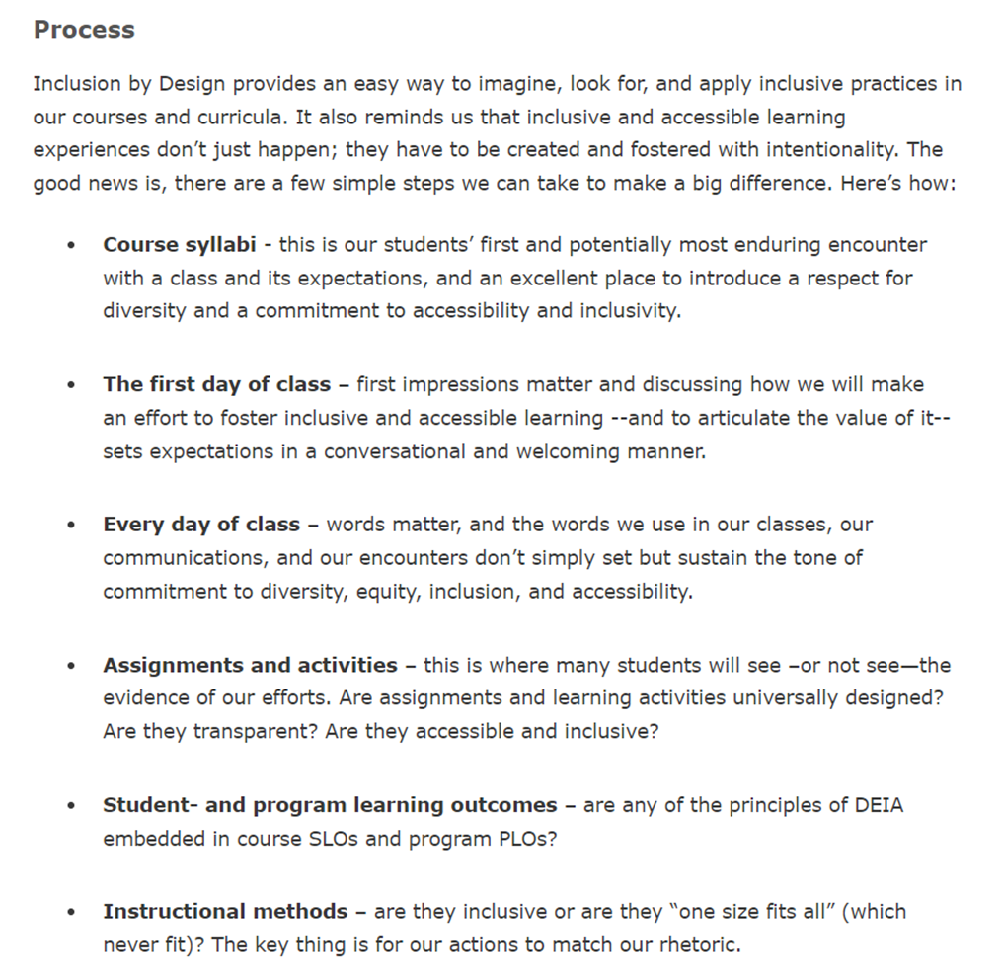

Slide 16
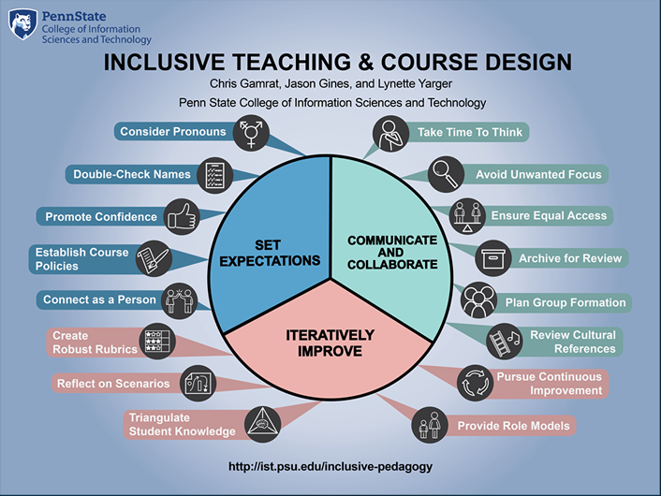

Slide 17
Guides for Growth and Development
Becoming an anti-racist educator, Wheaton College
Center for Urban Education (CUE) Racial Equity Tools, University of Southern California
Diversity Toolkit: A Guide to Discussing Identity, Power and Privilege, Master of Social Work Program, University of Southern California
Faculty Toolkit on Digital Inclusion, Office of Global Inclusion, New York University
Inclusive Pedagogy, University of Chicago
Inclusive Teaching Practices, Office of Teaching & Learning, University of Denver
Inclusive Teaching Resources and Strategies, CRLT, University of Michigan
Teaching Race: Pedagogy and Practice, Center for Teaching, Vanderbilt University
Incorporating Diversity, Center for Teaching Innovation, Cornell University

Slide 18
Select CETL Inclusive Teaching and Learning Resources
The Value of Diversity (pdf)
Inclusive Pedagogy Slides (pdf)
Keeping My Class Inclusive: Diversity, Inclusion, and Universal Design Online (pdf)
Universal Inclusive Design Checklist (pdf)
A Quick Guide to Using Inclusive Language (pdf)
Microaggressions in the Classroom (pdf)
Inclusion By Design Syllabus Survey
CETL Repository for DEIA's Inclusion by Design
POD Network’s Key Resources
Tips on Designing Inclusive Learning Experiences
Universal Design for Learning (UDL) Resources
Inclusive Learning Experiences don’t just happen; they are made…carefully and with intentionality

