Slide 1
Mary Godwin Shelley And Frankenstein
The Origin of Modern Psychology And Thematic Biography

Slide 2
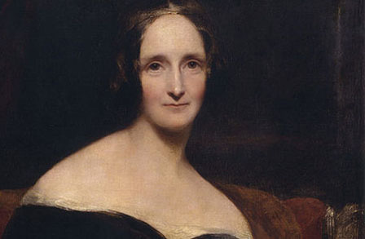
Mary Godwin Shelley 1797-1851

Slide 3
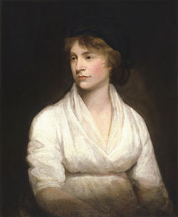
Mary Shelley’s Mother: Mary Wollstonecraft (1759-1797)

Slide 4
Mary Wollstonecraft
Author of A Vindication of the Rights of Women (1792): the first treatise on “feminism”.
Wollstonecraft was the first to argue that the intellectual and character differences between men and women are largely due to social experiences, not genetics or innate differences.
Wollstonecraft expanded John Locke’s tabula rasa theory and Rousseau’s theories concerning how societal influences shape (and corrupt) human character to argue that women are “inferior” to men because they are educated to act that way.

Slide 5
Wollstonecraft
If women were “weak” because they were educated to act that way, better education would make them men’s intellectual equals: we are simply what society makes us.
In a truly tragic twist, Wollstonecraft, the world’s first “feminist”, died from complications following her daughter, Mary’s, birth.

Slide 6
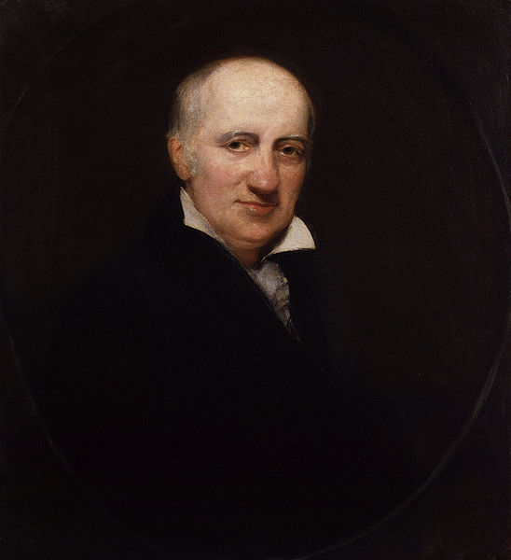
Mary Shelley’s Father: William Godwin (1756-1836)

Slide 7
William Godwin
Although largely forgotten today, in his, and Mary’s, lifetime, he was one of England’s most important and notoriously radical philosophers.
Godwin believed that eventually human reason and science would become so powerful that we would someday conquer death itself.

Slide 8
Godwin On Government
Godwin was the first “philosophical anarchist” or the father of the philosophy we now call “libertarianism”. He believed:
Individuals are inherently good (from Rousseau).
Governments are inherently corrupting forces (also from Rousseau).
Minimizing or even eliminating governments and maximizing individual freedoms would lead to the best societies.

Slide 9
Godwin On Justice
Godwin’s theories on justice were instrumental in modernizing England’s legal system. He argued that:
Justice must be applied equally to all members of society, regardless of birth, rank, race or gender.
As Rousseau had shown, criminals were not born criminals but were shaped by experience/societal influence; this in turn suggested criminals could be re-formed, re-educated to rejoin society.

Slide 10
Godwin On Justice Continued
Godwin also argued that the death penalty – which was still used for all sorts of petty crimes throughout Britain and Europe – was irrational. He reasoned:
If a criminal felt no remorse for his crime and was put to death, that criminal never truly felt responsible for his crime.
If a criminal felt great remorse for his crime and was put to death, he was simply relieved of his suffering.

Slide 11
Godwin On Justice Continued
Finally, recall that Godwin believed governments tend toward inevitable corruption, thus, he argued, they too easily abuse their powers against powerless individuals and put the innocent needlessly to death for crimes they did not commit.

Slide 12
Godwin’s Famous Fire Case
Godwin argued all human decisions should be made from a strictly logical, rational perspective rather than an emotional one.
In his “Famous Fire Case” he argued that if faced with saving one person from a burning barn – your mother or a famous, valuable public figure (the Archbishop Fenelon) – you should choose the person of more value to society as a whole, not someone you simply “love”; thus, you should choose the public figure, not your mother.

Slide 13
Godwin’s Friends
Raised by her father, Mary grew up hanging out with some of the most influential thinkers and writers of the Romantic Era, including the famous poets William Wordsworth and Samuel Coleridge.
Together, Wordsworth and Coleridge developed Rousseau’s nature philosophy into something approaching a religion: the belief that one could reach the sublime without organized religion and through experiencing the natural world.

Slide 14
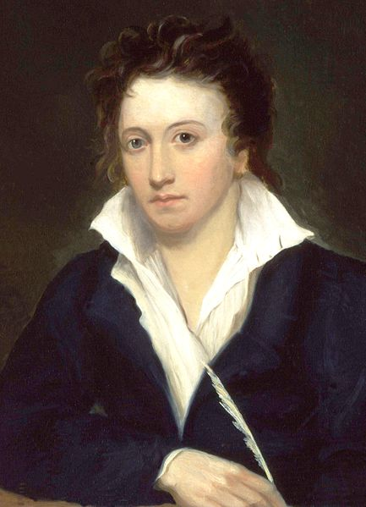
Mary Shelley’s Husband: Percy Byshe Shelley (1792-1822)

Slide 15
Percy Shelley
Along with being one of the greatest of the Romantic poets, Percy Shelley is notable for:
His outspoken atheism: he is expelled from Oxford for publishing The Necessity of Atheism
His outspoken faith in unfettered human freedom. While Mary writes Frankenstein, Percy is writing Prometheus Unbound, a radical reworking of the Greek Prometheus myth.

Slide 16
1812: Mary Age 14
Mary meets Percy Shelley, recently expelled from Oxford for publishing The Necessity of Atheism.
Percy leaves his first wife (Harriet Westbrook (1795-1816) and becomes Godwin's disciple. Eventually he will also come to financially support Godwin.

Slide 17
1814: Age 16
Mary runs away and shacks up with Shelley who is still married to Westbook. Mary is pregnant with his child (the child will be born prematurely 5 months later and die within days, in Mary's arms). Percy, who takes the Enlightenment concepts of "liberty" and "freedom" to extremes, has affairs with other women, even, many believe, during the time when Mary is nursing their dying child....
Travel through France and the wreckage of the Napoleonic Wars witnessing first hand the devastating effects of the French Revolution (which had been supported by Godwin, Wordsworth, Shelley etc.)
Godwin and Shelley's father both denounce Percy and Mary.

Slide 18
1816: Mary at age 19:
Mary's half sister (Fanny Imlay: daughter of Mary Wollstonecraft and Gilbert Imlay) commits suicide; their father Wm. Godwin refuses to identify or claim the body.
Percy Shelley's very pregnant ex-wife (Harriet Westbrooke) commits suicide
Mary marries Percy Shelley
Birth of son William (dies age 3)
Hanging out in Geneva with Shelley and Byron (two of the greatest living poets, Byron massive pop star)
Writes Frankenstein: Or, The Modern Prometheus June 1816 - May 1817
Prometheus Unbound published by Percy Shelley

Slide 19
Postscript
1822: Percy drowns at age 30 (sailing the Don Juan) (1792-1822) 1824: Byron dies at 36 (1788-1824) (illness, was fighting for Greek independence from Turkey)
1851: Mary Shelley dies, age 53

