Slide 1
Starting Small Converting a Single Lecture to an Active Format
Dan Cordon and Sean Quallen
Mechanical Engineering
University of Idaho

Slide 2
Participant Background
Self-Placement
A rookie of active learning
Earned my scars in active learning
Regularly use active learning in courses
As a Learner
Have had positive active learning experiences
Have had negative active learning experiences
As a Facilitator
Have had positive active learning experiences
Have had negative active learning experiences

Slide 3
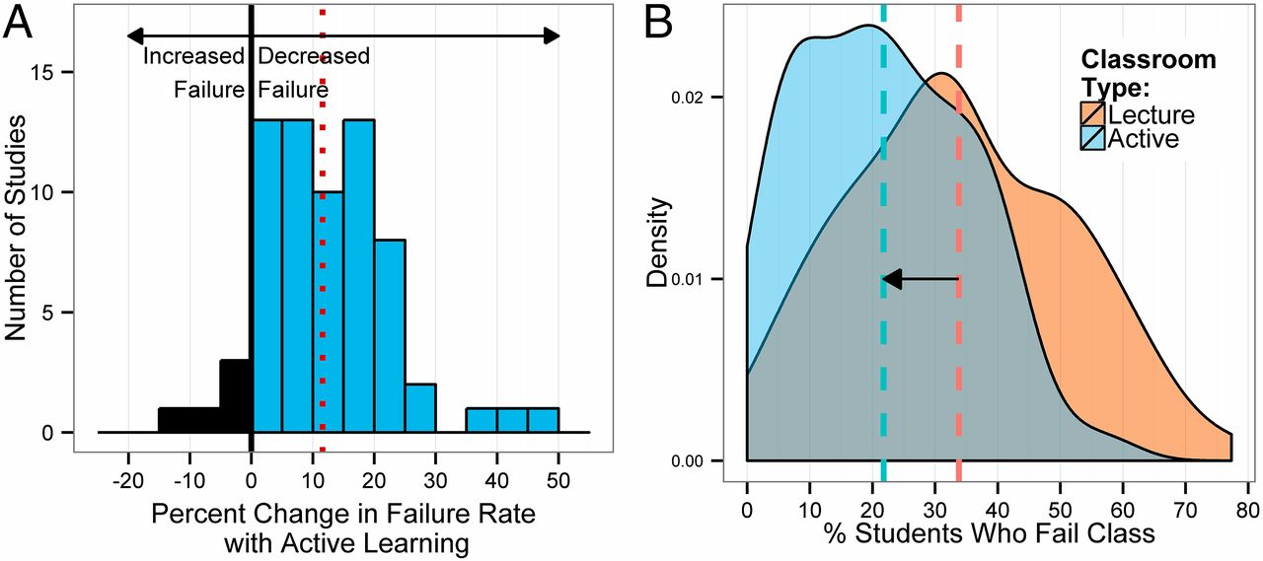
Active Learning Reduces Failure Rate
Changes in failure rate. (A) Data plotted as percent change in failure rate in the same course, under active learning versus lecturing. The mean change (12%) is indicated by the dashed vertical line. (B) Kernel density plots of failure rates under active learning and under lecturing. The mean failure rates under each classroom type (21.8% and 33.8%) are shown by dashed vertical lines.
Scott Freeman et al. PNAS 2014;111:8410-8415
©2014 by National Academy of Sciences

Slide 4
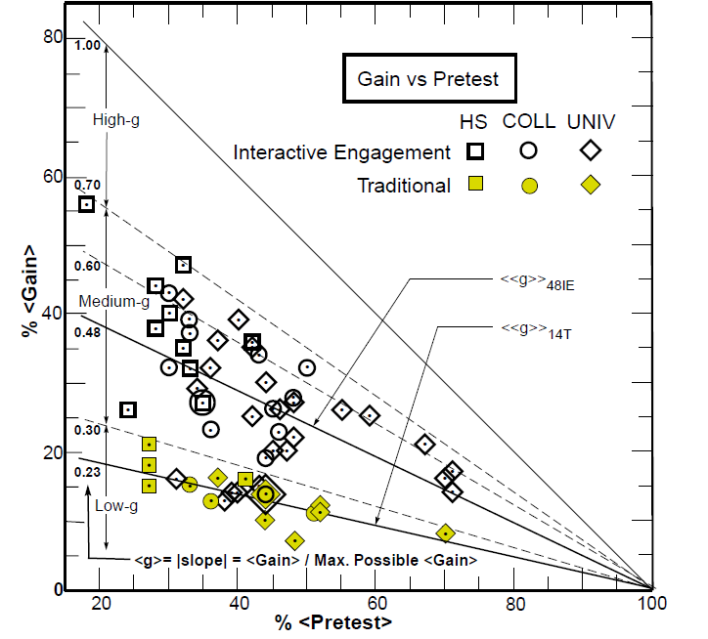
Active Learning vs. Lecture
%<Gain> vs %<Pretest> score on the conceptual Mechanics Diagnostic (MD) or Force Concept Inventory (FCI) tests for 62 courses enrolling a total N = 6542 students: 14 traditional (T) courses (N = 2084) which made little or no use of interactive engagement (IE) methods, and 48 IE courses (N = 4458) which made considerable use of IE methods.
Richard R. Hake, American Journal of Physics, 1998; 66:64-74

Slide 5
Resistance to Active Learning

Slide 6
Common Lectures to Convert
(~2 minutes) In small groups with people around you, come up with 2-3 examples of lectures types that are common to most classrooms
Idea 1 – Exploring the syllabus (pg 8-9)
Idea 2
Idea 3

Slide 7
Designing a College Classroom Activity with Application across Multiple Disciplines
Form teams of 4-6 members. Once formed, raise hand and we will give your team an activity sheet
Group Roles
Captain: (manage team)
Recorder: (pull off back page of reference packet)
Speaker: (prepared to share results with large group)
Planner: (manage time)
Spy: (check with neighboring groups if you’re stuck/confused)
Reflector: (lead collection of team insights)
Orientation
Learning Objectives
Targeted Skills
Speaker read to team

Slide 8
Workshop Discoveries
Title of your activity, description of your activity, and an insight after spending some time working through an activity design methodology
Insight 1
Insight 2

