Slide 1
Scope Optics Project
Team members:
Nick Kirby, David Schiff, and Vince Schwartz

Slide 2
Objective
Goal:
The goal of this project is to test CATIA’s ray tracing capabilities through a series of lenses. After exploring the ray tracing capabilities, the group will create a tutorial based on their findings.
Problem Definition:
CATIA has ray tracing abilities but there are currently no good tutorials available that work through how it is achieved or the limit of CATIA’s capabilities.

Slide 3
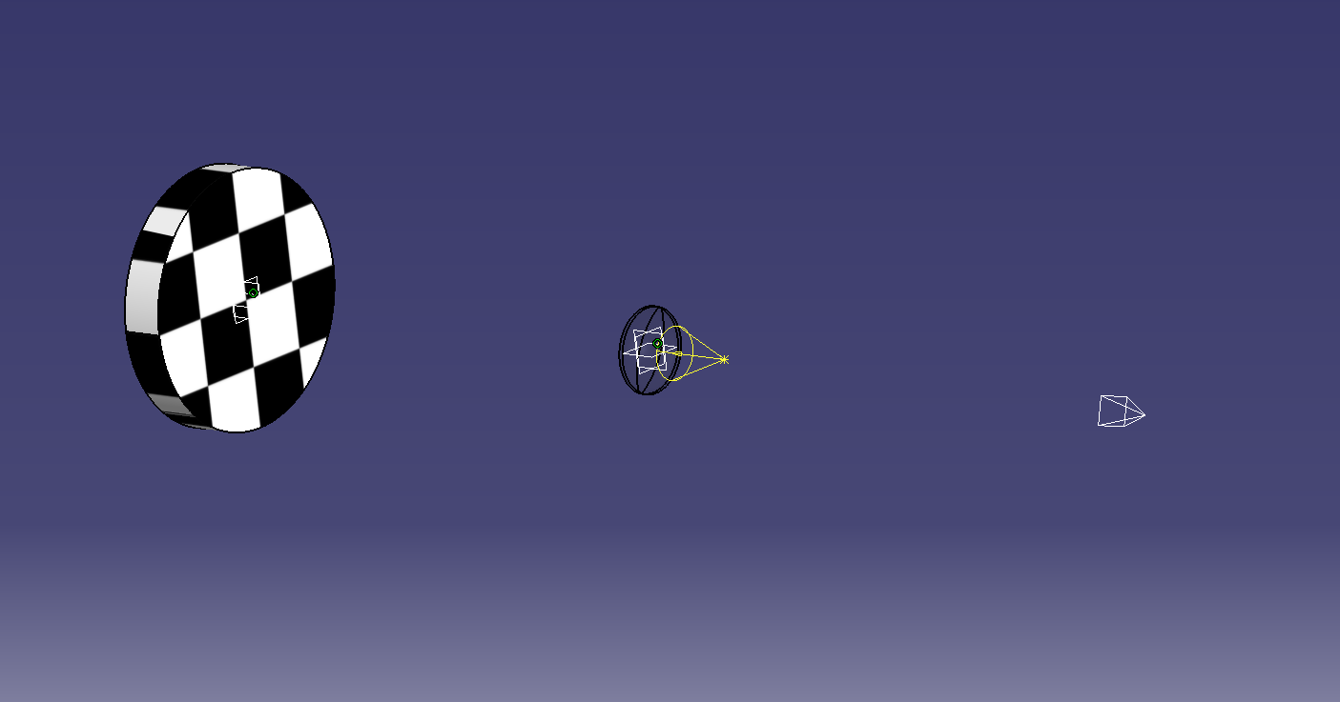
Approaches
Single lens rendering
  CATIA can easily render through one lens.
Lighting
  CATIA shows distortion along the path of the spot light.

Slide 4
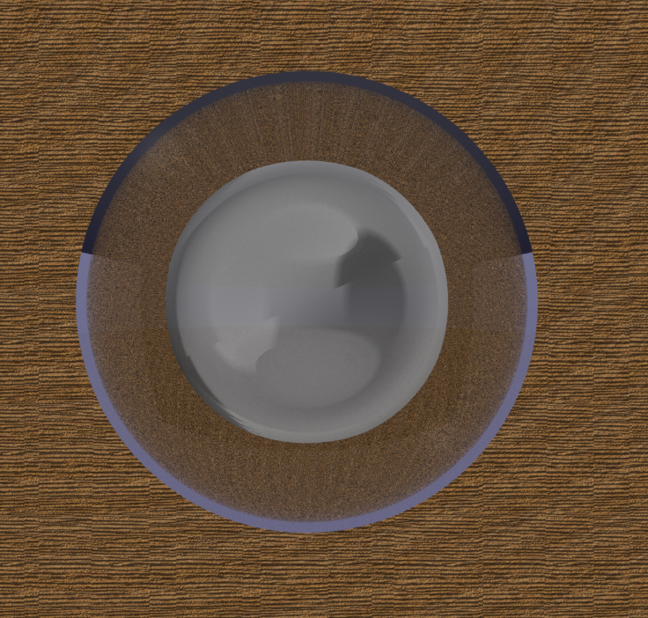
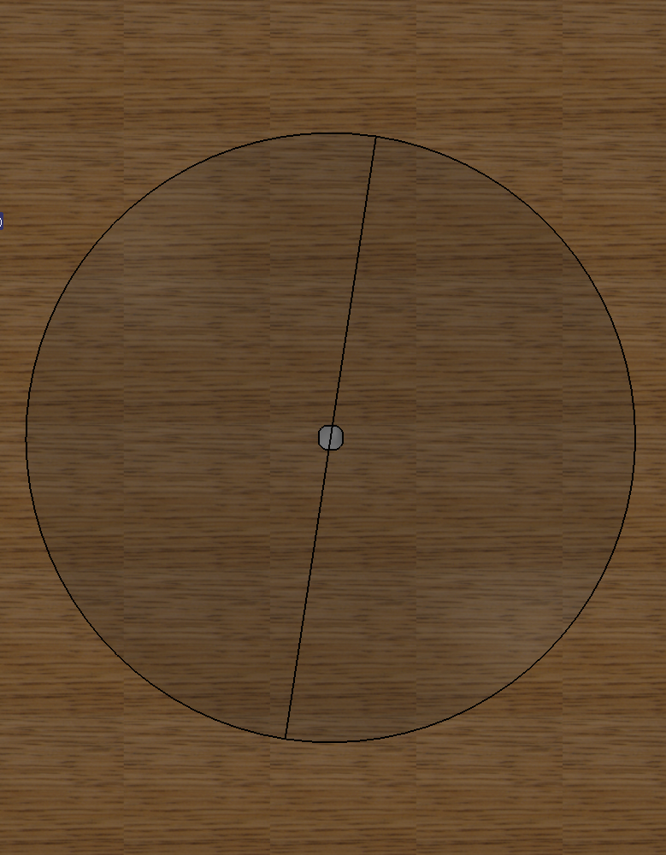
Simple Magnifying Lens
Another example of the single lens magnification abilities of CATIA.
Convex lens
Flat lens

Slide 5
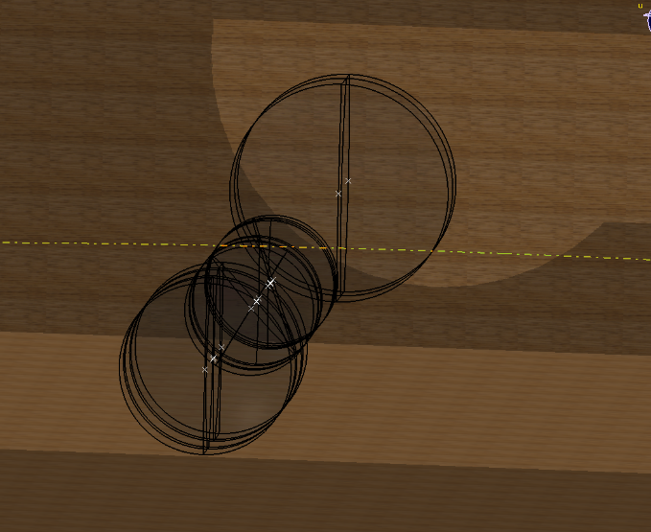
Problems
CATIA isn’t capable of rendering through multiple lenses to view a part. It is only capable of rendering through one lens.
Solution plan:
The group will attempt various solutions to achieve rendering through multiple objects.

Slide 6
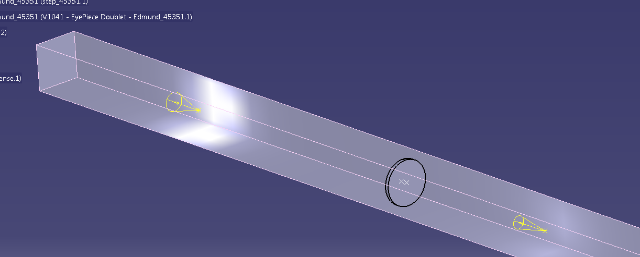
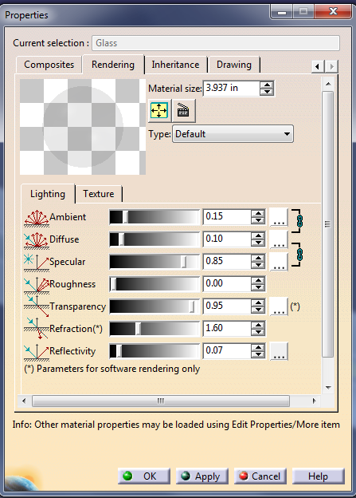
Approaches Cont.
Stepped rendering:
    One attempt to render through multiple lenses was to “trick” CATIA by pasting a picture as an environment. You would render the picture through the next lens, and repeat. The image quality became increasingly worse as the process went on and was eventually incoherent.
Changing lens materials
    The group changed material properties and rendering qualities to attempt to see through multiple lenses, but was unable to have any success.

Slide 7
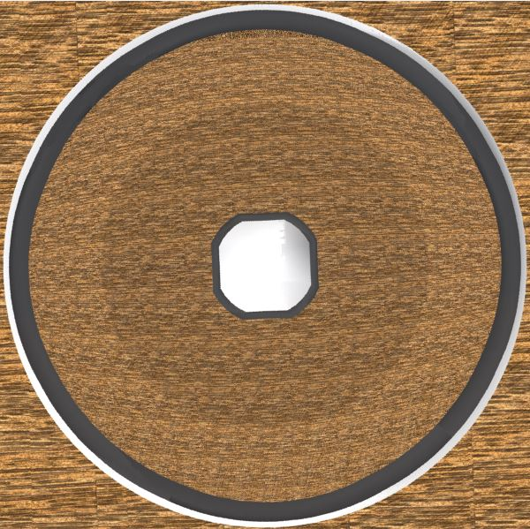
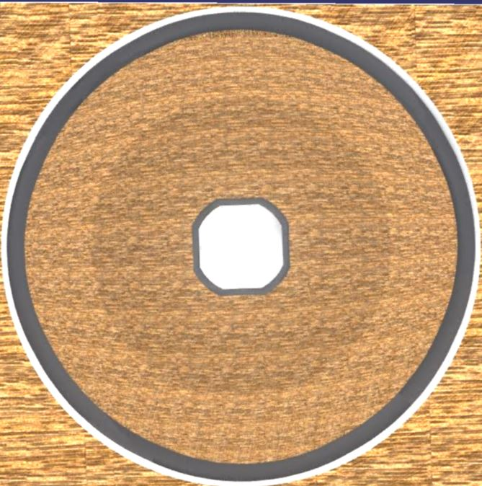
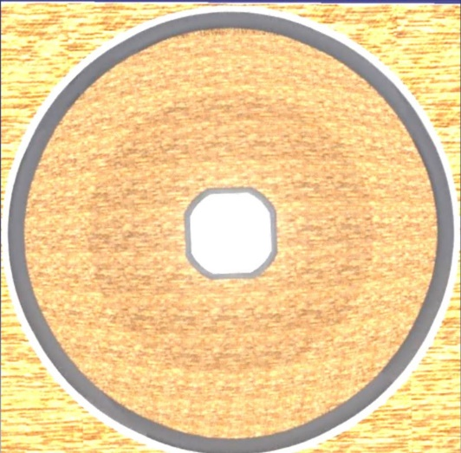
Stepped Rendering
Lens render 1
Lens render 2
Lens render 3
Lens render 4

Slide 8
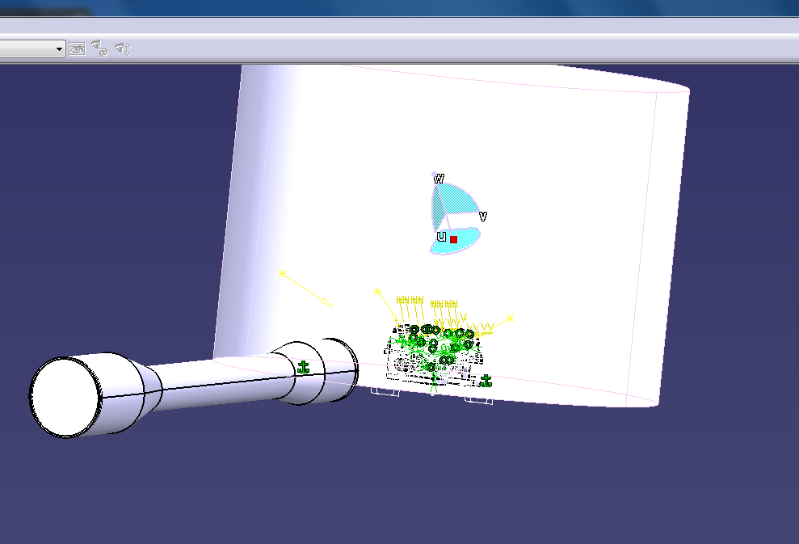
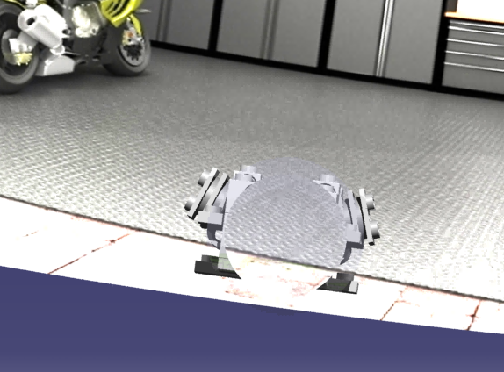
Findings
While CATIA isn’t capable of viewing a part through multiple lenses, it is capable of viewing an environment. The render will actually ignore the part completely if it is located between the lenses and the environment.

Slide 9
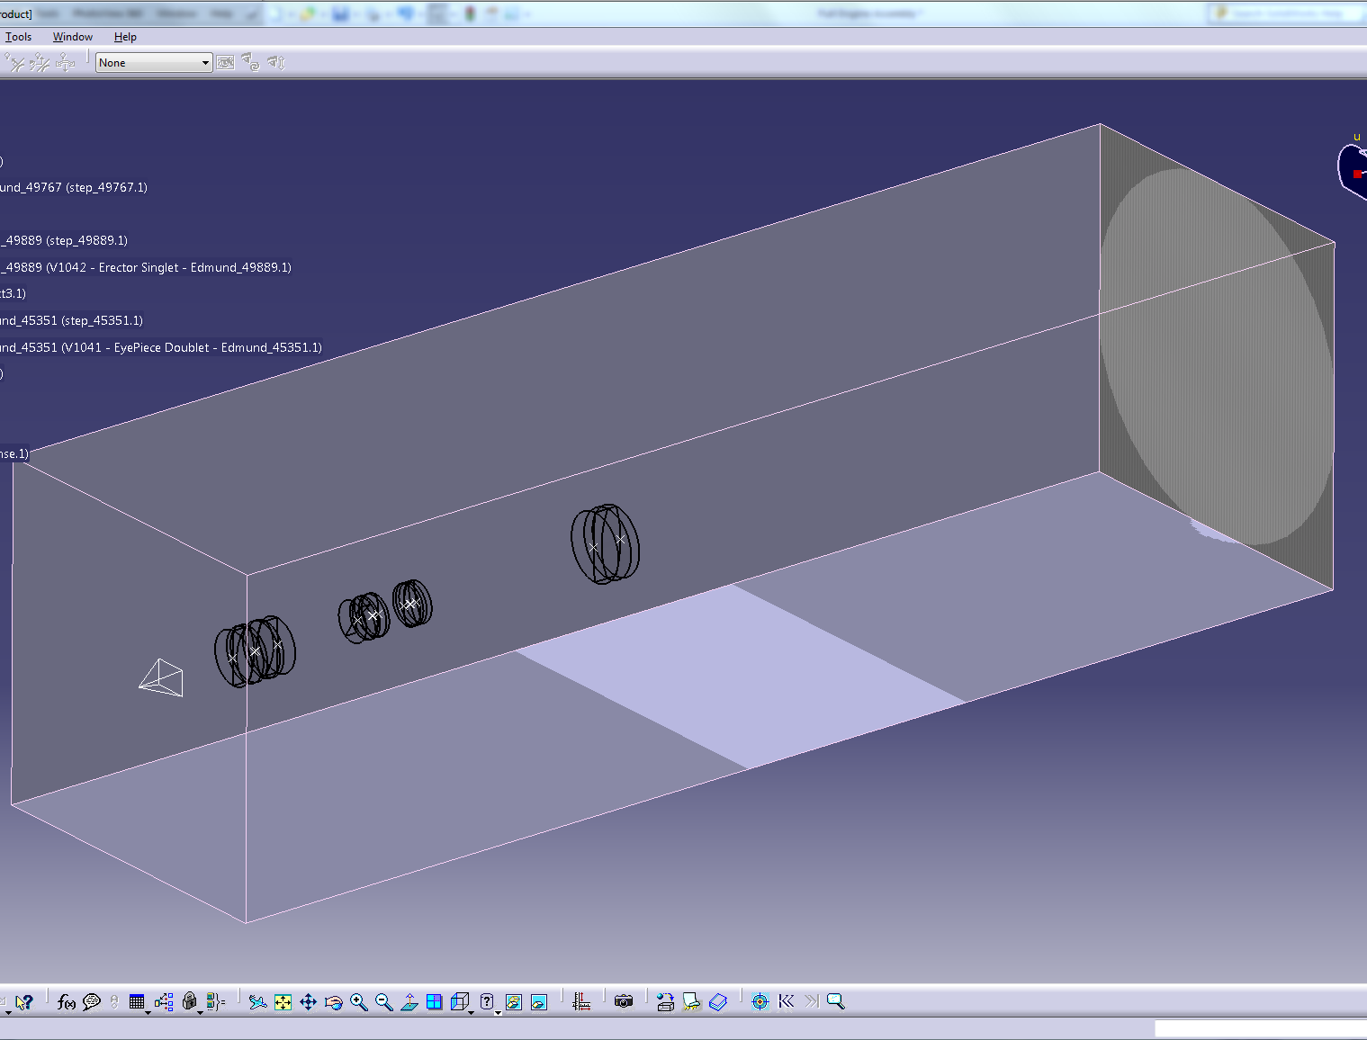
Large Optical Layout.
The picture to the left shows the assembled rifle scope lens package looking at a wall in an environment. The picture below shows the view looking through the lens package.

