Slide 1
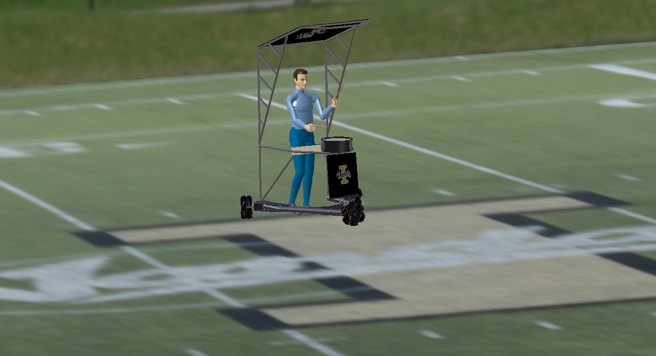
The Bandbeesten Experience With Catia V5 Human Builder Simulation Software
Allyson Labrum

Slide 2
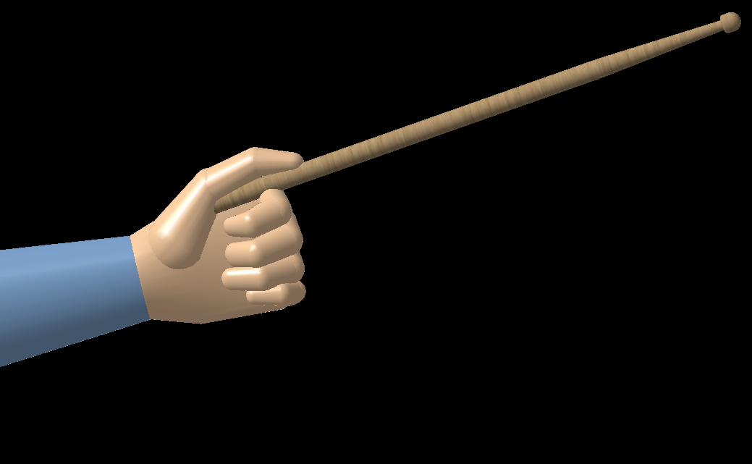
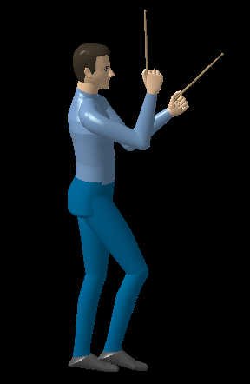
Manikin Capabilities
Simulation
Sequence of events created through manikin manipulation
Realistic Tool Interface with Grip Manipulation
Tool becomes an extension of manikin segment
Forward Kinematics
Manikin segments are manipulated for simulation
Gives insight into the drummer environment
Manikin Vision
Line of sight from Drummer’s prospective

Slide 3
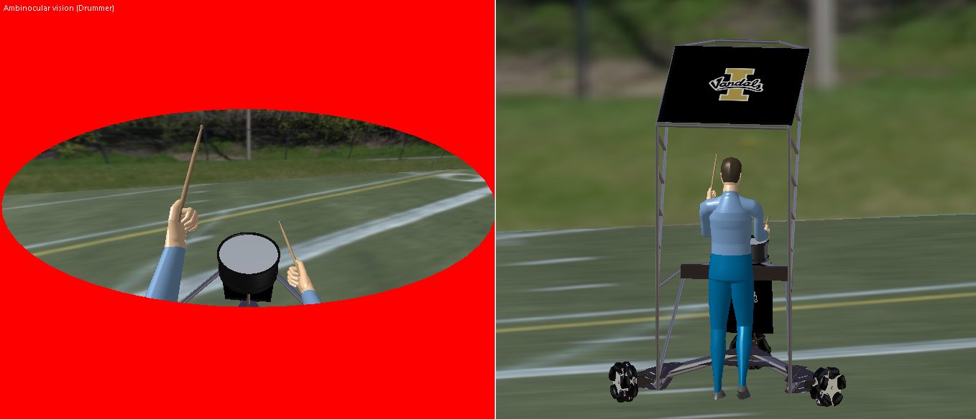
Manikin Vision

Slide 4
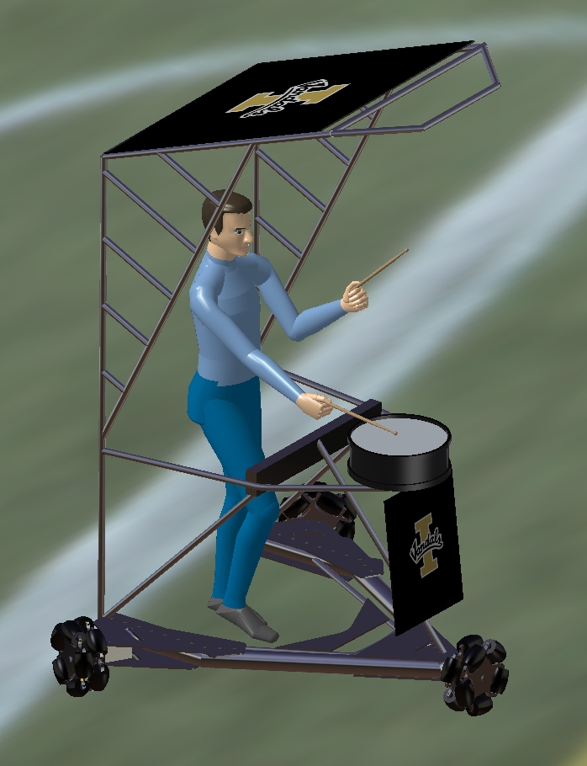
Animation Plan
Opens with Drummer Vision
Look Right Then Left
Band members in field of view
Drum and March
Highlights Bandbeesten robotic capabilities
Spin→ Stop→ Change to Side View
Fade to Live Shot (Go-Pro)

