Slide 1
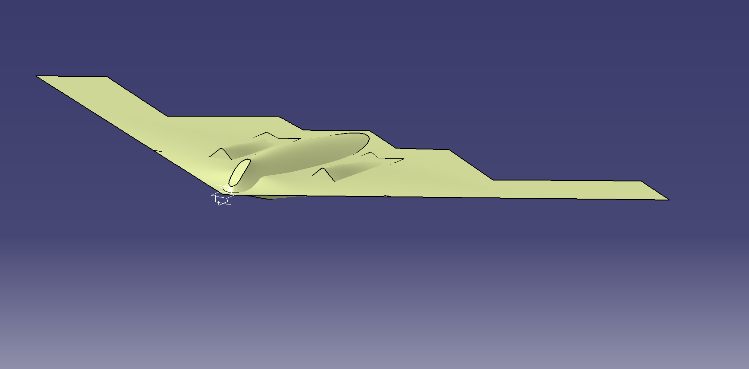
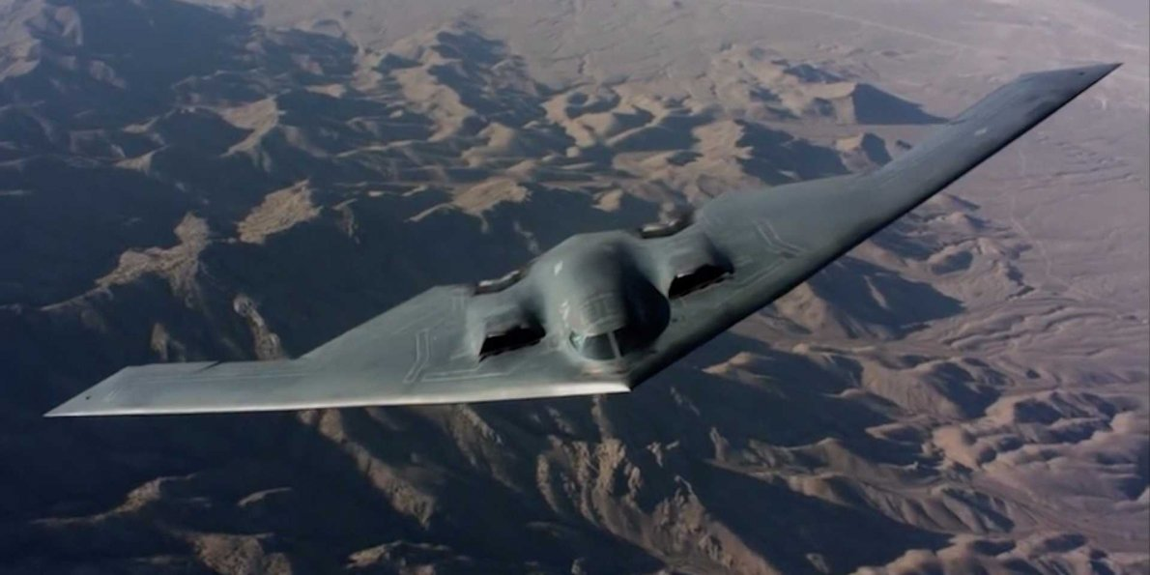
B-3 Bomber
By: Brock Baughman

Slide 2
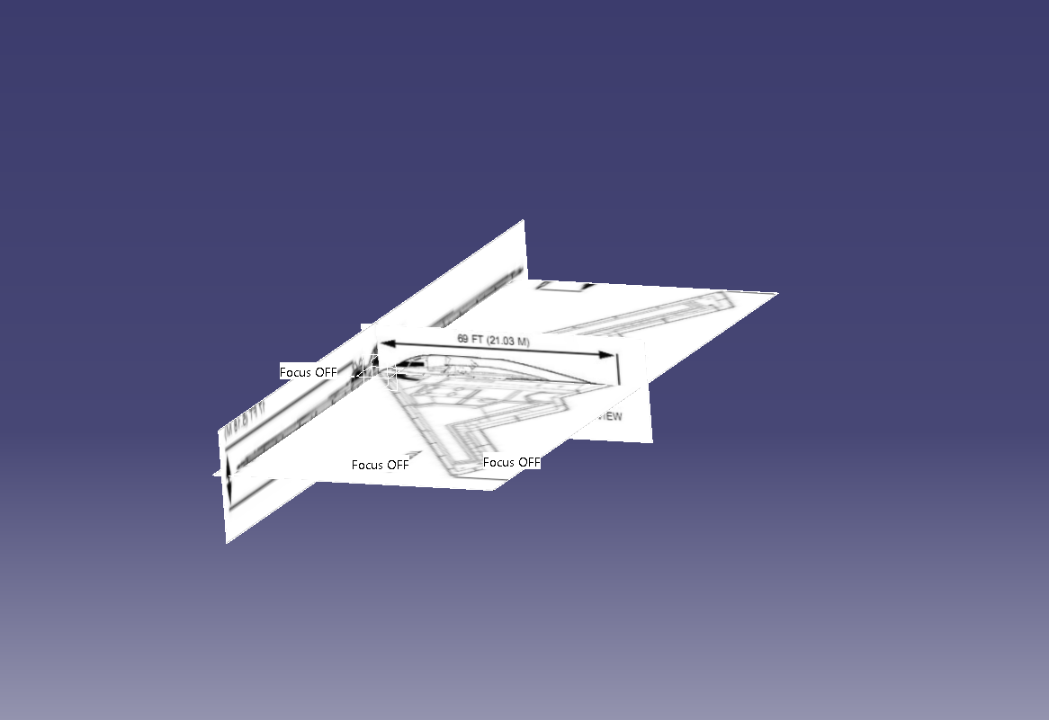
Sketcher
Used sketch tracer to outline shape
Found a top, side and front view to create shape

Slide 3
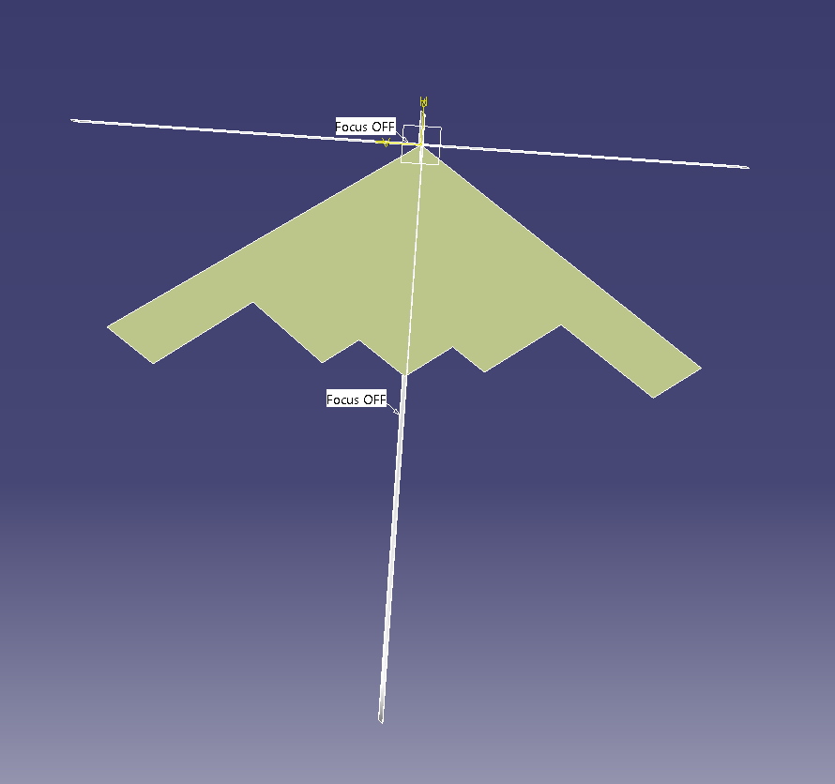
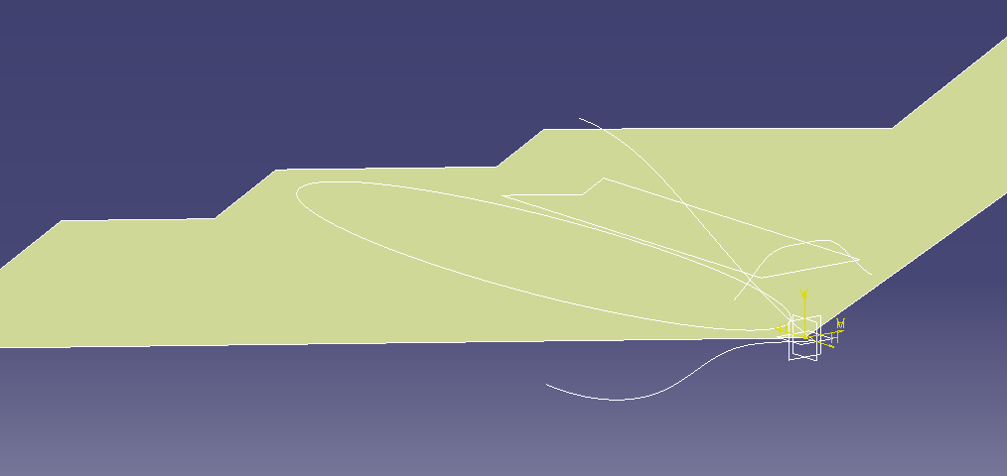
Shape design
Used images to trace features for later creation
Hid images after I traced what I needed

Slide 4
Shape design continued
Using bump tool to add the rough outline of features and curve to the bottom.
Used a symmetry tool to mirror feature

Slide 5
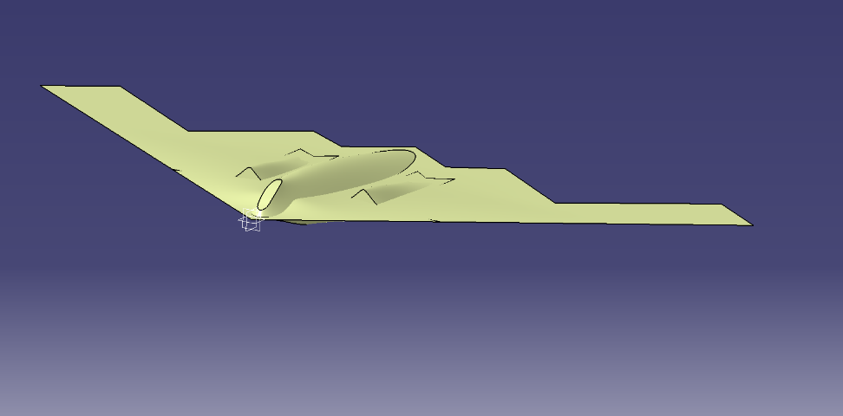
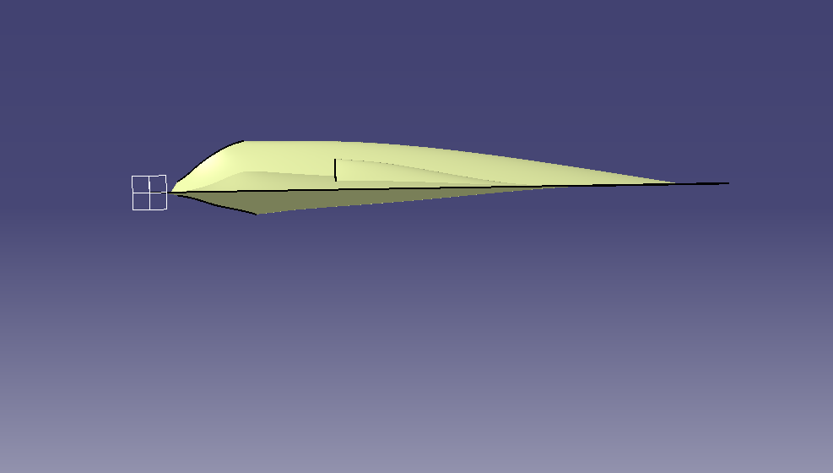
Current progress
Used the side view to correct the curves on top and bottom
From here need to make into solid model to add greater detail

