Slide 1
CRICRI Aircraft Wing
The Smallest Twin Engine Aircraft
Isaac Fisher & Kaleb Halen

Slide 2
Deliverables for final projects

Slide 3
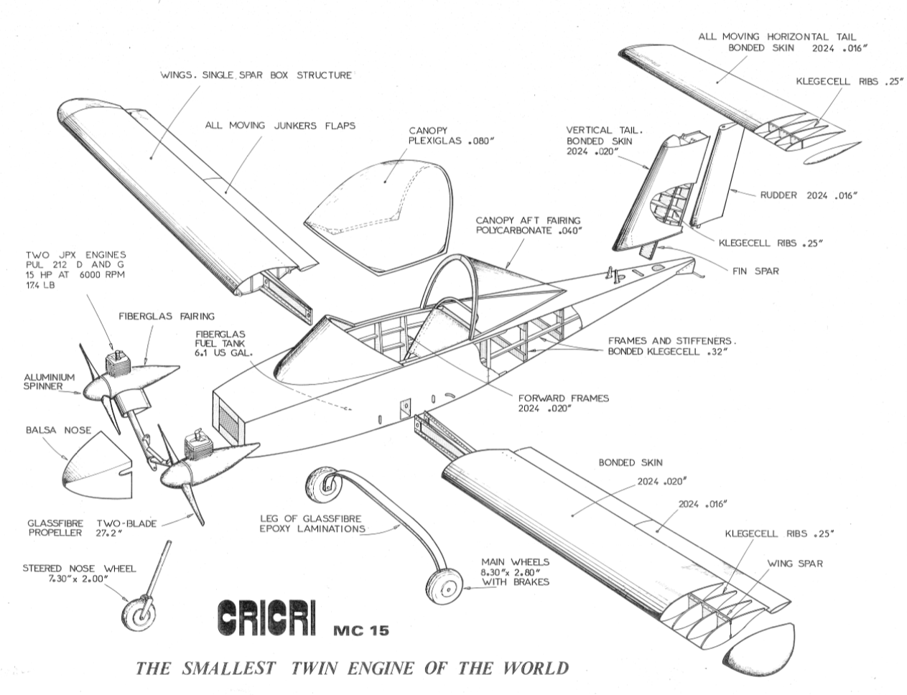
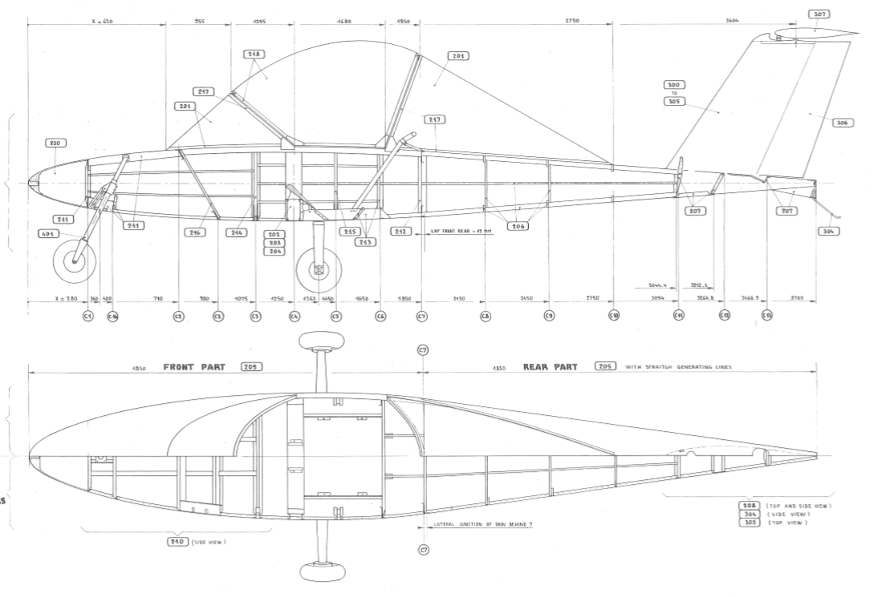
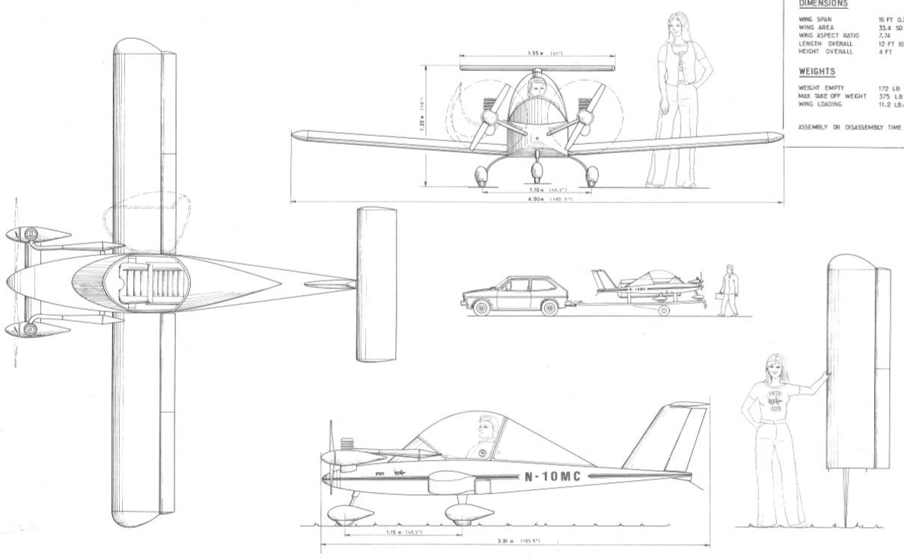
Drawings:
Drawings found online:

Slide 4
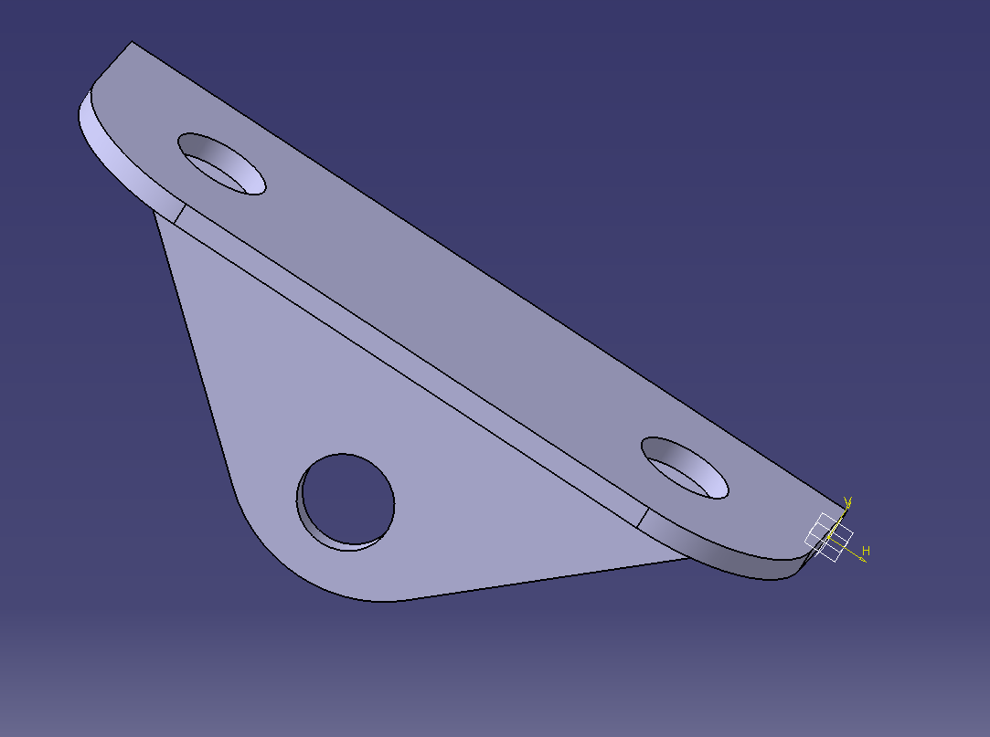
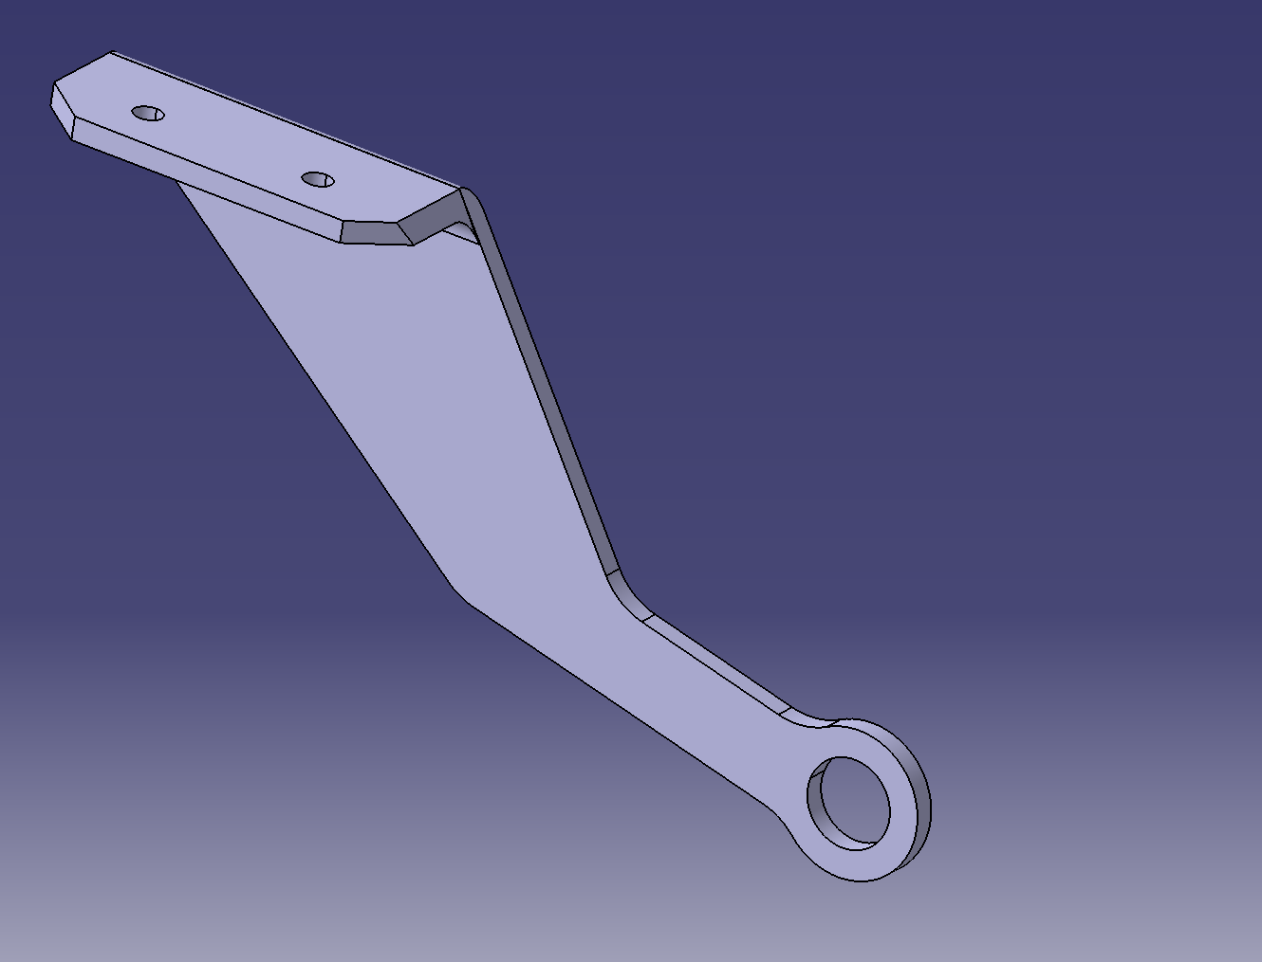
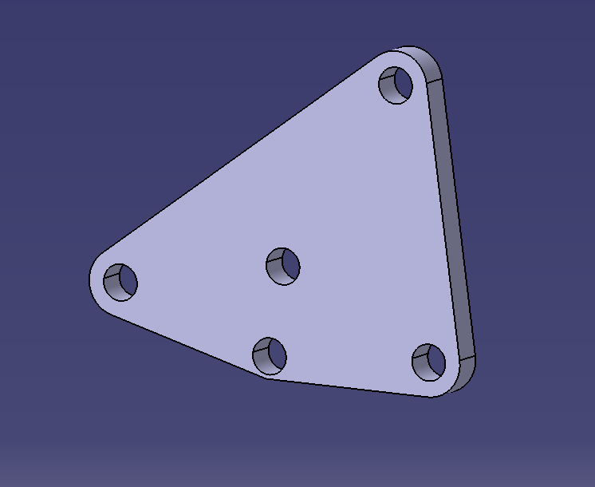
Building Individual Parts
Workbench used: Part Design

Slide 5
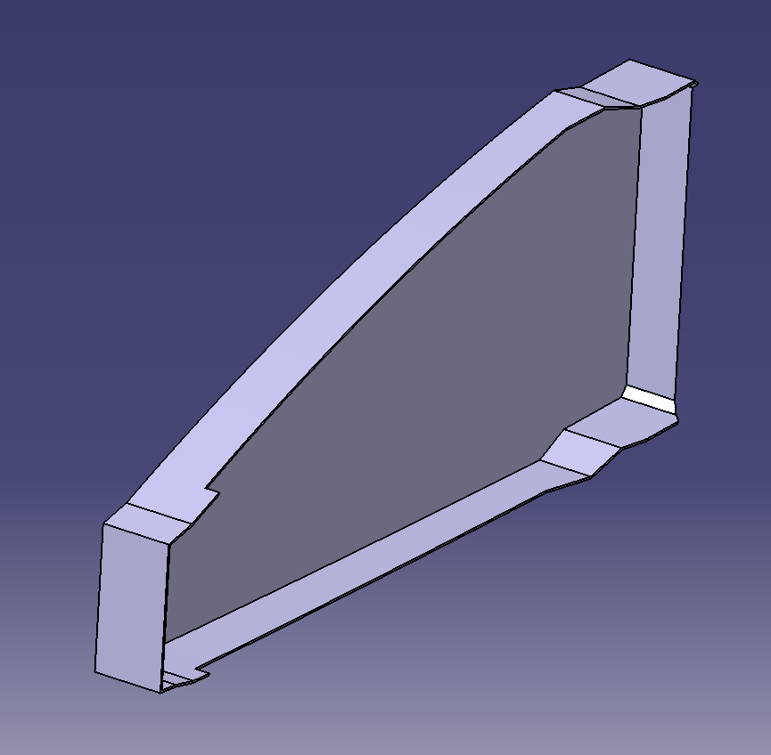
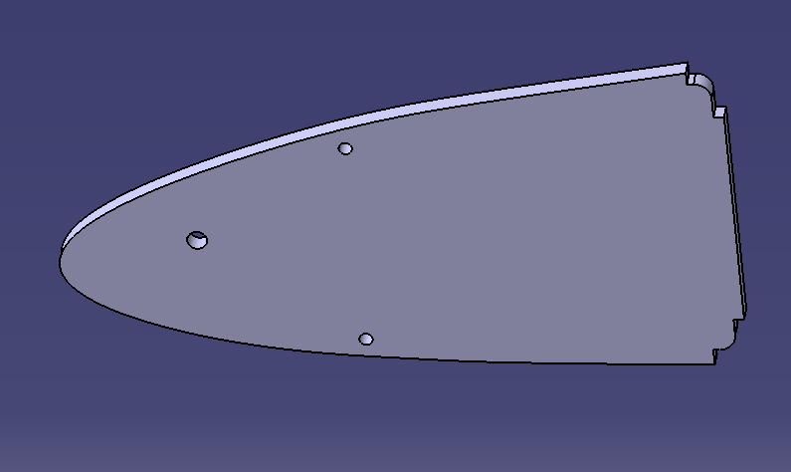
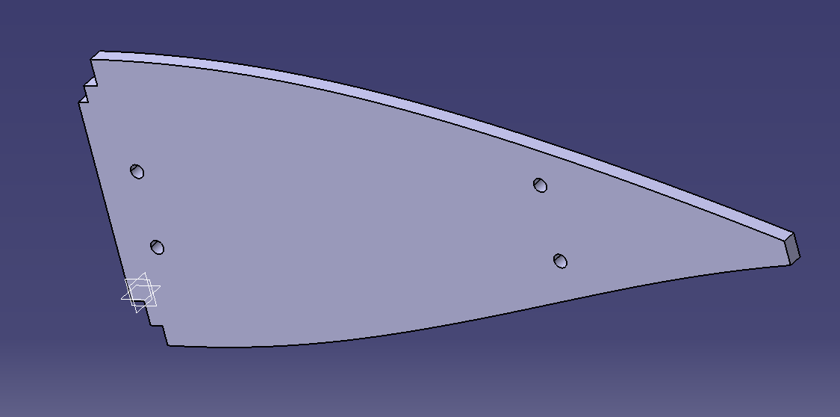
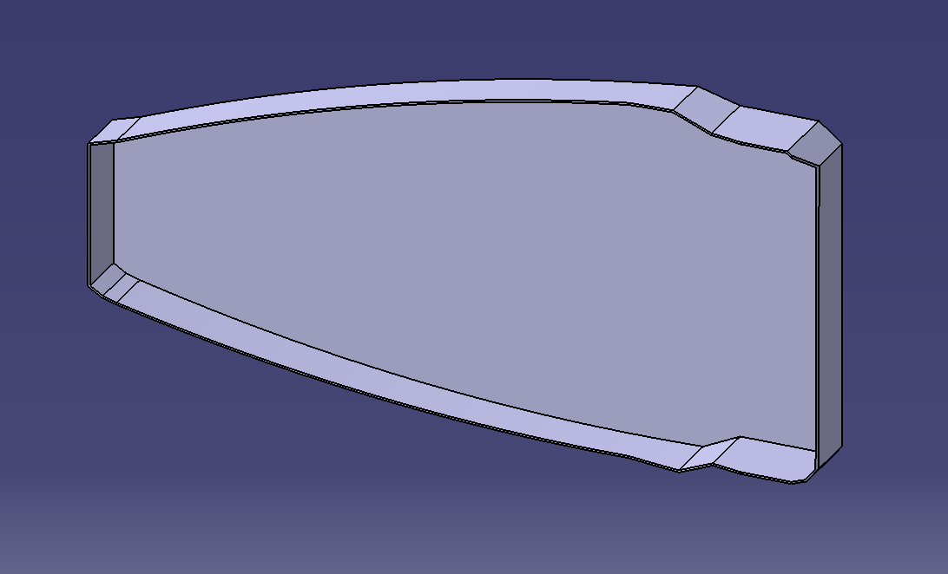
Building Individual Parts
The Sheet metal design workbench was used for these parts

Slide 6
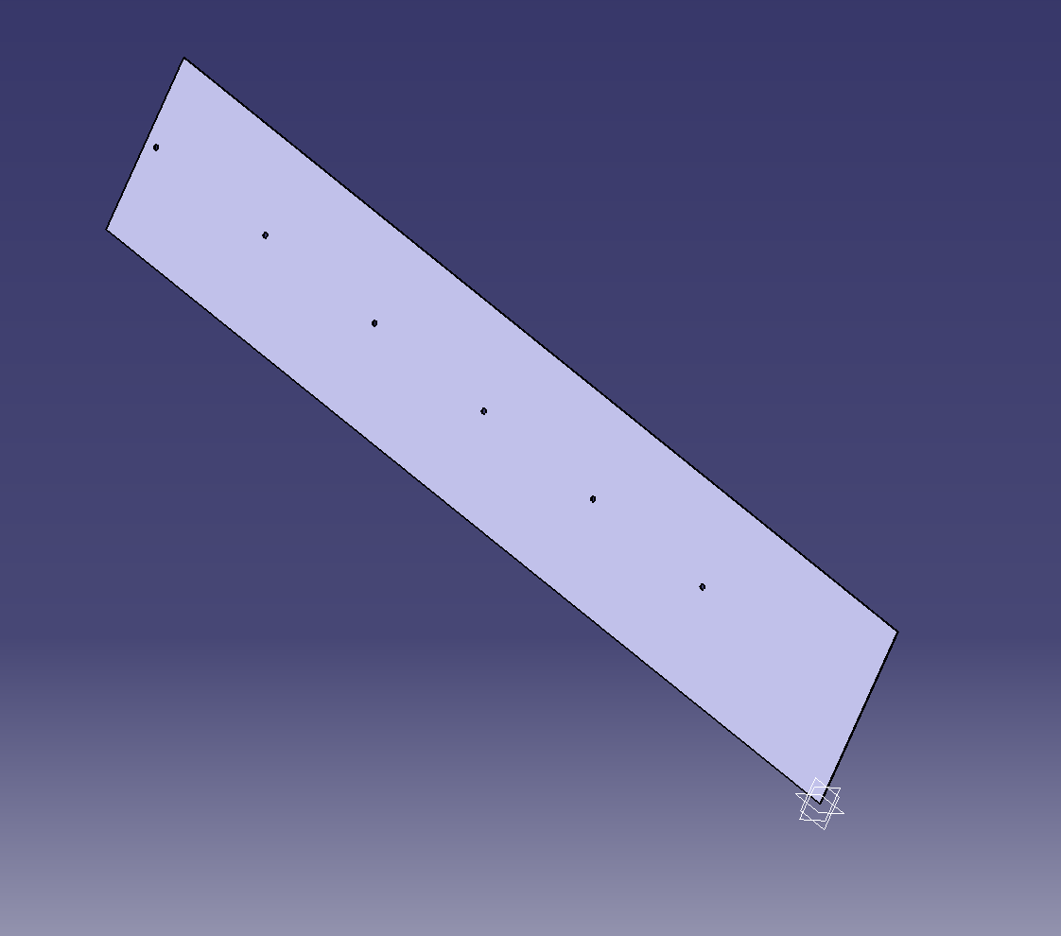
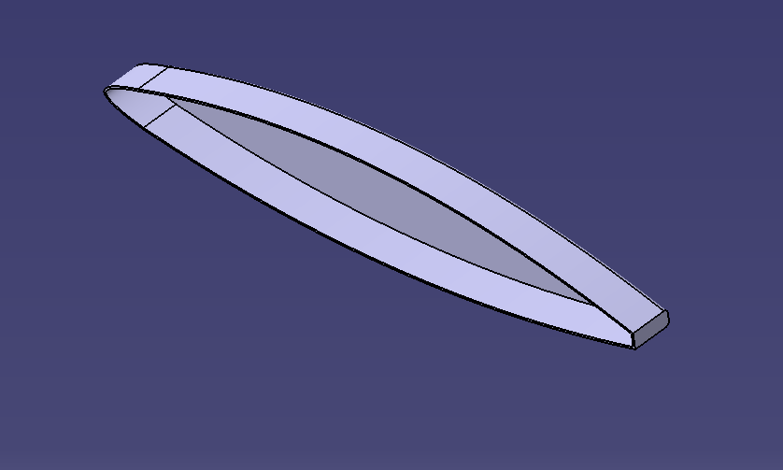
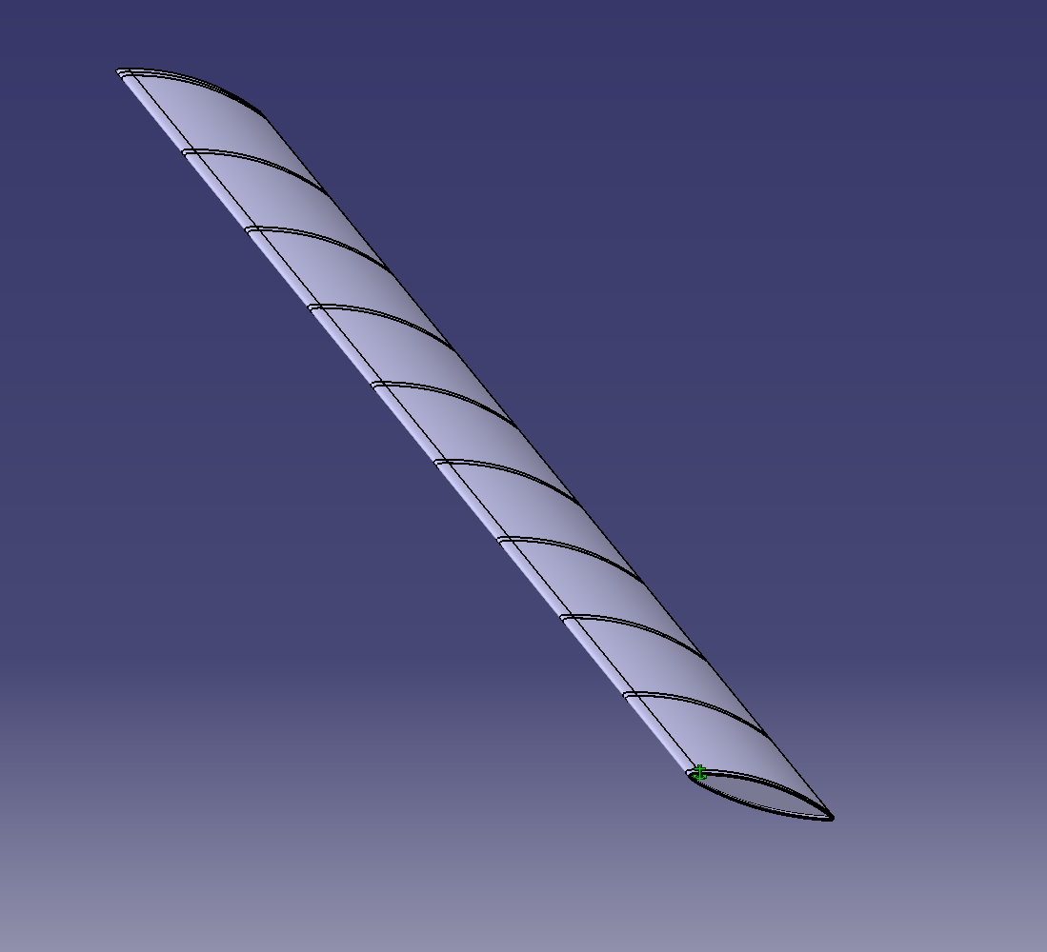
Building Individual Parts

Slide 7
We could show you snips of parts we built all day but lets go ahead and click through the assembly process.

Slide 8
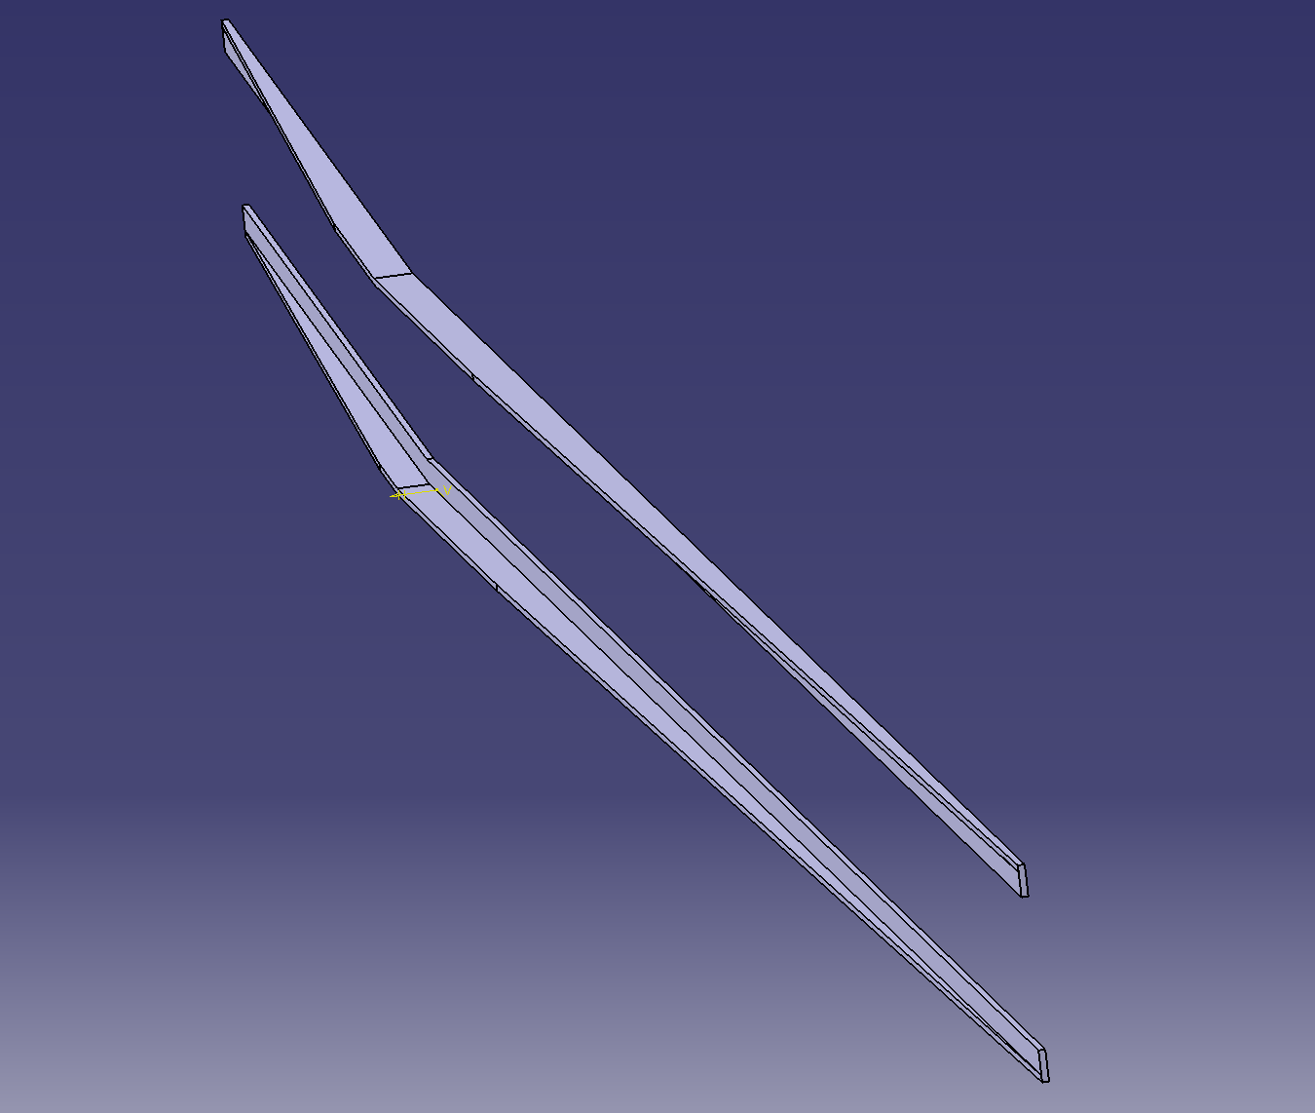
Each of the parts was made using pads and pockets in the part design workbench

Slide 9
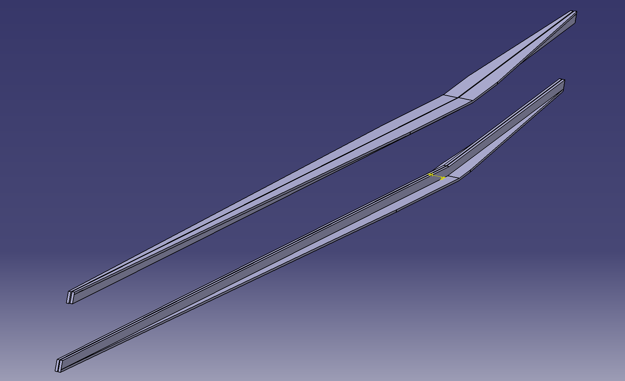

Slide 10
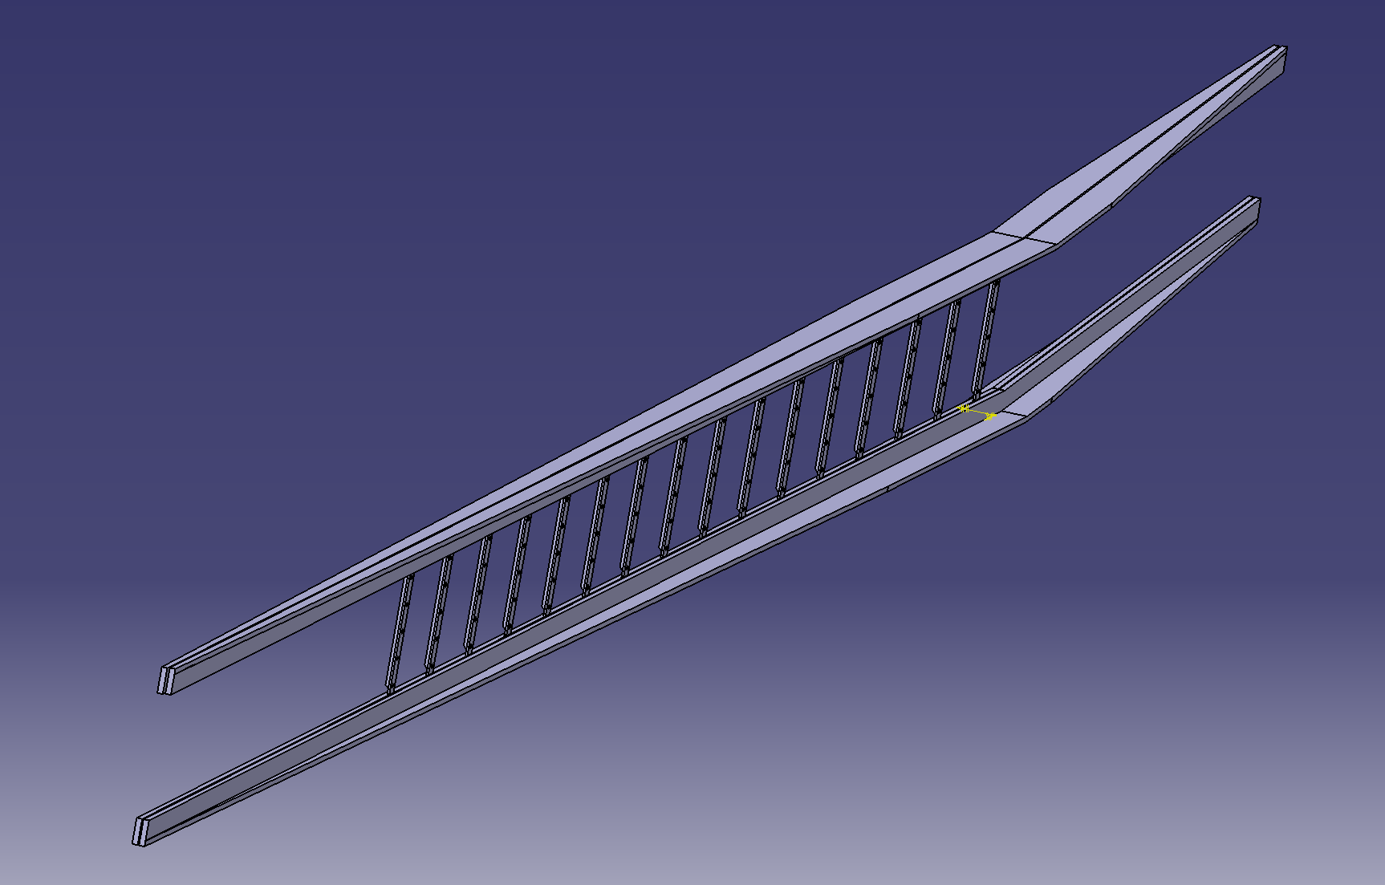

Slide 11
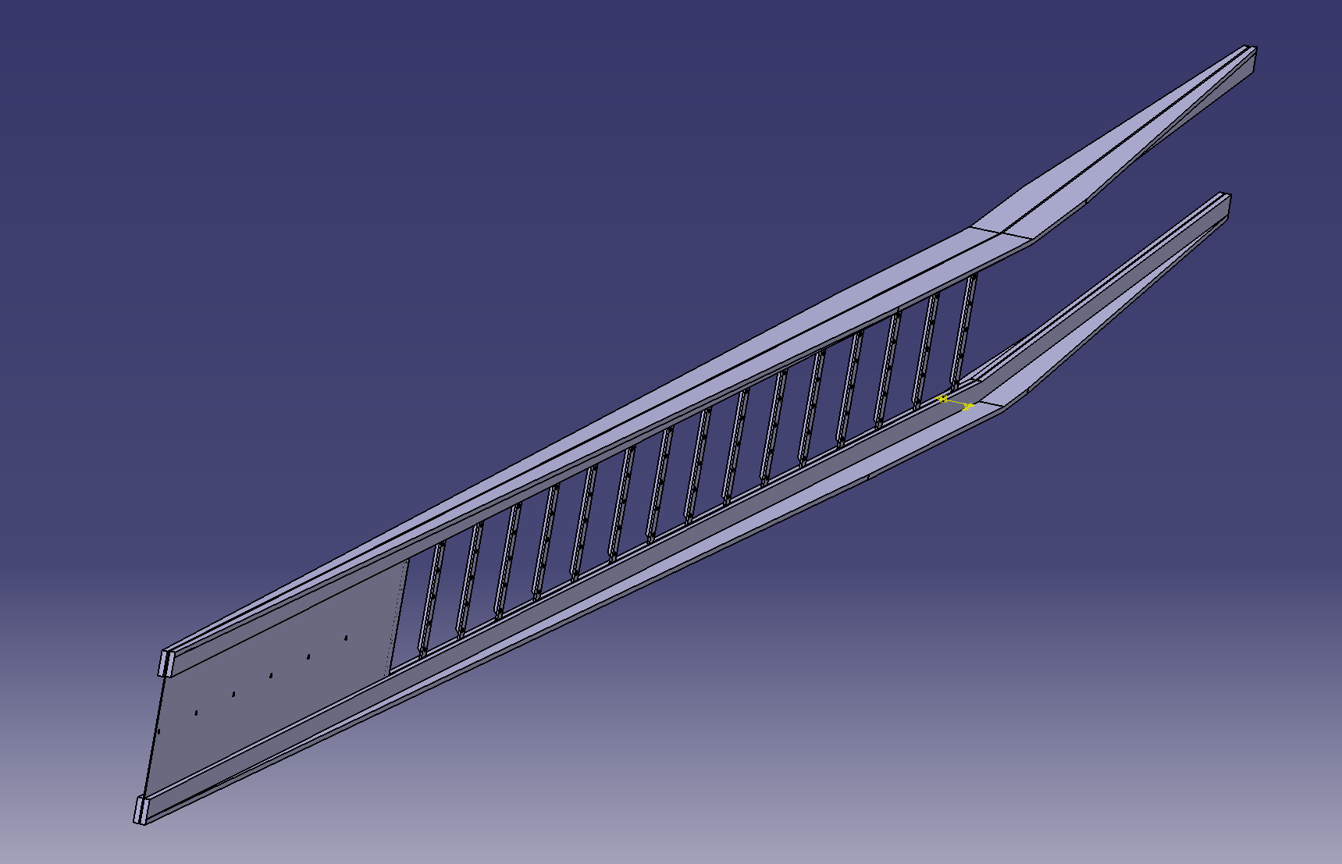

Slide 12
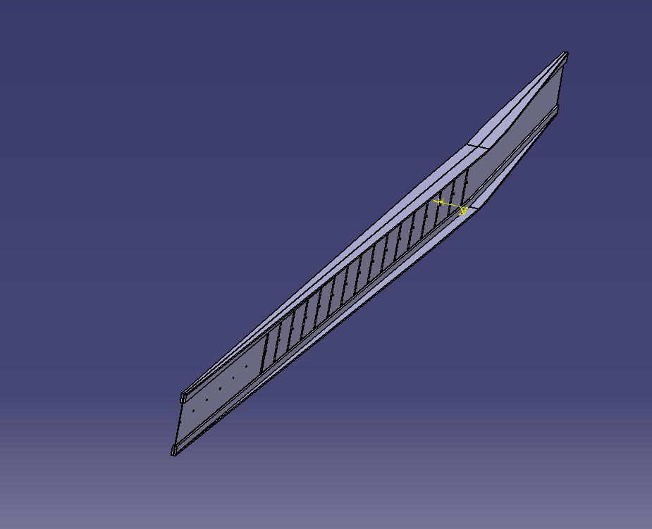

Slide 13
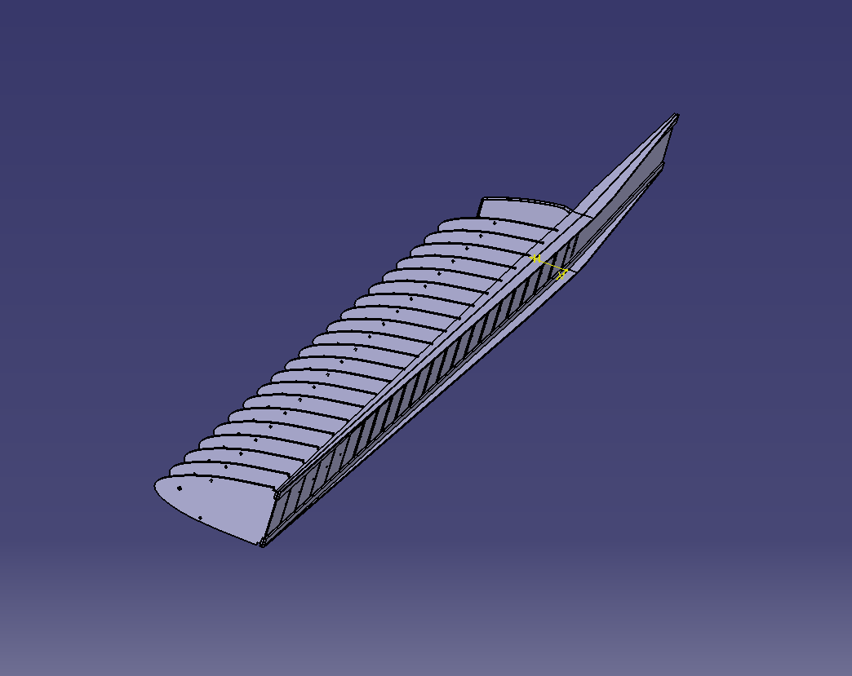
A contact mate was used at the back of each front rib and a coincident mate with the top right rib and the upper spar. Each rib was patterned with a specified offset from the previous rib.
This method was also used for the rear ribs.

Slide 14
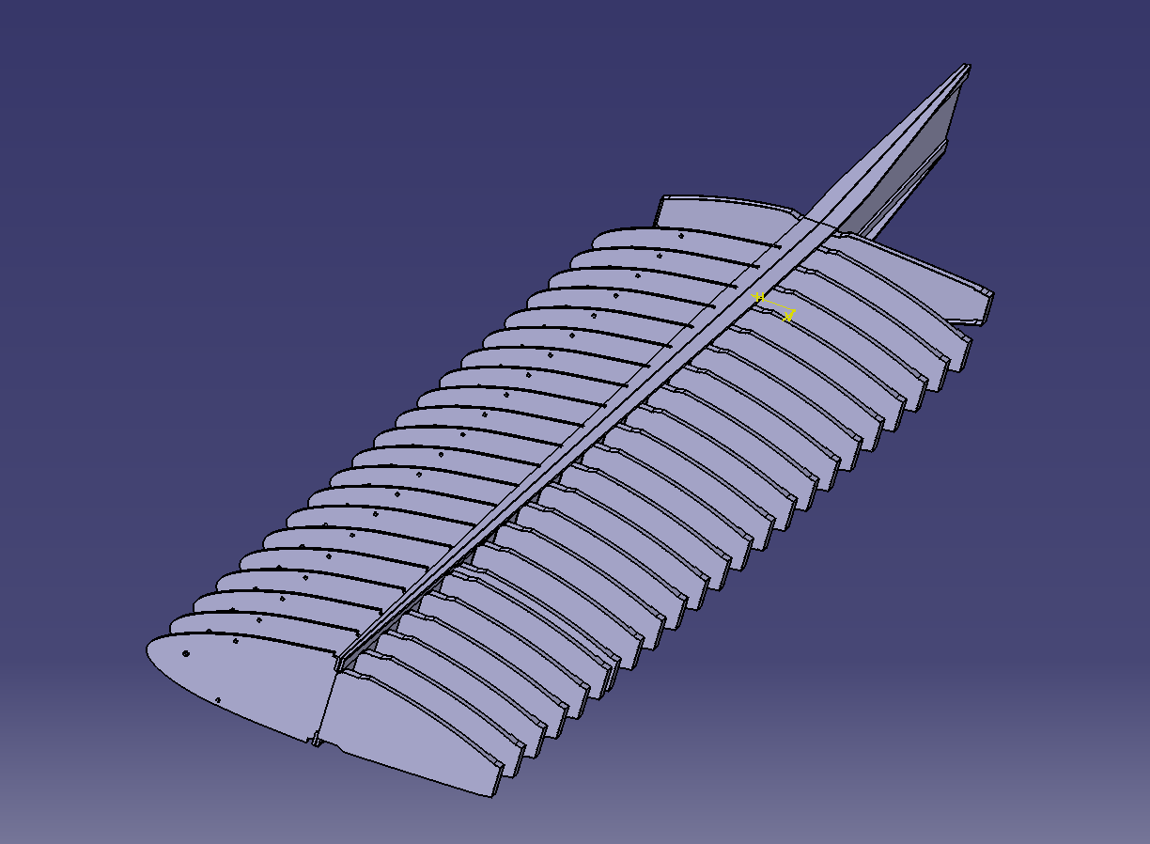

Slide 15
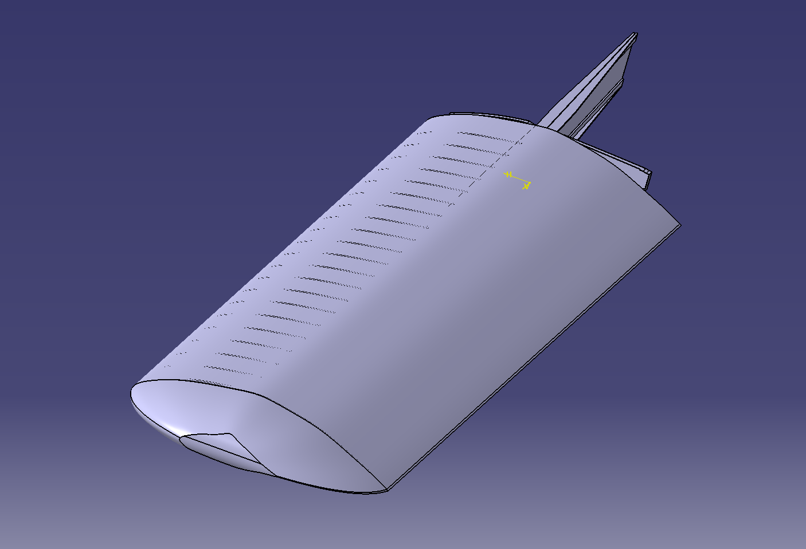
Both the skin and the end fairing for the wing were made using the Generative shape design workbench
The techniques we learned making the Bugatti hood were very applicable here. It required lofting between different shapes while using several guide curves

Slide 16
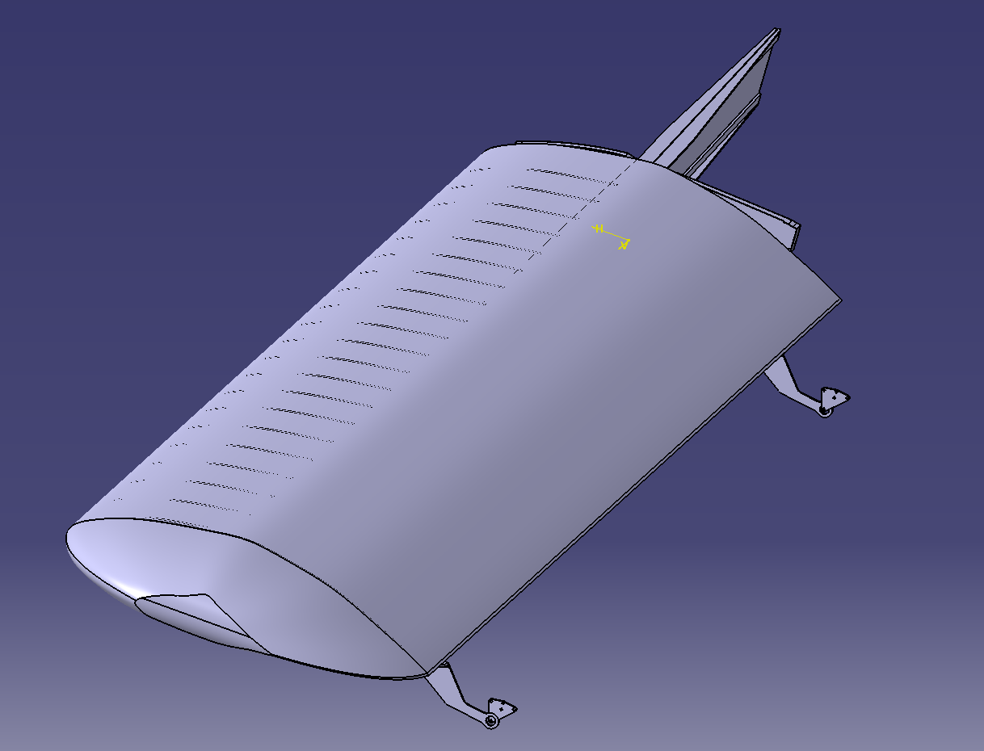

Slide 17
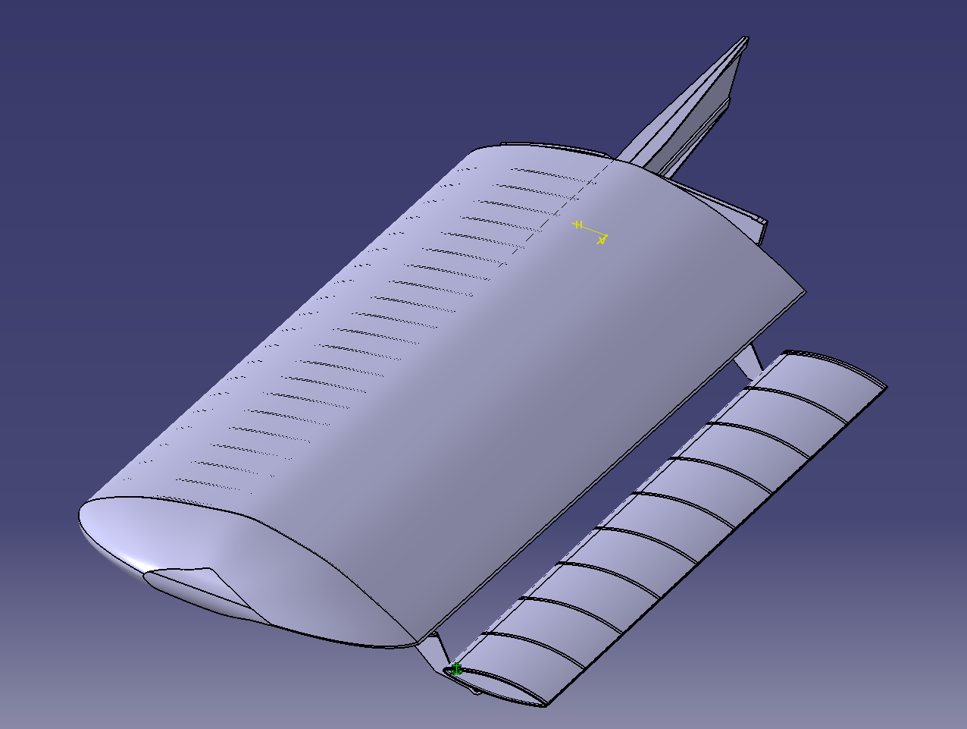

Slide 18
Lessons learned
During this project we learned how important it was to create a schedule and follow it throughout the projected time frame
We really took advantage of always having our parts done in advance of the time that they were due. This gave us the opportunity to go above and beyond, doing more than what was asked of us
We found that Catia’s generative shape design workbench was more than powerful enough to handle the simple surfacing we did near the end of the project.
The save management set up in this program was very helpful to us as well, while we had multiple versions of parts as we attempted to create each one.

Slide 19
Key Tools for future ME 421
If we were going to give advise for future ME 421 Students we would simply say, “when doing your projects be sure to take advantage of using multiple workbenches in Catia.” Because of the in depth amount of tooling that is available in this program, there is a huge advantage in learning how each workbench functions. In the long run this can simplify and more successfully help create parts and assemblies while working on projects. While we didn’t use FEA in our project, we both agree how helpful that tool is for conceptual views of functioning parts in the real world, so if possible everyone should attempt to incorporate this into their project.

Slide 20
Now I realize that we were only required to build and assemble the wing for the completion of this project; but we thought we would go above and beyond by creating a fuselage for the wing

Slide 21
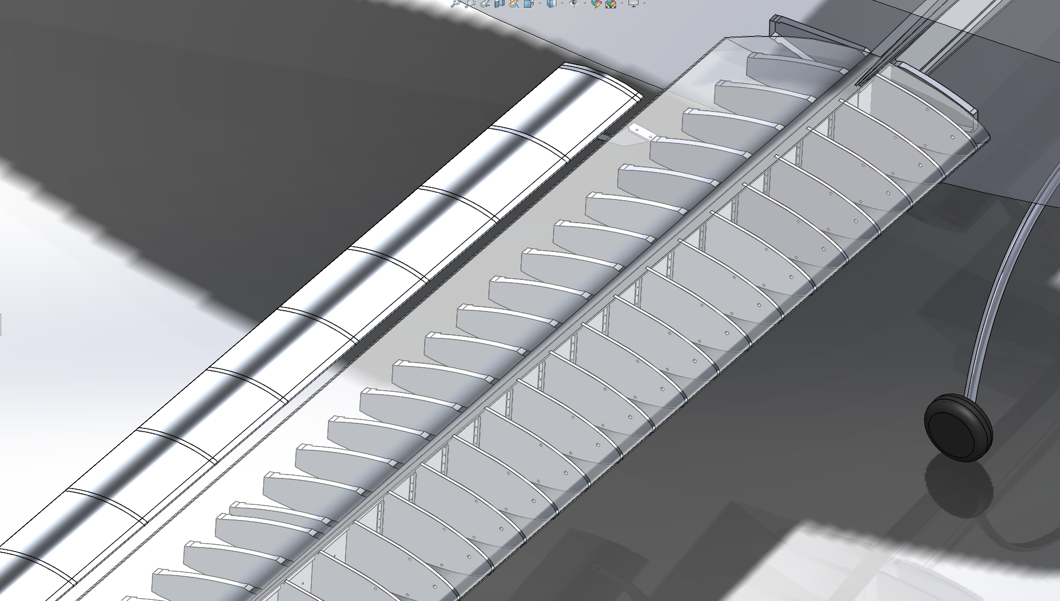

Slide 22
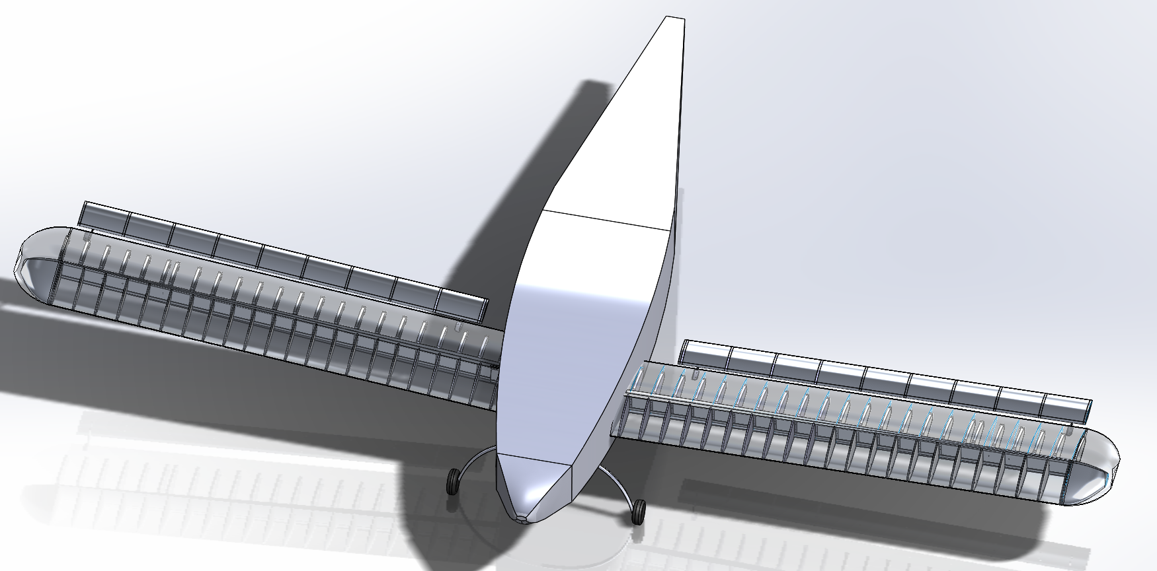

Slide 23
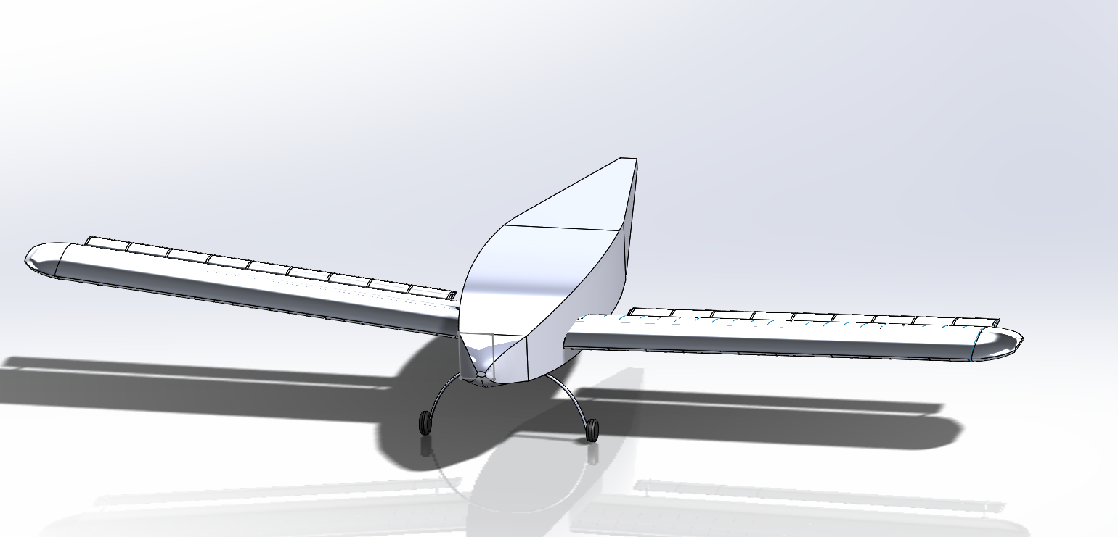

Slide 24
