Slide 1
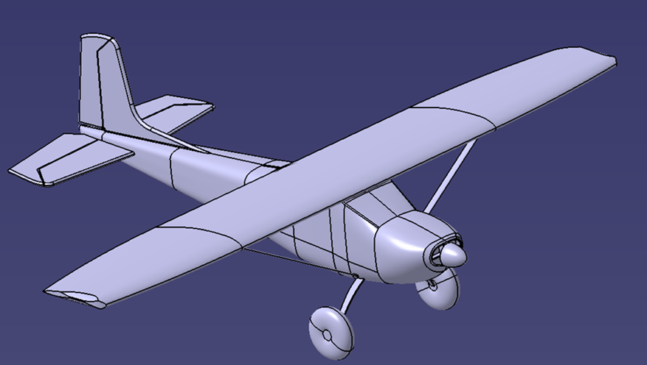
Modeling a Cessna Aircraft in Catia
Josh Frei

Slide 2
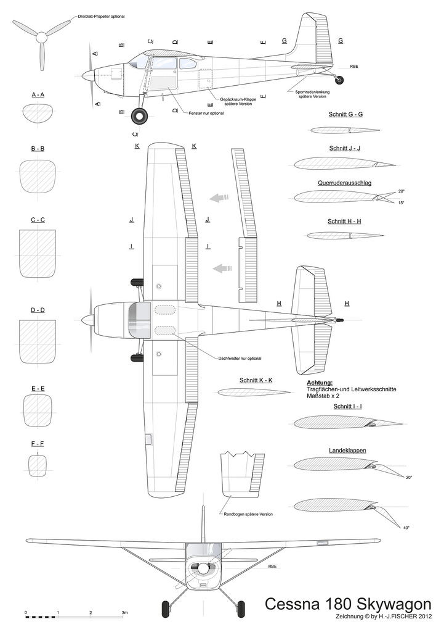
Pictures and Diagrams
To model this aircraft, first I found a diagram/blueprint to trace and follow. Using the sketch tracer feature I was able to accurately obtain the profiles of the complicated shapes. Pictures of the real airplane were also much help in maintaining visual accuracy.

Slide 3
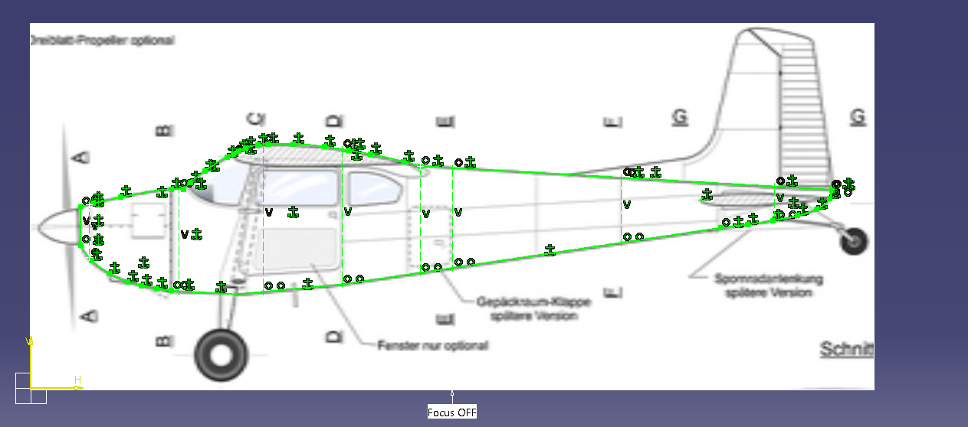
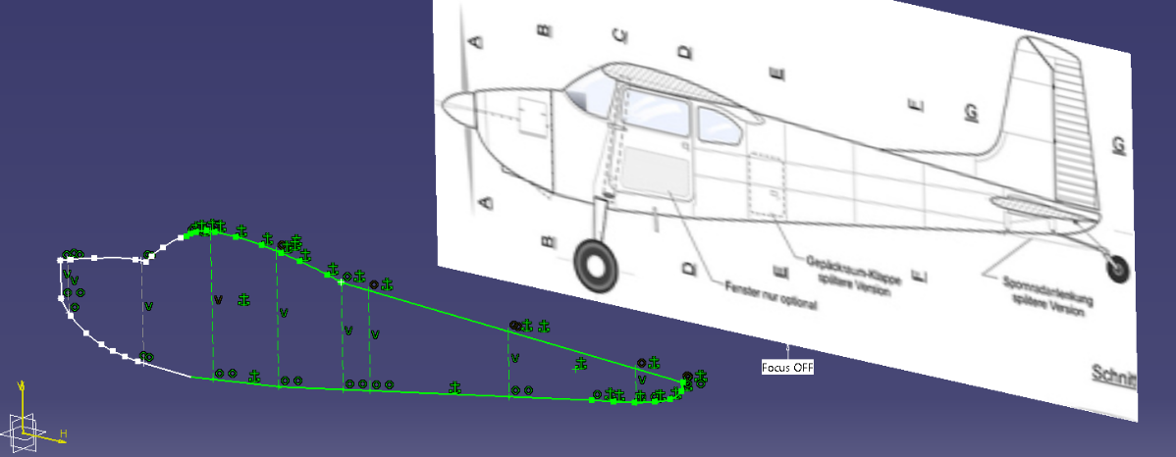
Tracing the Fuselage Profile
To get a profile of the fuselage I used the sketch tracer feature and a series of splines and lines. I used this profile as a guide to loft the different pieces of the fuselage.

Slide 4
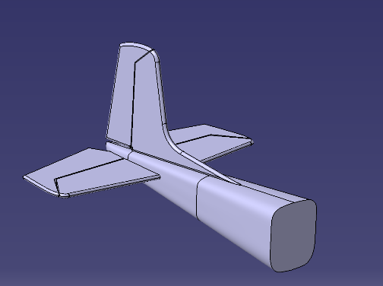
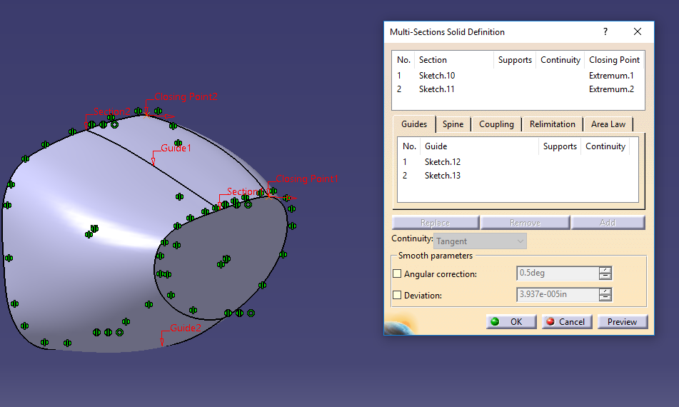
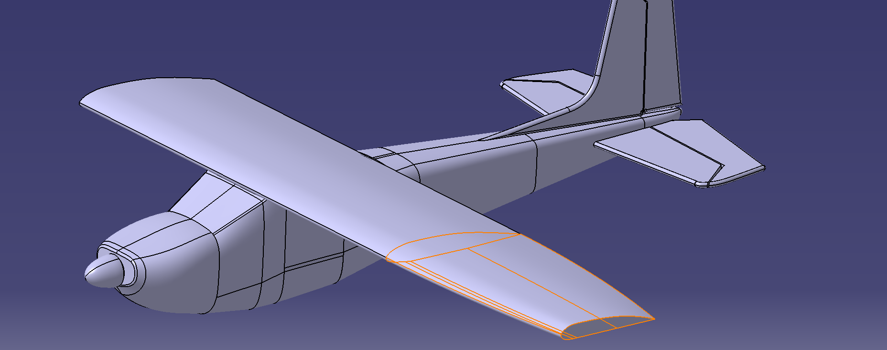
Lofting the Fuselage and Wings
Since the profile changed throughout the fuselage, I had to use different lofts every time the profile changed. Using the different profiles and the fuselage sketch as a guide, a series of lofts were performed to obtain the model of the fuselage. The same steps were taken to make the wings and the tails were done using a simple pad and filleting the edges

Slide 5
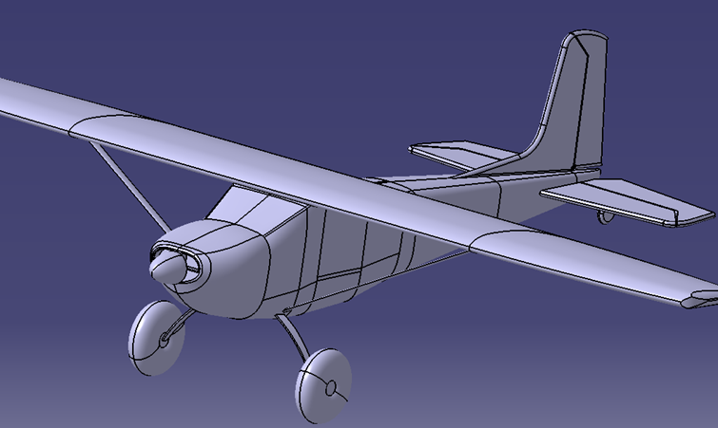
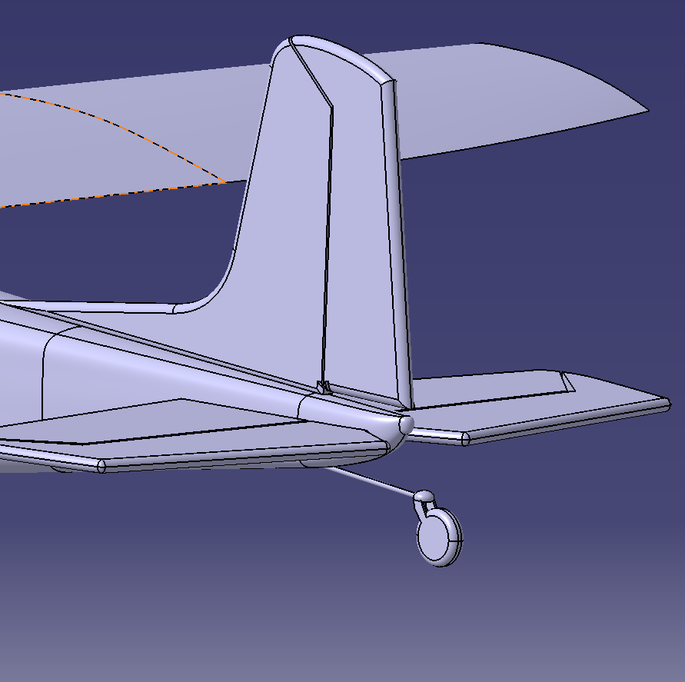
Current Progress and Future Plans
Currently I finished the fuselage, tail sections, wings, nose cone and tail wheel. To finish the project, the wing struts, main landing gear, windshields engine cowl scoop.

Slide 6
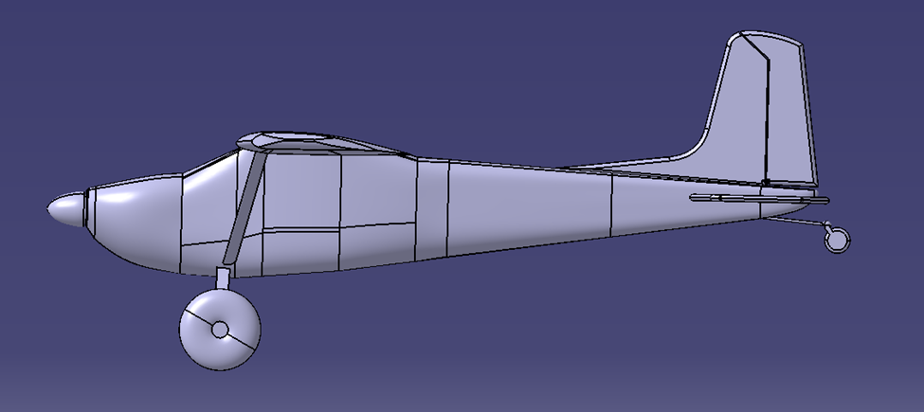
Lessons Learned
This project has been very beneficial for learning how to properly do a loft to different shaped profiles. Something I learned very fast was that in order to perform a loft with multiple guides, those guides has to be their own sketch and you cant use guides from other profiles. The other big thing that I learned was that sometimes you have to set the coupling to “ratio” instead of the default setting or it will have errors building the shape. This is in the multi-section solid properties window. I have yet to do any generative shape of surfacing with this project but I will have to with the windshield.

