Slide 1
Kibbie Dome Remodel & FreeStyle Workbench
Jessie Aldecoa, Caitlin Owsley,
Ben Reed, Josiah Savino

Slide 2
FreeStyle Workbench: The Goal
Explore and learn the features of the FreeStyle Workbench
Develop a simple tutorial to demonstrate key features of the workbench
Apply knowledge gained to create features in the Kibbie Dome Redesign

Slide 3
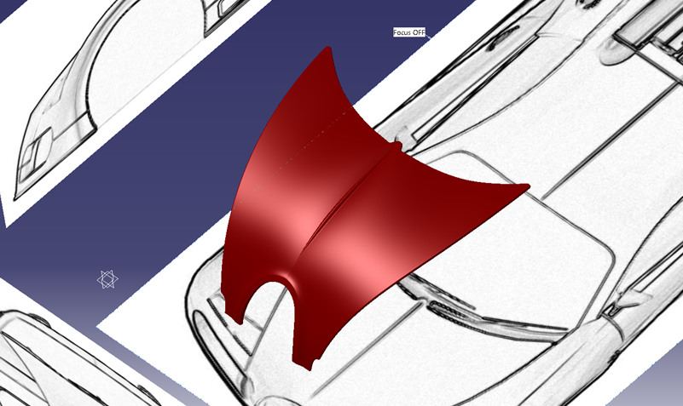
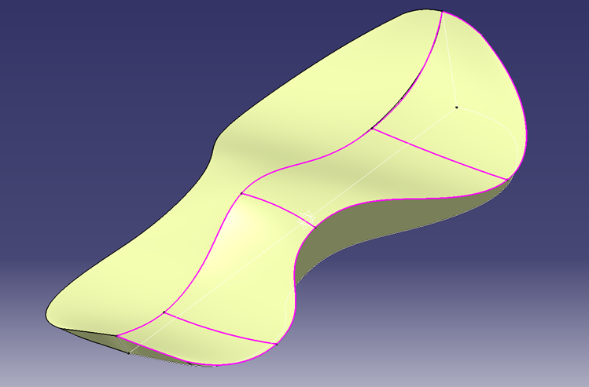
FreeStyle: Products Created
Bugatti Veyron Hood
Sketch Tracer
FreeStyle
Generative Shape
Spaceball Model
FreeStyle
Generative Shape

Slide 4
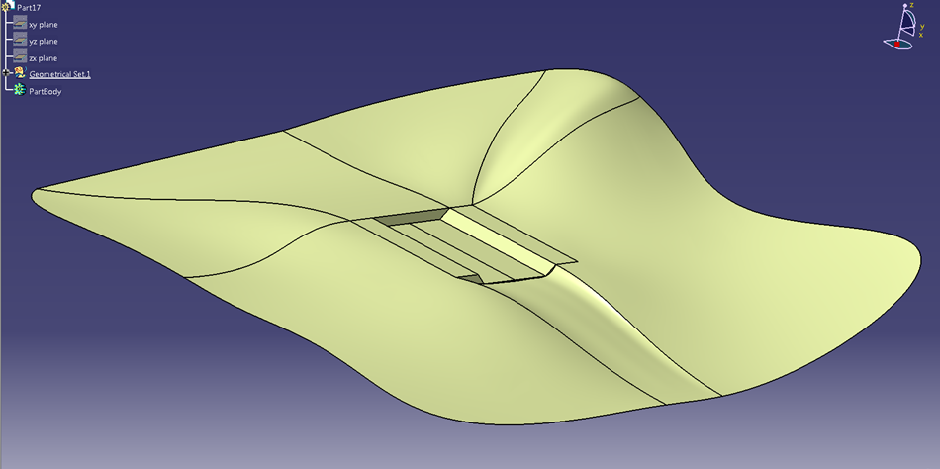
FreeStyle Workbench: Landscape
Generated landscape to model the Palouse rolling hills using the FreeStyle Workbench

Slide 5
Kibbie Dome Remodel: The Goal
Make the Kibbie Dome the ultimate facility for UI sports, speakers, & concerts
No limit of practicality, money, or time
Incorporate the use of the Freestyle Workbench in the design

Slide 6
Kibbie Dome: The Plan
Incorporate additional seating as well as an opening roof for sunny days
Dress up the landscape of the East end of the Kibbie Dome
Use the Freestyle Workbench to create the landscape of the Palouse

Slide 7
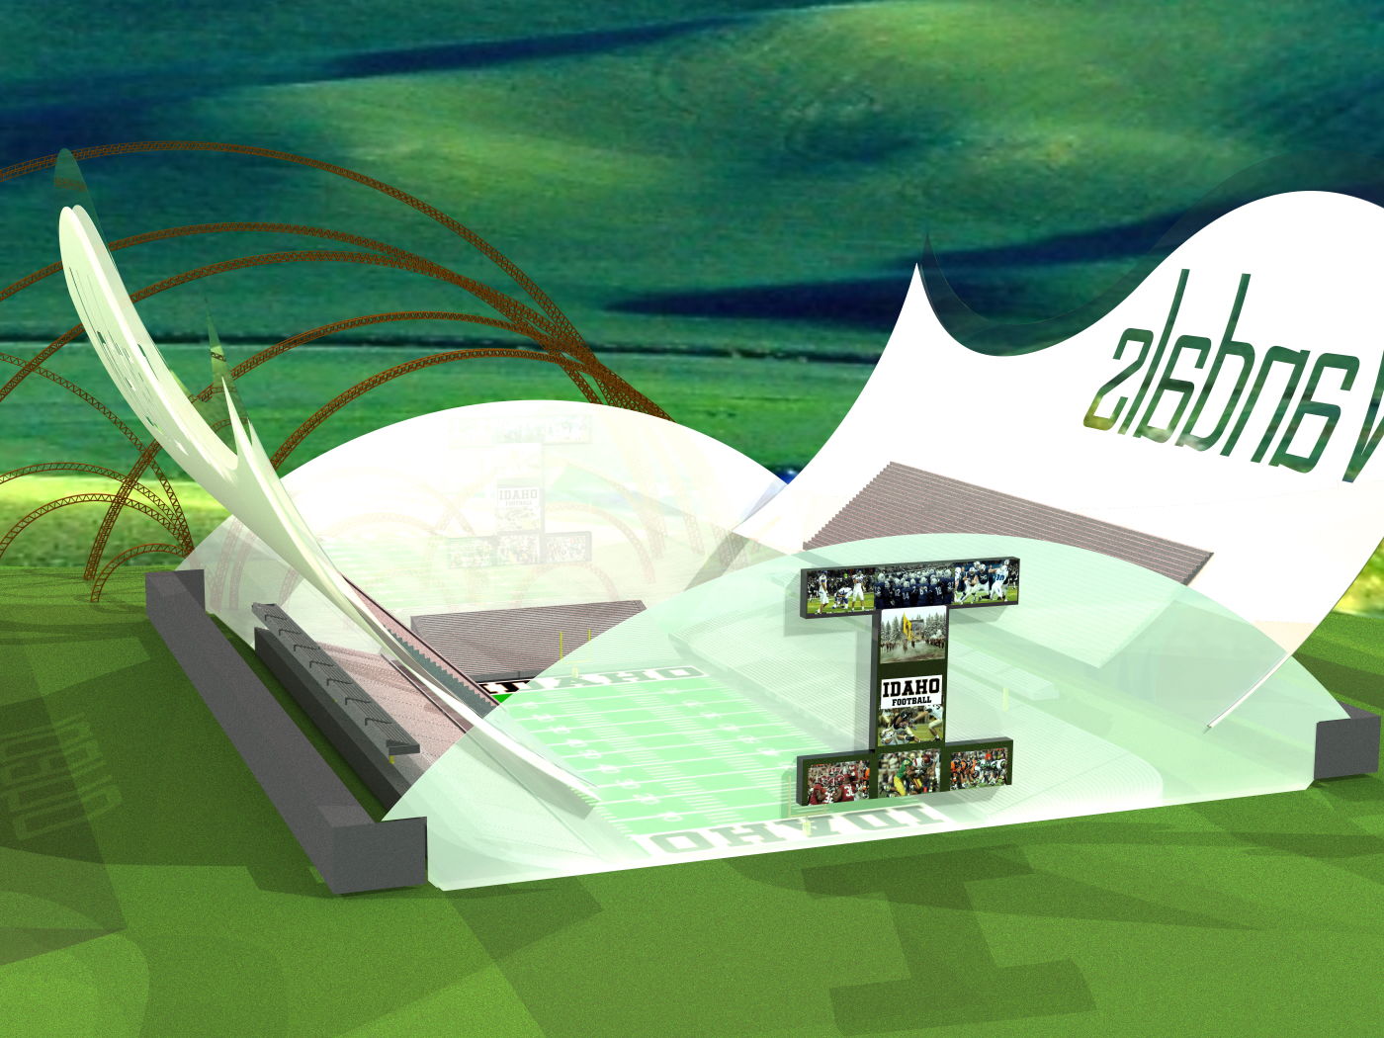
Kibbie Dome: The Final Product

Slide 8
Kibbie Dome: The Final Product

Slide 9
Kibbie Dome: The Final Product

