Slide 1
Modeling an English Style Bracket Clock in Creo
David Erickson, Chris Thilmony, Amanda White

Slide 2
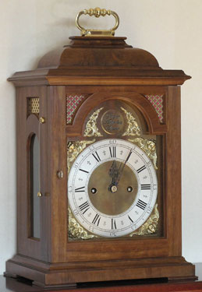
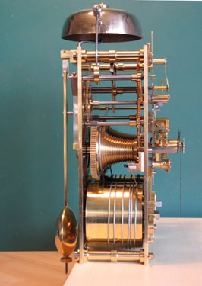
Objective
Goals
Explore Creo modeling software and its similarities to CATIA.
Model English Style Bracket Clock
Create drawing package and renders
Left: An actual finished clock is shown with complete case and inner workings.
Right: A picture of an actual clocks inner workings.

Slide 3
Modeling Process
Based on the instruction book used to machine the clock we derived the needed dimensions and parts in order to model this clock.
Rendered image of the partially assembled clock with front plate hidden
Rendered image of the clock.

Slide 4
Renders
Rendered image of the clock.
Rendered side profile of the clock.

Slide 5
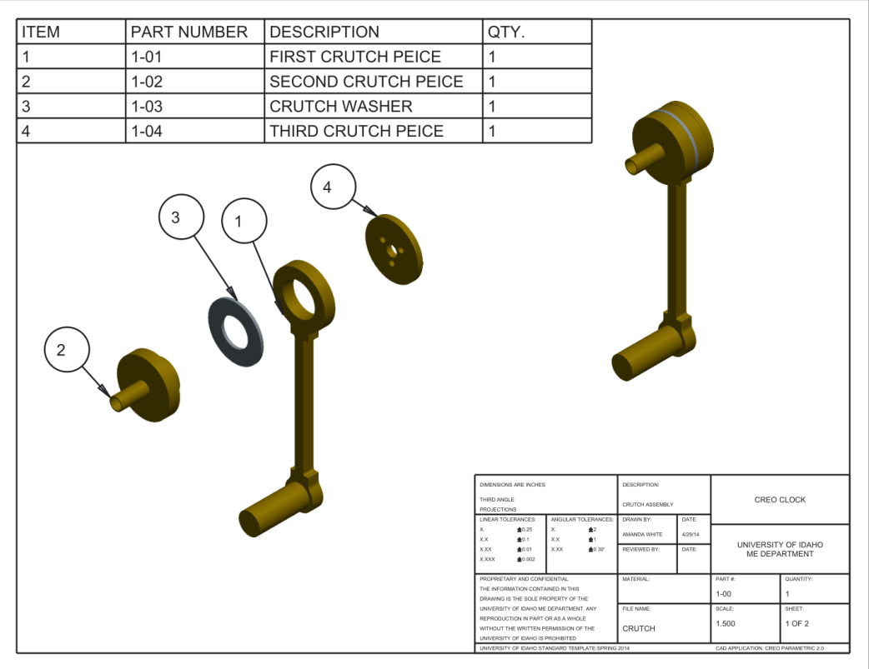
Renders of Internals
Rendered image of the Time Fusee Assembly
Example of an assembly drawing

Slide 6
Project Learning
Our group learned that Creo’s basic modeling is more similar to SolidWorks than CATIA.
The overall interface is not very complicated to learn and rather user friendly.
Once a template is set up for drawings the process is very similar to what is required for SolidWorks.

