Slide 1
Reverse-Engineering an overbored KTM525
Anthony Gatlin, Richard Leathers, Robert Willis

Slide 2
Objective
GOAL: Create a mockup of an over-bored KTM525 so that further study and redesign can be conducted.
KTM525 engine will be used on the Formula Hybrid Challenge race car in the future.

Slide 3
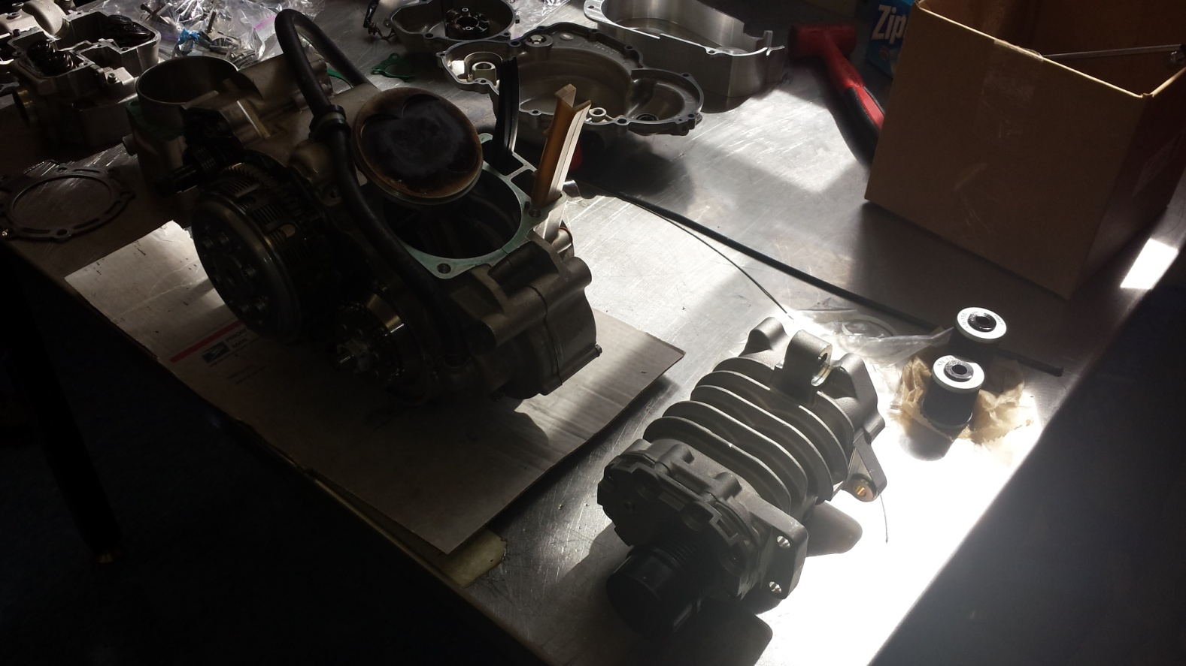
The Beginning…
Started with a partially disassembled engine and no previous experience with the MicroScribe Reverse Engineering system.

Slide 4
The MicroScribe…
Modeling a cylinder head gasket with the MicroScribe

Slide 5
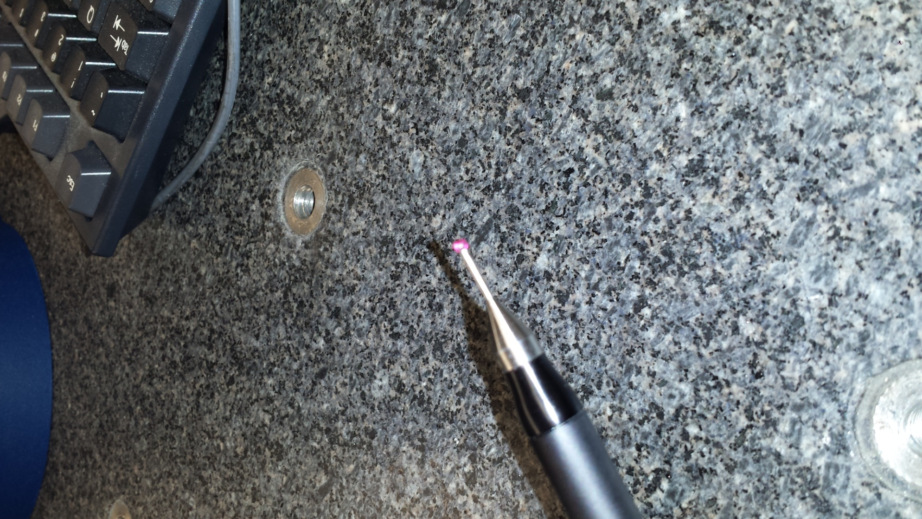
The MicroScribe…
The tip being used to “scan” the piece we are working on

Slide 6
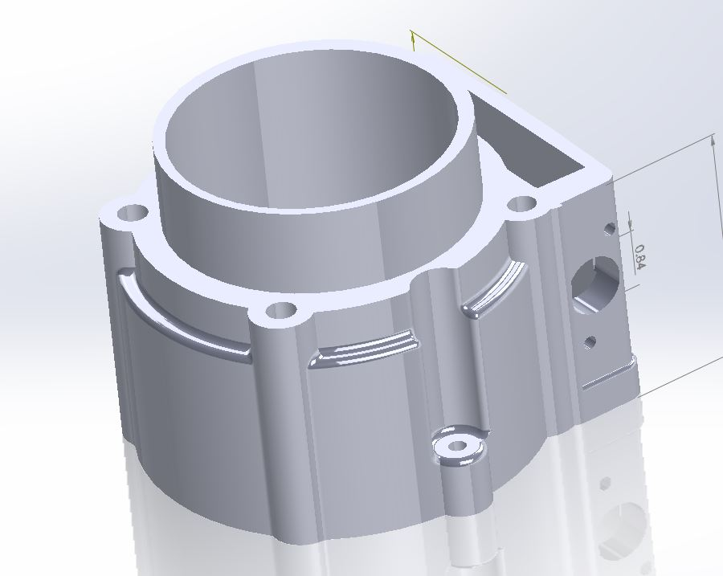
Results of our Labor…
A rendered representation of the cylinder, created with a combination of FARO arm use and manual modeling

Slide 7
The Real Parts…
The bored-out KTM525 cylinder

Slide 8
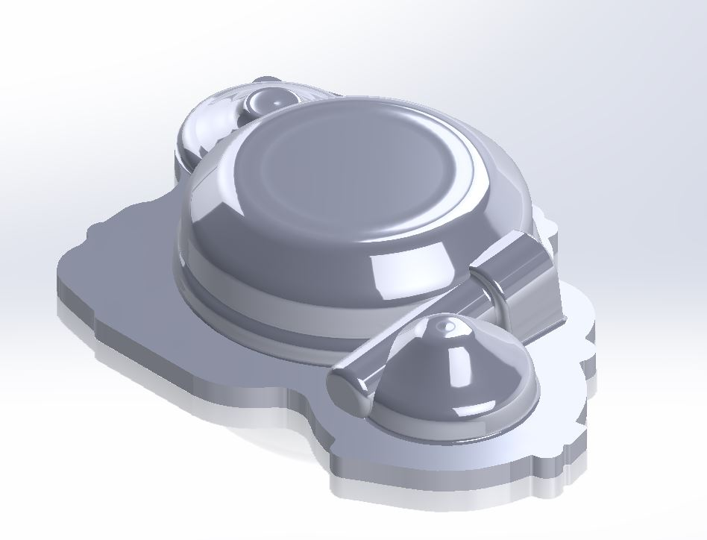
Another Part Reverse Engineered…
The features of the clutch cover are normally hard to capture with conventional techniques

Slide 9
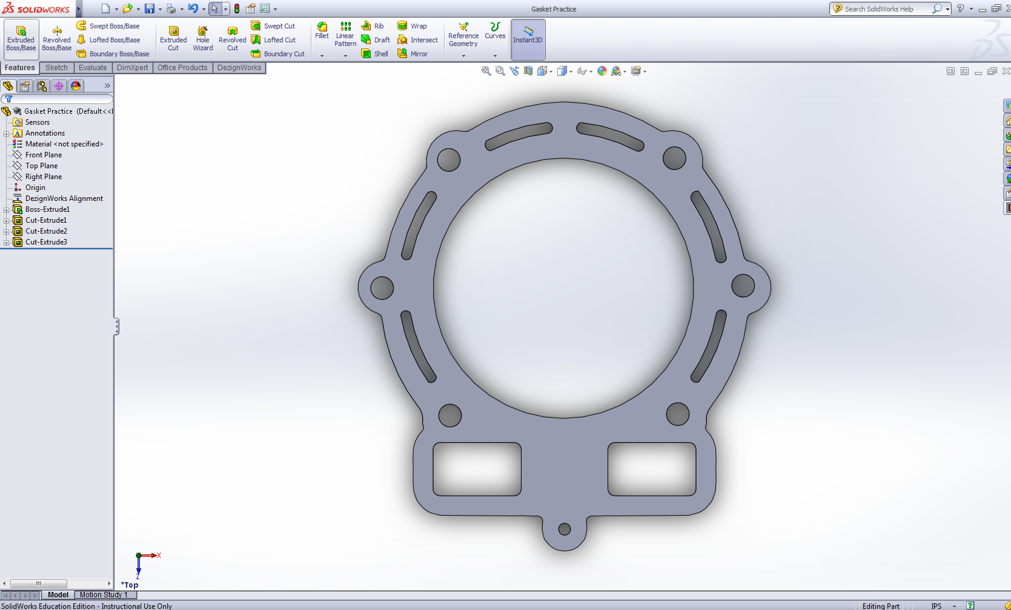
Another Part Reverse Engineered…
While this gasket is easy to model with conventional methods, the MicroScribe cut down on the effort involved.

Slide 10
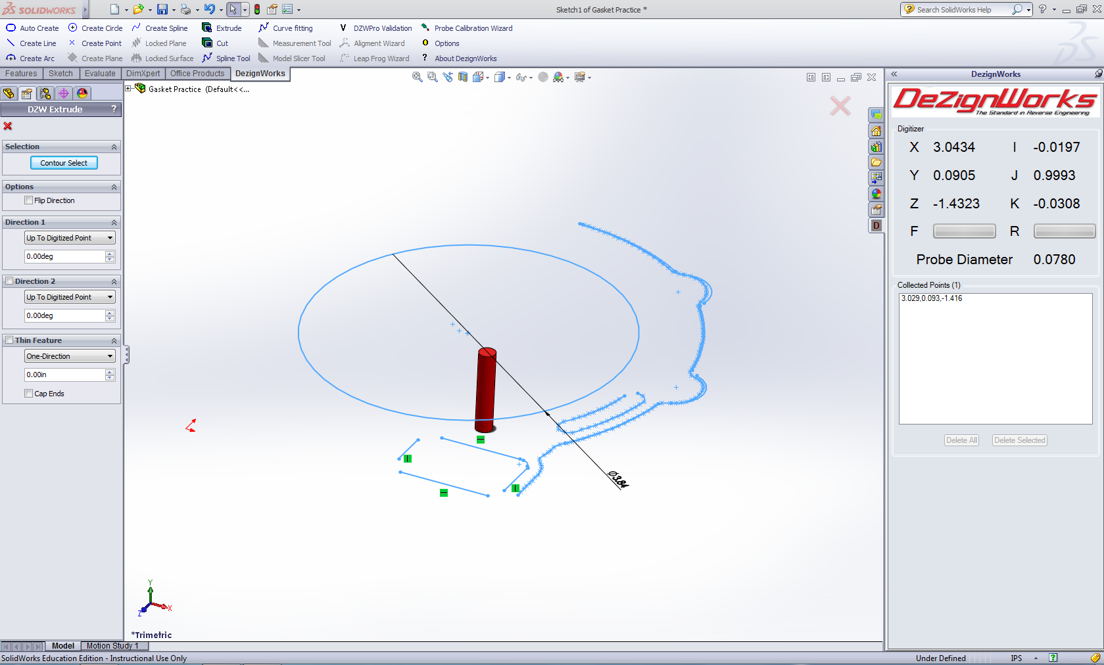
Another Part Reverse Engineered…
The interface when you are working with the MicroScribe. The stylus is represented by the red cylinder in real time.

