Slide 1
Idaho Engineering Works (An Active Learning Building) Signature Vision
Jesse Caudle, Jacquelin Remaley, Kylie Touchstone

Slide 2
Objective
Design an active learning building that will be located in the EP courtyard.
Create three interactive classrooms for 50, 100 and 150 students.
Create concepts for new additive and machining/ manufacturing suites.

Slide 3
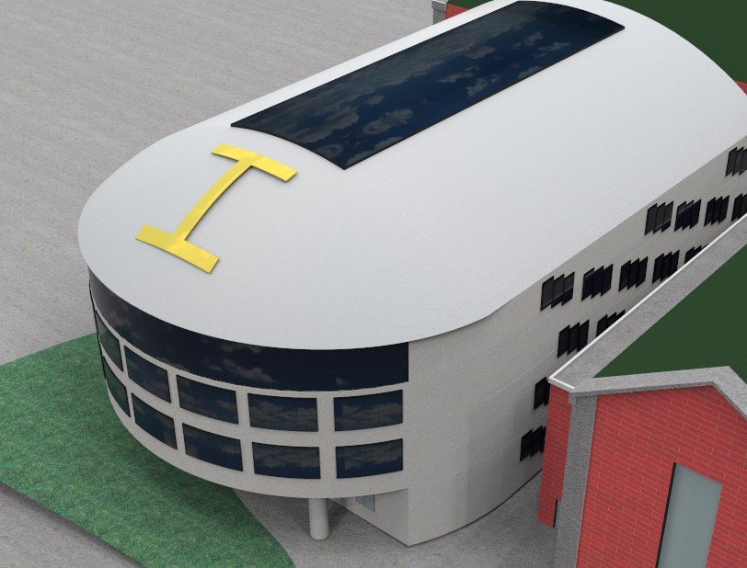
Signature Building Exterior
Idaho Engineering Works:
“A Building of cutting edge design and a modern look toward integrated learning and thought.”

Slide 4
Machine Shop and Senior Design Suite
Design Suite:
- Expanded to accommodate growth
- Lockers for student project storage
- Freight elevator access for shop convenience
- Open layout for optimal student interaction
Machine Shop:
- 4800 sq ft
- New machines
- Freight elevator access
- Open layout for safety/convenience

Slide 5
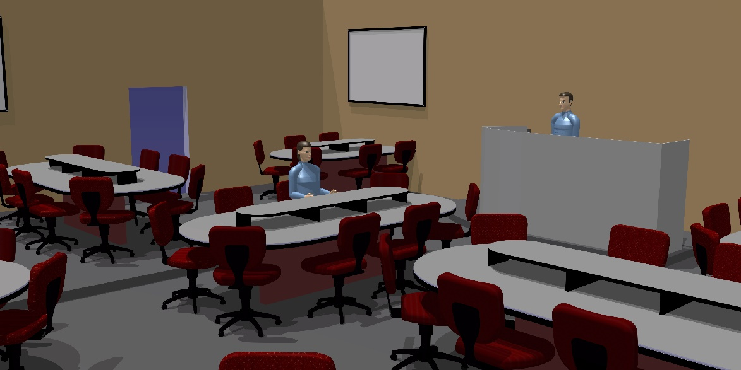
Active Learning Classrooms
50, 100, 150+ capacity classrooms designed for interactive learning and student-teacher involvement

Slide 6
The Cave – Virtual Design Visualization
Enclosed visualization room.
Utilizes simple geometry to display dynamic designs in a 3D environment.

Slide 7
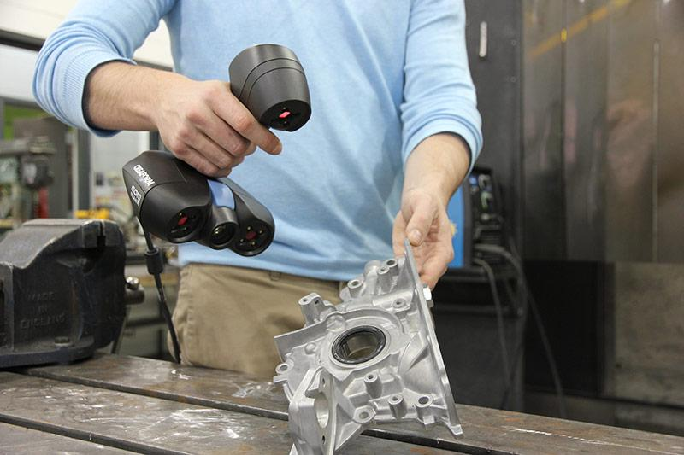
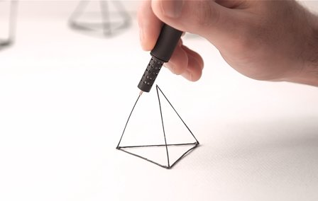
Creative Concepts and Thinking
Design Suite Lockers – storage for projects, charging ports for personal technology
Creaform – Reverse engineering tool for further advancing engineering skills and research
3D Printing Pens - quick design visualization

