Slide 1
Yamaha 250 Repackaging
Joey Gibson, Steven Nieuwenhuis, Dillon Quenzer

Slide 2
Objective
Repackage a hybrid YZ250 engine with a custom KTM 525 transmission inside the current formula car chassis.
Support rapid interchange of the KTM 525 engine and YZ250 hybrid engine so that the vehicle platform can be reconfigured for back to back competitions.

Slide 3
KTM 525 Assembly (starting point)
Modeling by 2014-15 capstone design team

Slide 4
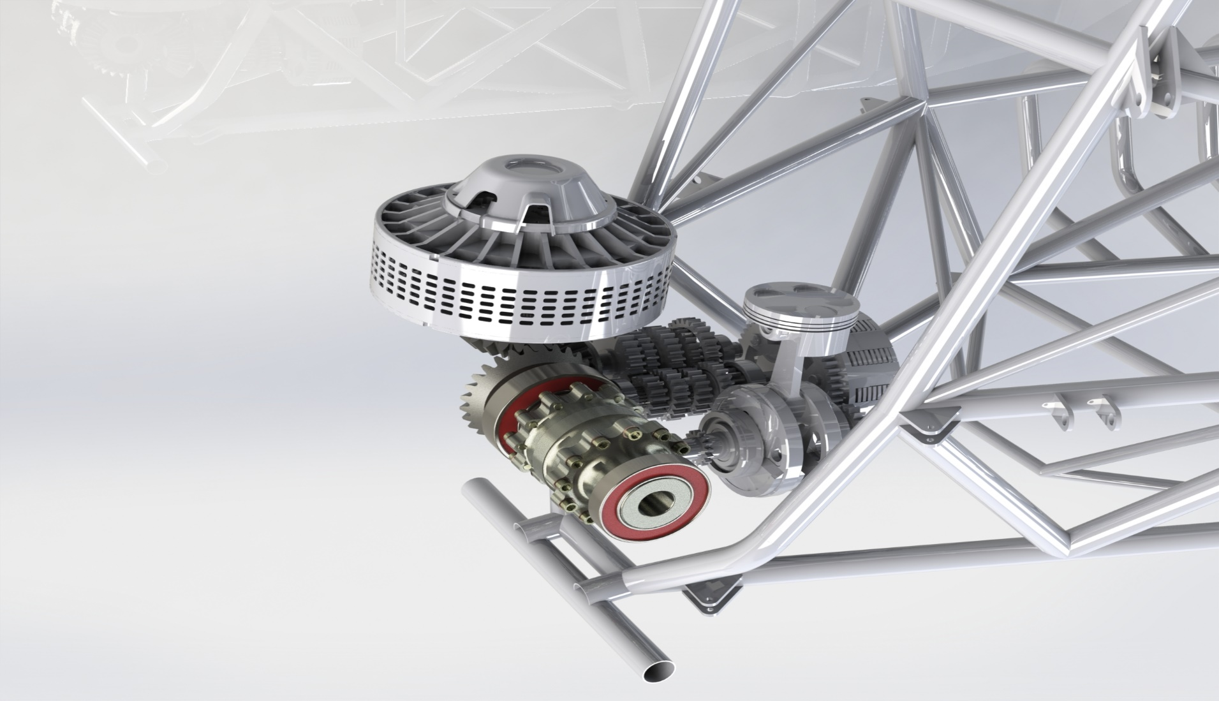
Hybrid YZ250 Design

Slide 5
Hybrid YZ250 Design

Slide 6
Hybrid YZ250 Design

