Slide 1
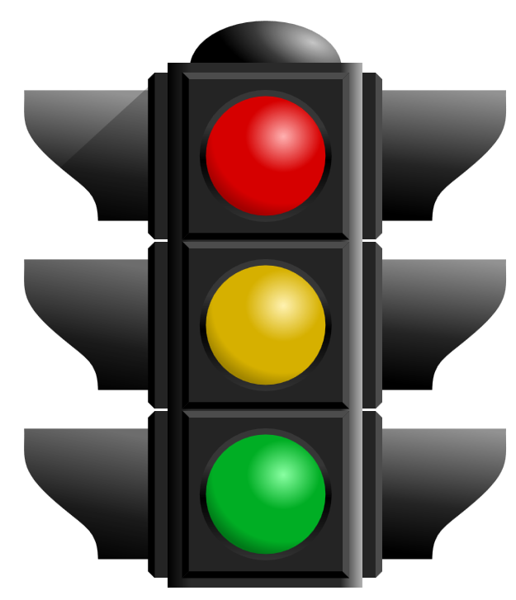
Project Status Report
A tool to quickly and effectively communicate project status
Items to report
Schedule
Budget
Quality
Team Dynamics
Client Reactions
Additional items
Next milestones: from timeline
Issues: current problems
Risks: foreseeable problems
Status Items to Report | R | Y | G
Schedule | X
Budget |  |  | X
Quality |  |  | X
Team Dynamics |  |  | X
Client Reactions |  | X
Next milestones:
Issues:
Risks:

Slide 2
STATUS REPORT RUBRIC
TRACKED ITEM | RED | YELLOW | GREEN
Schedule | Behind, missed deadline, no plan to make up time, schedule/timeline grossly inaccurate, no action items. | Slipping, schedule/timeline does not exist or inaccurate, tasks are not being completed. | On time, Schedule /timeline is accurate and project is tracking, tasks are being completed.
Budget | Over budget or budget does not exist, client has not been notified, major changes have driven cost up. | Break even, Foreseeable expenses might be over budget, no practical alternatives. | Under budget, All expenses and foreseeable expenses are accurate, alternatives are affordable.
Quality | Members disagree on approach and all solutions, client does not have confidence in team or disagrees with solution. | Some members disagree on solution approach, client is unaware, some issues are missing and some have ill conceived solutions. | All members and client support design and approach, all issues are identified with appropriate solutions.
Team Dynamics | No communication amongst members, client is in the dark, meetings are ignored, members are blaming and judging other members. | Members are present but not engaged, client is not up-to-date, members are taking on tasks individually without communicating to team | Members are engaged, everyone knows what the mission and goals are, client knows what is going on, members are open with progress and tasks are shared.
Client Reactions | Client is in the dark, does not have confidence in outcome or team, is not contributing and/or not being contacted. | Client is skeptical but supportive, does not understand direction, does not interact with team. | Client is confident in team, provides support input and information, interacts regularly with team.

