Slide 1
Continuously Variable Transmission (CVT)
by Colin parke

Slide 2
Overview
What is a CVT?
How does it work?
Our CVT
Primary Clutch
Secondary Clutch

Slide 3
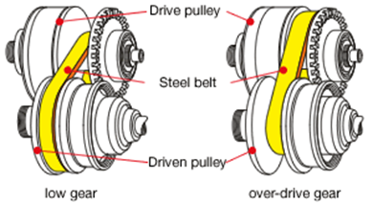
What is a CVT
Continuously variable transmission
Contains an infinite number of gear ratios within the maximum and minimum ratios determined by the primary and secondary
Components
Primary - mounted to engine output shaft
Secondary - driven by primary and outputs to drive shaft
Belt – connects primary and secondary

Slide 4
How it works
Engine outputs to the primary
The primary drives the secondary via the push belt
As engine speed changes, the primary compresses and decompresses the belt which changes the diameters of the primary and secondary

Slide 5
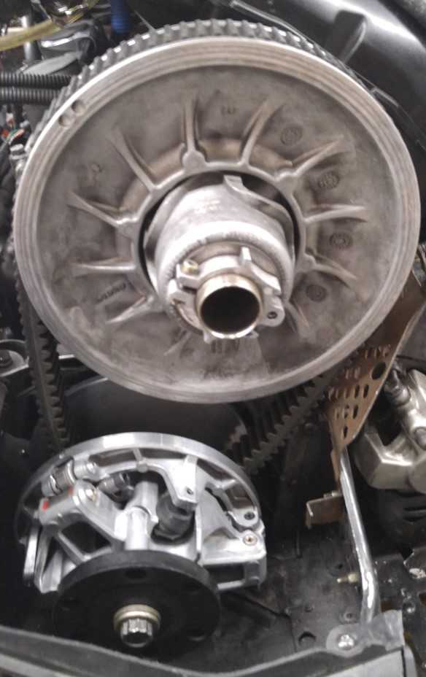
Our cvt
Primary - pDrive
Secondary - QRS
Belt – rubber v-belt

Slide 6
Primary
Ramps (Top)
Push on rollers as engine speeds up, which compresses the sheaves (conical plates the belt rides on). Determines shift rate.
Spring
Counter force to the rotational force supplied by the engine. Affects shift rate mainly.
Flyweight
Attach to ramps and mainly affects engagement speed and maximum speed

Slide 7
Secondary
Helix
Acts similarly to the ramps on the primary.
Springs
Acts similarly to the spring in the primary
The Secondary clutch reacts to the primary. As the primary compresses (increases radius), the secondary expands (decreases radius), and vice versa

