Slide 1
Testing methodology
By: Porter dallenbach

Slide 2
overview
Why do we test?
How can we test accurately?
Show examples of useful testing
How can we use test data?

Slide 3
Purpose of testing
To validate predictions of created parts or new modifications
To measure and generate data for comparison
To find limits and weaknesses in new designs and changes
To further findings from lab, bench, or early prototype testing

Slide 4
General ideology
Limit variables
Take note of all variables
Create many control factors
Maintain consistency
Perform repeatable tests which should yield similar results
Keep detailed records

Slide 5
Step 1: test procedure
Detailed plan made ahead of time to control test(s)
Specifications and step-by-step plan
Includes tools, supplies, and measurement devices needed
Keeps one dependent variable at all times
Tells what data is to be collected
Often SAE Standards or ASTM Standards
Record multiple sets of data

Slide 6
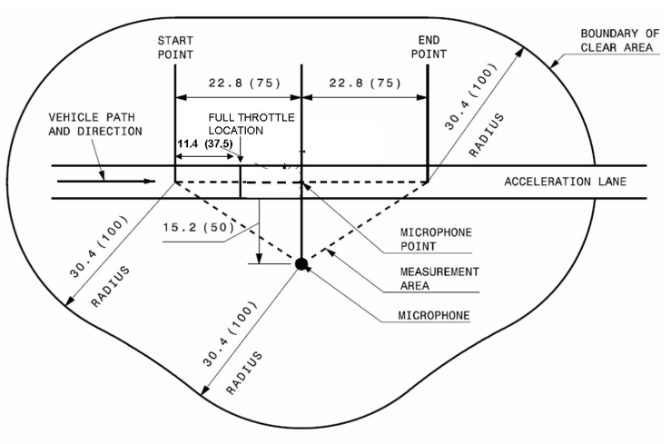
Example: Sound testing
J1161: Steady 15mph speed
J192: Entering at 15mph then increasing to 100% throttle
Note: Also record snow depth, packing, weather conditions, air temp and background noises
SAE standard for snowmobiles only

Slide 7
Making use of data
Get rid of outliers
Average between multiple data sets
Create graphs to see differences between different setups
Compile into charts or diagrams
Extract conslusions and write a review on the test day
Note what DIDN’T work well that day

Slide 8
Example from 2020 Testing

