Slide 1
Virtual Modeling
Me 201/401
Presented by:
Colin Parke

Slide 2
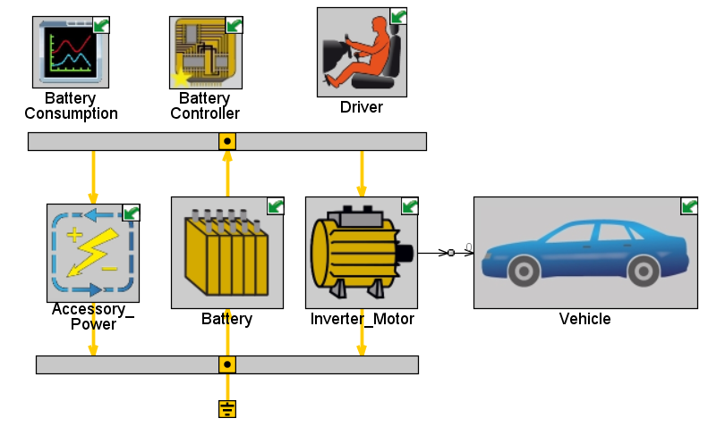
Outline
What it is a virtual model?
How they work
Why they’re useful
Examples

Slide 3
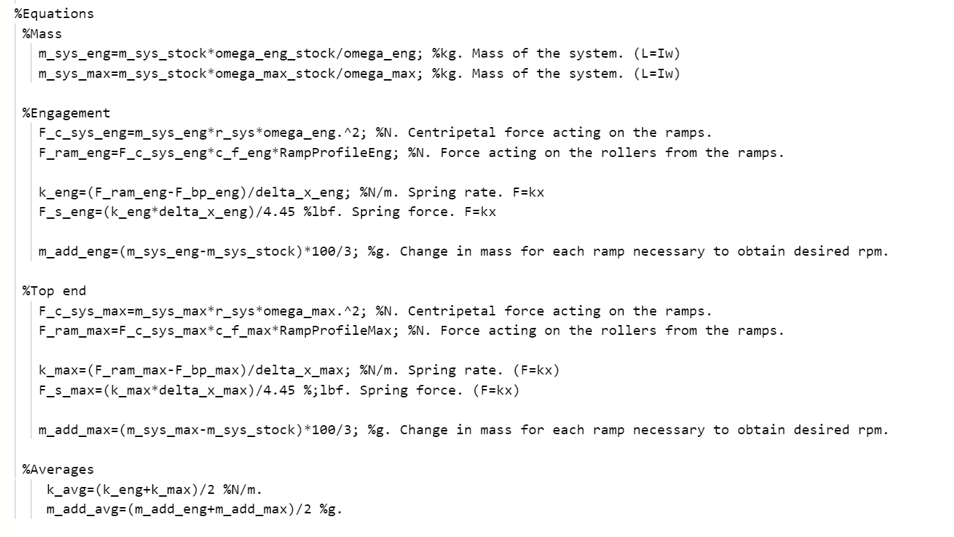
What is a virtual model?
Mathematical representation of a physical phenomena created in virtual space

Slide 4
How they work
Break phenomena down into core equations
Dynamically combine phenomena into systems
Predicts ‘real-world’ outputs dependent on inputs
Work in conjunction with test data

Slide 5
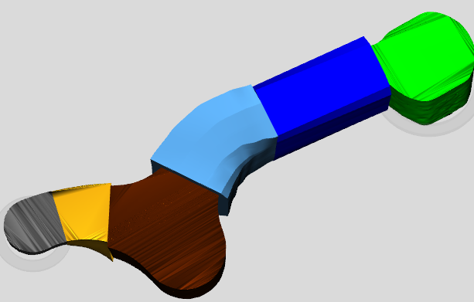
Why they’re useful
Reduce testing costs
Improve product design
Increase understanding of system

Slide 6
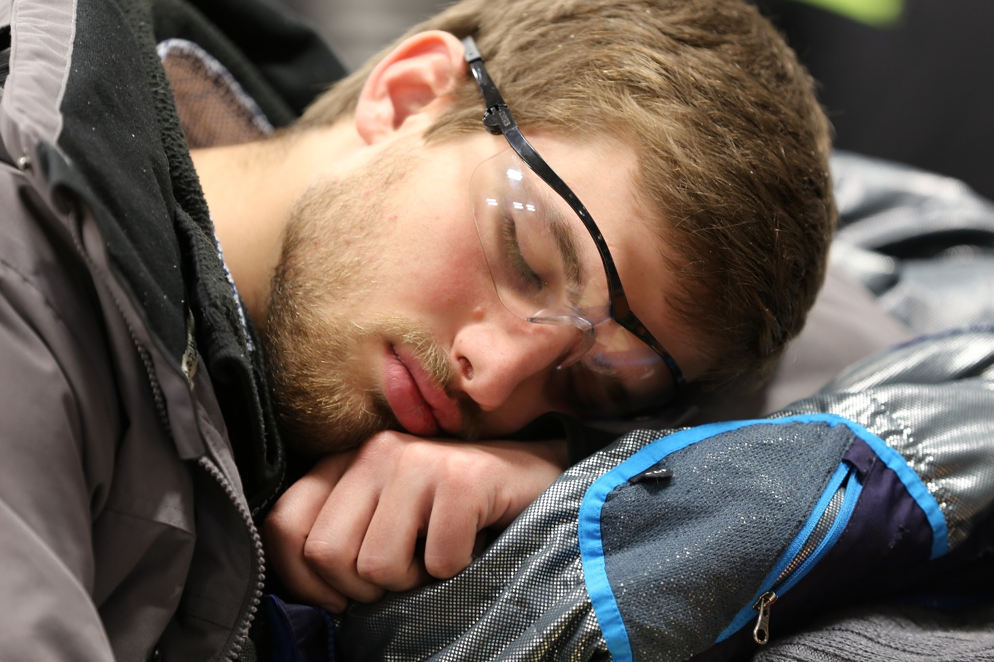
Questions?

