Slide 1
Course Logistics
Website?
Mindworks sample
Canvas sample
Quizzes
Once/week, typically Friday
Homework
Typically M and W
Documentation format?
Exams
3/semester
Series of Canvas quizzes?
In-class exams?
Textbook
Hibbeler Dynamics
Electronic access not required (I won’t give any assignments with it)
Hard copy not required
Any previous edition should be fine too
Literally *any* reputable Dynamics textbook is fine too, but the variables and notation I’ll use in class comes from Hibbeler

Slide 2
Pre-Reading Questions/Comments/Discussion
Section 12.1
How are kinematics and kinetics different from each other?
Which steps of the problem solving methodology are hardest for you? Why?
Section 12.2
Why is 's' used as a variable for rectilinear motion? How is this different from something like ‘x’?
What are the relationships (in words) between position, velocity, and acceleration?
What are the relationships (in equations) between position, velocity, and acceleration?
Why is it important to note if a variable is a scaler vs. a vector?
Where have you seen the three equations for a = a_c before?
Can you follow the thought process used to solve example problems 12-1 through 12-5?
How are the "Problem Solving" steps different and similar to the "Procedure for Analysis" steps?

Slide 3
ENGR 220: Dynamics
Chapter 12 Kinematics of a Particle
Chapter 13 Kinetics of a Particle: Force and Acceleration
Chapter 14 Kinetics of a Particle: Work and Energy
Chapter 15 Kinetics of a Particle: Impulse and Momentum
Chapter 16 Planar Kinematics of a Rigid Body
Chapter 17 Planar Kinetics of a Rigid Body: Force and Acceleration

Slide 4
Introduction
12.1
MECHANICS
STATICS
DYNAMICS
(objects in equilibrium)
(objects in motion)
KINEMATICS
KINETICS
(geometric aspects of motion)
(analysis of forces causing motion)

Slide 5
Problem-Solving
12.1
Methodology for Solving Dynamics Problems:
Read problem and try to understand what physical phenomenon is taking place. ← Dr. Dan Pro Tip: Make an educated guess of the answer
Draw a diagram of what is happening in the problem. ← How to you draw something that is moving?
Establish a coordinate system and write out appropriate equations in that system. ← Can do most problems in any coordinate system (some are easier)
Solve the equations algebraically, paying attention to units used. Report reasonable sig. fig. ← This is your boxed answer
Take some time to think about your answer. Is it reasonable? ← How does it compare to your guess after Step 1?
Figure out if there is an alternative way to check or validate that this answer is somewhat realistic.
← Hint: Yes, there is. Figure out a way to be confident in your answer
A single coordinate axis, s, defines the location of a particle.

Slide 6
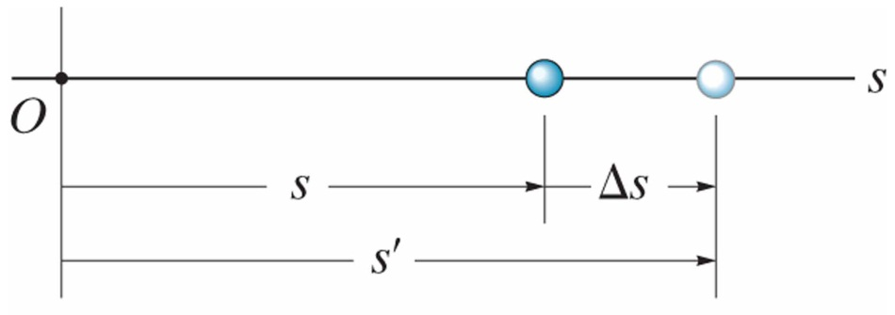
Rectilinear Kinematics: Continuous Motion
12.2
Rectilinear Kinematics:
One-dimensional motion. A particle’s position, velocity, and acceleration define its kinematic state.
A particle is an idealization of a body where mass is concentrated at a point. A particle has mass but negligible size and shape. A particle has location but not rotation.
Position:
A single coordinate axis, s, defines the location of a particle.
Displacement:
Change in position.

Slide 7
Rectilinear Kinematics: Continuous Motion
12.2
Velocity:
Change in position.
average velocity:
instantaneous velocity:
common units: in/s, ft/s, m/s
instantaneous velocity is the time derivative of position
Acceleration:
Change in velocity.
average acceleration:
instantaneous acceleration:
common units: in/s², ft/s², m/s²
instantaneous acceleration is the time derivative of velocity

Slide 8
Rectilinear Kinematics: Continuous Motion
12.2
Position, Velocity, Acceleration:
instantaneous velocity:
Instantaneous acceleration:
The resulting differential relationship excludes differential time (dt)

Slide 9
Rectilinear Kinematics: Continuous Motion
12.2
Special Case: Constant Acceleration
Velocity as a Function of Time:
Position as a Function of Time:
Velocity as a Function of Position:

Slide 10
Example Problems
For each problem, feel free to work/chat with those around you on:
What’s happening in this problem? Any key words in the problem statement?
What are the relevant dynamics concept(s)?
What equation(s) to use?
Write out the equation(s) and determine if you know how to solve them.
If you have time, do the algebra/calculus.
The goal here is to put the thinking on display, and identify where any sticking point might be, and how to work through them.
What you want to clarify during example problems are things like:
Why did you do that?
How did you know to do that?
When is it okay to do that?
Is there a different way to get to a correct answer?
A single coordinate axis, s, defines the location of a particle.

Slide 11
What’s happening? Key words, and what are their implications?
Dynamics concept(s)?
Equation(s)?
Do you know how to solve them?
Prove it!

Slide 12
Have a(t), and want v(t)
Have v(t), and want s(t)

Slide 13
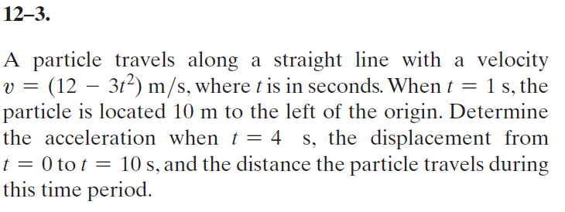
What’s happening? Key words, and what are their implications?
Dynamics concept(s)?
Equation(s)?
Do you know how to solve them?
Prove it!

Slide 14
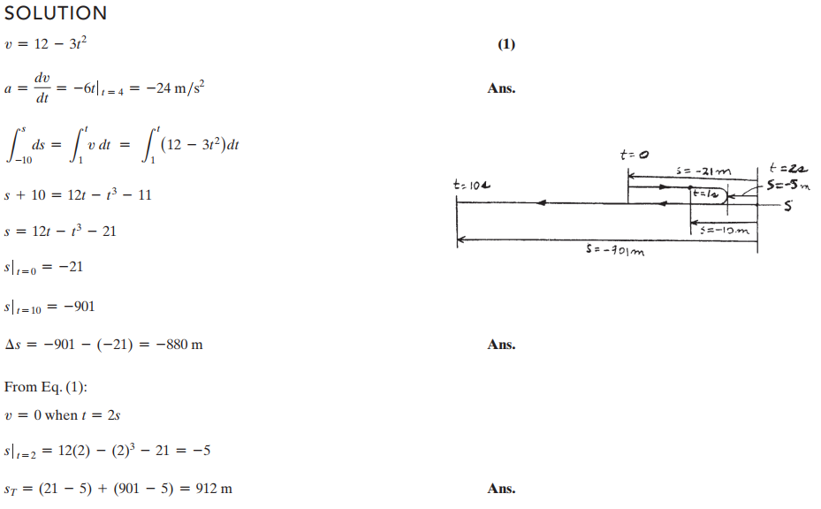

Slide 15
What’s happening? Key words?
Dynamics concept(s)?
Equation(s)?
Do you know how to solve them?
Prove it!
Hint: Define a single coordinate system for both cars. Wherever you decide s = 0, use that point for car A and B. This means the initial position of car B is going to be ‘d’ more than car A.

Slide 16
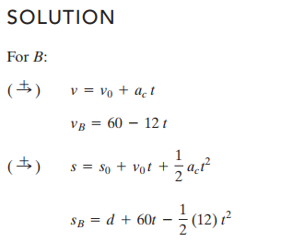
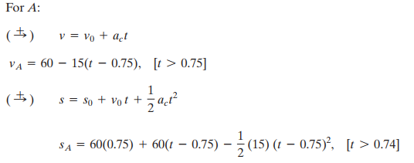
Some assumptions:
Point A is the nose of Car A
Point B is the tail of Car B
The origin (s=0) is at Car A when time = 0.
Distance Car A moved before hitting the brakes
Position of Car B as a function of time
Position of Car A as a function of time

Slide 17
