Slide 1
Curvilinear Motion
To visualize things in 3-dimensional space you are probably most familiar with the x-y-z coordinate system (cartesian). We covered rectilinear motion the last few lectures, and now we will move to 3D space
We can describe a position vector (r) that has the tail at the origin, and the head at the particle position.
The coordinate system does *not* change the following relationships between position, velocity, and acceleration. As we explore different coordinate systems, the equations may change, but the foundational relationships do not.

Slide 2
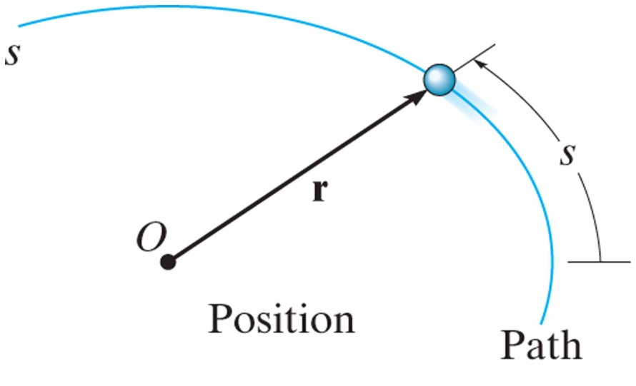
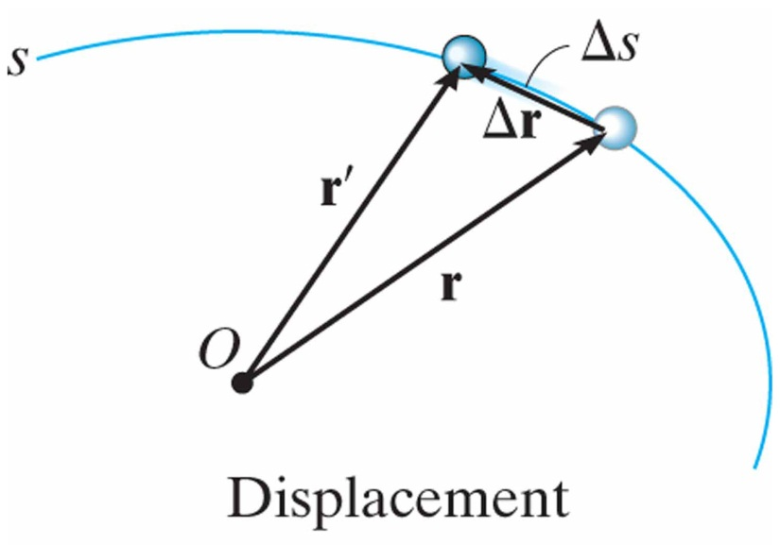
General Curvilinear Motion
12.4
Curvilinear Motion:
Curved motion in 3 dimensions (3D)
Position:
Position of a particle measured from fixed point 0 described with a vector:
position vector is a function of time
Displacement:
Change in position.

Slide 3
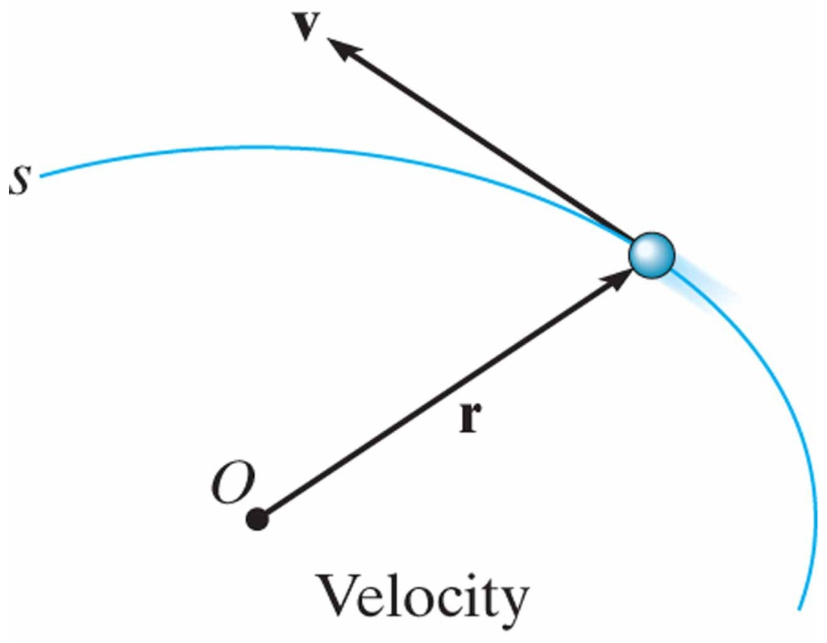
General Curvilinear Motion
12.4
Velocity:
Change in vector position.
average velocity:
common units: in/s, ft/s, m/s
instantaneous velocity:
instantaneous velocity is the derivative of position
velocity is always tangent to the curve
velocity magnitude (speed):

Slide 4
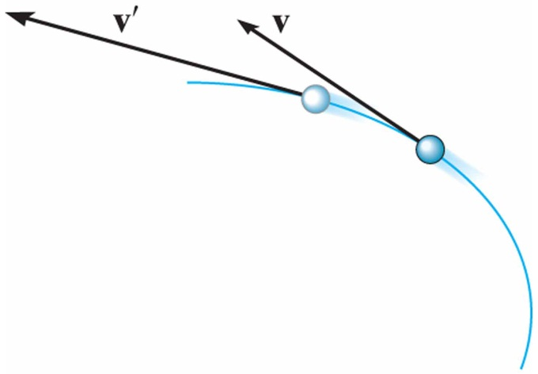
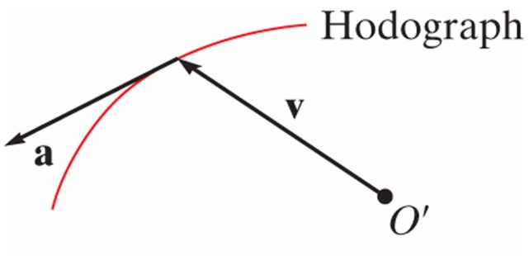
General Curvilinear Motion
12.4
Acceleration:
Change in vector velocity.
average acceleration:
common units: in/s², ft/s², m/s²
A hodograph is a plot of velocity vectors with their tails located at a fixed point 0’
instantaneous acceleration:
instantaneous acceleration is the derivative of velocity
Acceleration points to the “inside” or “concave side” of the path

Slide 5
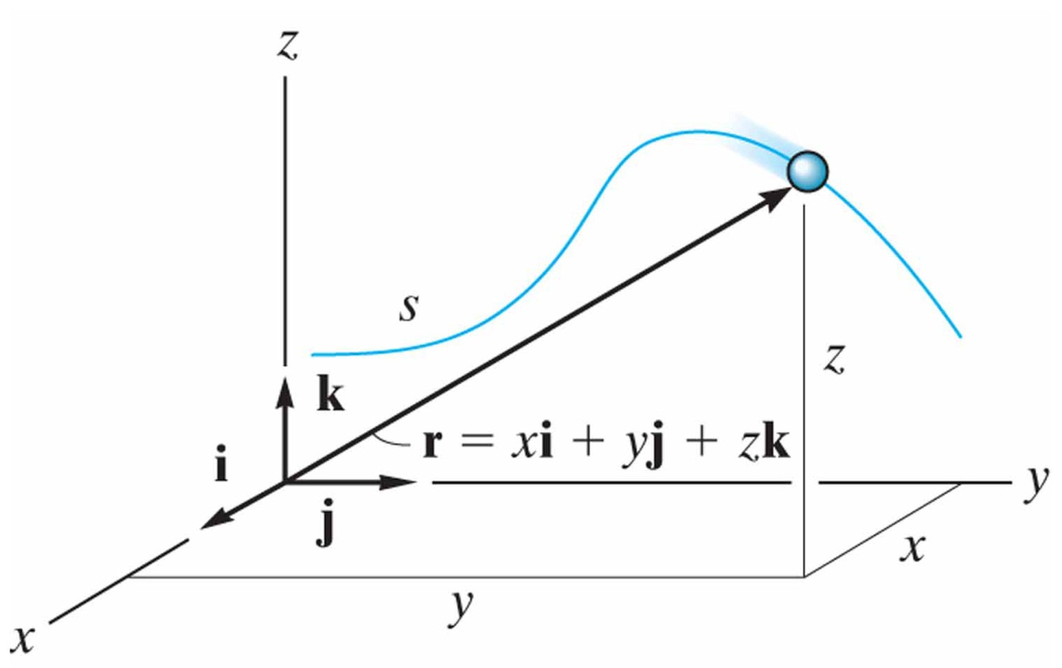
Curvilinear Motion: Rectangular Components
12.5
Position:
A particle located at (x,y,z) from origin 0.
position:
magnitude:
direction: (unit vector)

Slide 6
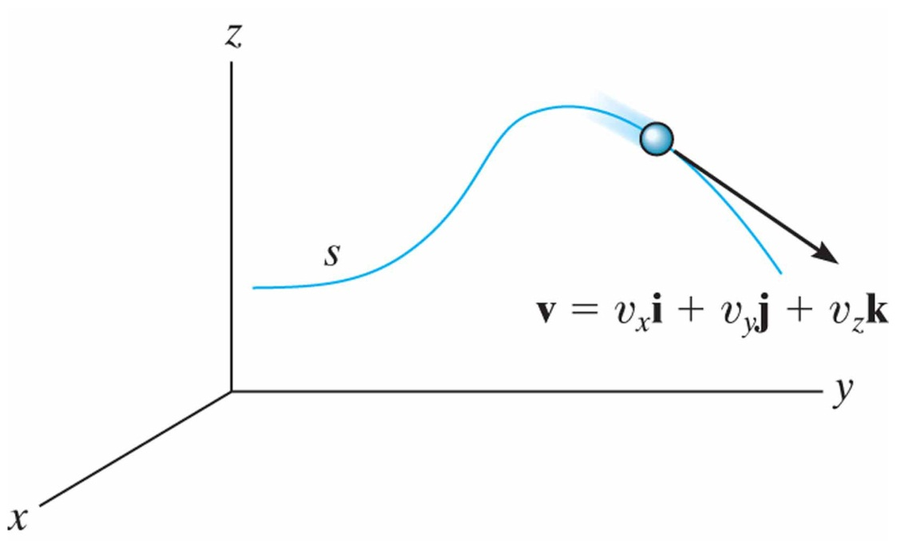
Curvilinear Motion: Rectangular Components
12.5
Velocity:
Velocity has direction and magnitude. Velocity is always tangent to the path. Tail emanates from the particle.
vector velocity:
magnitude:
direction: (unit vector)

Slide 7
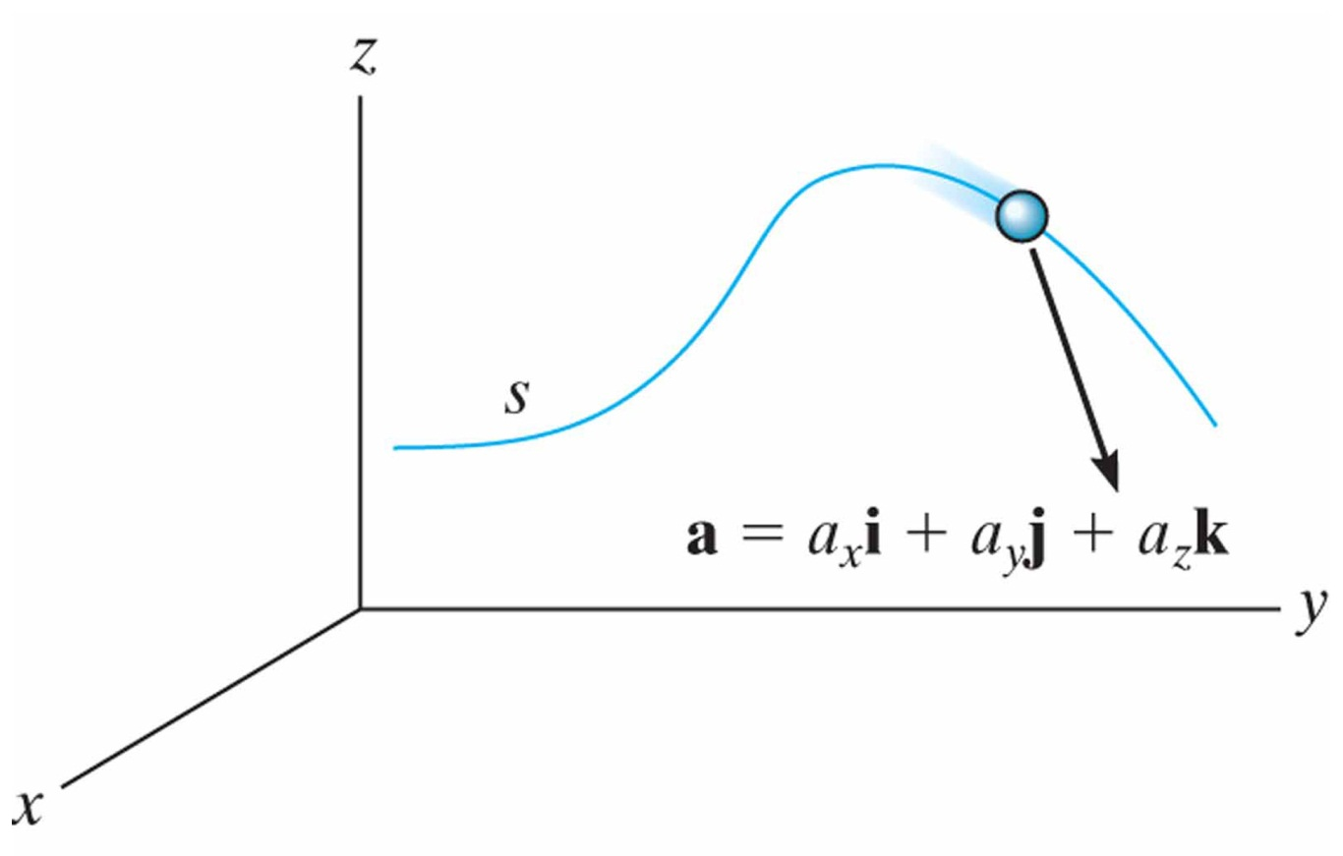
Curvilinear Motion: Rectangular Components
12.5
Acceleration:
Acceleration has direction and magnitude. Acceleration points towards the inside of the path curve.
vector acceleration:
magnitude:
direction: (unit vector)

Slide 8
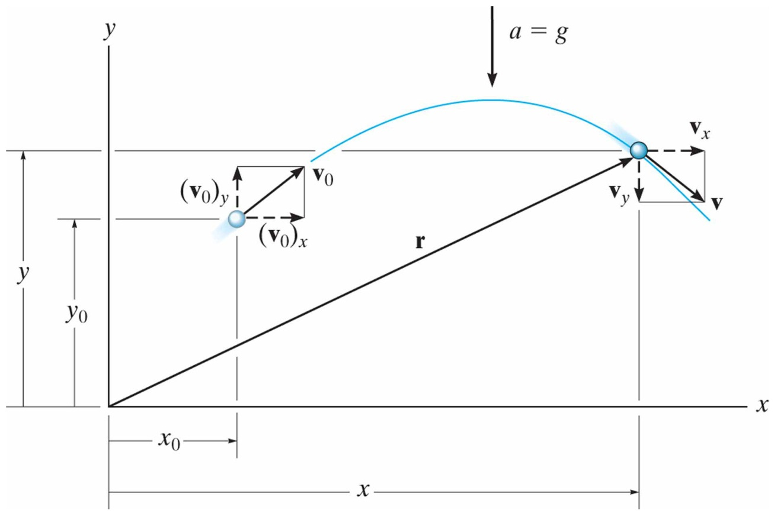
Motion of a Projectile
12.6
Free-flight motion of a projectile using rectangular components.
Assumptions for Analysis:
constant acceleration (no variation with altitude or elevation)
no friction/damping from air (no forces act on particle during flight)
Constant Acceleration
Equations:
$$a_{c}=g=9.81\frac{ \text{m}}{s^{2}}=32.2\frac{ \text{ft}}{s^{2}}$$
For projectile flight, use:
Horizontal Motion:
Vertical Motion:

Slide 9
In-Class Practice Problem 1
What do you notice about this problem?
Key words?
What information do you know?
What are you trying to find?
How to you approach the problem?
What equation(s) will you use?

Slide 10
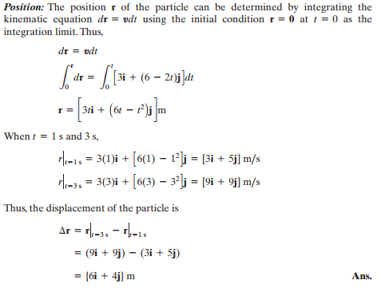
In-Class Practice Problem 1

Slide 11
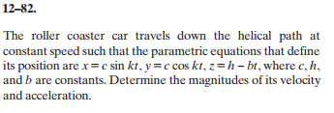
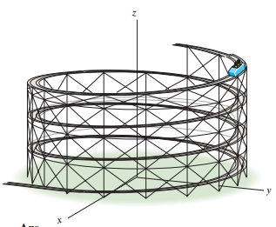
In-Class Practice Problem 2
What do you notice about this problem?
Key words?
What information do you know?
Does the lack of numbers bother you?
What are you trying to find?
How to you approach the problem?
What equation(s) will you use?

Slide 12
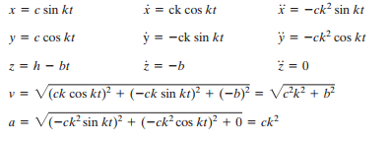
In-Class Practice Problem 2

Slide 13
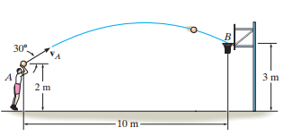
In-Class Practice Problem 3
What do you notice about this problem?
Key words or information?
What information do you know?
What are you trying to find?
How to you approach the problem?
What equation(s) will you use?

Slide 14
In-Class Practice Problem 3
Horizontal Motion:

Slide 15
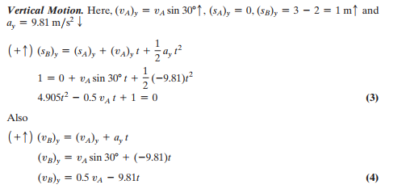
In-Class Practice Problem 3
$$v_{y}=(v_{0})_{y}−gt \\ y=y_{0}+(v_{0})_{y}t−\frac{1}{2}gt^{2}$$
Vertical Motion:

Slide 16
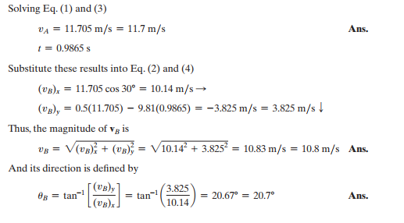
In-Class Practice Problem 3

