Slide 1
Normal and Tangential Coordinate System (n-t)
One transferrable skill I want you to get from Dynamics is the use of various coordinate systems. You’re already familiar with cartesian (rectangular) coordinate systems, and in calculus you’ve probably played with cylindrical (r, θ, z) and spherical (r, θ, ϕ) systems.
Each of the above coordinate systems are used from a FIXED reference point.
Today you are going to learn about the n-t (n, t, b) coordinate system. What makes this coordinate system unique is that it is a coordinate system that moves with the particle.
In engineering we distinguish between
Eulerian viewpoints – observing something from a fixed reference point
Lagrangian viewpoints – riding along what is being observed

Slide 2
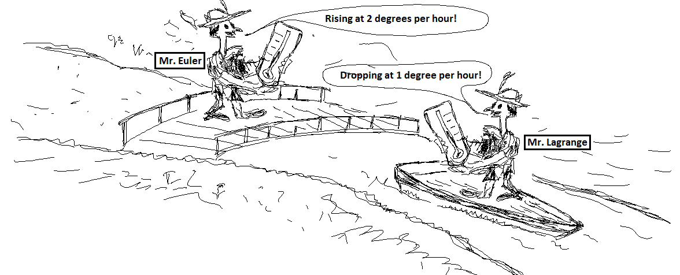
Normal and Tangential Coordinate System (n-t)
Fluid dynamics is one field that frequently uses these two viewpoints.
Your choice of a coordinate system shouldn’t change the behavior being simulated. But it should change the equations. Some phenomenon will be easier to math model in a certain coordinate system.

Slide 3
Normal and Tangential Coordinate System (n-t)
Here are two other examples from Pacific Raceways (Kent, WA)
Eulerian: https://www.youtube.com/watch?v=t7lyDfgegbU
Lagrangian: https://vimeo.com/30318739
FWIW: Lagrangians have more fun ;)

Slide 4
Normal and Tangential Coordinate System (n-t)
But wait, there’s more!!!
Here is some in-car footage with telemetry. Pay attention to the g-meter (lower left of the gauges).
What are the peak values in the normal direction?
What are the peak values in the tangential direction?
What is the transition like between peaks in each?
https://www.youtube.com/watch?v=UkNHuhuKKYo
Outside the scope of this class, what are the implications of a 3-axis accelerometer mounted to a car vs. a motorcycle?
What does this mean for other things, like oil and fuel pump inlets?

Slide 5
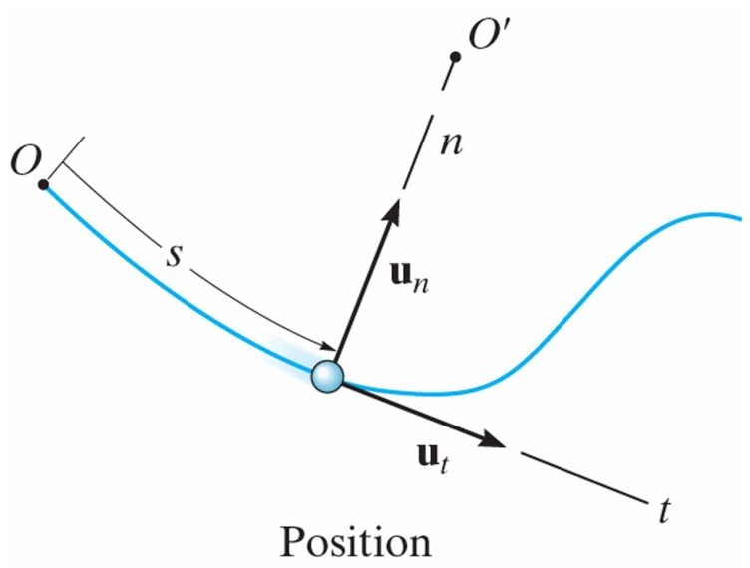
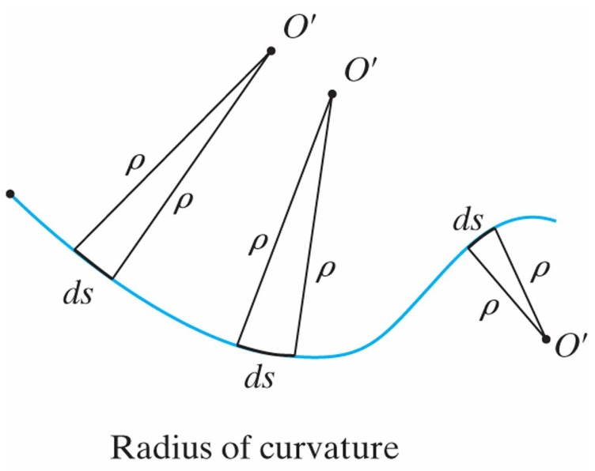
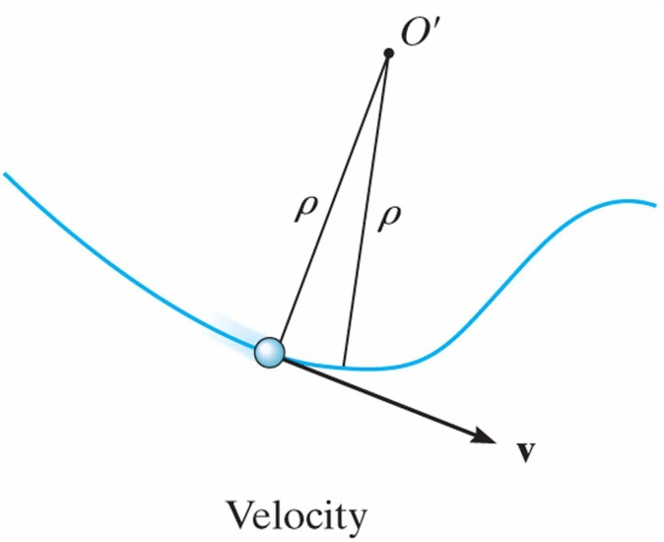
Curvilinear Motion: Normal and Tangential Components
12.7
Planar Motion:
Coordinate system has origin at a fixed point on the curve, and at the instant considered this origin happens to coincide with the location of the particle.
Position:
The tangential direction, t is tangent to the path and points in the direction of motion.
Velocity:
The normal direction, n is perpendicular to the tangential direction and points to the instantaneous center of curvature 0’.

Slide 6
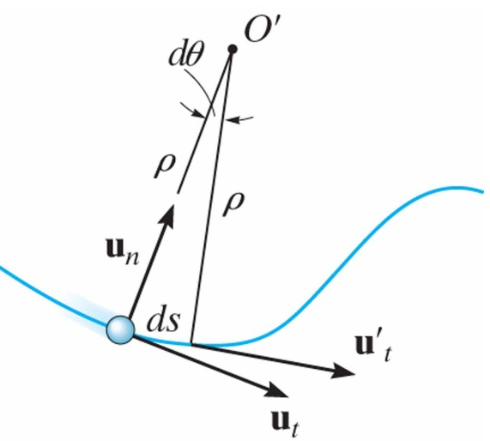
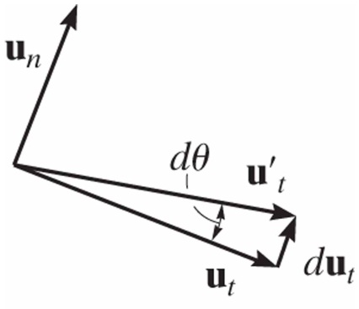
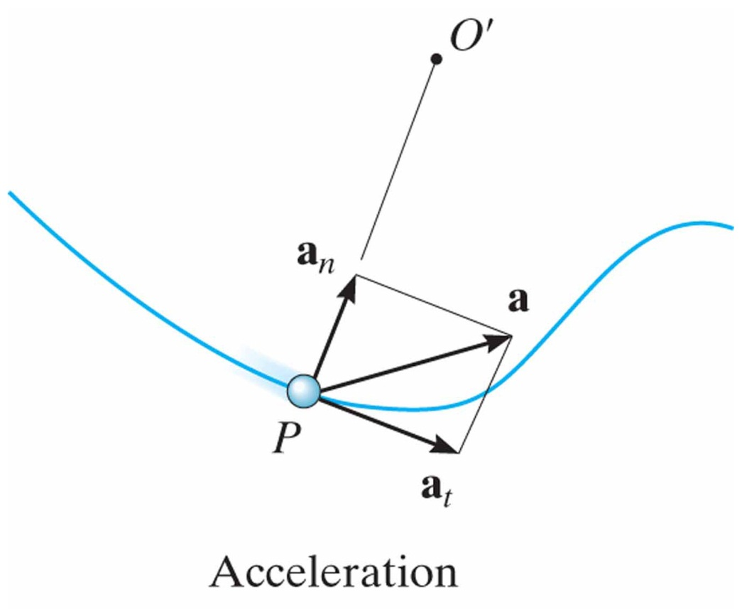
Curvilinear Motion: Normal and Tangential Components
12.7
Acceleration
Analysis:
Acceleration is time rate of change of velocity:
Acceleration:
magnitude:

Slide 7
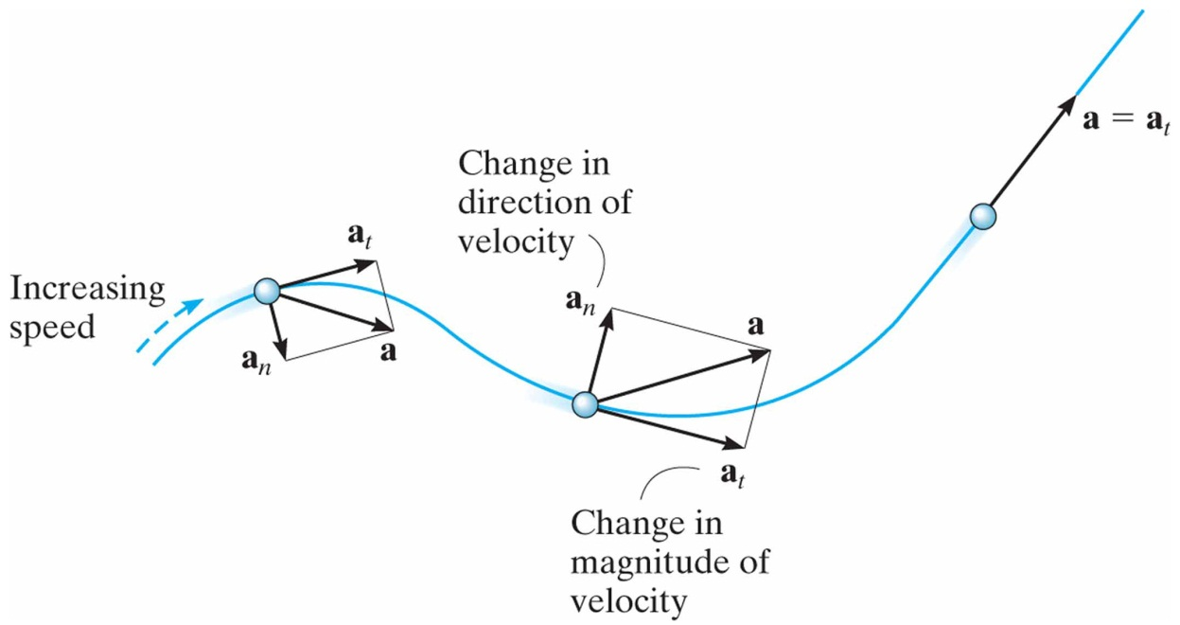
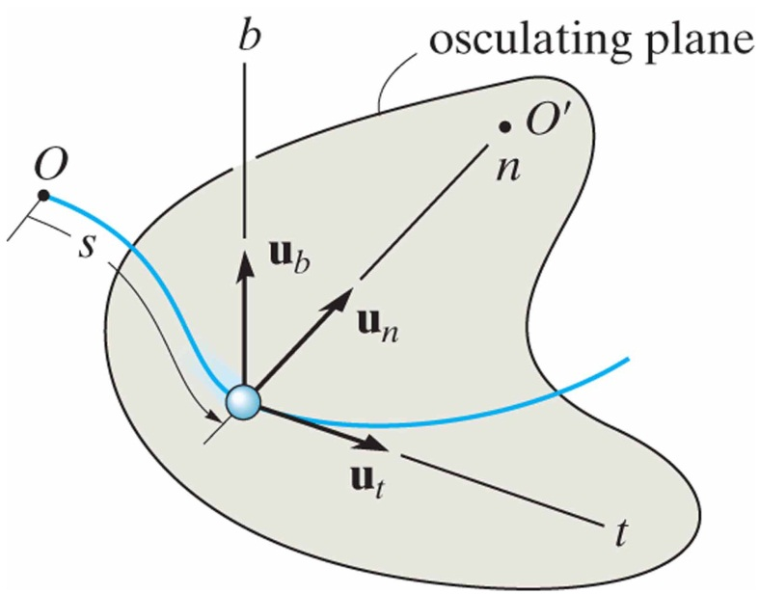
Curvilinear Motion: Normal and Tangential Components
12.7
Acceleration Special Cases:
Particle moves along a straight line:
Particle moves along a curve with constant speed:
Three-Dimensional Motion:
binormal axis:

Slide 8
Chain Rule
For your homework tonight (and in many cases this semester) you will need to use the Chain Rule and Product Rule in order to take derivatives. Here is a quick refresher:
You may remember from calculus classes:
If a = f(b), and b = f(c), then the derivative of a with respect to c will be found using the chain rule
$$\frac{da}{dc}=\frac{da}{db}\frac{db}{dc}$$
In problem 12-79 you have:
y = f(x), and x = f(t). The time derivative of y will be found using the chain rule
$$\frac{dy}{dt}=\frac{dy}{dx}\frac{dx}{dt}$$

Slide 9
Chain Rule and Product Rule
To get the second time derivative of y you will use both the Chain Rule and the Product Rule
Derivative of the first term (treating second term as a constant) + derivative of the second term (treating first term as a constant)
$$\frac{dy}{dt}=\frac{dy}{dx}\frac{dx}{dt}$$
$$\frac{d^{2}y}{{dt}^{2}}=\left(\frac{d^{2}y}{{dx}^{2}}\frac{dx}{dt}\right)\left(\frac{dx}{dt}\right)+\frac{dy}{dx}\frac{d^{2}x}{{dt}^{2}}$$
$$\frac{d^{2}y}{{dt}^{2}}={\frac{d^{2}y}{{dx}^{2}}\left(\frac{dx}{dt}\right)}^{2}+\frac{dy}{dx}\frac{d^{2}x}{{dt}^{2}}$$
Time derivative of $\frac{dy}{dx}$
Time derivative of $\frac{dx}{dt}$

Slide 10
In-Class Practice Problem 1
What do you notice about this problem?
Key words?
What information do you know?
What are you trying to find?
How to you approach the problem?
What equation(s) will you use?

Slide 11
In-Class Practice Problem 1
About 87 mph

Slide 12
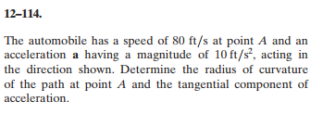
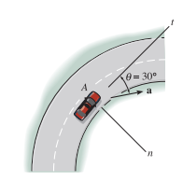
In-Class Practice Problem 2
What do you notice about this problem?
Key words?
How to you approach the problem?
What do you do with the acceleration vector?
What equation(s) will you use?

Slide 13
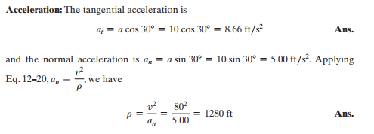
In-Class Practice Problem 2

Slide 14
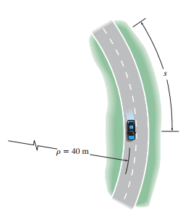
In-Class Practice Problem 3
What do you notice about this problem?
Key words?
How to you approach the problem?
What equation(s) will you use?

Slide 15
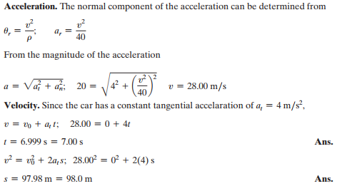
In-Class Practice Problem 3
Could have also used $s=s_{0}+v_{0}t+\frac{1}{2}a_{c}t^{2}$
$s=0+0t+\frac{1}{2}(4){6.999}^{2}$ → s = 97.97 m

