Slide 1
Newton’s Second Law of Motion
So far we have done a bunch of particle motion. You can do things like:
1D motion – s(t)
2D and 3D motion in rectangular coordinates – x(t), y(t), and z(t)
2D and 3D chain rule – y(x), x(t)
2D and 3D motion in normal and tangential coordinates – n(t), t(t)
2D and 3D motion in polar and cylindrical coordinates – r(t), θ(t), z(t)
Within particle motion we have considered position, velocity, and acceleration. But we haven’t yet talked about forces.
If we prescribe a path of motion, what forces are necessary to make that happen?
If we put external forces on a particle, what is the resulting motion?

Slide 2
Newton’s Second Law of Motion
13.1
Newton’s Second Law:
When an unbalanced force acts on a particle, the particle will accelerate in the direction of the force with a magnitude that is proportional to the force.
This is Newton’s “Equation of Motion”
Mass is a quantitative measure of the resistance of the particle to a change in velocity.
acceleration is in the same direction as force.
Units of force in the SI (System International) system are derived from Newton’s E.O.M.
Units of mass in FPS (Foot Pound Second) system are derived from Newton’s E.O.M.

Slide 3
Newton’s Second Law of Motion
13.1
Newton’s Law of Gravitational Attraction:
when an unbalanced force acts on a particle, the particle will accelerate in the direction of the force with a magnitude that is proportional to the force.
mass of particle 1 mass of particle 2
distance between particle centers
Typically only consider gravitational force between earth and particles because:
Universal Gravitational Constant
$$m_{\text{earth}}≫m_{\text{particle}}$$
Mass and Weight
Mass – A relative quantity, manifests as weight
Weight – Combination of mass and a gravitational field
Let:
Define:
acceleration due to gravity @ sea level & latitude = 45°
So now a particle in Earth’s gravitational field:
weight is the force caused by Earth’s gravity acting on the particle

Slide 4
The Equation of Motion
13.1
Mass, Acceleration, and Force Units:
Mass is fundamental Force is derived
Force is fundamental Mass is derived

Slide 5
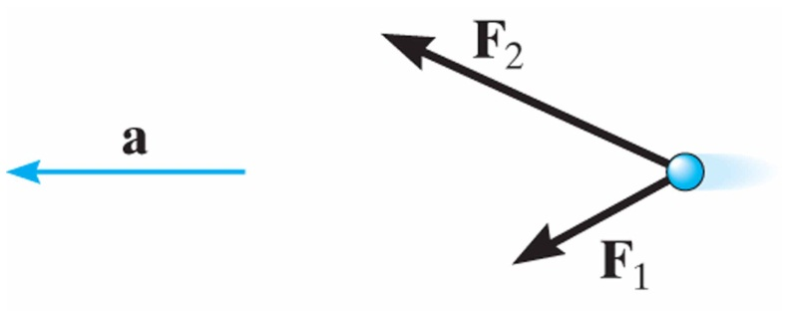
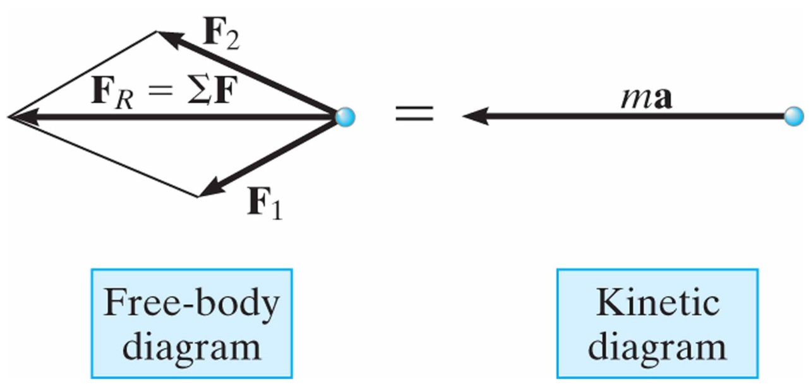
The Equation of Motion
13.2
The Equation of Motion
For the general case with multiple forces, we can write:
sum of all forces
resultant force
And the equation of motion can be written:
A free-body diagram graphically accounts for the magnitude and direction of each force acting on the particle.
A kinetic diagram graphically accounts for the magnitude and direction of the vector

Slide 6
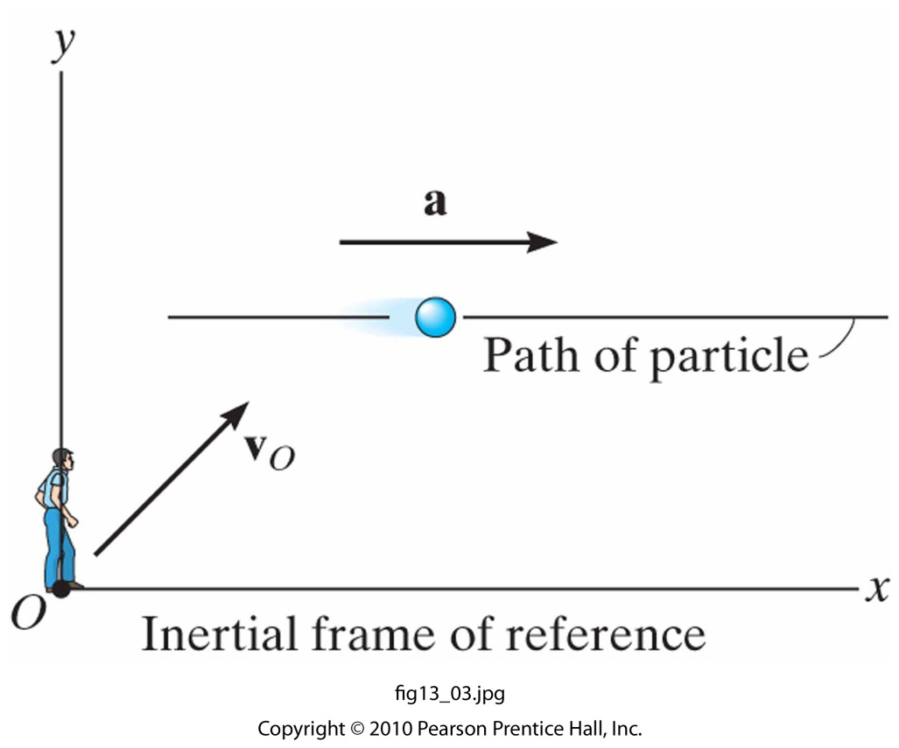
The Equation of Motion
13.2
Inertial Reference Frame (or Newtonian Reference Frame)
When applying the equation of motion, the acceleration of a particle must be measured with respect to a reference frame that is fixed or translates with a constant velocity.
Measurement of a particle acceleration will be the same from any inertial reference frame.
Dynamics problems concerned with motions on or near the surface of the earth may be solved by using an inertial frame which is assumed fixed to the earth.
The accelerations created by the rotations of the earth (about own axis, sun, galaxy, etc) are relatively small and can be neglected for most applications.

Slide 7
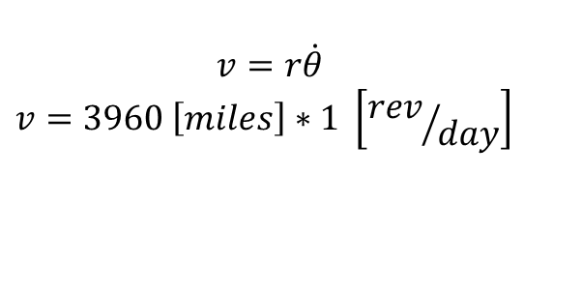
The Equation of Motion
“Dr. Dan….I don’t believe you. Prove it!”
- Imaginary Student
Challenge accepted! What is the normal and tangential acceleration of a particle on the surface of the Earth (relative to the center of the Earth)?
$a_{t}=0$ – constant velocity at surface
$$v=r\dot{θ}$$
$$v=3960 \left[miles\right]∗1 \left[{rev}/{day}\right]$$
$$v=\frac{3960 \left[miles\right]∗5280 \left[{ft}/{mile}\right]∗1 \left[{rev}/{day}\right]∗2π\left[{rad}/{rev}\right]}{24\left[{hr}/{day}\right]∗ 3600\left[{sec}/{hr}\right]}=1520 \left[{ft}/{sec}\right]$$
$a_{n}=\frac{{\left(1520 \left[{ft}/{sec}\right]\right)}^{2}}{20,908,800 \left[ft\right]}=0.11 {ft}/{\sec^{2}}$ – pretty small compared to gravitational constant

Slide 8
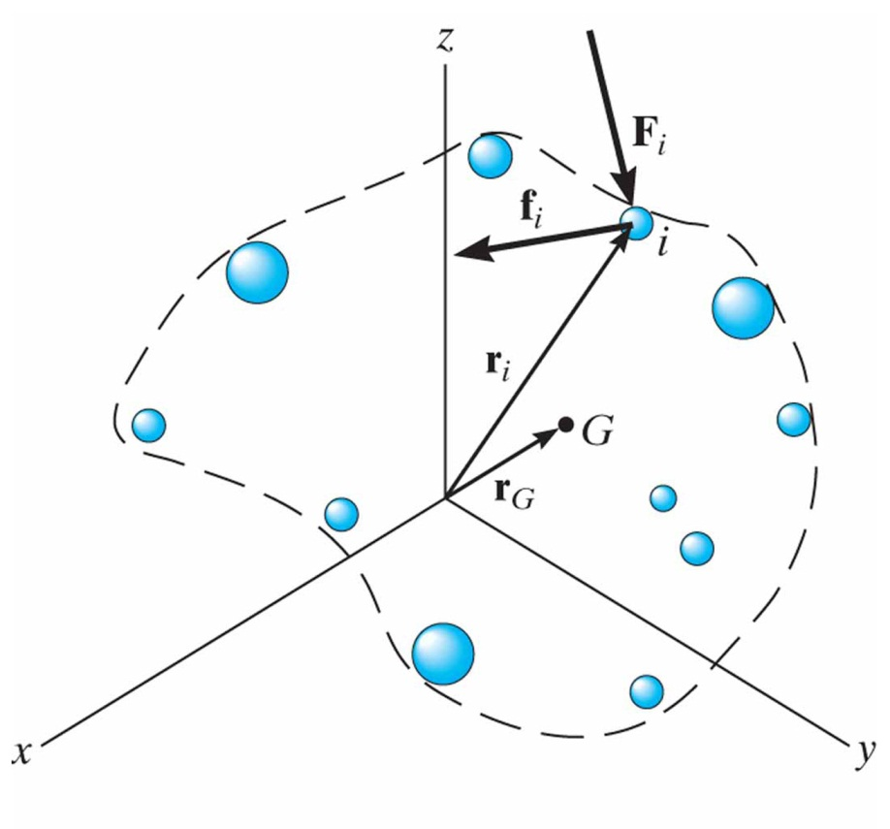
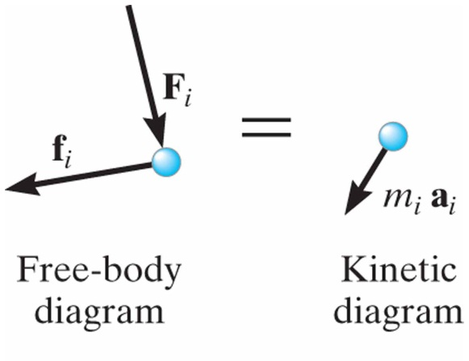
Equation of Motion for a System of Particles
13.3
Equation of Motion for a System of i Particles
Including internal and external forces:
The summation of all internal forces will be zero, thus:
Now define a position vector to the center of mass of the particles:
Differentiating twice with respect to time gives:
Combining this result with the previous equation of motion:

Slide 9
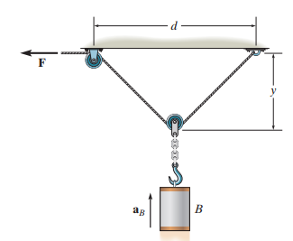
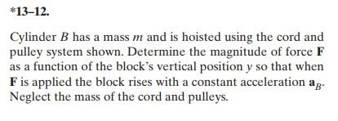
In-Class Practice Problem 1
Statics problem?
No numbers?
Key words?
What does equilibrium equation look like for Mass B?
What does equation of motion look like for Mass B?

Slide 10
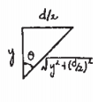
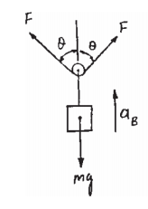
In-Class Practice Problem 1

Slide 11
In-Class Practice Problem 1
External Forces
Motion

Slide 12
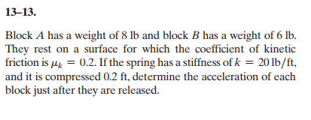
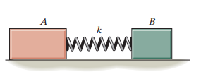
In-Class Practice Problem 2
Did you learn about coefficient of friction already?
(Statics, Physics)
Which block moves more?
What does equation of motion for each block look like?

Slide 13
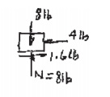
In-Class Practice Problem 2
For Block A
Note Direction!

Slide 14
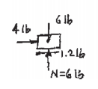
In-Class Practice Problem 2
For Block B
Note Direction!

Slide 15
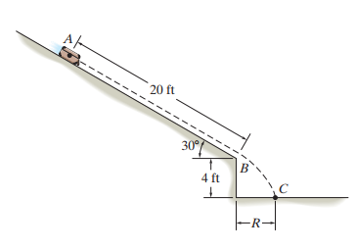
Next Homework
Apply Equations of Motion
Could be given a(t), then need to use particle motion equations to find position and/or velocity at a specific time
Could be given mass, friction, initial velocity
Find R, time, etc.
Along with answers I’ve also given some intermediate answers so you can check along the way.

