Slide 1
Summary
Work (Force dot distance) and Energy Conservation
After including gravitational potential in the work term, in todays section they introduce real terms for it.
The variables used are also unconventional.
Kinetic Energy = T
Gravitational Potential Energy = V
Work = U
Textbook differentiates “Conservative” and “Non-Conservative” forces.
Conservative – independent of path (PE and KE)
Non-Conservative – depends on path (Work, friction work)

Slide 2
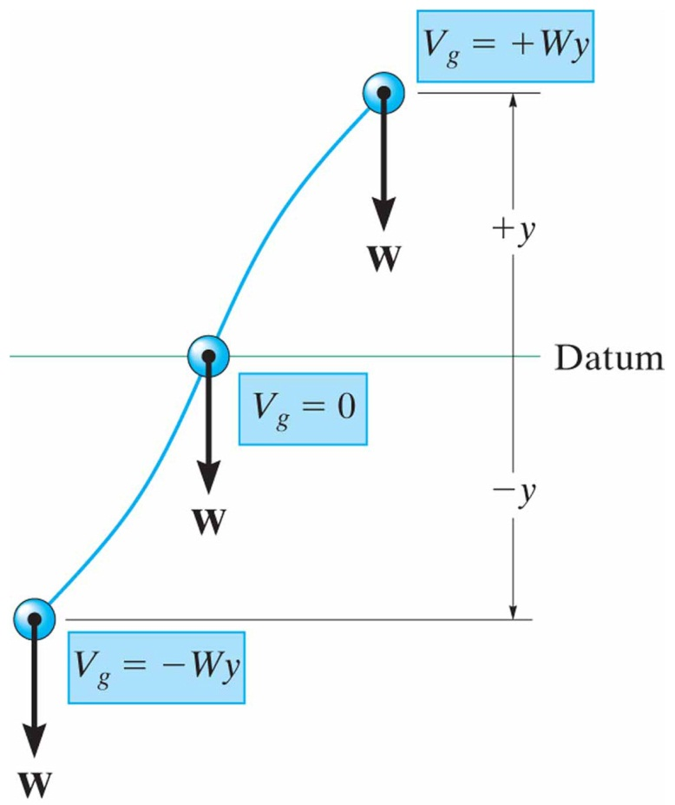
Conservative Forces and Potential Energy
14.5
Conservative Force
If the work of a force is independent of the path and depends only on the forces’ initial and final positions on the path, then we can classify this force as a conservative force.
Examples include work of a weight and work of a spring.
An examples of a non-conservative force is the work of friction (the longer the path, the more friction).
Energy
Energy is defined as the capacity for doing work.
Kinetic energy is equal to the work that must be done on a particle to bring from a rest to a specific speed.
Gravitational Potential Energy
If a particle is located a distance above an arbitrarily selected datum. The particle’s weight has a positive gravitational potential energy.

Slide 3
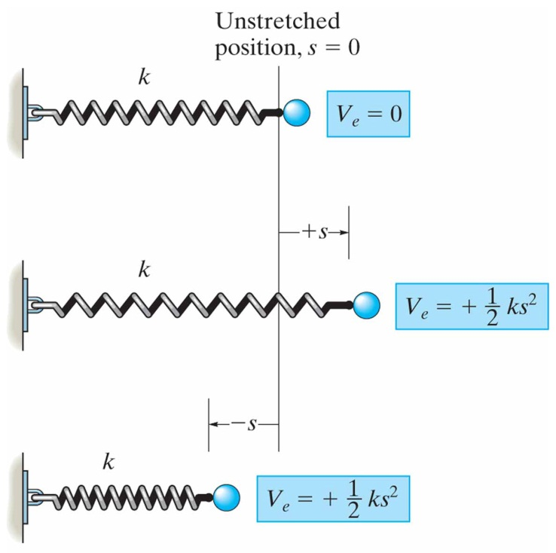
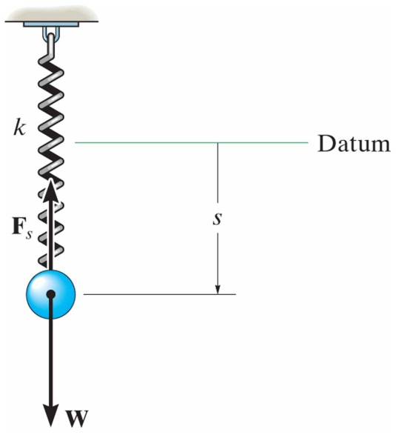
Conservative Forces and Potential Energy
14.5
Elastic Potential Energy
The potential energy of a displaced spring is given as:
$$\boxed{V_{e}=+\frac{1}{2}ks^{2}} \text{EQ}\text{ 14−14}$$
Potential Function
When a particle is subjected to both gravitational and elastic forces, the particles potential energy can be expressed as a potential function, which the algebraic sum:
$$\boxed{V=V_{g}+V_{e}} \text{EQ}\text{ 14−15}$$
For example, the potential function for a weight suspend from a spring is:

Slide 4
Conservation of Energy
14.6
Conservation of Energy
When a particle is acted upon by a system of both conservative and non-conservative forces, the portion of work done by the conservative forces can be written in terms of the difference in their potential energies, thus:
Conservation of Energy (conservative systems)
If only conservative forces act on the system:
Conservation of Energy for a System of Particles (conservative systems)
The conservation of energy equation can be extended to a system of particles:

Slide 5
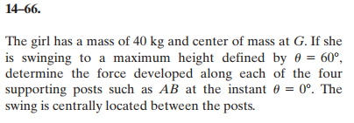
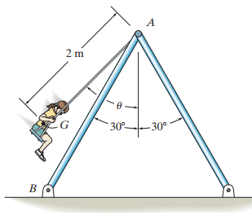
In-Class Practice Problem 1
Use Energy Conservation to find v_{bottom}
Knowing the velocity, use n-t to find acceleration
Use EoM to calculate tension in cable
Sum forces in y to find forces in posts

Slide 6
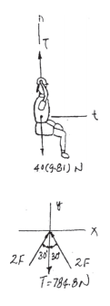
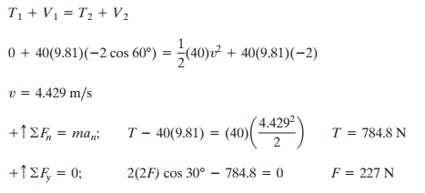
In-Class Practice Problem 1

Slide 7
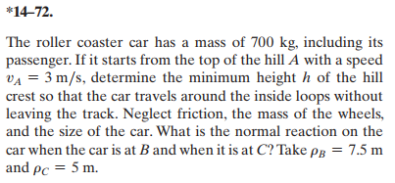
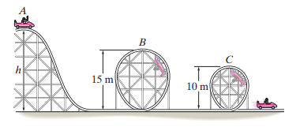
In-Class Practice Problem 2
Solving two problems – same method
Use n-t to find velocity necessary for car to stay on tracks while inverted.
Back-solve for height necessary to ensure those velocities.
Can choose any datum you want….just be consistent.

Slide 8
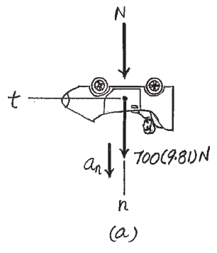
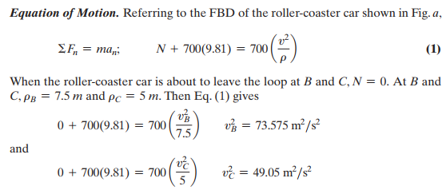
In-Class Practice Problem 2

Slide 9
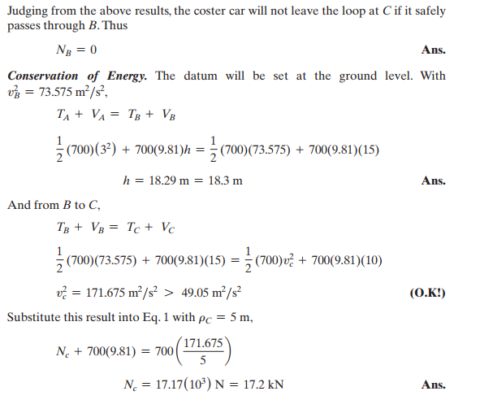
In-Class Practice Problem 2

Slide 10
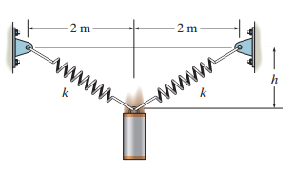
In-Class Practice Problem 3
Problems like this are almost too easy using conservation of energy.
State 1 is h = 0, but includes elastic potential energy of stretched springs
State 2 is h = 0.5 m and includes V_{e} and V_{g} terms.
Use right triangle to determine the length the spring is stretched.
Follow-up Questions
What happens after the mass is at the bottom?
Can you calculate the force in each spring as a function of height?
Can you apply EoM to find the acceleration of the mass at any given height?

Slide 11
In-Class Practice Problem 3

