Slide 1
ME 433 Internal Combustion Engines
Professor:
Dr. Dan Cordon (AKA Dr. Dan)

Slide 2
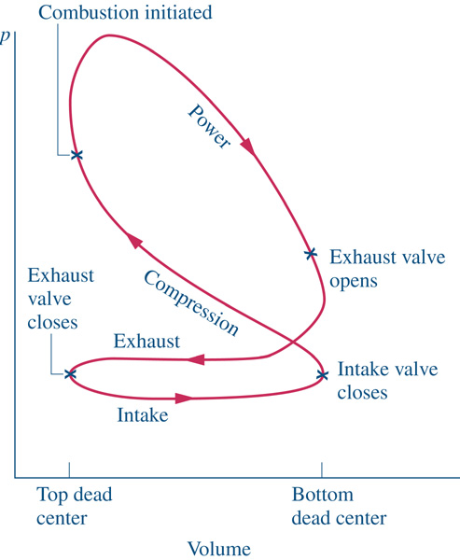
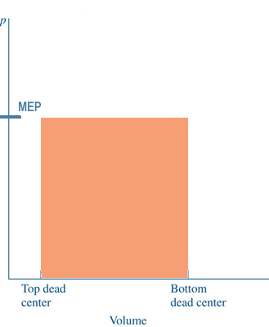
Mean Effective Pressure
The name implies that it is the average pressure. That is exactly what it is. If you were to look at the net work of the actual cycle, then replace that with a power stroke at constant pressure that delivered the same net work, that pressure would be the MEP.
Same Work

Slide 3
Mean Effective Pressure
$$MEP=\frac{W_{cycle}}{V_{swept}}=\frac{2π∗Torque∗n_{R}}{V_{swept}}$$
SI Engine CI Engine
Peak MEP N.A. ~850-1200 kPa N.A. ~700-900 kPa
F.I. ~1200-1700 kPa F.I. ~1400-2000 kPa
Note: MEP is relatively consistent for given engine types, regardless of displacement. This means that it is fairly easy to predict Torque output if you know the engine type and the displaced volume.

Slide 4
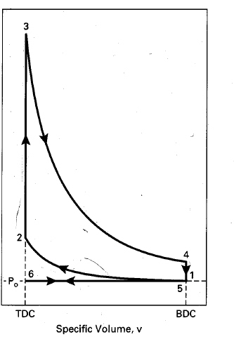
Intake and Exhaust Strokes – Ideal Cycles
In the ideal four-stroke cycle the exhaust process is modeled as
constant volume heat extraction and does not consider the actual gas flow.
At WOT the exhaust and intake processes
are often shown as a constant pressure
processes, e.g., 5→6 and 6→1 where
states 1 and 5 are the same.
Process 5-6 indicates a decrease in
specific volume which is incorrect since
as the cylinder volume decreases so does
the mass →specific volume remains the
same!
This inconsistency is a byproduct of modeling
an open system problem with a closed
system equations.
Pressure, P
EV closes
IV opens
IV closes
EV opens
Specific volume, v

Slide 5
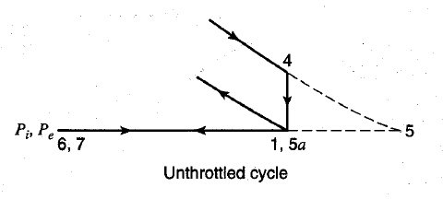
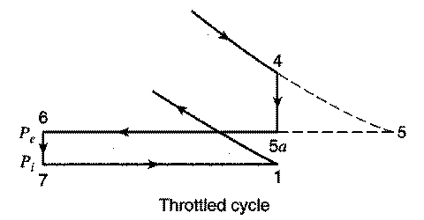
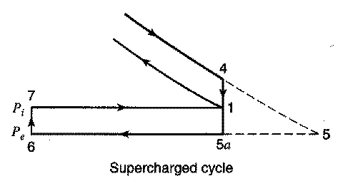
Intake and Exhaust Strokes – Ideal Cycles
In an ideal four-stroke Otto cycle engine valves operate instantaneously, and both exhaust and intake process are adiabatic and constant pressure.
Unthrottled: P_{i} = P_{e} = 1 atm
EV opens
Result: No Pumping Loss
IV closes (state1)
EV closes
IV opens
Throttled: P_{i} < P_{e}
EV opens
Result: Net Pumping Loss
EV closes
6’
IV closes
IV opens
Supercharged: P_{i} > P_{e}
Result: Net Pumping Gain
EV opens
IV opens
6’
1
IV closes
EV closes

Slide 6
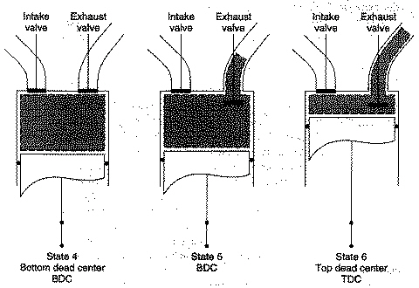
Actual Exhaust Strokes
The actual exhaust process consists of two phases: Blowdown → Displacement
P_{i} T_{i}
P_{e}
Products
State 4 (BC)
State 5 (BC)
State 6 (TC)
Blowdown
Displacement
Blowdown – At the end of the power stroke when the exhaust valve opens
the cylinder pressure is much higher than the exhaust manifold pressure
which is typically ~1 atm (P₄ > P_{e}), so the cylinder gas flows out through the
exhaust valve and the pressure rapidly drops to P_{e}.
Displacement – Remaining gas is pushed out of the cylinder by the piston
moving to TDC.

Slide 7
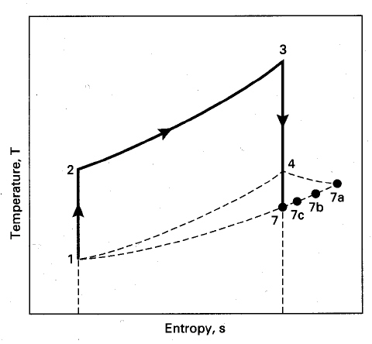
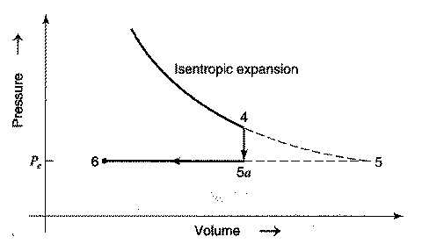
Blowdown
During the blowdown (if we neglect heat transfer) the gas remaining in the cylinder undergoes an isentropic expansion process (circled in red)
Blowdown
Displacement
5
5 (Otto/Diesel)
TC
BC
State 5 at the end of blowdown is a fictitious state corresponding to no actual piston location.
The p*dV work from State 4 to fictitious State 5 ends up equaling the flow work required to move the gas out of the cylinder.
You can find T₅ with the following relationships:
$$T_{5}=T_{4}{\left(\frac{P_{5}}{P_{4}}\right)}^{{k−1}/k}=T_{4}{\left(\frac{P_{e}}{P_{4}}\right)}^{{k−1}/k}$$
$$P_{5}=P_{e}$$

Slide 8
Displacement
After Blowdown the cylinder (still assumed to be at V_{BDC}) is still full of exhaust products.
P₄ (before Blowdown) will depend on State 3
For Otto Cycle engine, what was throttle position, and peak pressure
For Diesel Cycle engine, how much fuel was added, and Cut-Off Ratio
For an engine under high load, as much as 75% of the trapped mass in the cycle (exhaust products) exit during Blowdown. At very light loads sometimes as little as 15% of the trapped mass leave during blowdown.
The exhaust gasses remaining at BDC are pushed out by the piston displacement (exhaust stroke). The work required for this can be approximated by:
Note: V is total volume, not specific volume
$$W_{exh}=p_{e}(V_{BDC}−V_{TDC})$$

Slide 9
Residual Gas
The gas remaining in the cylinder when the piston reaches TC is called
residual gas which mixes with intake gas (fuel-air for SI and air for CI)
The residual gas temperature T₆ is equal to T₅
The Residual gas fraction f is defined as the ratio of the mass of residual gas to the mass of the fuel-air at the start of the cycle. (Assume ideal gas Pv = RT)
Typically values of f are in the range 3% to 12%, depending on load, and will typically be lower in Diesels (larger CR)

Slide 10
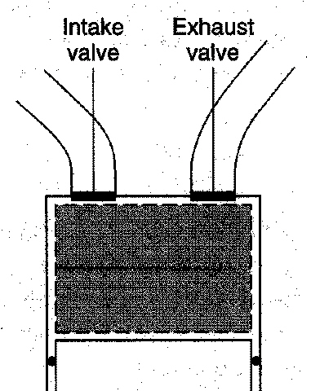
Intake Stroke 6→ 1
When the intake valve opens the fresh gas (mass of m_{i}) mixes with the hotter residual gas (mass of m_{R}) so the gas temperature at the end of the intake stroke T₁ will be greater than the inlet temperature T_{i}.
Applying conservation of mass:
T_{i}
Applying conservation of energy (open system):

Slide 11
Intake Gas Temperature (T₁)
Recall m₆ = m₁*f and assuming ideal gas P₆v₆ = RT₆ and h = c_{p}T
In terms of inlet and exhaust conditions P₁ = P_{i} , P₆ = P_{e} , T₆ = T_{e}

Slide 12
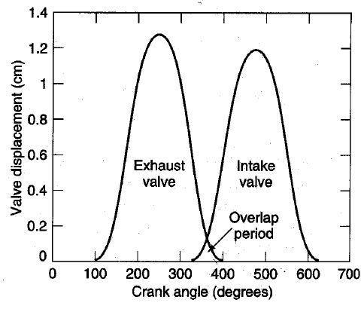
Valve Overlap
In real engines valves don’t open and close instantaneously.
In order to ensure that the valve is fully open during a stroke for volumetric efficiency, the valves are open for longer than 180º.
The exhaust valve opens before TC and closes after BC and the intake valve opens before TC and closes after BC.
At TC there is a period of valve overlap where both the intake and exhaust valves are open.

Slide 13
Valve overlap
When the intake valve opens the cylinder pressure is at P_{e}
Part throttle (P_{i} < P_{e}): residual gas flows into the intake port. During intake
stroke the residual gas is first returned to the cylinder then fresh gas is
introduced. Residual gas reduces part load performance.
WOT (P_{i} = P_{e}): some fresh gas can flow out the exhaust valve reducing
performance and increasing emissions.
Supercharged (P_{i} > P_{e}): fresh gas can flow out the exhaust valve
P_{i}
P_{e}
P_{i}
P_{e}
Throttled
P_{i} < P_{e}
Supercharged
P_{i} > P_{e}

Slide 14
Valve Timing
Conventional engines operate at low rpms, with idle and part load important
High performance engines operate at high rpms at WOT, with power and
volumetric efficiency important
At high engine speeds less time available for fresh gas intake so need more
crank angles to get high volumetric efficiency → large valve overlap
At low engine speed and part throttle valve overlap is minimized by reducing
the angle duration for valves staying open.

Slide 15
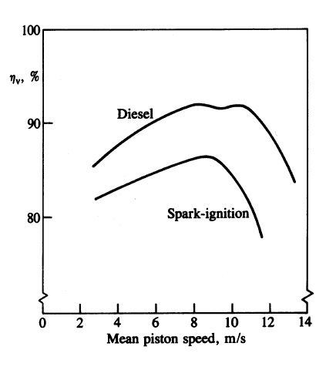
Volumetric Efficiency
Where:
m_{a} = mass of air trapped at start of cycle
ρ_{a,o} = density of ambient air
V_{d} = displaced volume
Volumetric efficiency is affected by :
Fuel evaporation
Mixture temperature
Pressure drop in the intake system
Gas dynamic effects
Note: piston speed is proportional
to air flow velocity

Slide 16
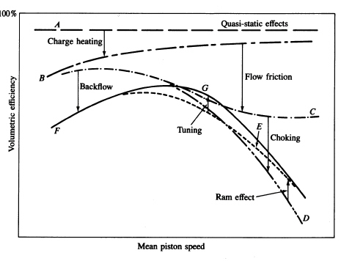
Factors affecting η_{v} as a function of speed
Fuel vapour pressure

Slide 17
Variable Valve Timing
Camshaft Profiles
https://youtu.be/BQ05PDVApJw?si=bhKq1SziVQNnU-I7&t=94
The Honda VTEC and Mitsubishi MIVEC engines have two camshaft profiles on each cam lobe.
The low-speed cam profile has little exhaust-intake overlap
The high-speed cam profile has more overlap, longer duration, and a higher overall lift
The high-speed cam profile is either the same, or a larger radius than the low-speed cam profile.
At a set condition (usually engine speed) a hydraulic actuator allows the valves to be operated by the high-speed cam profile rather than the low-speed profile.
https://youtu.be/tSCuRXnfLuI?si=-v_XTm_c93DrPKZ3&t=159
When *should* the switch from low-speed to high-speed occur?
https://youtu.be/lcohmc-yB5A?si=fz-uFBpSB47cw1pg&t=15

Slide 18
Variable Valve Timing – Cam Phasers
Many engines designed after the mid 2000’s. use cam phasing as a way to increase volumetric efficiency across the operating speed of the engine.
https://youtu.be/Qr7J6Rl4P24?si=PZq0R26QzQo8lxU_&t=15
Phase only represents a change in the camshaft timing relative to the crankshaft.
The camshaft profile does not change, but the camshaft can be either advanced or retarded by several degrees.
The phase change takes time (100-250 ms) to occur, so it is not able to advance, then retard the profile during a single cycle.
Advancing cam timing will close the valves sooner, and is usually better for low-speed operation.
Retarding cam timing will close the valves later, which is usually better for high-speed operation.
On DOHC (dual overhead camshaft) engines you can alter phase of the intake and exhaust cam separately.

Slide 19
Variable Valve Timing – Discrete Valve Control
If you don’t constrain yourself to metal camshafts as a means of opening and closing valves, what are some ideas you could do?
Four-stroke, six-stroke, 8-stroke diesel engines.
Atkinson cycle engine
Throttless engine (minimize parasitic pumping loss)
Challenges with discrete valve control
PTVC (piston to valve clearance)
Energy requirements
Reliability of components
Natural frequency (resonance)
Longevity of components
Cost of components

Slide 20
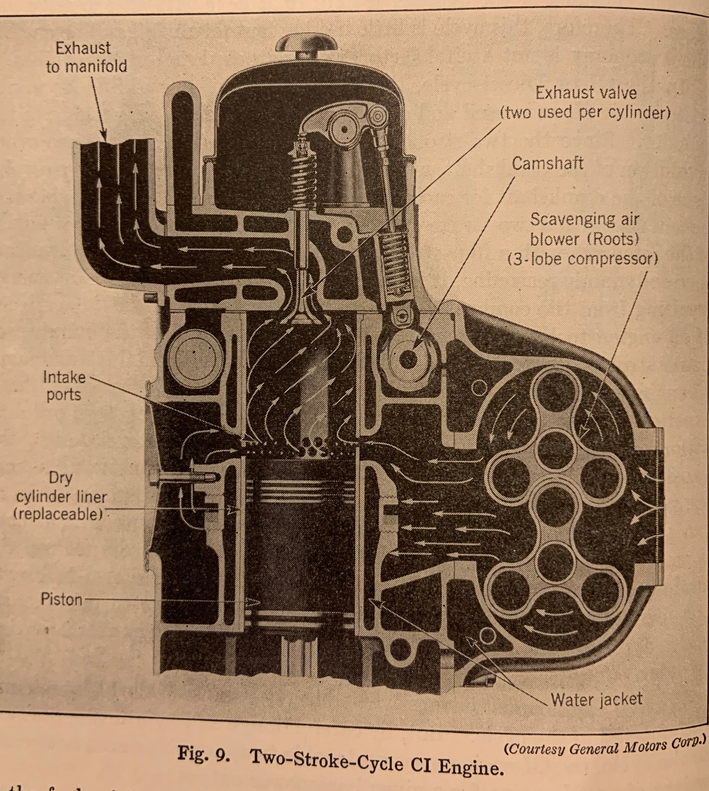
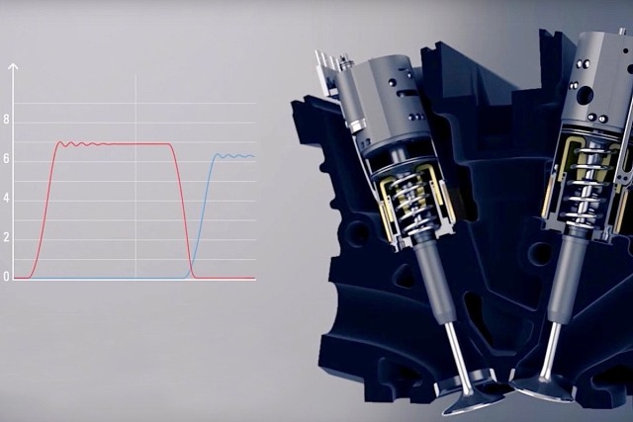
Valveless Engines?
Most four-stroke engines have intake and exhaust valves to control the gas exchange process. But it doesn’t *have* to be that way.
Coates Spherical Rotary Valve
Detroit Diesel externally scavenged two-stroke engine
Dr. Dan’s uniflow DI two-stroke
Koenigsegg Freevalve
The Wankel (rotary) engine

