Slide 1
ME 433 Internal Combustion Engines
Professor:
Dr. Dan Cordon (AKA Dr. Dan)

Slide 2
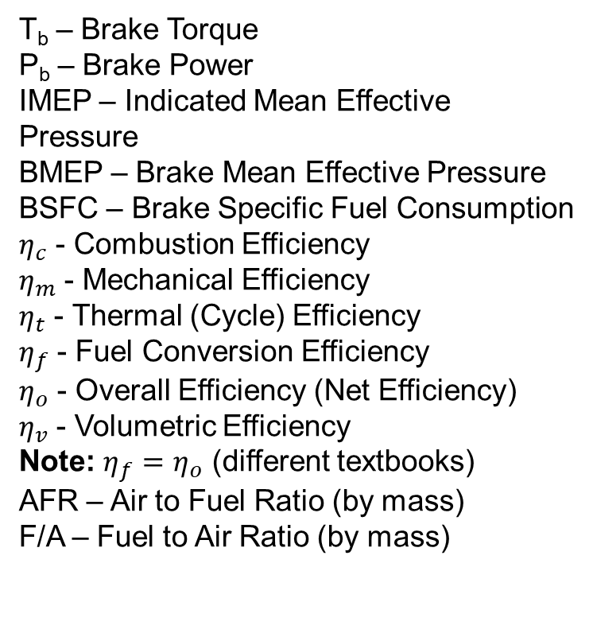
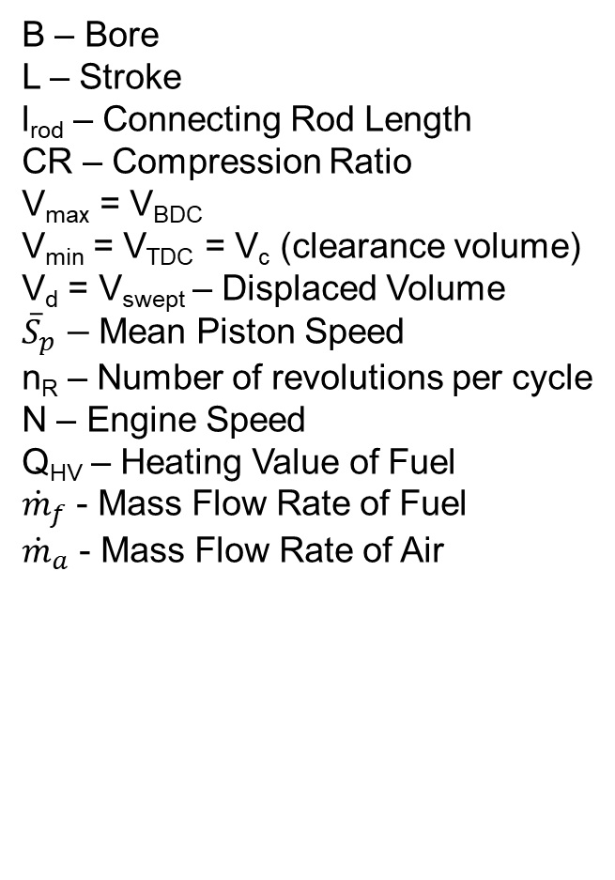
Key Variables from Lecture 6
B – Bore
L – Stroke
l_{rod} – Connecting Rod Length
CR – Compression Ratio
V_{max} = V_{BDC}
V_{min} = V_{TDC} = V_{c} (clearance volume)
V_{d} = V_{swept} – Displaced Volume
${\overline{S}}_{p}−$Mean Piston Speed
n_{R} – Number of revolutions per cycle
N – Engine Speed
Q_{HV} – Heating Value of Fuel
${\dot{m}}_{f}$ - Mass Flow Rate of Fuel
${\dot{m}}_{a}$ - Mass Flow Rate of Air
T_{b} – Brake Torque
P_{b} – Brake Power
IMEP – Indicated Mean Effective Pressure
BMEP – Brake Mean Effective Pressure
BSFC – Brake Specific Fuel Consumption
$η_{c}$ - Combustion Efficiency
$η_{m}$ - Mechanical Efficiency
$η_{t}$ - Thermal (Cycle) Efficiency
$η_{f}$ - Fuel Conversion Efficiency
$η_{o}$ - Overall Efficiency (Net Efficiency)
$η_{v}$ - Volumetric Efficiency
Note: $η_{f}=η_{o}$ (different textbooks)
AFR – Air to Fuel Ratio (by mass)
F/A – Fuel to Air Ratio (by mass)

Slide 3


Calculating Power Output
$$P=η_{f}{∗Q}_{HV}∗{\dot{m}}_{f}$$
Power Output
$$η_{f}=η_{o}=η_{m}∗η_{t}∗η_{c}$$
Efficiencies
$${\dot{m}}_{f}=\frac{{\dot{m}}_{a}}{AFR}$$
Mass Flows
$${\dot{m}}_{a}=\frac{m_{a}∗N}{n_{R}}$$
Mass Airflow
$$m_{a}=η_{v}∗ρ_{bdc}∗V_{bdc}$$
Trapped Air Mass
$$ρ_{bdc}=\frac{p_{bdc}}{R∗T_{bdc}}$$
Ideal Gas Law

Slide 4
Substitutions for Power Output Equation
$$ρ_{bdc}=\frac{p_{bdc}}{R∗T_{bdc}}$$
Ideal Gas Law
$$m_{a}=\frac{η_{v}∗p_{bdc}∗V_{bdc}}{R∗T_{bdc}}$$
Trapped Air Mass
$${\dot{m}}_{a}=\frac{η_{v}∗p_{bdc}∗V_{bdc}∗N}{R∗T_{bdc}∗n_{R}}$$
Mass Airflow
$${\dot{m}}_{f}=\frac{η_{v}∗p_{bdc}∗V_{bdc}∗N}{AFR∗R∗T_{bdc}∗n_{R}}$$
Mass Flows
$$η_{f}=η_{o}=η_{m}∗η_{t}∗η_{c}$$
Efficiencies
$$P=\frac{η_{m}∗η_{t}∗η_{c}{∗Q}_{HV}∗η_{v}∗p_{bdc}∗V_{bdc}∗N}{AFR∗R∗T_{bdc}∗n_{R}}$$

Slide 5
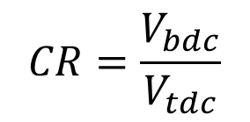
More Substitutions
$$CR=\frac{V_{bdc}}{V_{tdc}}$$
$$V_{d}=\frac{π∗B^{2}∗L}{4}∗n_{cyl}$$
$$V_{d}=V_{bdc}−V_{tdc}$$
$$V_{bdc}=\frac{π∗B^{2}∗L}{4∗\left(1−1/{CR}\right)}∗n_{cyl}$$
Combine to give us:
Then the Power Equation Becomes:
$$P=\frac{η_{m}∗η_{t}∗η_{c}{∗Q}_{HV}∗η_{v}∗p_{bdc}∗π∗B^{2}∗L∗n_{cyl}∗N}{4∗\left(1−1/{CR}\right)∗AFR∗R∗T_{bdc}∗n_{R}}$$

Slide 6
Rearranging Power Equation
$$P=\frac{η_{m}∗η_{t}∗η_{c}{∗Q}_{HV}∗η_{v}∗p_{bdc}∗π∗B^{2}∗L∗n_{cyl}∗N}{4∗\left(1−1/{CR}\right)∗AFR∗R∗T_{bdc}∗n_{R}}$$
$$P=\frac{η_{m}∗η_{t}∗η_{c}{∗Q}_{HV}}{AFR}∗\frac{η_{v}∗p_{bdc}}{R∗T_{bdc}}∗\frac{π∗B^{2}∗L∗n_{cyl}∗N}{4∗\left(1−1/{CR}\right)∗n_{R}}$$
Thermo-Chemistry
Kinematics
Fluid Dynamics
$$P=\frac{η_{m}∗η_{t}∗η_{c}{∗Q}_{HV}}{AFR}∗\frac{η_{v}∗p_{bdc}}{R∗T_{bdc}}∗\frac{π∗B^{2}∗L∗n_{cyl}∗N}{4∗\left(1−1/{CR}\right)∗n_{R}}$$

Slide 7
Implications of Power Equation
$$P=\frac{η_{m}∗η_{t}∗η_{c}{∗Q}_{HV}}{AFR}∗\frac{η_{v}∗p_{bdc}}{R∗T_{bdc}}∗\frac{π∗B^{2}∗L∗n_{cyl}∗N}{4∗\left(1−1/{CR}\right)∗n_{R}}$$
What can you do to increase power output?
Increase any of the efficiencies
Use a fuel with higher energy content
Decrease the Air-Fuel Ratio (but combustion efficiency will drop once you are below stoichiometric mixture)
Increase BDC pressure (forced induction)
Increase Bore, Stroke, and/or Number of cylinders
Increase Compression Ratio
Increase Engine Speed
Decrease number of revolutions per cycle
Decrease BDC Temperature

Slide 8
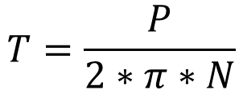
Torque Equation
$$P=\frac{η_{m}∗η_{t}∗η_{c}{∗Q}_{HV}}{AFR}∗\frac{η_{v}∗p_{bdc}}{R∗T_{bdc}}∗\frac{π∗B^{2}∗L∗n_{cyl}∗N}{4∗\left(1−1/{CR}\right)∗n_{R}}$$
$$T=\frac{P}{2∗π∗N}$$
$$P=T∗2∗π∗N$$
So Torque can be calculated by:
$$T=\frac{η_{m}∗η_{t}∗η_{c}{∗Q}_{HV}}{AFR}∗\frac{η_{v}∗p_{bdc}}{R∗T_{bdc}}∗\frac{B^{2}∗L∗n_{cyl}}{8∗\left(1−1/{CR}\right)∗n_{R}}$$
Things to Notice:
Torque equation does not include engine speed?!!
Otherwise nearly the same variables as Power Equation

Slide 9
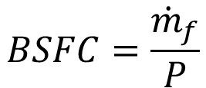
Brake Specific Fuel Consumption (BSFC)
$$P=\frac{η_{m}∗η_{t}∗η_{c}{∗Q}_{HV}}{AFR}∗\frac{η_{v}∗p_{bdc}}{R∗T_{bdc}}∗\frac{π∗B^{2}∗L∗n_{cyl}∗N}{4∗\left(1−1/{CR}\right)∗n_{R}}$$
$$BSFC=\frac{{\dot{m}}_{f}}{P}$$
$$BSFC=\frac{1}{η_{m}∗η_{t}∗η_{c}{∗Q}_{HV}}$$
But
$$η_{f}=η_{o}=η_{m}∗η_{t}∗η_{c}$$
$$SFC=\frac{1}{η_{o}{∗Q}_{HV}}=\frac{1}{η_{f}{∗Q}_{HV}}$$
Things to Notice:
BSFC is basically overall efficiency, but with units
Volumetric Efficiency does *not* change Overall Efficiency
We call it BSFC if fuel flow and power are measured on a dynamometer
We call it SFC if we know Overall Efficiency and the heating value of the fuel

