Slide 1
Lecture 1: Overview
Course goals and syllabus
Logbook expectations & logbook review form
Mass Production vs Lean Enterprise Systems
Lean Manufacturing overview
Plant layout models.

Slide 2
Mass Production System * Example: Ford * Status as of 1950 8000/day Low-skilled immigrant labor Vertical integration Abundant investment capital * High volume, low mix * Capital, Quantity, Repeatability

Slide 3
Lean Enterprise System * Example: Toyota * Status as of 1950 2500/year Diversified market Limited capital Dedicated, high skilled labor * Low volume, high mix * People, Quality, Flexibility

Slide 4
Definition of Lean
“A systematic approach to identifying and eliminating waste (non-value-added activities) in a company’s operations.
Lean emphasizes flowing the product at the pull of the customer.”
Lean is implemented through both rapid and continuous improvement.
Kaizen- “kai’ means “little” or “ongoing”. “Zen” means “for the better” or “good.” Small continuous improvements on everyone’s part leads to world class manufacturing.

Slide 5
Concept of Value-Added Activity
Value-Added Time
Any activity that increases the market form or function of the product or service. (These are things the customer is willing to pay for.)
Non-Value Added Time (Waste or muda)
Any activity or use of resources that does not add market form or function or is not necessary. (These activities should be reduced, integrated, simplified, or eliminated.)

Slide 6
Common Manufacturing Terms: Batches Order of Operations Inventory Work in Progress (WIP) Fixturing Set-Up Time Inspection Plant Layout Manufacturing Lead Time (MLT)

Slide 7
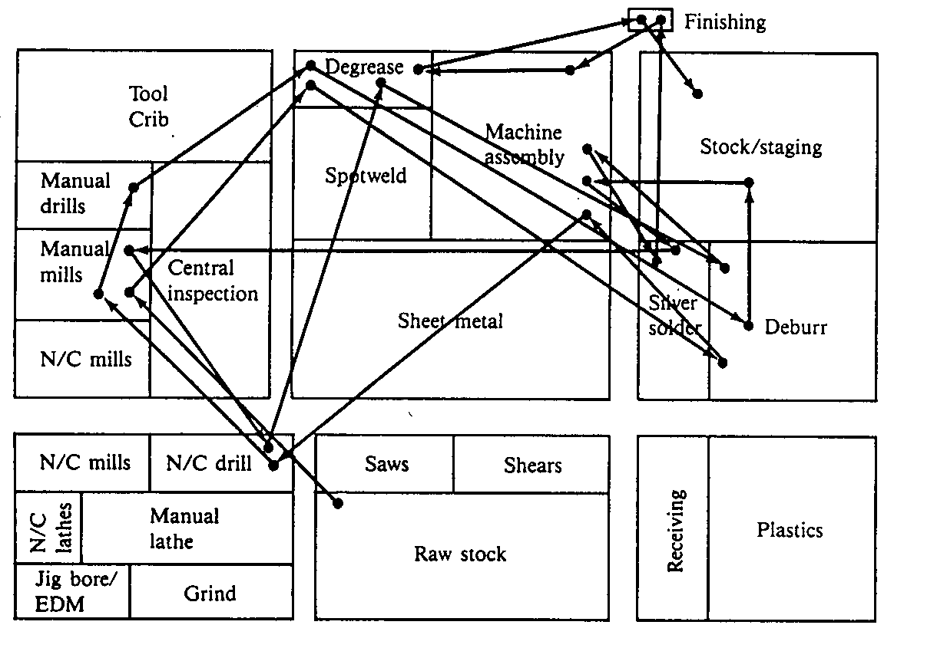
Process Layout – small shop

Slide 8
Process Layout - factory
QC
Rec
Ship
Raw Stock
Screw Machine
QC
Shear
Stamp
Lathe
Drill
Brake
Mill
Assembly
Weld
Grind
Finish
Parts Stock

Slide 9
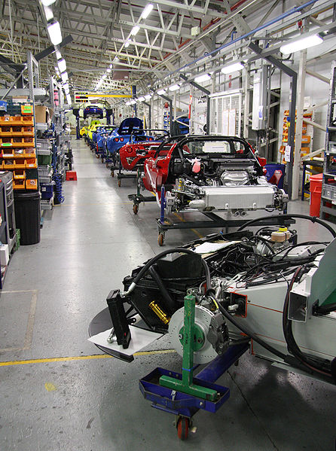
Product Layout
Products typically ride along on conveyor belts or chains.
This layout may have several parallel lines of processes combining at one node.
This arrangement is relatively inflexible compared to a Process Layout.

Slide 10
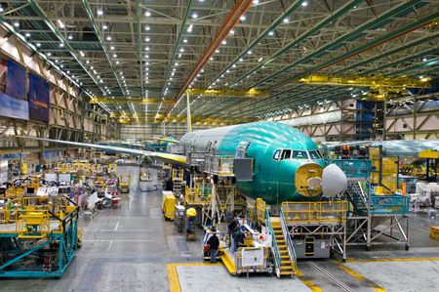
Fixed Position Layout
In this layout, the product’s position is fixed due to its size or weights such as a jetliner. Equipment, components, and labor is brought to the product for the operations. When the product is complete, it is then moved.

Slide 11
Cellular Layout
Linking of manual and machine operations into the most efficient combination to maximize value-added content while minimizing waste.
Punch
De-burr
Cut to size
Package
Form
Sand

Slide 12
Lean = Eliminating Waste
Non-Value-Added: Hold all waste in a “CLOSED MITT”
Value-Added
Complexity
Labor
Overproduction
Space
Energy
Defects
Materials
Idle Materials
Transportation
Time
Typically 95% of all lead time is non-value-added

Slide 13
Lean Building Blocks
KAIZEN
Pull/Kanban
Cellular/Flow
TPM
Quality at Source
POUS
Quick Changeover
Standardized Work
Batch Reduction
Teams
5S System
Visual
Plant Layout
Value
Stream
Mapping

