Slide 1
Poster Guidelines
Poster Content
Begin with a descriptive title
Include team name and picture
Prominently display final product
Supply captions for all pictures, diagrams, and graphs
Minimize text; use strategic phrases or single sentences
Poster Formatting
Recommended Program: PowerPoint
Preferred Size: ANSI ‘D’ -- 22”x 34” (GJ 114 Plotter)
Optional Size: ANSI ‘E‘-- 34” x 44” (JEB 321 Plotter)
Make sure background colors and fonts don’t blend
Use borders to focus attention on posters, graphs, and pictures
Printer Settings (see reverse side)
Precautions
Use letter size for hard copy proofs - Do not waste paper and ink
Use Print Preview before every poster-size print job
Be physically present when job is printing; be prepared to CANCEL
---See GJ Hallway for exemplary posters---

Slide 2
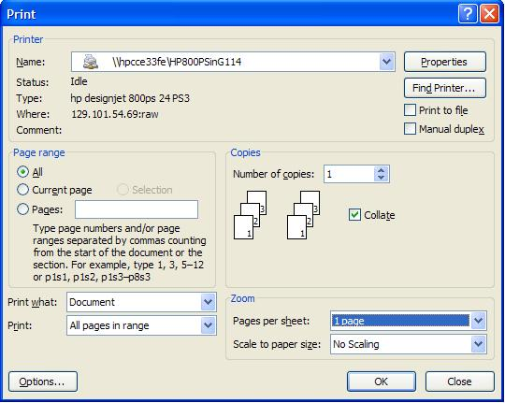
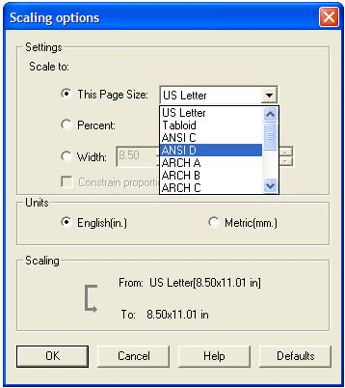
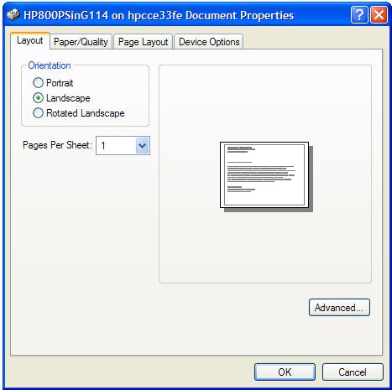
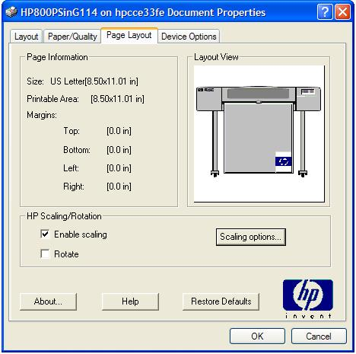
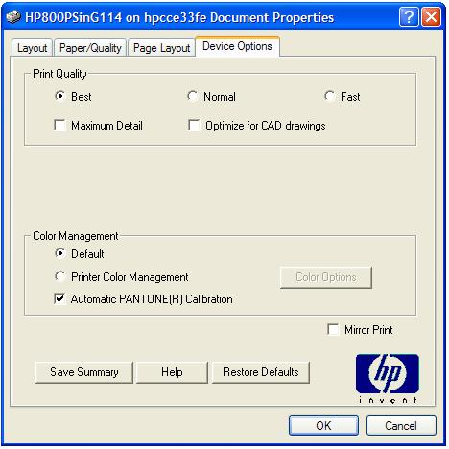
1. Select the HP800 Plotter
2. Select Properties
4. In Page Layout, Select Enable Scaling, then Scaling Properties. Once in Scaling Properties, Select ANSI D in the Page Size dropdown box.
3. Select Landscape in the Layout Tab
5. Select Best Quality in the Device Options Tab

